Slide 1

2.5 FIR Filter
Peter H. Chen

Slide 2
2.5 FIR Filter
https://github.com/freechipsproject/chisel-bootcamp
FIR (Finite Impulse Response) Filter
We discuss how to implement the FIR (Finite Impulse Response) Filter with combinational Logic and Sequential logic.
Topics:
1. Setup: Start the Jupyter Notebook, select the scalar interpreter, run Scala in Jupyter Notebook.
2. FIR (Finite Impulse Response) with 4-Coefficients
3. FIR 8-bit Specification
4. FIR Filter problem
5. FIR Filter Scala Solution
6. FIR Testbench with input x and coefficients: 0, 0, 0, 0
7. FIR Testbench with input x and coefficients: 1, 1, 1, 1
8. FIR Testbench with input x and coefficients: 1, 2, 3, 4
9. FIR Generator and View Module with Visualize(): It is a preview. We will discuss more in 3.2 Generator Collections.
10. DSP Block Integration: It is a preview. We will discuss more details in SoC (Rocket Chip).
11. Test DSP Block: We will discuss more in SoC (Rocket Chip).

Slide 3
2.5.1 Setup

Slide 4
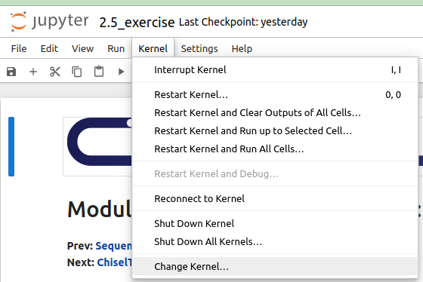
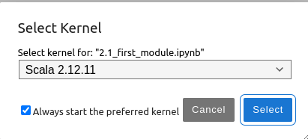
2.5.1 Setup
https://github.com/freechipsproject/chisel-bootcamp
Setup
1. Change folder to chisel-bootcamp. If you want to work on your working space, copy image folder and source folder to your working directory.
> cd chisel-bootcamp
2. Start Jupyter notebook
> jupyter notebook 2.5_sequential_loigc.ipynb
3. Select the scala interpreter: > Kernel > Change Kernel… >Scala 2.12.11
3

Slide 5
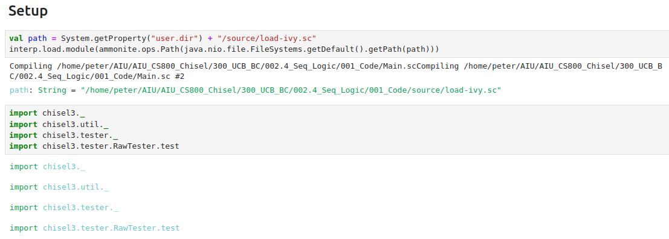
2.5.1 Setup
https://github.com/freechipsproject/chisel-bootcamp
Setup
1. Scala uses maven to setup path to with for source folder for Scala Libraries and get Scala Property.
2. import chisel3 library, utility, tester harness (horse controller), and test interface function.

Slide 6
2.5.2 FIR with 4-Coefficients

Slide 7
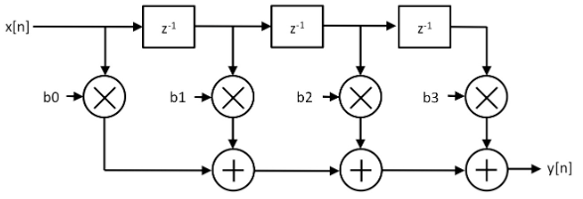
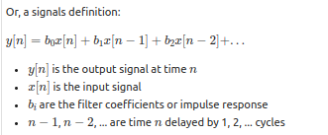
2.5.2 FIR with 4-Coefficients
https://github.com/freechipsproject/chisel-bootcamp
FIR with 4-Coefficients
Below diagram is the FIR Filter.
In FIR Filter, we do the convolution.
1. Input: input a signal at time n, x[n], then,
2. Shift: shift input a time, i.e., i * z^(-1)
3. Multiplication: Multiply the associated coefficients (bi: b0, b1, b2, b3),
4. Sum: Sum the multiplications
5. Output: Output the Summation.
The above process is called Convolution.
6. We can express the math equation on the right below.
https://en.wikipedia.org/wiki/Finite_impulse_response
1
2
6
3
4
5

Slide 8
2.5.3 FIR 8-Bit Specification

Slide 9
2.5.3 FIR 8-Bit Specification
https://github.com/freechipsproject/chisel-bootcamp
8-bit Specification
1. In the below diagram, we build a 4-element FIR (Finite Impulse Response) filter where the four filter coefficients are parameters.
2. A module skeleton and basic tests are provided for you.
Note:
a. Both the input and output are 8-bit unsigned integers.
b. Note: You will need to save necessary state (like delayed signal values) using constructs like shift registers.
c. Use the provided testers to check your implementation.
d. Registers with constant inputs can be created using a ShiftRegister of shift value 1, or by using the RegNext construct.
e. For the tests to pass, our registers must be initialized to 0.U.
1

Slide 10
2.5.4 FIR Filter Problem

Slide 11
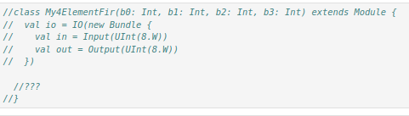
2.5.4 FIR Filter Problem
https://github.com/freechipsproject/chisel-bootcamp
FIR Filter Problem
Below, we have FIR Filter Problem written in Scala.
The implementation is marked out with “//???”.

Slide 12
2.5.5 FIR Filter Solution

Slide 13
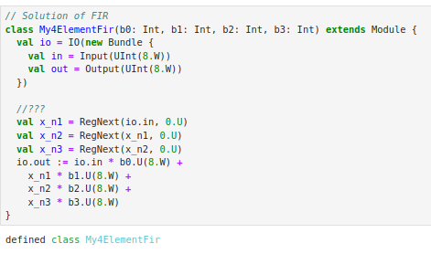
2.5.5 FIR Filter Solution
https://github.com/freechipsproject/chisel-bootcamp
FIR Filter Solution
1. Define class My4ElementFir(): we passed in 4 coefficient, i.e., b0, b1, b2, b3.
2. Instantiate io
3. Bundle io with input and output.
4. Input io.in (x_n0)
5. shift x_n0 to x_n1, x_n1 to x_n2, x_n2 to x_n3
6. sum = x_n0 * b1 + x_n1 * b1 + x_n2 * b2 + x_n3 * b3
7. out := sum

Slide 14
2.5.6 Coefficients: 0, 0, 0, 0

Slide 15
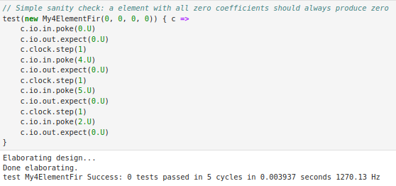
2.5.6 Input Coefficients: 0, 0, 0, 0
https://github.com/freechipsproject/chisel-bootcamp
Input Coefficients: 0, 0, 0, 0
Input:
All coefficients: 0, 0, 0, 0
Poke:
Time 0, time 4, time 5, time 2
Expect Output:
All zeros in the output.

Slide 16
2.5.7 Input Coefficients: 1, 1 ,1, 1

Slide 17
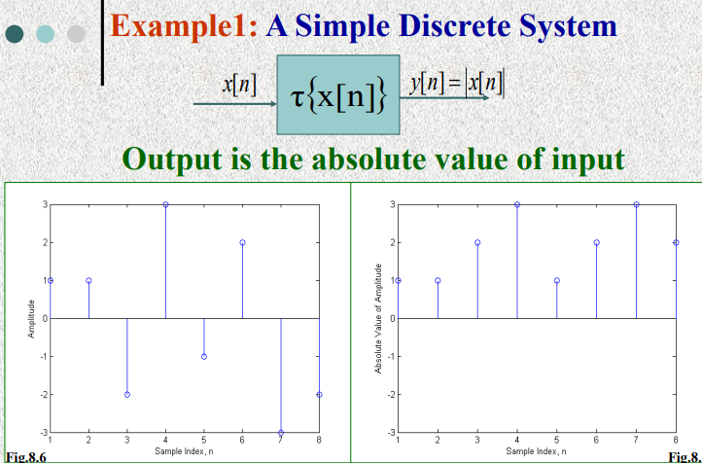
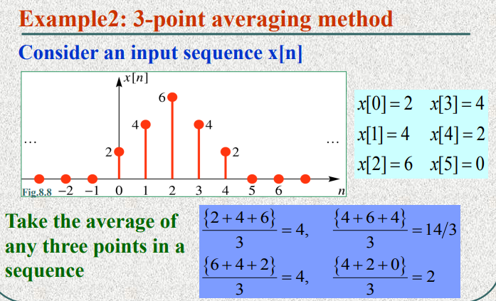
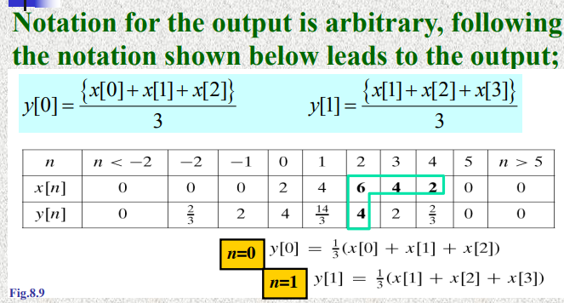
2.5.7 Input Coefficients: 1, 1 ,1, 1
https://github.com/freechipsproject/chisel-bootcamp
Input Coefficients: 1, 1, 1, 1
Below is the convolution calculation example:
https://web.ece.ucsb.edu/~yoga/courses/DiscreteTime/P8_FIR1.pdf

Slide 18
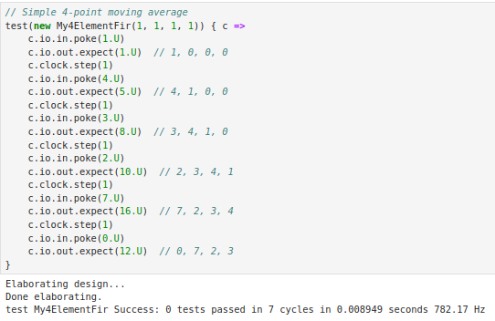
2.5.7 Input Coefficients: 1, 1 ,1, 1
https://github.com/freechipsproject/chisel-bootcamp
Input Coefficients: 1, 1, 1, 1
Input:
All coefficients: 1, 1, 1, 1
Poke: clock continue to run
Time=1, time=4, time=3, time =2, time=7, time=0
Expect Output:
We have 4 -point moving average
Poke Time = 1: 1, 0, 0, 0
sum = 1*1 + 0*1 + 0*1 + 0*1 = 1
Poke Time = 4: 4, 1, 0, 0
sum = 4*1 + 1*1 + 0*1 + 0*1 = 5
Poke Time = 3: 3, 4, 1, 0
sum = 3*1 + 4*1 + 1*1 + 0*1 = 8
Poke Time = 2: 2, 3, 4, 1
sum = 2*1 + 3*1 + 4*1 + 1*1 = 10
Poke Time = 7: 7, 2, 3, 4
sum = 7*1 + 2*1 + 3*1 + 4*1 = 16
Poke Time = 0: 0, 7, 2, 3
sum = 0*1 + 7*1 + 2*1 + 3*1 = 12

Slide 19
2.5.8 Input Coefficients: 1, 2, 3, 4

Slide 20
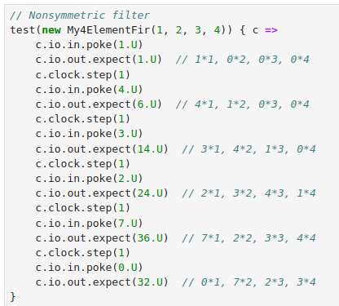
2.5.8 Input Coefficients: 1, 2, 3, 4
https://github.com/freechipsproject/chisel-bootcamp
Input Coefficients: 1, 2, 3, 4
Input:
All coefficients: 1, 2, 3, 4,
Poke: clock continue to run
Time=1, time=4, time=3, time =2, time=7, time=0
Expect Output:
We have 4 -point moving average
Poke Time=1: 1, 0, 0, 0
sum = 1*1+ 0*2 + 0*3 + 0*4 = 1
Poke Time=4: 4, 1, 0, 0
sum = 4*1 + 1*2 + 0*3 + 0*4 = 4+ 2 = 6
Poke Time=3: 3, 4, 1, 0
sum = 3*1 + 4*2 + 1*3 + 0*4 = 3 + 8 + 3 = 14
Poke Time=2: 2, 4, 4, 1
sum = 2*1 + 3*2 + 4*3 + 1*4 = 2 + 6 + 12 + 4 = 24
Poke Time=7: 7, 2, 3, 4
Sum = 7 * 1 + 2 * 2 + 3 * 3 + 4 * 4 = 7 + 4 + 9 + 16
= 36
Poke Time=0: 0, 7, 2, 3
Sum = 0 * 1 + 7 * 2 + 2 * 3 + 3 * 4 = 14 + 6 + 12
= 32

Slide 21
2.5.9 FIR Filter Generator

Slide 22
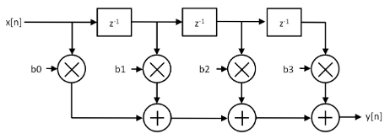
2.5.9 FIR Filter Generator
https://github.com/freechipsproject/chisel-bootcamp
FIR Filter Generator
1. For this module, we use modification of from Module 3.2: Generators: Collection.
2. Since we do not started Module 3.2, we can ignore this generator right now.
3. We will learn about the details of how MyManyDynamicElementVecFir works, but the basic idea is FIR filter generator.
4. The generator has one parameter: length. That parameter describes how many taps the filter has, and the taps are inputs to the hardware Module.
5. The generator has 3 inputs:
  a. in, the input to the filter
  b. valid, a boolean that says when the input is valid
  c. consts, a vector for all the taps
4. and 1 output:
  out, the filtered input

Slide 23
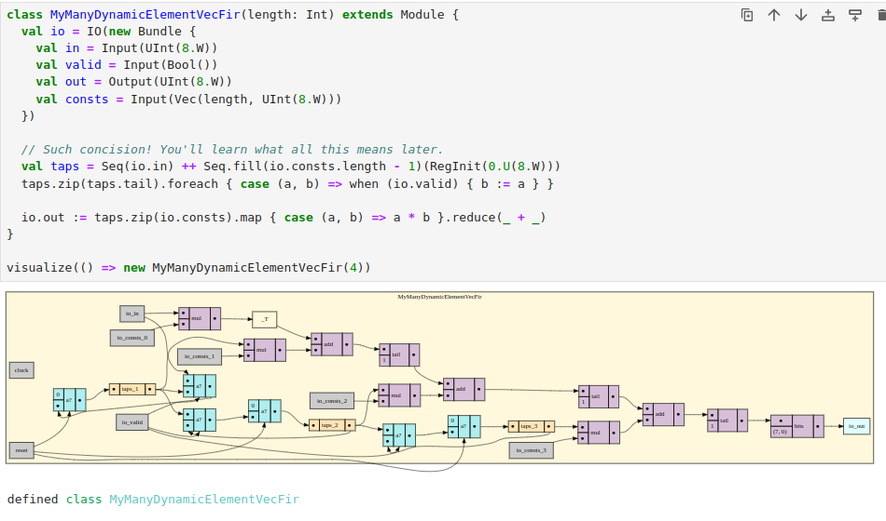
2.5.9 FIR Filter Generator
https://github.com/freechipsproject/chisel-bootcamp
FIR Filter Generator
Visualize the FIR Filter Generator with the input, output, valid, output, and constants.

Slide 24
2.5.10 DSP Block

Slide 25
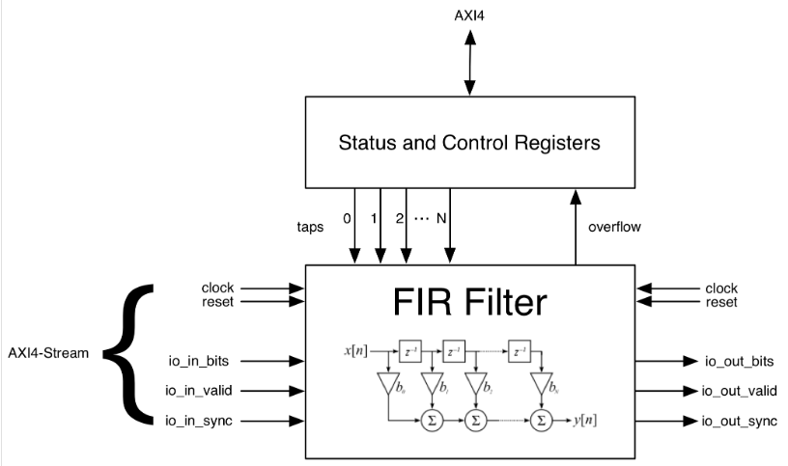
2.5.10 DSP Block
https://github.com/freechipsproject/chisel-bootcamp
DSP Block
1. Below, we Integrate a DSP component, i.e., FIR Filter into a larger system.
2. It is challenging and error prone.
3. The will discuss more in the rocket section of the dsptools repository consists of useful generators that should help with such tasks.
4. One of the core abstractions is the notion of a DspBlock.
5. A DspBlock has:
  a. AXI-4 Stream input and output
  b. Memory-mapped status and control (in this example, AXI4)

Slide 26
2.5.10 DSP Block
https://github.com/freechipsproject/chisel-bootcamp
DSP Block
1. DspBlocks use diplomatic interfaces from rocket.
2. This site has a good overview of the basic of diplomacy, but don't worry too much about how it's working for this example.
3. Diplomacy really shines when you're connecting a lot of different blocks together to form a complex SoC.
4. In this example, we're just making a single peripheral.
5. The StandaloneBlock traits are mixed in to make diplomatic interfaces work as top-level IOs.
6. You only need them when the DspBlock is being used as a top level interface without any diplomatic connections.

Slide 27
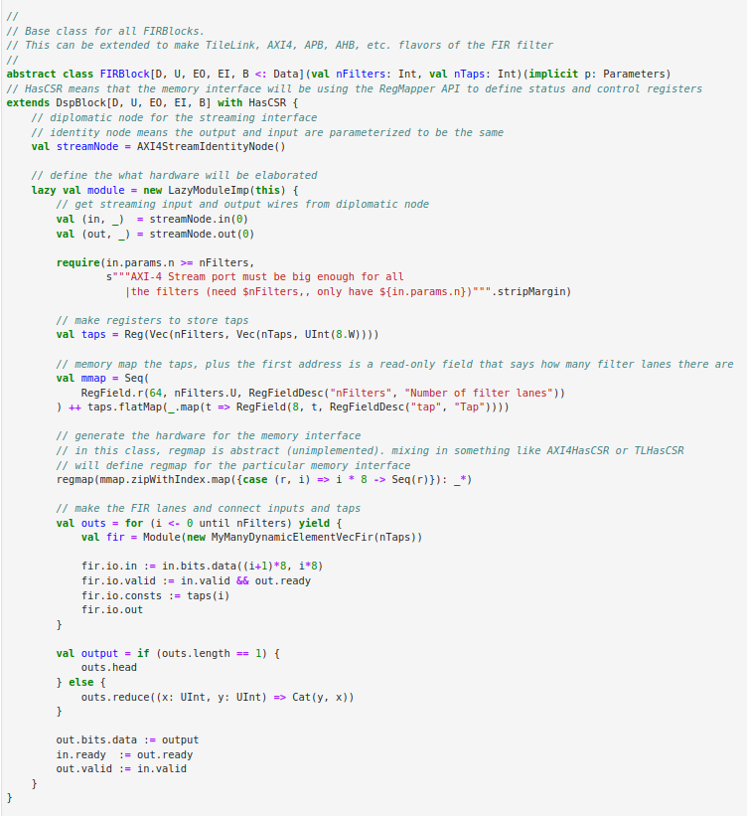
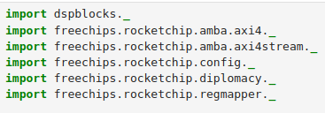
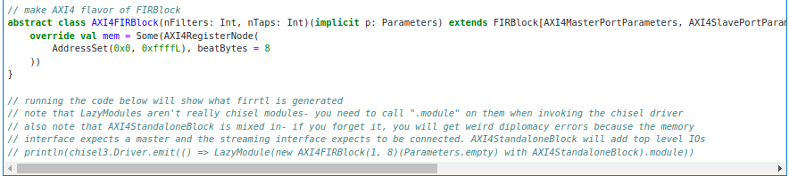
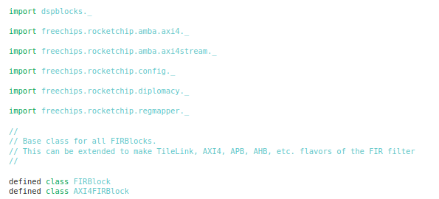
2.5.10 DSP Block
https://github.com/freechipsproject/chisel-bootcamp
DSP Block
1. The following code wraps the FIR filter in AXI4 interfaces.

Slide 28
2.5.11 Test DSP Block

Slide 29
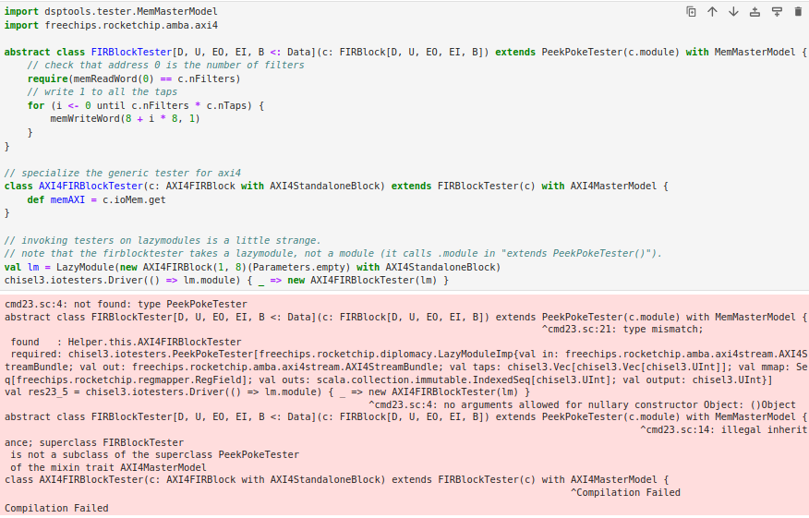
2.5.11 Test DSP Block
https://github.com/freechipsproject/chisel-bootcamp
Test DSP Block
There are error messages.
We will discuss DSP in Module 3.2: Generators: Collection

Slide 30
End

