Slide 1

0.3 Install Scala
Peter H. Chen

Slide 2
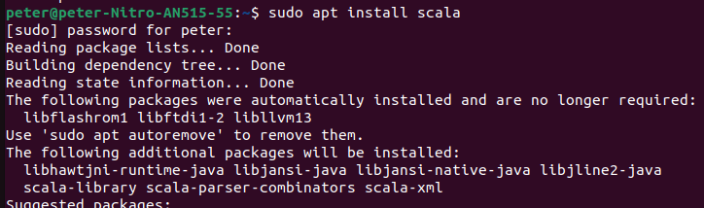
0.3 Install Scala
https://medium.com/beeranddiapers/installing-scala-on-ubuntu-7a4b14d26bdc
Install Scala
After we install JDK, we can install Scala.
> sudo apt install scala
https://medium.com/beeranddiapers/installing-scala-on-ubuntu-7a4b14d26bdc

Slide 3
0.3 Install Scala
https://medium.com/beeranddiapers/installing-scala-on-ubuntu-7a4b14d26bdc
Check Scala Version
Check scala version
> scala -version
>> Scala code runner version 2.11.12
https://medium.com/beeranddiapers/installing-scala-on-ubuntu-7a4b14d26bdc

Slide 4
End

