Slide 1

0.4 Run SBT
Peter H. Chen

Slide 2
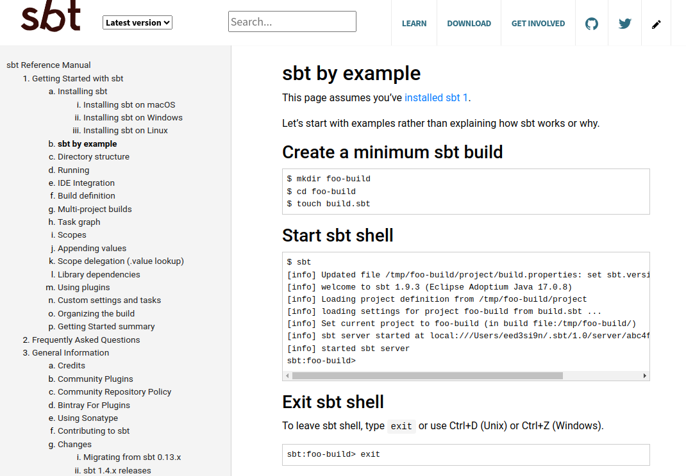
0.4 Run SBT
https://www.scala-sbt.org/release/docs/sbt-by-example.html
SBT Example
https://www.scala-sbt.org/release/docs/Installing-sbt-on-Linux.html

Slide 3
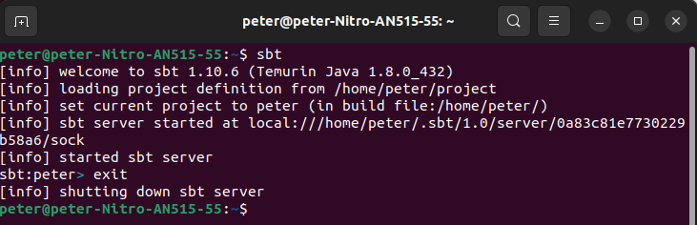
0.4 Run SBT
https://www.scala-sbt.org/release/docs/sbt-by-example.html
Run/Exit SBT
1. Start SBT:
> sbt
2. exit sbt
> exit
https://www.scala-sbt.org/release/docs/Installing-sbt-on-Linux.html
1
2

Slide 4
End

