Slide 1

3.4 Functional Programming
Peter H. Chen

Slide 2
3.4 Functional Programming
https://github.com/freechipsproject/chisel-bootcamp
Function Programming
We discuss Scala/Chisel FP (Functional Programming)
1. Setup: In Jupyter Notebook, select Scala interpreter and run.
2-3. Scala Functional Programming/Example
4-5. Scala Functional Object/Example
6. Scala Higher Order Function
7. Scala Value Object vs Function Comparison
8. Anonymous Function
9. Exercise/Solution: Calculation Sequence and Manipulation
10. Chisel Functional Programming
11. Chisel FP for FIR
12. Review Custom FIR
13. Window Function for FIR
14. Example: Chisel FIR Tester
15. Exercise: Chisel Neural Network Description
16. Exercise/Solution: Implement Chisel Neuron in Neural Network
17. Exercise/Solution: Implement Chisel Activation function, Step and ReLU (Rectified Linear Unit).
18. Exercise/Solution: Implement Chisel Tester in Neural Network

Slide 3
3.4.1 Setup

Slide 4
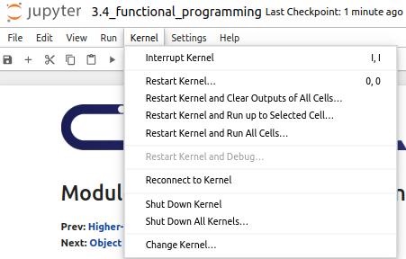
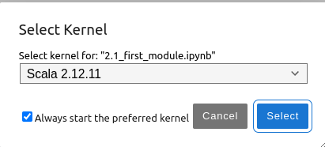
3.4.1 Setup
https://github.com/freechipsproject/chisel-bootcamp
Setup
1. Change folder to chisel-bootcamp. If you want to work on your working space, copy image folder and source folder to your working directory.
> cd chisel-bootcamp
2. Start Jupyter notebook
> jupyter notebook 3.4_functional_programming.ipynb
3. Select the scala interpreter: > Kernel > Change Kernel… >Scala 2.12.11
3

Slide 5
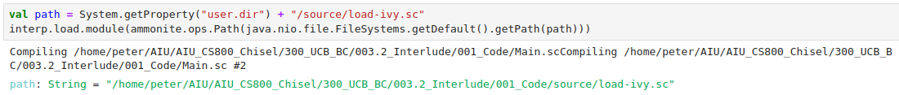
3.4.1 Setup
https://github.com/freechipsproject/chisel-bootcamp
Setup
1. Scala uses maven to setup path to with for source folder for Scala Libraries and get Scala Property.

Slide 6
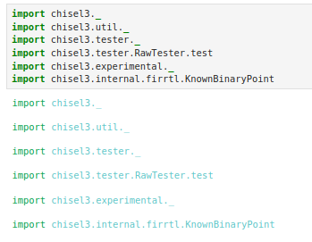
3.4.1 Setup
https://github.com/freechipsproject/chisel-bootcamp
Setup
1. import chisel3 library, utility, tester harness (horse controller), and FIRRTL library.

Slide 7
3.4.2 Scala Functional Programming

Slide 8
3.4.2 Scala Functional Programming
https://github.com/freechipsproject/chisel-bootcamp
Scala Functional Programming
1. We discuss the Scala functions in Section/Module 1.
2. We see a lot of functions in the previous Section/Module.
3. Functions take any number of inputs and produce one output.
4. Inputs are often called arguments to a function.
5. To produce no output, return the Unit type.

Slide 9
3.4.3 Scala Function Example

Slide 10
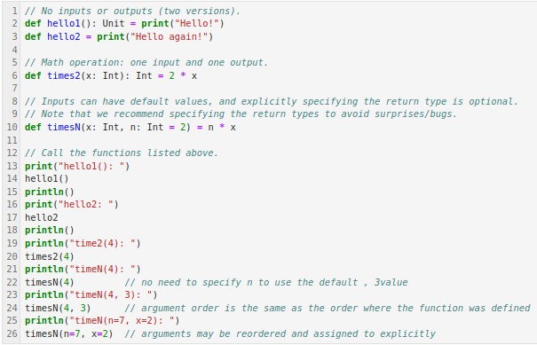
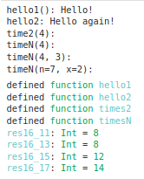
3.4.3 Scala Function Example
https://github.com/freechipsproject/chisel-bootcamp
Function Example
1. Below are some Scala functions.
2. Note: the return value is display results after the print statement.

Slide 11
3.4.4 Scala Function Objects

Slide 12
3.4.4 Function Objects
https://github.com/freechipsproject/chisel-bootcamp
Function Objects
1. Functions in Scala are first-class objects.
2. That means we can assign a function to a val and pass it to classes, objects, or other functions as an argument.

Slide 13
3.4.5 Function Object Example

Slide 14
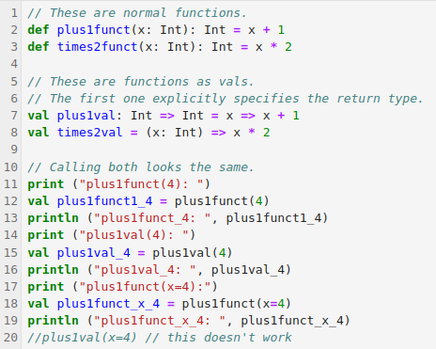
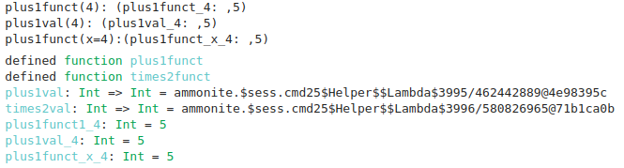
3.4.5 Function Object Example
https://github.com/freechipsproject/chisel-bootcamp
Function Object Example
1. Below are the same functions implemented as functions and as objects.
2. Why would you want to create a val instead of a def?
3. With a val, you can now pass the function around to other functions. We will see more examples.
4. You can even create your own functions that accept other functions as arguments.
5. Formally, functions that take or produce functions are called higher-order functions.
6. We print the result value of function object to understand the details.
6
6

Slide 15
3.4.6 Higher-Order Function Example

Slide 16
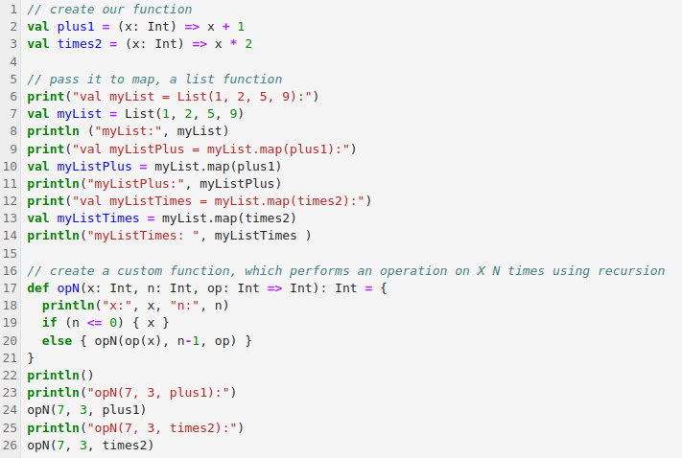
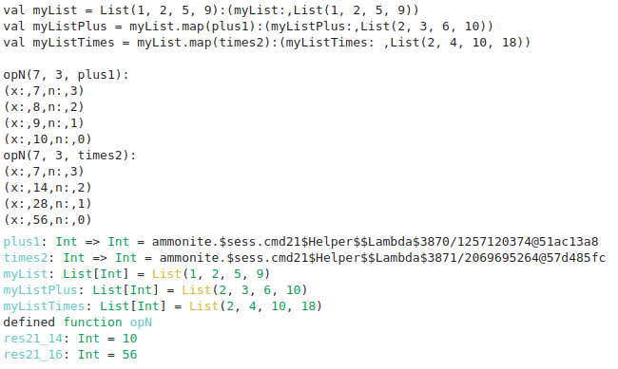
3.4.6 Higher-Order Function Example
https://github.com/freechipsproject/chisel-bootcamp
4
Higher-Order Function Example
1. Here, we use map again.
2. We also create a new function, opN ().
3. opN () accepts a function, op, as an argument.
4. Print the output of map for details.
5. Print the output of opN() for details.
5
4
5

Slide 17
3.4.7 Value Object vs Function

Slide 18
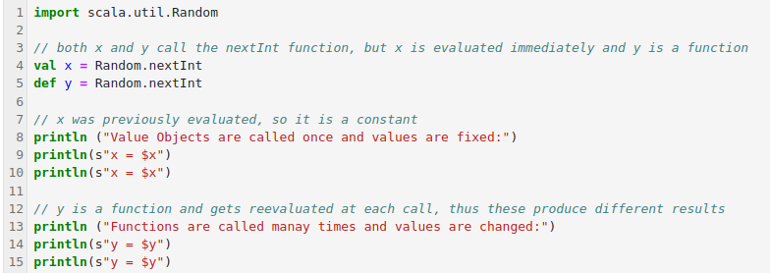
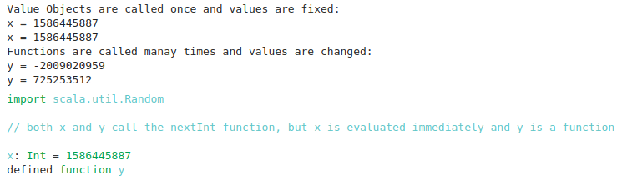
3.4.7 Value Object vs Function
https://github.com/freechipsproject/chisel-bootcamp
Value Object vs Function
1. Below, we compare the value and functions.
2. Value objects are evaluated at instantiation. We only instantiate vals once and value are fixed.
3. Functions are evaluated every time they are called. Each time, we call the functions, the values are different.
2
3

Slide 19
3.4.8 Anonymous Function

Slide 20
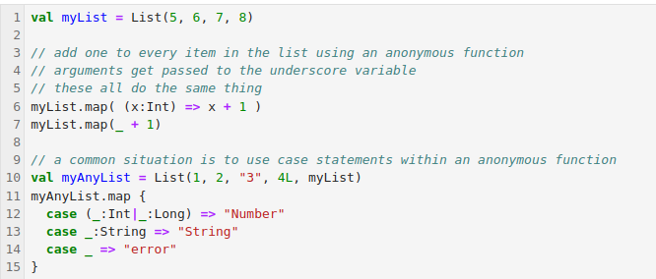
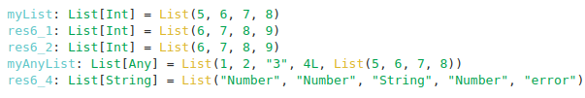
3.4.8 Anonymous Function
https://github.com/freechipsproject/chisel-bootcamp
Anonymous Function
1. Anonymous functions do not have name, they are nameless.
2. There's no need to create a val for a function if we'll only use it once.
3. Below are examples of anonymous function.

Slide 21
3.4.9 Exercise: Sequence Manipulation

Slide 22
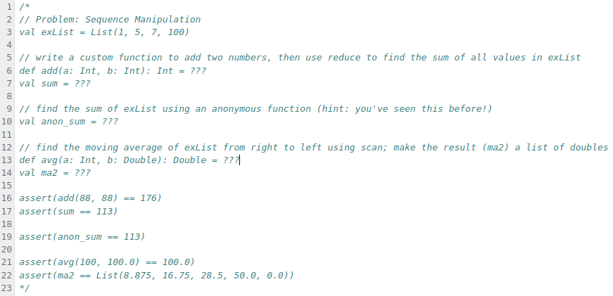
3.4.9 Exercise: Sequence Manipulation
https://github.com/freechipsproject/chisel-bootcamp
Exercise Problem: Sequence Manipulation

Slide 23
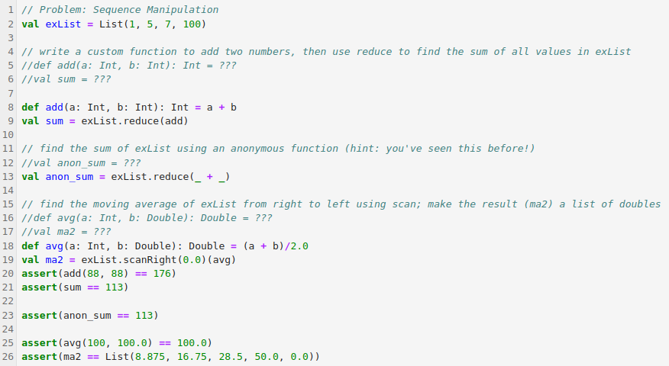
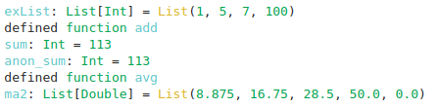
3.4.9 Exercise: Sequence Manipulation
https://github.com/freechipsproject/chisel-bootcamp
Exercise Solution : Sequence Manipulation

Slide 24
3.4.10 Chisel Functional Programming

Slide 25
3.4.10 Chisel Functional Programming
https://github.com/freechipsproject/chisel-bootcamp
Chisel Functional Programming
Chisel FP (Functional Programming) is used for hardware construction.
Chisel Functional Programming is based on Scala Functional Programming.

Slide 26
3.4.11 Chisel FP for FIR

Slide 27
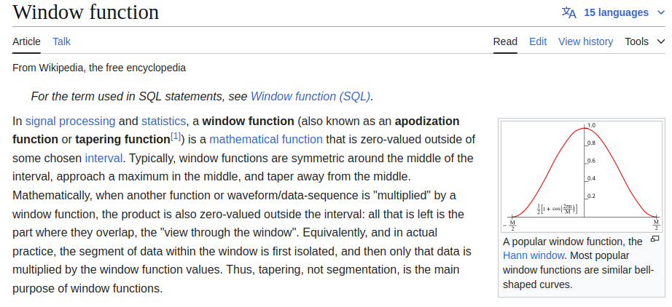
3.4.11 Chisel FP For FIR
https://github.com/freechipsproject/chisel-bootcamp
Chisel FP for FIR
Below, we use Chisel FP (Functional Programming) FIR Design.
1. We use the FIR filter from previous examples.
2. Instead of passing in the coefficients as parameters to the class or making them programmable, we pass a function to the FIR that defines how the window coefficients are calculated.
3. This function will take the window length and bitwidth to produce a scaled list of coefficients.
4. Here are two example of windows.
5. To avoid fractions, we scale the coefficients to be between the max and min integer values.
6. For window function, please check out the this Wikipedia page (https://en.wikipedia.org/wiki/Window_function).

Slide 28
3.4.12 Review Custom FIR

Slide 29
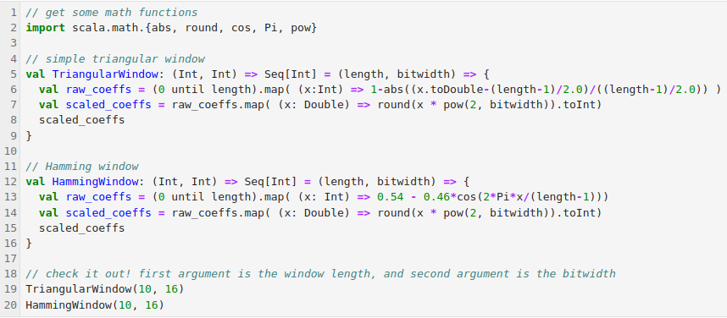
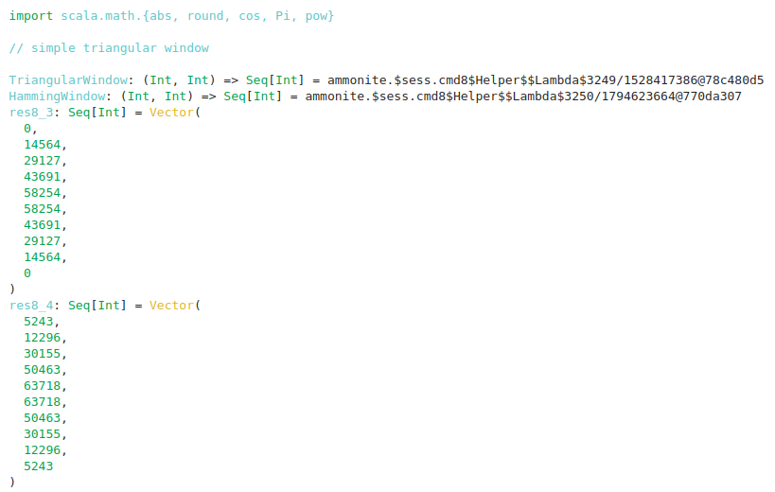
3.4.12 Review Custom FIR
https://github.com/freechipsproject/chisel-bootcamp
Review Custom FIR
Our custom FIR Filter

Slide 30
3.4.13 Window Function For FIR

Slide 31
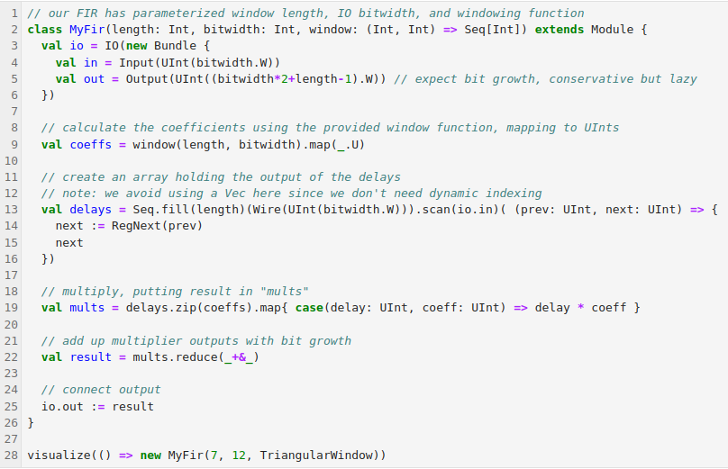
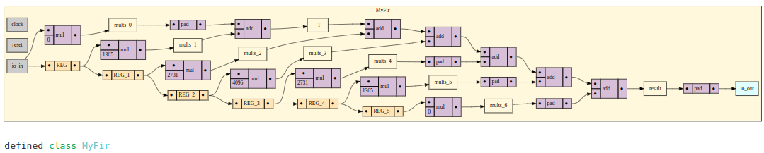
3.4.13 Window Function For FIR
https://github.com/freechipsproject/chisel-bootcamp
Window Function For FIR
1. Below, we create a FIR filter that accepts a window function as the argument.
2. This allows us to define new windows later on and retain the same FIR generator.
3. It also allows us to independently size the FIR, knowing the window will be recalculated for different lengths or bitwidths.
4. Since we are choosing the window at compile time, these coefficients are fixed.
5. The last three lines could be easily combined into one line.
6. Note the how the code handles bitwidth growth conservatively to avoid loss.

Slide 32
3.4.14 Example: Chisel FIR Tester

Slide 33
3.4.14 Example: Chisel FIR Tester
https://github.com/freechipsproject/chisel-bootcamp
Example: Chisel FIR Tester
1. Previously, we write our custom FIR Golden model.
2. This time, we use the Scala Library called Breeze as the linear algebra and signal processing function to replace the custom FIR Golden Model.
3. The code compare our custom FIR golden model with Scala Breeze Library (Linear Algebra and Signal Processing library).
4. Code has comment for explanation.
5. We can remove the comment the print statement at the end just after the expect call. Also try changing the window from triangular to Hamming.

Slide 34
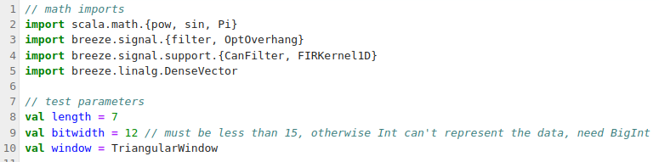
3.4.14 Example: Chisel FIR Tester
https://github.com/freechipsproject/chisel-bootcamp
Example: Chisel FIR Tester
1. Below, we import the math function and define test parameters

Slide 35
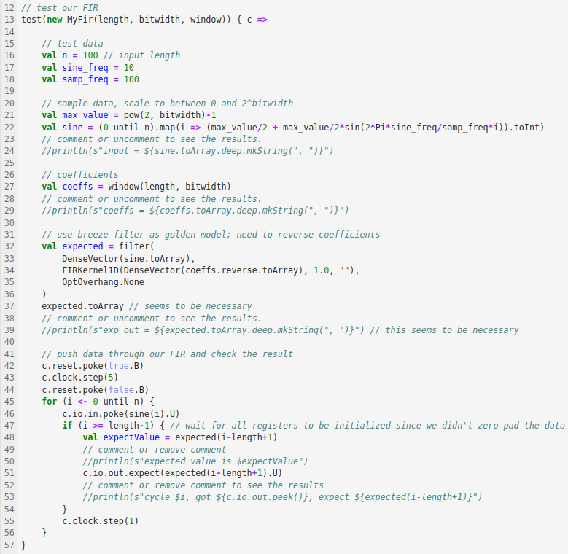
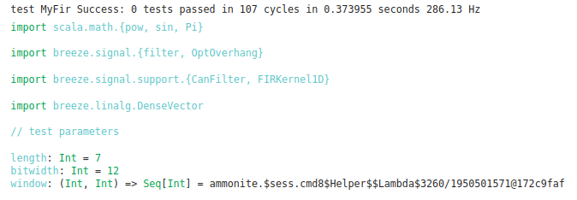
3.4.14 Example: Chisel FIR Tester
https://github.com/freechipsproject/chisel-bootcamp
Example: Chisel FIR Tester
Below, we test the FIR Tester.

Slide 36
3.4.15 Exercise: Chisel Neural Network

Slide 37
3.4.15 Exercise: Chisel Neural Network
https://github.com/freechipsproject/chisel-bootcamp
Exercise: Chisel Neural Network
1. Below exercise is for Neural Network implementation.
2. Complete the below exercises for writing functions, using them as arguments to hardware generators, and avoiding mutable data.

Slide 38
3.4.16 Exercise: Chisel Neuron for NN

Slide 39
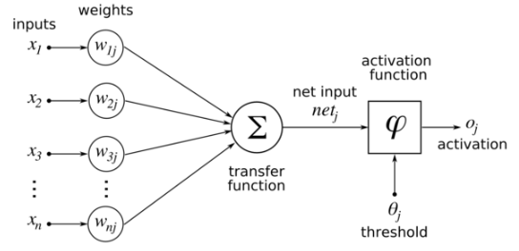
3.4.15 Exercise: Chisel Neuron for NN
https://github.com/freechipsproject/chisel-bootcamp
Exercise: Chisel Neuron for NN (Neural Network)
1. Our first exercise is to build a neuron, the building block of fully-connected layers in artificial neural networks.
2. Neurons take inputs and a set of weights, one per input, and produce one output.
3. The weights and inputs are multiplied and added, and the result is fed through an activation function.
4. In this exercise, you will implement different activation functions and pass them as an argument to your neuron generator.
5. Below Diagram shows Neurons.

Slide 40
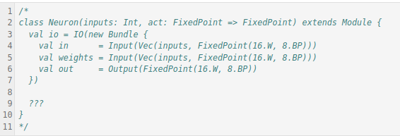
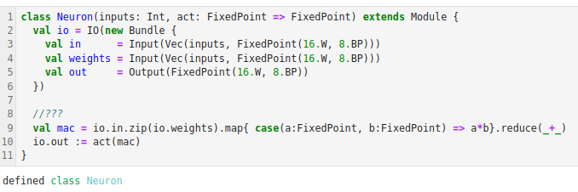
3.4.15 Exercise: Chisel Neuron for NN
https://github.com/freechipsproject/chisel-bootcamp
Exercise: Chisel Neuron for NN (Neural Network)
1. Below codes show the multiplication and summation in neuron.
2. We want to implement with “???”.
3. We use map and reduce to perform the the multiplication and summation in neuron.

Slide 41
3.4.17 Exercise: Chisel Activation in NN

Slide 42



3.4.17 Exercise: Chisel Activation in NN
https://github.com/freechipsproject/chisel-bootcamp
Exercise: Chisel Activation Function in NN (Neural Network)
1. Below, we create ReLU (Rectified Linear Unit) as the activation functions.
2. We use ReLU to avoid the infinite large when we take differential at step change.
3. Below is the sigmoid function (we use to approximate the step function but avoid the step change).
4. We call the sigmoid function as the logistic function as below.
5. However, computing the exponential function in hardware is quite challenging and expensive.
6. We approximate this as the step function.
7. The ReLU change step function as below.

Slide 43


3.4.17 Exercise: Chisel Activation in NN
https://github.com/freechipsproject/chisel-bootcamp
Exercise: Chisel Activation Function in NN (Neural Network)
1. Implement the step and ReLU activation functions in (“???”).

Slide 44
3.4.18 Exercise: Chisel Tester for NN

Slide 45
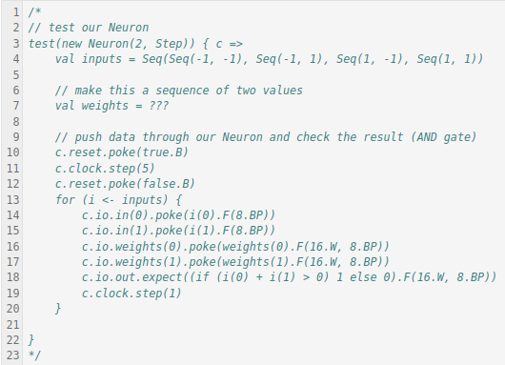
3.4.18 Exercise: Chisel Tester for NN
https://github.com/freechipsproject/chisel-bootcamp
Exercise: Chisel Tester for NN (Neural Network)
1. Problem: Finally, we create a tester that checks the correctness of our Neuron.
2. With the step activation function, neurons may be used as logic gate approximators.
3. Proper selection of weights and bias can perform binary functions.
4. We'll test our neuron using AND logic. Complete the following tester to check our neuron with the step function.
5. Note that since the circuit is purely combinational, the reset(5) and step(1) calls are not necessary.
6. Below we implement the prob;em (“???”).

Slide 46
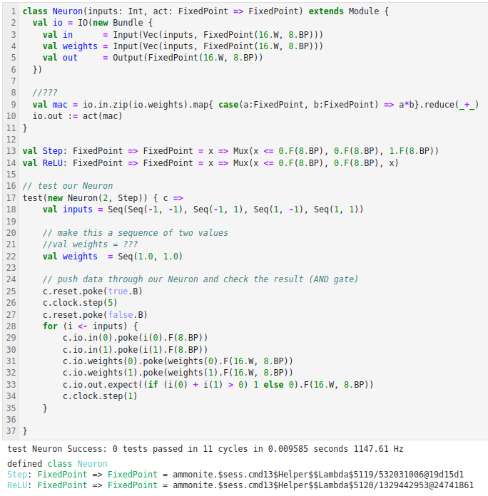
3.4.18 Exercise: Chisel Tester for NN
https://github.com/freechipsproject/chisel-bootcamp
Exercise: Chisel Tester for NN (Neural Network)
Solution:

Slide 47
End

