Slide 1

12.1 Chisel Developer
Peter H. Chen

Slide 2
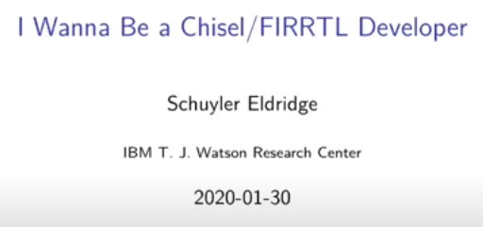
11.1 Chisel Language
https://www.youtube.com/watch?v=ddariAPH6us&list=PLlu0CT-JnSasfpk8tq1ZDiE2G0AK1BhOg&index=12
Chisel Developer (0:00-0:01/1:05:33)
Schuyler Eldridge, IBM Watson Research Center

Slide 3
End

