Slide 1

0.1 TOC (Table Of Content)
Peter H. Chen

Slide 2
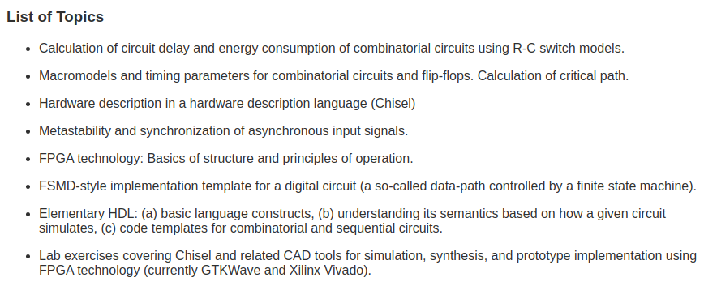
0.1 TOC (Table Of Content)
https://www2.imm.dtu.dk/courses/02139/
Digital Electronics 2
1. Calculate Circuit Delay/Energy consumption of RC switch model.
2. Calculate critical path
3, Chisel (Constructing Hardware in Scala Embedded Language)
4. Asynchronous input signals5. FPGA
6. FSMD (Finite State Machine Datapath)
7. HDL (Hardware Description Language)
8. Chisel (Simulation, Synthesis, Implementation, FPGA, GTKWave, Xilinx Vivado)

Slide 3
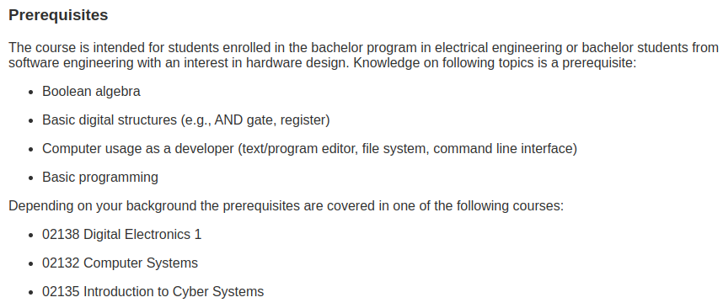
0.1 TOC (Table Of Content)
https://www2.imm.dtu.dk/courses/02139/
Prerequisites

Slide 4
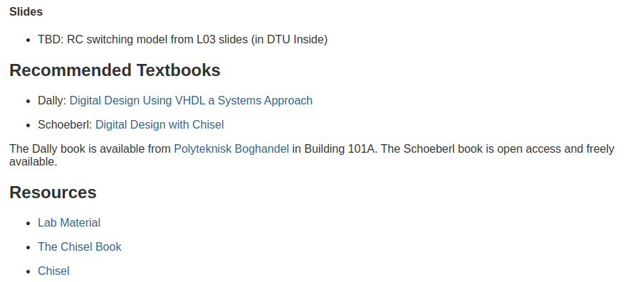
0.1 TOC (Table Of Content)
https://www2.imm.dtu.dk/courses/02139/
Slides, Textbooks, Resource
1. Williams Dally: Digital Design Using VHDL: A System Approach
2. Martin Schoeberl: Digital Design with Chisel

Slide 5
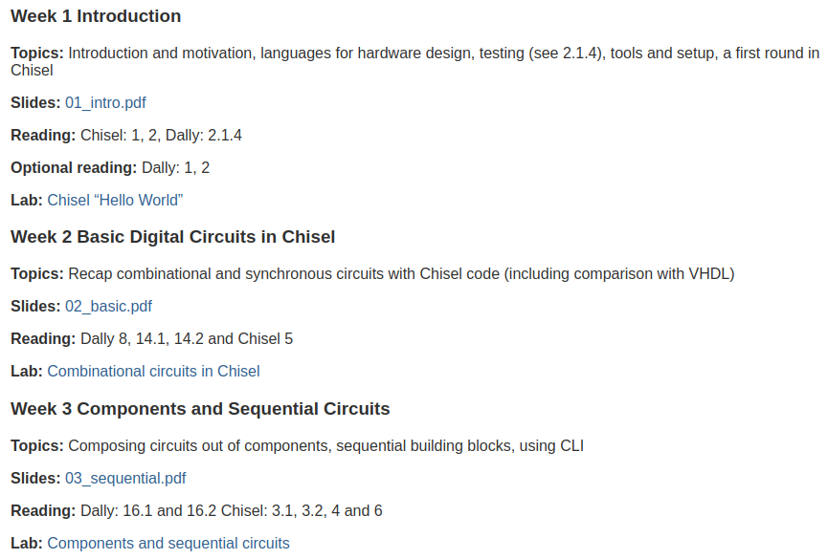
0.1 TOC (Table Of Content)
https://www2.imm.dtu.dk/courses/02139/
Week 1-3
1. Introduction
2. Basic Digital Circuits in Chisel
3. Components and Sequential Circuits

Slide 6
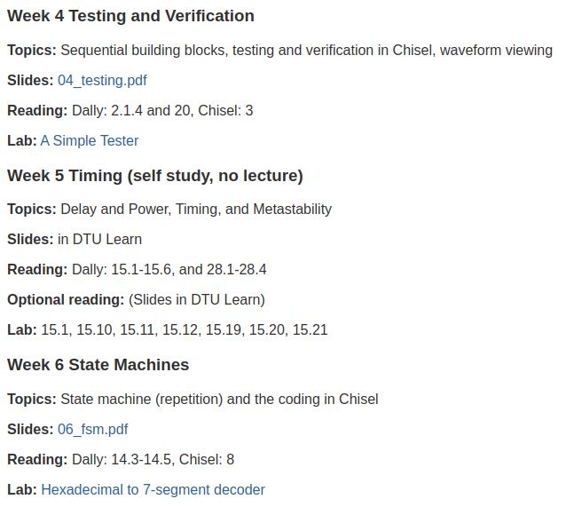
0.1 TOC (Table Of Content)
https://www2.imm.dtu.dk/courses/02139/
Week 4-6
4. Testing/Verification
5. Timing
6. State Machine

Slide 7
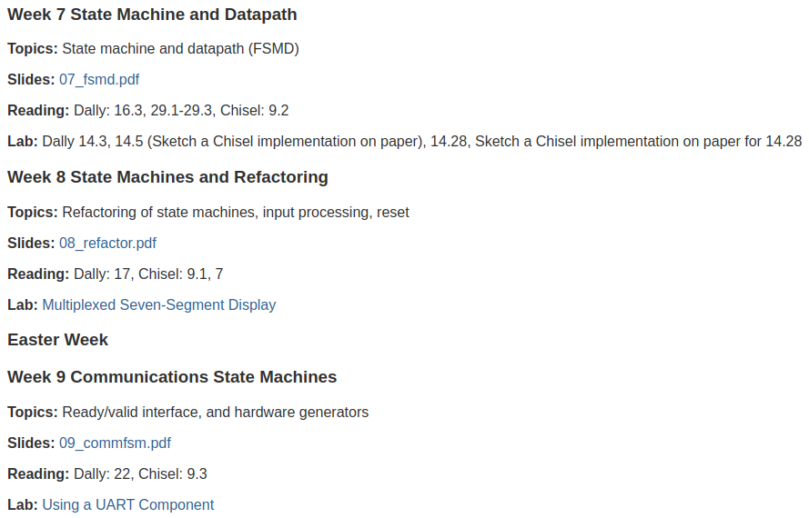
0.1 TOC (Table Of Content)
https://www2.imm.dtu.dk/courses/02139/
Week 7-9
7. State Machine and Datapath
8. State Machine and Refractory
9. Communication State Machine

Slide 8
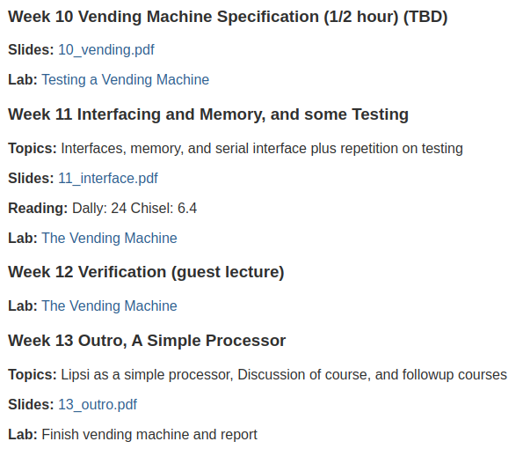
0.1 TOC (Table Of Content)
https://www2.imm.dtu.dk/courses/02139/
Week 10-13
10. Vending Machine
11. Memory and Testing
12. Verification
13. Simple Processor

Slide 9
End

