Slide 1

4.4 Add Op
Peter H. Chen

Slide 2
4.4 Add Op
https://github.com/freechipsproject/chisel-bootcamp
Add Op
We discuss Add Op in Chisel Code.
Topics:
1. Setup: Jupyter notebook and select scala interpreter.

Slide 3
4.4.1 Setup

Slide 4
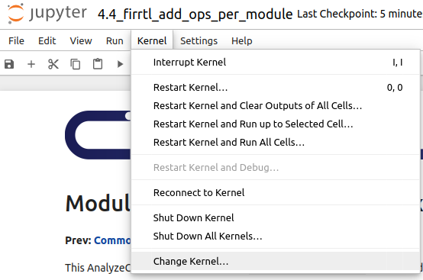
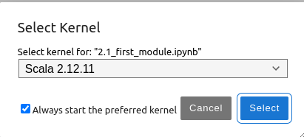
4.4.1 Setup
https://github.com/freechipsproject/chisel-bootcamp
Setup
1. Change folder to chisel-bootcamp. If you want to work on your working space, copy image folder and source folder to your working directory.
> cd chisel-bootcamp
2. Start Jupyter notebook
> jupyter notebook 4.4_firrtl_add_ops_per_module.ipynb
3. Select the scala interpreter: > Kernel > Change Kernel… >Scala 2.12.11
3

Slide 5
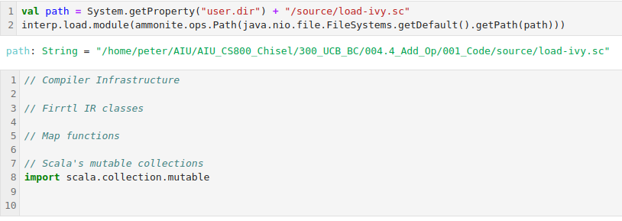
4.4.1 Setup
https://github.com/freechipsproject/chisel-bootcamp
Setup
1. Setup path and load path.

Slide 6
4.4.2 Counting Adder Per Module

Slide 7
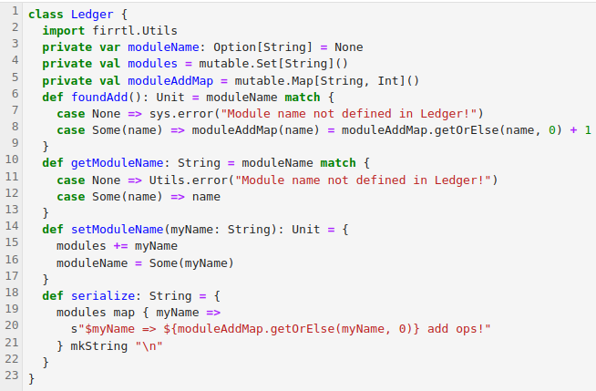
4.4.2 Counting Adder Per Module
https://github.com/freechipsproject/chisel-bootcamp
Counting Adder Per Module
1. As discussed earlier, a FIRRTL circuit is represented using a tree representation. Here, we define the Ledger (账本) class to do the book keeping of circuit.
  a. A FIRRTL Circuit contains a sequence of DefModules.
  b. A DefModule contains a sequence of Ports, and maybe a Statement.
  c. A Statement can contain other Statements, or Expressions.
  d. A Expression can contain other Expressions.

Slide 8
4.4.2 Counting Adder Per Module
https://github.com/freechipsproject/chisel-bootcamp
Counting Adder Per Module
1. To traverse all FIRRTL IR nodes in a circuit, we write functions that recursively walk down this tree.
2. To record statistics, we will pass along a Ledger class and use it when we come across an add op.

Slide 9
4.4.3 FIRRTL Ledger

Slide 10
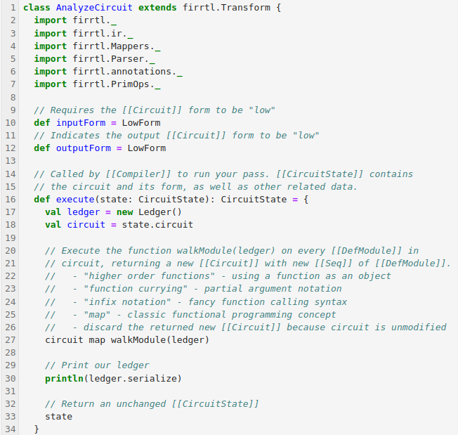
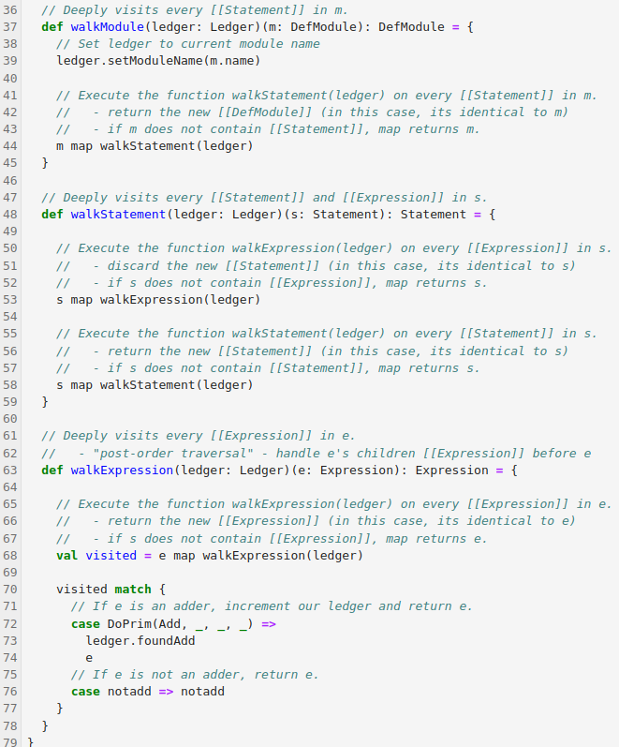
4.4.3 FIRRTL Ledger
https://github.com/freechipsproject/chisel-bootcamp
FIRRTL Ledger (账本)
1. Here, we define a FIRRTL Transform that walks the circuit and updates our Ledger whenever it comes across an adder (DoPrim with op argument Add). Don't worry about inputForm or outputForm for now.
2. Take some time to understand how walkModule, walkStatement, and walkExpression enable traversing all DefModule, Statement, and Expression nodes in the FIRRTL AST.

Slide 11
4.4.3 FIRRTL Ledger
https://github.com/freechipsproject/chisel-bootcamp
FIRRTL Ledger
1. Questions to answer:
  a. Why doesn't walkModule call walkExpression?
  b. Why does walkExpression do a post-order traversal?
  c. Can you modify walkExpression to do a pre-order traversal of Expressions?

Slide 12
4.4.4 Run Transform

Slide 13
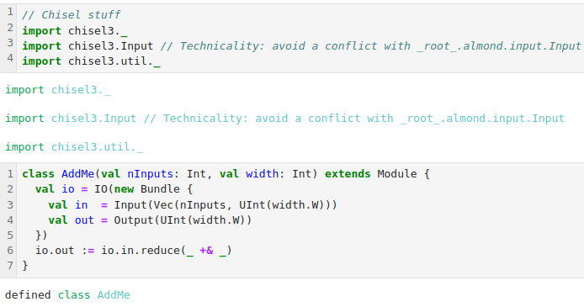
4.4.4 Run Transform
https://github.com/freechipsproject/chisel-bootcamp
Run Transform
1. Below, we have defined the transform. We will run the transform on a Chisel design.
2. First, we import libraries.
3. Then, we define a Chisel module (AddMe)

Slide 14
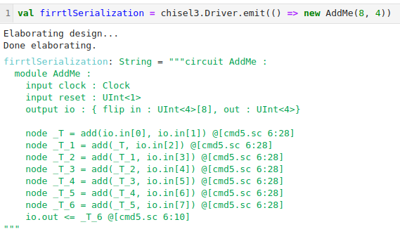
4.4.4 Run Transform
https://github.com/freechipsproject/chisel-bootcamp
Run Transform
1. Next, we elaborate Module AddMe into FIRRTL AST syntax.

Slide 15
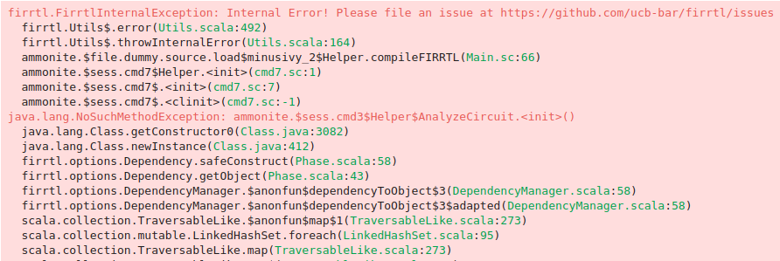
4.4.4 Run Transform
https://github.com/freechipsproject/chisel-bootcamp
Run Transform
1. Then, we compile our FIRRTL into Verilog, but include our custom transform into the compilation. Note that it prints out the number of add ops it found!
Note (January 2021): The following line may be broken due to a bug.
The compileFIRRTL function is defined only in this tutorial - in a future section, we will describe how the process of inserting customTransforms.

Slide 16
End

