Slide 1

11.11 Application-Specific
Peter H. Chen

Slide 2
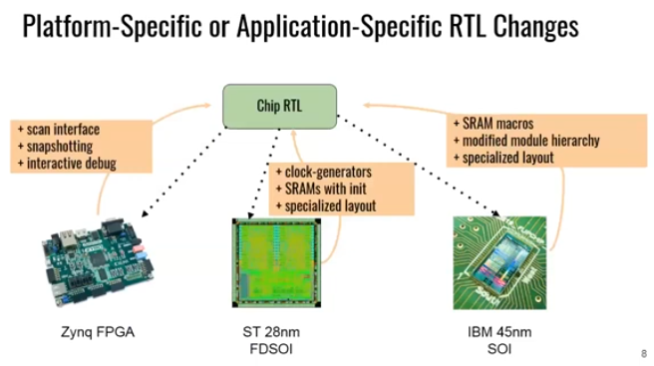
11.11 Application-Specific
https://www.youtube.com/watch?v=VU9XdMJqkeM&list=PLlu0CT-JnSasfpk8tq1ZDiE2G0AK1BhOg&index=11
Application-Specific (5:24-6:23/27:20)
We need Platform-Specific or Application-Specific for RTL Changes.

Slide 3
End

