Slide 1

5 Write Scala Testbench
Peter H. Chen

Slide 2
5 Write Scala Testbench
https://github.com/ucb-bar/chisel-tutorial/wiki/Writing-Scala-Testbenches
Write Scala Testbench
1. Chisel's Scala based testbench is the first line of defense against simple bugs in your design.
2. The Scala testbench uses several unique Chisel constructs to perform the test.
3. We look at the scala testbench with example.

Slide 3
5 Write Scala Testbench
https://github.com/ucb-bar/chisel-tutorial/wiki/Writing-Scala-Testbenches
Write Scala Testbench
Topics:
1. Scala Testbench Example: ByteSelector.scala Example
2. Simulation and Debug Output
3. General Testbench:
  3.1 Use Poke to set inputs
  3.2 Use step to move time step
  3.3 Use expect to check expected value
  3.4 Loop 3.1 to 3.3 for all cases
  3.5 For sequential circuit, we need to delay time period for the output.
4. Max2 Testbench: How to implement the problem UC Berkeley class assignment to final solution.
5. Scala Testbench limitation: SBT (Scala Build Tool) infrastructure is slow. For complicate case testcase, we need to write testcase with C++ and Verilog directly.

Slide 4
5.1 Scala Testbench Example

Slide 5
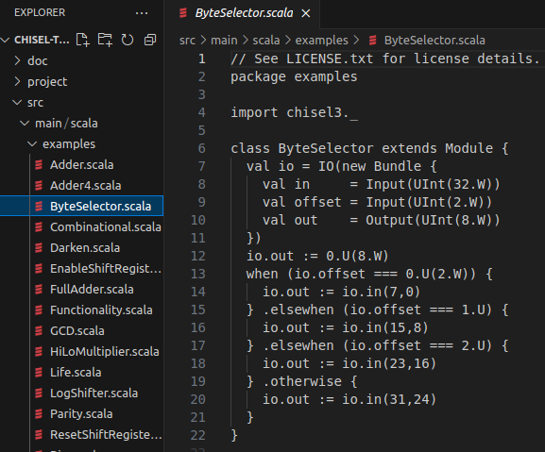
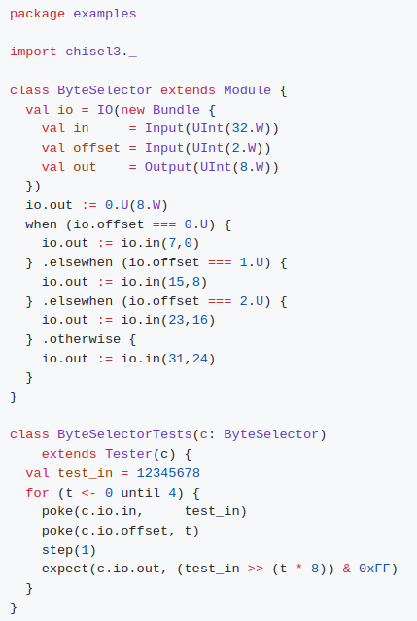
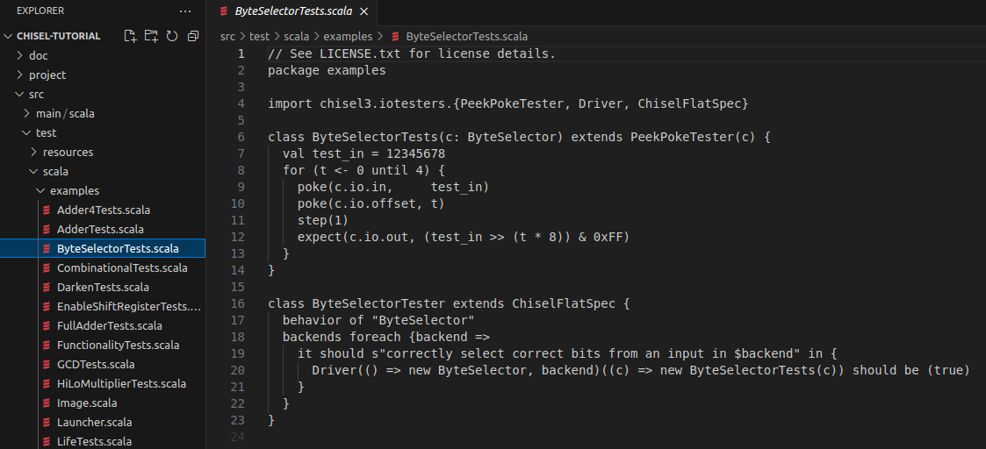
5.1 Scala Testbench Example
https://github.com/ucb-bar/chisel-tutorial/wiki/Writing-Scala-Testbenches
Scala Testbench Example
1. Below is the ByteSelector.scala module definition from the previous tutorial and the corresponding Chisel test harness.
2. On the right is the Scala circuit the src/main/scala/examples/ByteSelector.scala.
3. Right below is the Scala Test src/test/scala/examples/ByteSelectorTests.scala.
2
1
3

Slide 6
5.1 Scala Testbench Example
https://github.com/ucb-bar/chisel-tutorial/wiki/Writing-Scala-Testbenches
Scala Testbench Example
In the test harness ByteSelectorTests we see that the test portion is written in Scala with some Chisel constructs inside a Tester class definition. The device under test is passed to us as a parameter c.

Slide 7
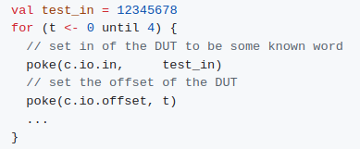
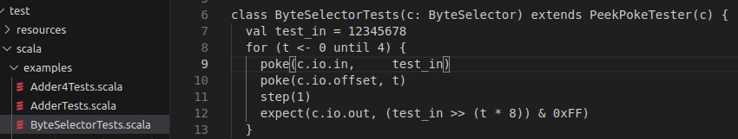
5.1 Scala Testbench Example
https://github.com/ucb-bar/chisel-tutorial/wiki/Writing-Scala-Testbenches
Scala Testbench Example
1. In the for loop, the assignments for each input of the ByteSelector is set to the appropriate values using poke.
2. For this particular example, we are testing the ByteSelector by hardcoding the input to some known value and checking if each of the 4 offsets returns the appropriate byte.
3. To do this, on each iteration we generate appropriate inputs to the module and tell the simulation to assign this value to the input of the device we are testing c:
3
1
3
1
2

Slide 8
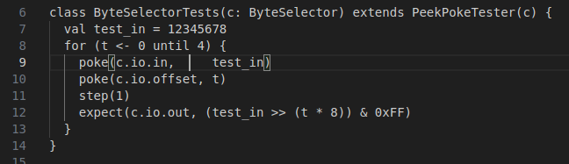

5.1 Scala Testbench Example
https://github.com/ucb-bar/chisel-tutorial/wiki/Writing-Scala-Testbenches
Scala Testbench Example
1. Next we step the circuit.
2. We next advance the simulation by calling the step function.
3. This effectively advances the simulation one clock cycle in the presence of sequential logic.

Slide 9

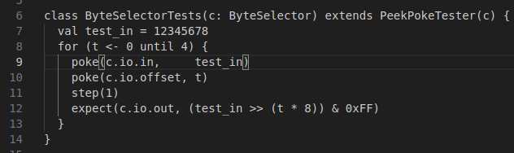
5.1 Scala Testbench Example
https://github.com/ucb-bar/chisel-tutorial/wiki/Writing-Scala-Testbenches
Scala Testbench Example
1. Finally, we check for expected outputs.
2. In this case, we check the expected output of ByteSelector as follows:

Slide 10

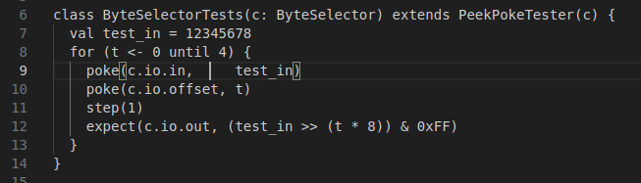
5.1 Scala Testbench Example
https://github.com/ucb-bar/chisel-tutorial/wiki/Writing-Scala-Testbenches
Scala Testbench Example
1. This defines the reference output expected for this particular cycle of the simulation.
2. Since the circuit we are testing is purely combinational, we expected that the output we define appears on any advancement of the simulation.
3. The expect function will record either true or false after checking if the output generates the expected reference output.
4. The results of successive expect's are anded into a Tester field called ok which starts out as true.
5. The value of the ok field determines the success or failure of the tester execution.
6. Actually expect is defined in terms of peek roughly as follows:

Slide 11
5.2 Simulation/Debug Output

Slide 12
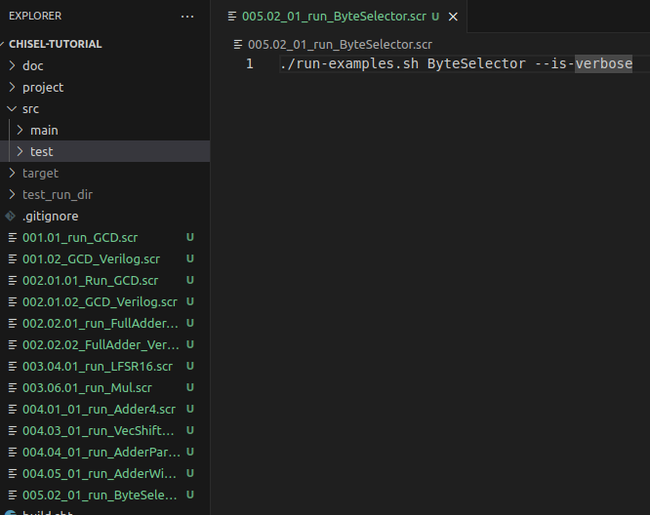
5.2 Simulation/Debug Output
https://github.com/ucb-bar/chisel-tutorial/wiki/Writing-Scala-Testbenches
Simulation/Debug Output
1. > 005.02_01_run_ByteSelector.scr
>> ./run-examples.sh ByteSelector --is-verbose
Now suppose we run the testbench for the ByteSelector defined previously.
2. To do this, run ./run-examples.sh ByteSelector --is-verbose from the tutorials directory.
We've added the is-verbose flag to get the actual sequence of peeks and pokes used during the test.
1

Slide 13
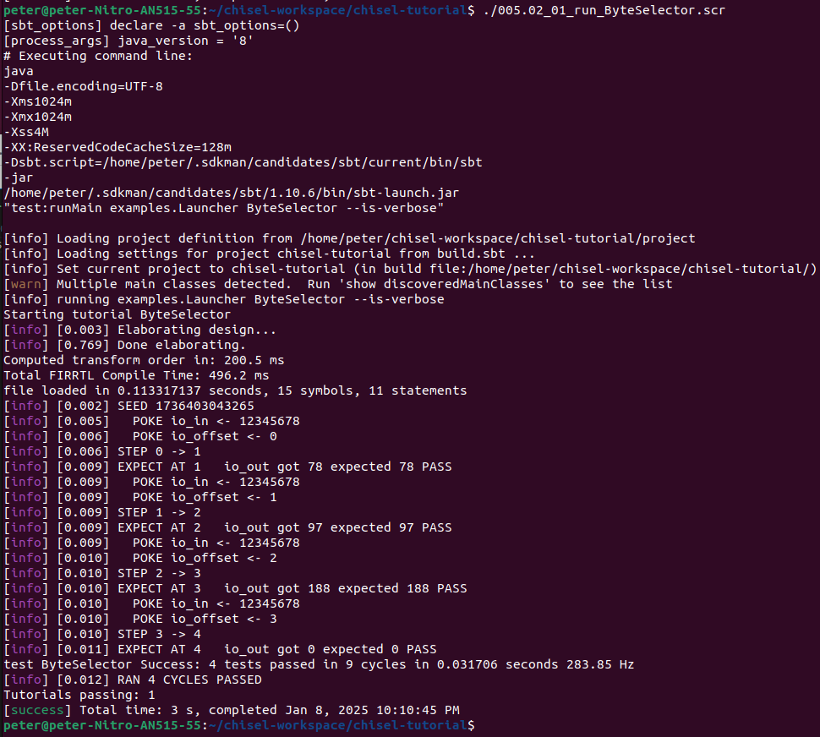
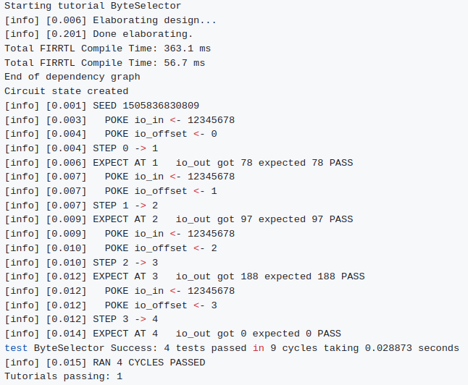
5.2 Simulation/Debug Output
https://github.com/ucb-bar/chisel-tutorial/wiki/Writing-Scala-Testbenches
Simulation/Debug Output
1. > 005.02_01_run_ByteSelector.scr
2. When we run the testbench, we will notice that the simulation produces debug output every time the step function is called.
3. Each of these calls gives the state of the inputs and outputs to the ByteSelector and whether the check between the reference output and expected output matched as shown below:
2
1
2

Slide 14
5.2 Simulation/Debug Output
https://github.com/ucb-bar/chisel-tutorial/wiki/Writing-Scala-Testbenches
Simulation/Debug Output
Note:
1. There is a final pass assertion "PASSED" at the end which corresponds to the allGood at the very end of the testbench.
2. In this case, we know that the test passed since the allGood assertion resulted in a "PASSED".
3. In the event of a failure, the assertion would result in a "FAILED" output message here.

Slide 15
5.3 General Testbench

Slide 16
5.3 General Testbench
https://github.com/ucb-bar/chisel-tutorial/wiki/Writing-Scala-Testbenches
General Testbench
In general, the scala testbench should have the following rough structure:
  Set inputs using poke
  Advance simulation using step
  Check expected values using expect (and/or peek)
  Repeat until all appropriate test cases verified
For sequential modules we may want to delay the output definition to the appropriate time as the step function implicitly advances the clock one period in the simulation.
Unlike Verilog, you do not need to explicitly specify the timing advances of the simulation; Chisel will take care of these details for you.

Slide 17
5.4 Max2 Testbench

Slide 18
5.5 Testbench Limitation
https://github.com/ucb-bar/chisel-tutorial/wiki/Writing-Scala-Testbenches
Testbench Limitation
1. The Chisel testbench works well for simple tests and small numbers of simulation iterations.
2. For larger test cases, the Chisel testbench becomes very slow due to script infrastructure
3. For these larger and more complex test cases, we can use C++ emulator or Verilog test harnesses. They run faster and can handle more complicated test cases.
Next, we will see how to create the Chisel project.

Slide 19
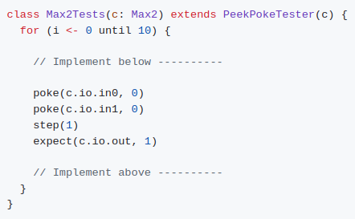
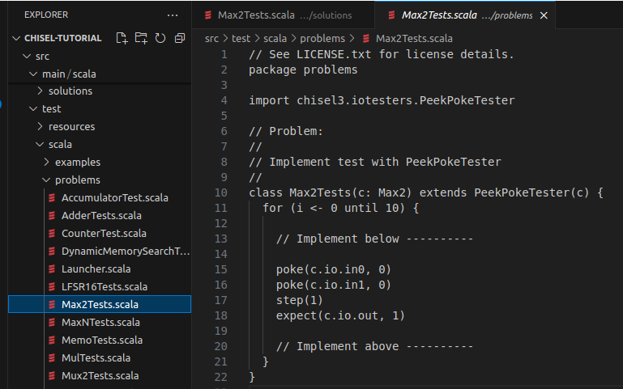
5.4 Max2 Testbench
https://github.com/ucb-bar/chisel-tutorial/wiki/Writing-Scala-Testbenches
Max2 Testbench
By filling in the following tester (found in $TUT_DIR/src/test/scala/problems/Max2Tests.scala ):

Slide 20

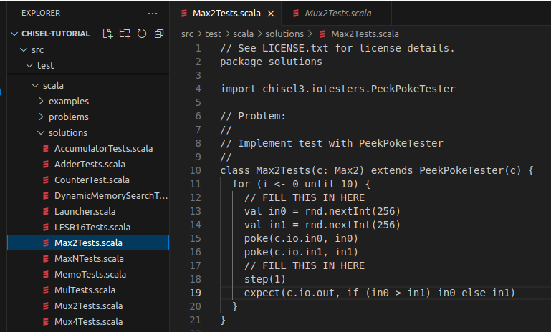
5.4 Max2 Testbench
https://github.com/ucb-bar/chisel-tutorial/wiki/Writing-Scala-Testbenches
Max2 Testbench
Using random integers generated as follows:

Slide 21
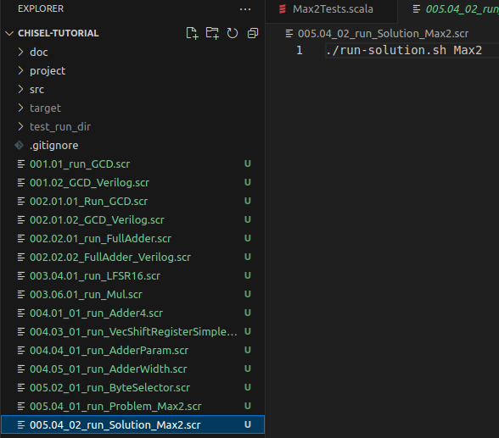
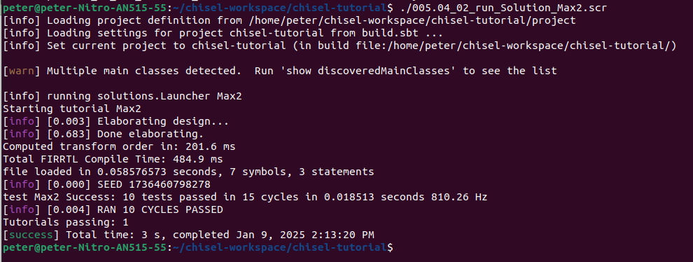
5.4 Max2 Testbench
https://github.com/ucb-bar/chisel-tutorial/wiki/Writing-Scala-Testbenches
1
Max2 Testbench
We fix the testbench until the circuit passes your tests.
1. > ./005.04_02_run_Solution.scr
>> ./run_Solution.sh Max2
2. Result
2

Slide 22
5.5 Testbench Limitation

Slide 23
5.4 Max2 Testbench
https://github.com/ucb-bar/chisel-tutorial/wiki/Writing-Scala-Testbenches
1
Max2 Testbench
We fix the testbench until the circuit passes your tests.
1. > ./005.04_02_run_Solution.scr
>> ./run_Solution.sh Max2
2. Result
2

Slide 24
5.4 Max2 Testbench
https://github.com/ucb-bar/chisel-tutorial/wiki/Writing-Scala-Testbenches
Max2 Testbench
We fix the testbench until the circuit passes your tests.
1. > ./005.04_02_run_Solution.scr
>> ./run_Solution.sh Max2
2. Result

Slide 25
End

