Slide 1

1 Chisel Developer Guide
Peter H. Chen

Slide 2
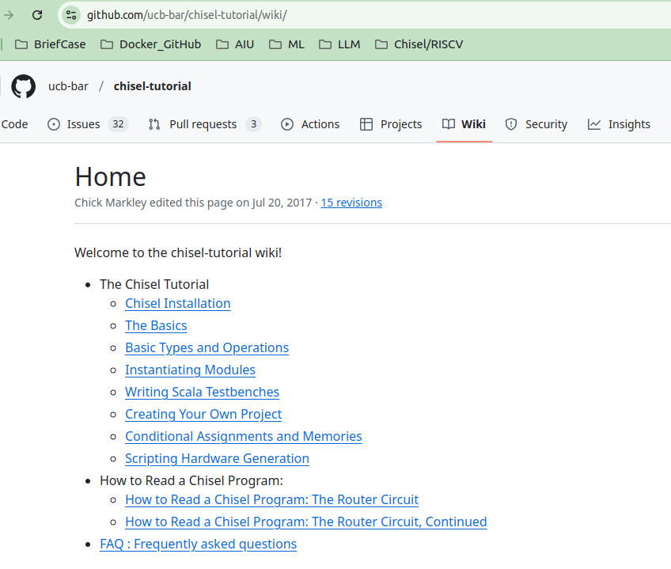
1 Chisel Developer Guide
https://github.com/ucb-bar/chisel-tutorial/wiki/
Chisel Develop Guide
UCB Chisel Tutorial (https://github.com/ucb-bar/chisel-tutorial?tab=readme-ov-file) provides: installed, tested problems, tested solutions, and tested examples.
Chick Markley made Chisel Developer Guide (https://github.com/ucb-bar/chisel-tutorial/wiki/) with example for chisel development.
Chick works for FIRRTL, Chisel, Tester, and Scala Circuit Simulator, FIRRTL Interpreter, and Treadle (踏板).
1. Review chisel installation,
2. Chisel basics
3. Basic Types and Operation
4. Instantiate Models
5. How to write Scala Testbench
6. How to Create Project
7. Conditional Assignments and Memories
8. Write Script for Hardware Generation
9. How to read a Chisel program: Router Circuit (I)
10. How to read a chisel program, Router Circuit (II)
11. Question and Answer.

Slide 3
End

