Slide 1

3 Mux2
Peter H. Chen

Slide 2
3 Mux2
https://github.com/ucb-bar/chisel-tutorial?tab=readme-ov-file
Mux2
To learn Chisel, we learn by exercises.
1. Circuit example: src/main/scala/problems
2. Circuit example with test hardness: src/test/scala/problems
3. Sample solutions: src/main/scala/solutions
4. Sample solutions with test hardness: src/test/scala/solutions
5. The hierarchical organization of separation of circuits and tests are good practice and use them for the future hardware design.
6. When we work on hardware design, we need editor, such as, vi, MS-code, IntelliJ, Jupyter Notebook, etc. We need to edit two files, circuit and test.

Slide 3
3.1 Command Mode for Mux2

Slide 4
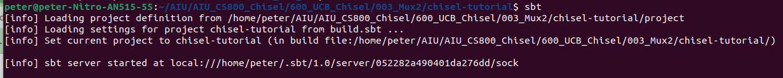
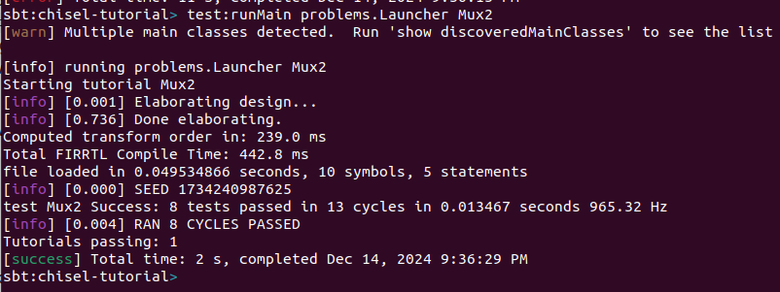
3.1 Command Mode for Mux2
https://github.com/ucb-bar/chisel-tutorial?tab=readme-ov-file
Command Mode for Mux2
1. > cd chisel-tutorials
2. > sbt
3. > test:runMain problems.Launcher Mux2
Note:
Maxu2 is defined in Mux4.scala
2
3

Slide 5
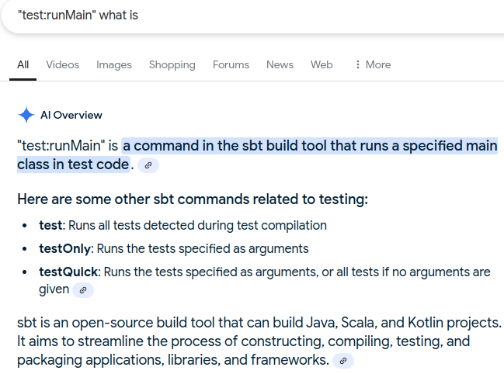
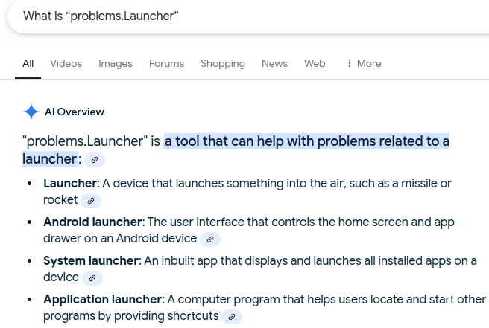
3.1 Command Mode for Mux2
https://github.com/ucb-bar/chisel-tutorial?tab=readme-ov-file
Command Mode for Mux2
Q1: What is the meaning of “test:runMain”?
Ans: The test:runMain command in Scala's sbt runs a specified main class in test code, passing it the provided arguments:
Q2: What is “problems.Launcher”
Cans: Launch the circuit example in src/main/scala/problems

Slide 6
3.2 Batch Mode for Mux2

Slide 7
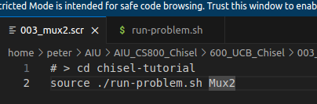
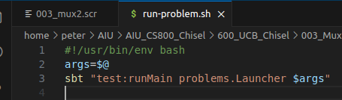
3.2 Batch Mode for Mux2
https://github.com/ucb-bar/chisel-tutorial?tab=readme-ov-file
Batch Mode for Mux2
1. In the chisel-tutorial
Below we pass in “Mux2” into run-problem.sh
> source ,/run-problem.sh Mux2
2. run-problem.sh is a bash script.
The argument is passed from external bash shell. With args=$@.
We get the Mux2 in the script and run the sbt “test:runMain problems.Launcher $args”
> #!/usr/bin/env bash
> args=$@
> sbt "test:runMain problems.Launcher $args"
1
2

Slide 8
End

