Slide 1

8 Generate Hardware by Script
Peter H. Chen

Slide 2
8 Generate Hardware by Script
https://github.com/ucb-bar/chisel-tutorial/wiki/Scripting-Hardware-Generation
Generate Hardware by Script
We discuss how to Generate Hardware by Chisel with looping, if/else logic, components, and array buffer.
Topics:
1. Use for Loop to construct multiple components
2. Use if, else if, else to construct the hardware
3. Use def to define the new component
4. Construct a bit shift register with delay is the parameter
5. Multiply two vector (table) by ArrayBuffer

Slide 3
8.1 For Loop

Slide 4
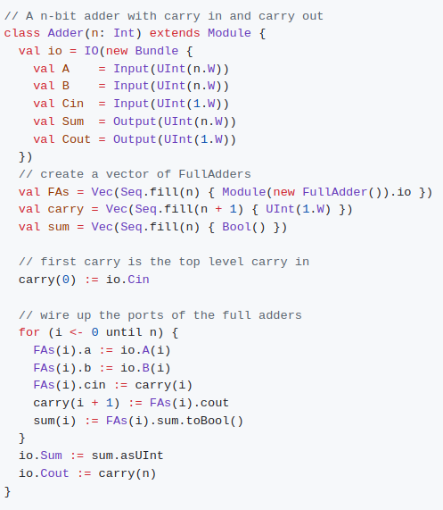
8.1 For Loop
https://github.com/ucb-bar/chisel-tutorial/wiki/Scripting-Hardware-Generation
For Loop
1. Often times parametrization requires instantiating multiple components which are connected in a very regular structure.
2. On the right, the parametrized Adder component definition shows the for loop construct in action:
Note:
1. A Scala integer i value is used in the for loop definition as the index variable. This indexing variable is specified to take values from 0 until n, which means it takes values 0, 1, 2..., n-1. If we wanted it to take values from 0 to n inclusive, we would use for (i <- 0 to n).
2. The indexing variable i does not in the generated hardware. It exclusively belongs to Scala and is only used in declaring how the connections are specified in the Chisel component definition.
3. The for loop construct is also very useful for assigning the Vec.

Slide 5
8.2 Use if, else if, else

Slide 6
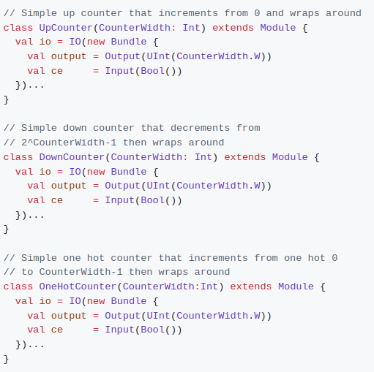
8.2 Use if, else if, else
https://github.com/ucb-bar/chisel-tutorial/wiki/Scripting-Hardware-Generation
Use if, else if, else
1. The if, elseif, and else keywords are reserved for Scala control structures.
2. What this means for Chisel is that these constructs allow you to selectively generate different structures depending on parameters that are supplied.
3. This is particularly useful when you want to turn certain features of your implementation "on" or "off", or if you want to use a different variant of some component.
4. For instance, suppose we have several simple counters that we would like to package up into a general purpose counter module: UpCounter, DownCounter, and OneHotCounter.
5. From the definitions below, we notice that for these simple counters, the I/O interfaces and parameters are identical.
6. We could just instantiate all three of these counters and multiplex between them but if we needed one at any given time this would be a waste of hardware.

Slide 7
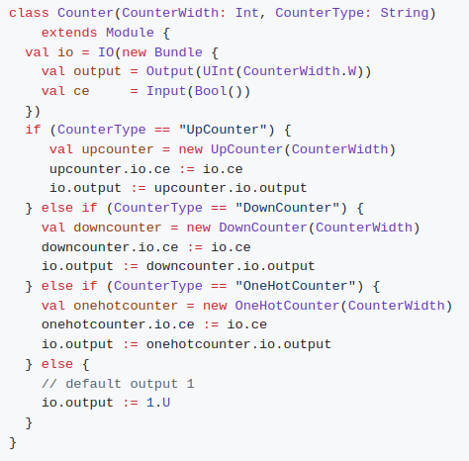
8.2 Use if, else if, else
https://github.com/ucb-bar/chisel-tutorial/wiki/Scripting-Hardware-Generation
Use if, else if, else
In order to choose between which of these three counters we want to instantiate, we can use Scala's if, else if, else statements to tell Chisel how to pick which component to instantiate based on a CounterType parameter:

Slide 8
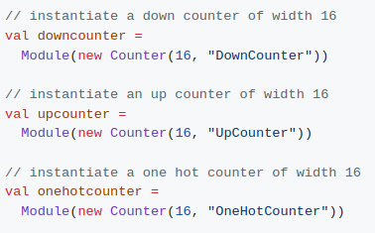
8.2 Use if, else if, else
https://github.com/ucb-bar/chisel-tutorial/wiki/Scripting-Hardware-Generation
Use if, else if, else
Below, we pass different parameter for different components of the Counter module.

Slide 9
8.3 Use def

Slide 10
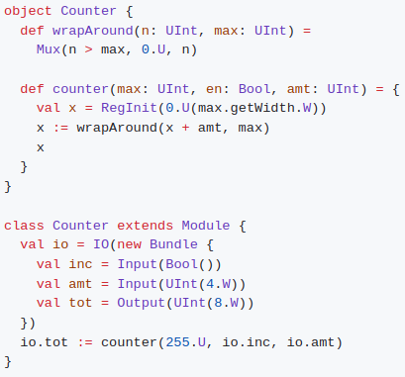
8.3 Use def
https://github.com/ucb-bar/chisel-tutorial/wiki/Scripting-Hardware-Generation
Use def
Chisel allows the usage of the Scala def statement to define Chisel code that may be used frequently.
These def statements can be packaged into a Scala Object and then called inside a Module.
The following Chisel code shows an alternate implementation of an counter using def that increments by amt if the inc signal is asserted.
Note:
In this example, we use calls to subroutines defined in the Counter object in order to perform the appropriate logic.

Slide 11
8.4 Parameterized Vec Shift Register

Slide 12
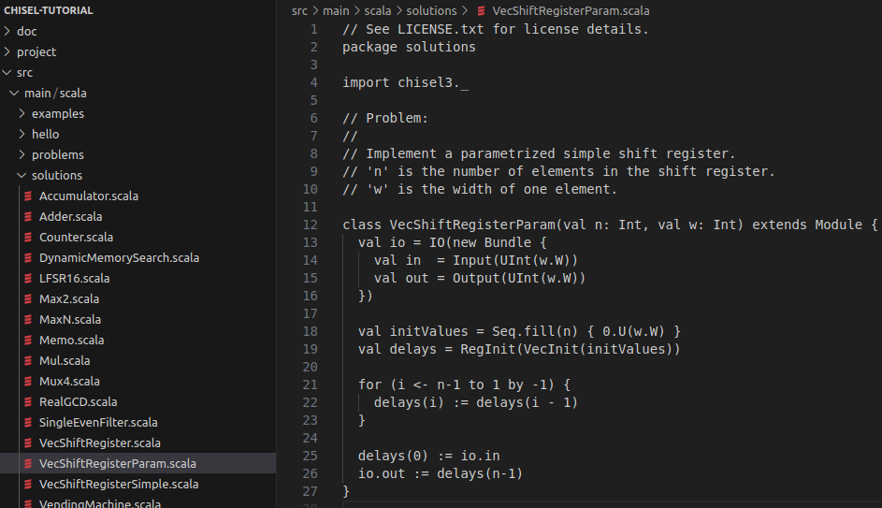
8.4 Parameterized Vec Shift Register
https://github.com/ucb-bar/chisel-tutorial/wiki/Scripting-Hardware-Generation
Parameterized Vec Shift Register
1. The next UC Berkeley class assignment is to construct a bit shift register with delay parameter.
2. Below code is from $TUT_DIR/src/main/scala/problems/VecShiftRegisterParam.scala.
3. Here, out is a n cycle delayed copy of values on in.
Note:
1. val is added to each parameter value to allow those values to be accessible from the tester.

Slide 13
8.4 Parameterized Vec Shift Register
https://github.com/ucb-bar/chisel-tutorial/wiki/Scripting-Hardware-Generation
Parameterized Vec Shift Register
1. > code $TUT_DIR/src/main/scala/problems/VecShiftRegisterParam.scala
2. run:
> ./run-problem.sh VecShiftRegisterParam
until your circuit passes the tests.

Slide 14
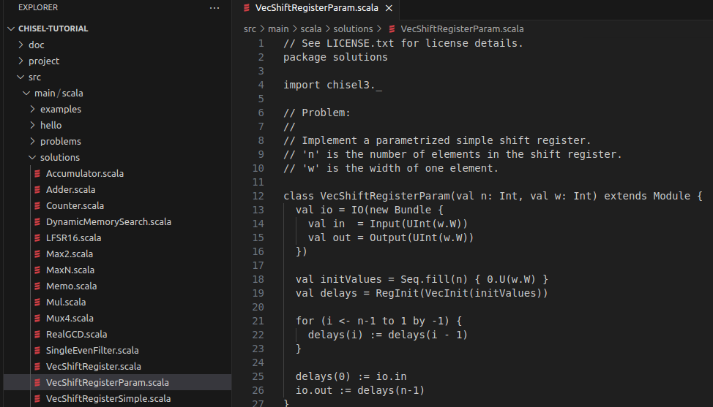
8.4 Parameterized Vec Shift Register
https://github.com/ucb-bar/chisel-tutorial/wiki/Scripting-Hardware-Generation
Parameterized Vec Shift Register
Below is the solution.
> code $TUT_DIR/src/main/scala/problems/VecShiftRegisterParam.scala

Slide 15
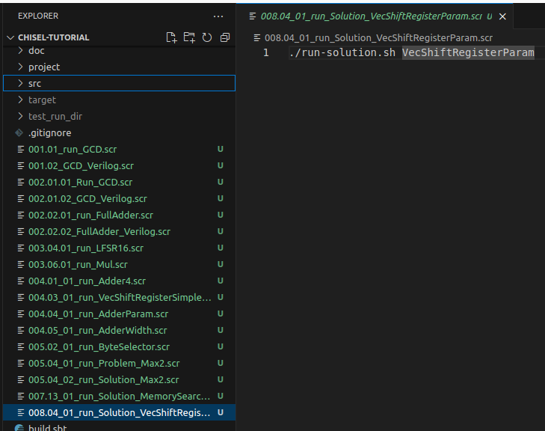
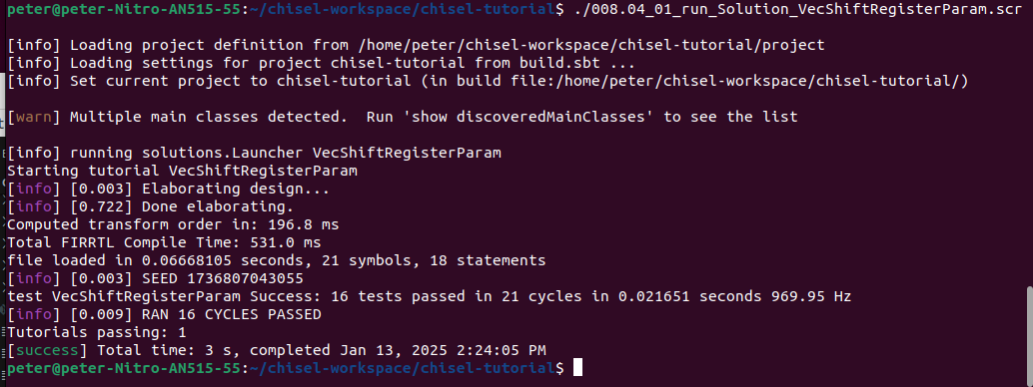
8.4 Parameterized Vec Shift Register
https://github.com/ucb-bar/chisel-tutorial/wiki/Scripting-Hardware-Generation
Parameterized Vec Shift Register
Below is the solution.
1. > ./008.04_01_run_Solution_VecShiftRegisterParam.scr
>> ./run-solution.sh VecShiftRegisterParam
2. Result
1
2

Slide 16
8.5 Multiplication Table

Slide 17
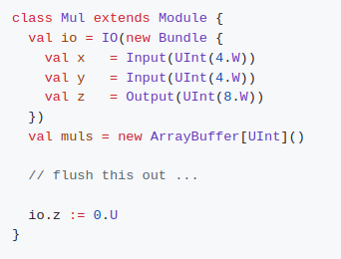
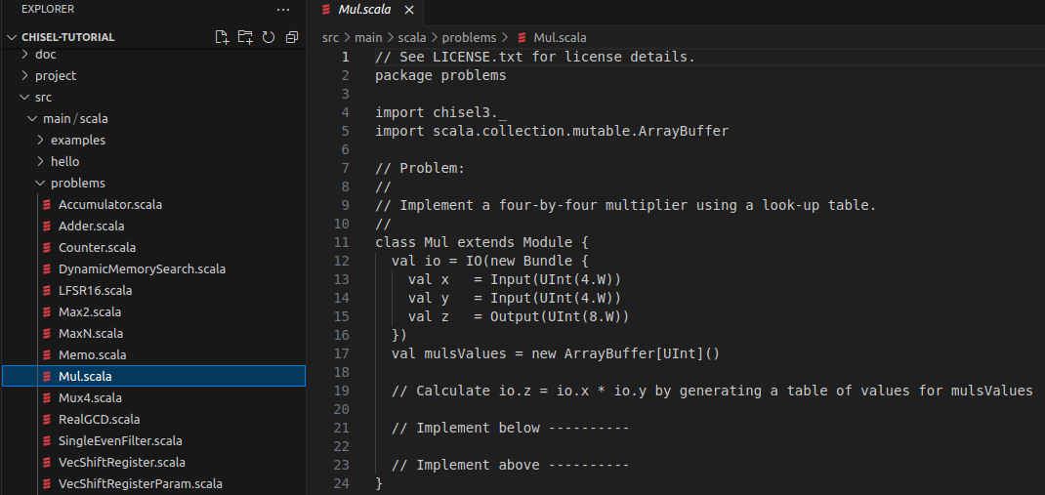
8.5 Multiplication Table
https://github.com/ucb-bar/chisel-tutorial/wiki/Scripting-Hardware-Generation
Multiplication Table
1. The next UC Berkeley class assignment is to write a 16x16 multiplication table using Vec.
2. Below code is from $TUT_DIR/src/main/scala/problems/Mul.scala:

Slide 18



8.5 Multiplication Table
https://github.com/ucb-bar/chisel-tutorial/wiki/Scripting-Hardware-Generation
Multiplication Table
1. We build the lookup table using a rom constructed from the tab lookup table represented as a Scala ArrayBuffer with incrementally added elements (using +=):
2. We lookup the result using an address formed from the x and y inputs as follows:
2. We edit $TUT_DIR/src/main/scala/problems/Mul.scala and run:

Slide 19
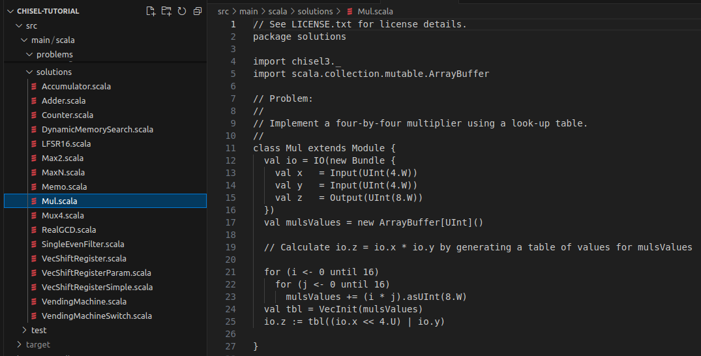
8.5 Multiplication Table
https://github.com/ucb-bar/chisel-tutorial/wiki/Scripting-Hardware-Generation
Multiplication Table
Below is the Solution is in $TUT_DIR/src/main/scala/solutions/Mul.scala

Slide 20
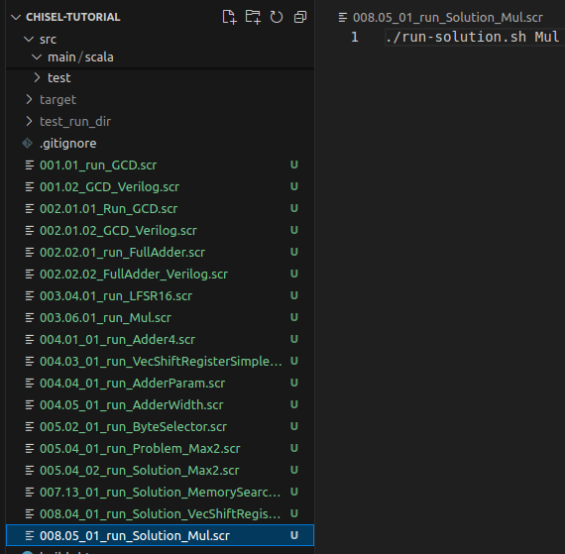
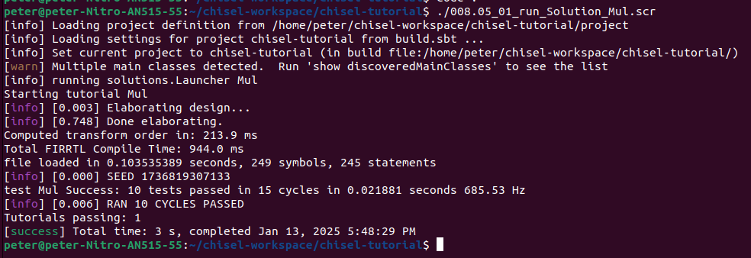
8.5 Multiplication Table
https://github.com/ucb-bar/chisel-tutorial/wiki/Scripting-Hardware-Generation
Multiplication Table
1. > ./008.05_01_run-solution_Mux.scr
>> ./run-solution.sh Mul
2. Result
1
2

Slide 21
End

