Slide 1

0.2 Install JDK/SBT
Peter H. Chen

Slide 2
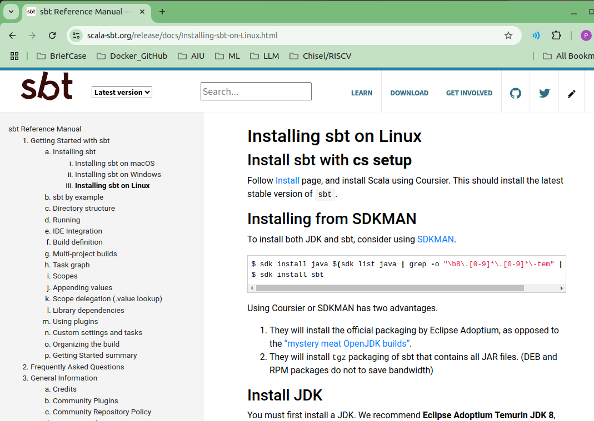
0.2 Install JDK/SBT
https://github.com/ucb-bar/chisel-tutorial?tab=readme-ov-file
Install JDK/SBT
After we install the SDK, then we can use SDK to install JDK and SBT.
1. We need to install SDK to install JDK and SBT.
https://www.scala-sbt.org/release/docs/Installing-sbt-on-Linux.html

Slide 3
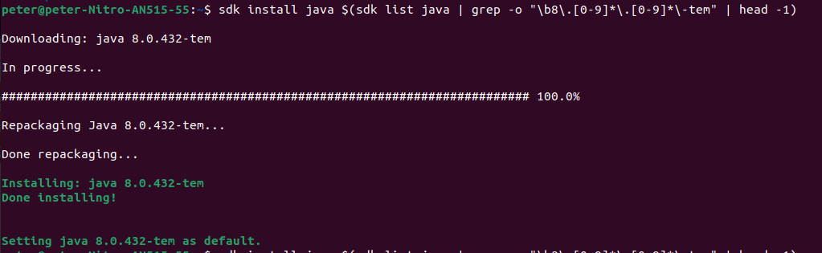
0.2 Install JDK/SBT
https://github.com/ucb-bar/chisel-tutorial?tab=readme-ov-file
Install JDK
> sdk install java $(sdk list java | grep -o "\b8\.[0-9]*\.[0-9]*\-tem" | head -1)
https://www.scala-sbt.org/release/docs/Installing-sbt-on-Linux.html

Slide 4

0.2 Install JDK/SBT
https://github.com/ucb-bar/chisel-tutorial?tab=readme-ov-file
Install JDK
After we install JDK, we can check
https://www.scala-sbt.org/release/docs/Installing-sbt-on-Linux.html

Slide 5
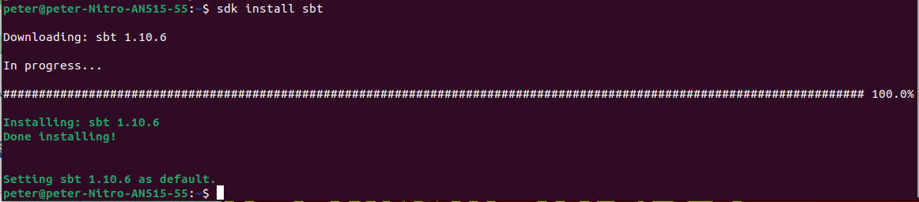
0.2 Install JDK/SBT
https://github.com/ucb-bar/chisel-tutorial?tab=readme-ov-file
Install SBT
Install SBT:
> sdk install sbt
https://www.scala-sbt.org/release/docs/Installing-sbt-on-Linux.html

Slide 6

0.2 Install JDK/SBT
https://github.com/ucb-bar/chisel-tutorial?tab=readme-ov-file
Install SBT
After we install SBT, we can check sbt version
> sbt -version
https://www.scala-sbt.org/release/docs/Installing-sbt-on-Linux.html

Slide 7
End

