Slide 1

4.21 ROCC Interface with L2$
Peter H. Chen

Slide 2
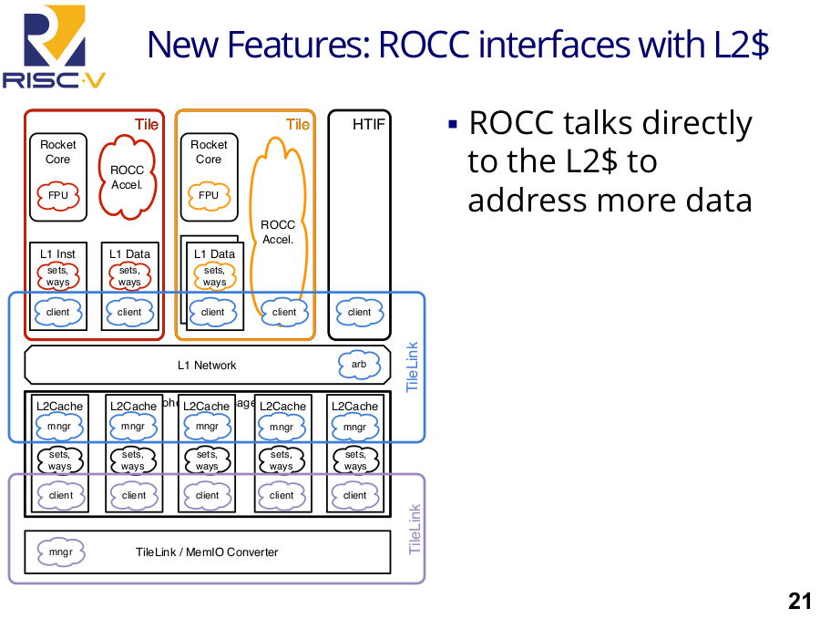
4.21 ROCC Interface with L2$
https://www.youtube.com/watch?v=Ir3h3qWcNlg&list=PLlu0CT-JnSasfpk8tq1ZDiE2G0AK1BhOg&index=4
ROCC Interface with L2$ (26:51-27:22/41:08)
If ROCC (Rocket Core) accelerator has a lot of state and the L1$ is not enough to handle inside the CPU, we can have ROCC talks directly to the outside world GPU. In this case, we can have bigger cache, such as, L2$ to address more data to the outside word.

Slide 3
4.22 New Features on Deck

Slide 4
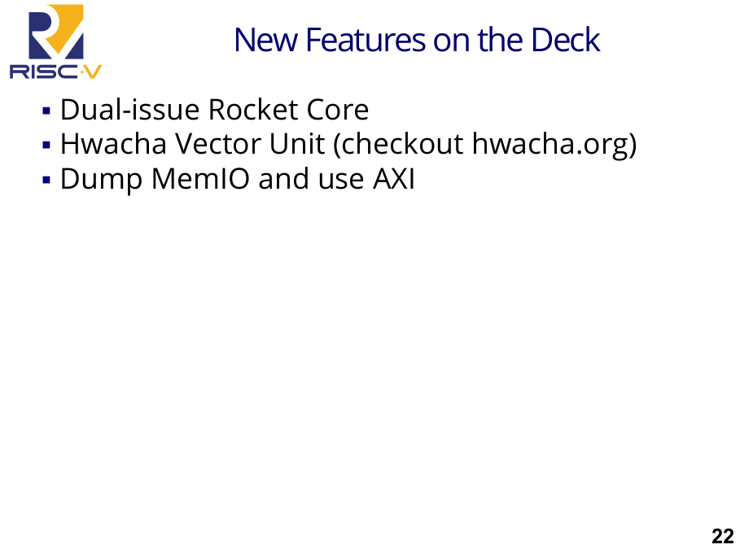
4.22 New Features on Deck
https://www.youtube.com/watch?v=Ir3h3qWcNlg&list=PLlu0CT-JnSasfpk8tq1ZDiE2G0AK1BhOg&index=4
New Features on Deck (27:23-27:47/41:08)
We have Dual-issues Rocket Core, Vector Unit, Dump MemIO

Slide 5
4.23 Test Chip from Rocket Chip Generator

Slide 6
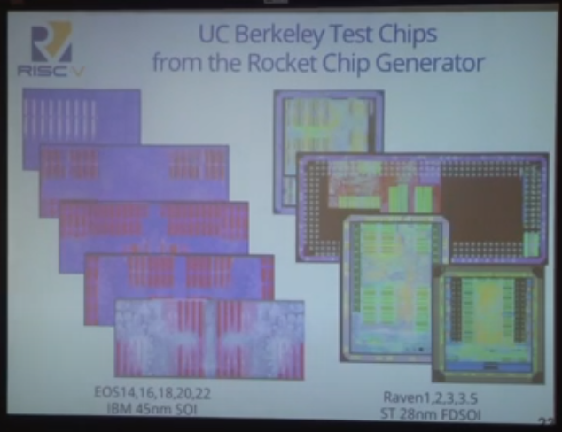
4.23 Test Chip from Rocket Chip Generator
https://www.youtube.com/watch?v=Ir3h3qWcNlg&list=PLlu0CT-JnSasfpk8tq1ZDiE2G0AK1BhOg&index=4
Test Chip from Rocket Chip Generator (27:47-28:04/41:08)
These are Test Chips from Rocket Chip Generator.
1. There are five chips: EOS (End of Full Support) 14, 16, 18, 20, 22 for IBM 45 nm SOI (Silicon On Insulator) process.

Slide 7
4.24 3mm x 6mm Chip

Slide 8
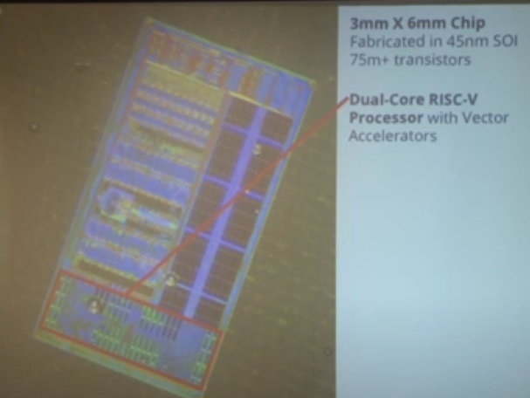
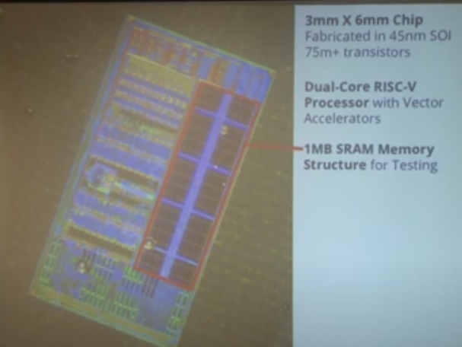
4.24 3mm x 6mm Chip
https://www.youtube.com/watch?v=Ir3h3qWcNlg&list=PLlu0CT-JnSasfpk8tq1ZDiE2G0AK1BhOg&index=4
3mm x 6mm chip (27:47-28:00/41:08)
This is 3 mm x 6 mm chip in 45 nm SOI (Silicon On Insulator). It consists of more than 75 M transistors which are used to implement:
1. a dual-core a5 processor with vector accelerators that was instantiated by the Rocket Chip SoC generator.
2. it has 1 MB SRAM Memory structure for Testing.
1
2

Slide 9
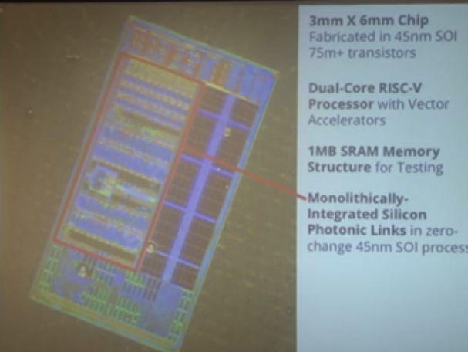
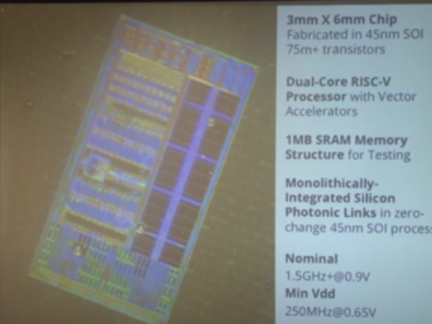
4.24 3mm x 6mm Chip
https://www.youtube.com/watch?v=Ir3h3qWcNlg&list=PLlu0CT-JnSasfpk8tq1ZDiE2G0AK1BhOg&index=4
3mm x 6mm chip (28:01-28:57/41:08)
1. It contains the circuit research with putting monolithically integrated silicon photonic in the same die.
2. The chip runs a nominal voltage of 0.9 volts and it is able to achieve higher than 1.5 GHz frequency and can run all the way down to 0.65 Volts at 250 MHz.
1
2

Slide 10
4.25 List of Test Chip

Slide 11
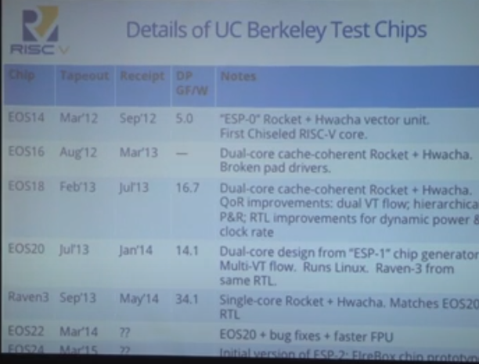
4.25 List of Test Chip
https://www.youtube.com/watch?v=Ir3h3qWcNlg&list=PLlu0CT-JnSasfpk8tq1ZDiE2G0AK1BhOg&index=4
List of Test Chip (27:47-29:31/41:08)
Below is the list of test chip.
We work of SoC to build the real chip.

Slide 12
End

