Slide 1

4.26 Questions
Peter H. Chen

Slide 2
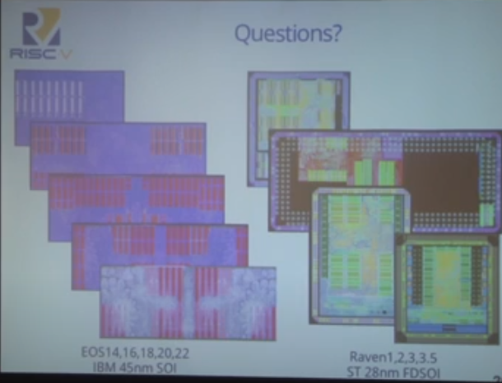
4.26 Questions
https://www.youtube.com/watch?v=Ir3h3qWcNlg&list=PLlu0CT-JnSasfpk8tq1ZDiE2G0AK1BhOg&index=4
Questions (29:32-30:31/41:08)
Question and Answer

Slide 3
End

