Slide 1

1 Introduction
Peter H. Chen

Slide 2
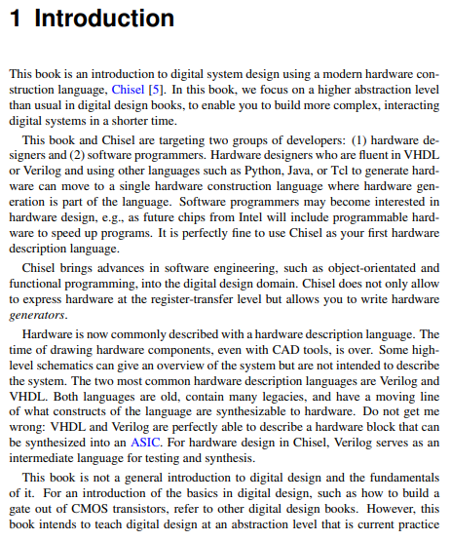
1 Introduction
https://www.imm.dtu.dk/~masca/chisel-book.html
Introduction
Chisel is for two group of engineers:
1. Hardware Designer: Hardware designer who is expert in VHDL, Verilog and use Python, Java, TCL to generate hardware. He want to move move to single programming language.
2. Software Programmer who interested in hardware design.
In Chisel, Verilog is an intermediate language for testing and synthesis.

Slide 3
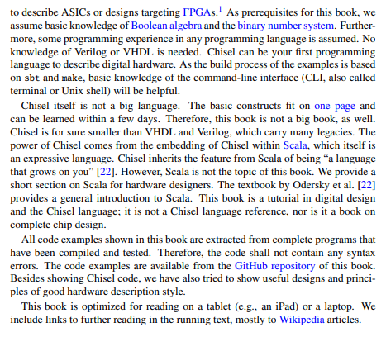
1 Introduction
https://www.imm.dtu.dk/~masca/chisel-book.html
Introduction
Prerequisite:
1. Boolean Algebra
2. Binary Number system.
Chisel is a small language, one page of command.
Chisel is embedded in Scala.
The Code Examples are extracted from programs.
Code examples are in GitHub Repository.

Slide 4
1.1 Install Chisel and FPGA Tool

Slide 5
1.1 Install Chisel and FPGA Tool
https://www.imm.dtu.dk/~masca/chisel-book.html
Install Chisel and FPGA Tool

Slide 6
End

