Slide 1

7 Register
Peter H. Chen

Slide 2

7 Register
https://github.com/ucb-bar/chisel-tutorial/wiki/The-Basics
Register
1. Unlike Verilog, specifying a register in Chisel tells the compiler to actually generate a positive edge triggered register.
2. In this section, we explore how to instantiate registers in Chisel by constructing a shift register.
3. In Chisel, when you instantiate a register there are several ways to specify the connection of the input to a register.
4. As shown in the GCD example, you can "declare" the register and assign what it's input is connected to in a when... block or you can simply pass the value that the register is clocking as a parameter to the register.
5. If we choose to pass a next value to the register on construction using the next named parameter, or the specialized register constructor RegNext, it will clock the new value every cycle unconditionally:

Slide 3
7.1 when Block

Slide 4
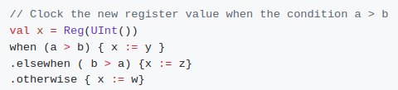
7.1 when Block
https://github.com/ucb-bar/chisel-tutorial/wiki/The-Basics
when Block
If we only want to update if certain conditions are met we use a when block to indicate that the registers are only updated when the condition is satisfied:
It is important to note that when using the conditional method, the values getting assigned to the input of the register match the type and bitwidth of the register you declared.
In the unconditional register assignment, we do not need to do this as Chisel will infer the type and width from the type and width of the input value.

Slide 5
7.2 Unconditional Register Update

Slide 6
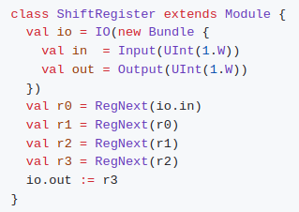
7.2 Unconditional Register Update
https://github.com/ucb-bar/chisel-tutorial/wiki/The-Basics
Unconditional Register Update
1. Suppose we want to construct a basic 4 bit shift register that takes a serial input in and generates a serial output out.
2. For this first example we won't worry about a parallel load signal and will assume the shift register is always enabled. We also will forget about the register reset signal.
If we instantiate and connect each of these 4 registers explicitly, our Chisel code will look something like:

Slide 7
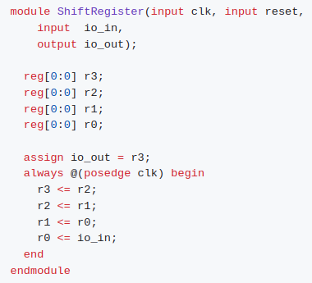
7.2 Unconditional Register Update
https://github.com/ucb-bar/chisel-tutorial/wiki/The-Basics
Unconditional Register Update
If we take a look at the generated Verilog, we will see that Chisel did indeed map our design to a shift register.
One thing to notice is that the clock signal and reset signals are implicitly attached to our design.

Slide 8
7.3 Conditional Register Update

Slide 9
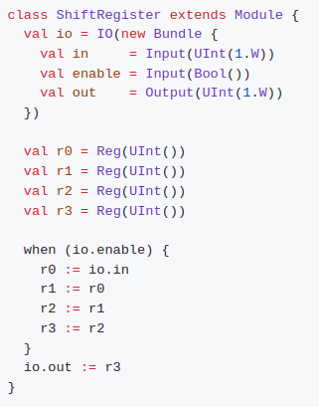
7.3 Conditional Register Update
https://github.com/ucb-bar/chisel-tutorial/wiki/The-Basics
Conditional Register Update
As mentioned earlier, Chisel allows you to conditionally update a register (use an enable signal) using the when, .elsewhen, .otherwise block.
Suppose we add an enable signal to our shift register, that allows us to control whether data is shift in and out on a given cycle depending on an enable input signal.
The new shift register now looks like:
Note:
It is not necessary to specify an .otherwise condition as Chisel will correctly infer that the old register value should be preserved otherwise.

Slide 10
7.4 Register Reset

Slide 11
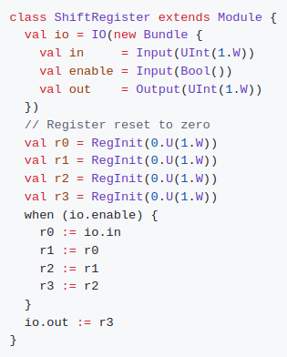
7.4 Register Reset
https://github.com/ucb-bar/chisel-tutorial/wiki/The-Basics
Register Reset
Chisel allows you to specify a synchronous reset to a certain value by specifying an additional parameter when you first declare them.
In our shift register, let's add a reset capability that resets all the register values to zero synchronously.
To do this we need to provide our register declarations a little more information using the init parameter, or using the specialized constructor RegInit, with what value we want on a synchronous reset:

Slide 12
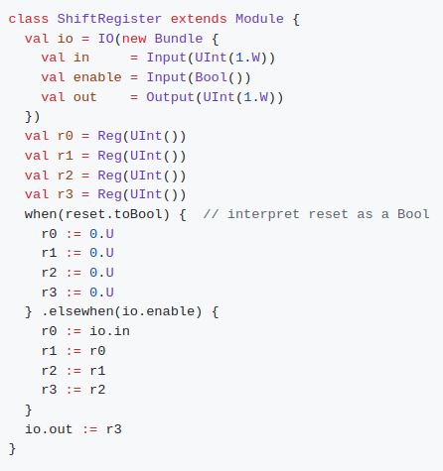
7.4 Register Reset
https://github.com/ucb-bar/chisel-tutorial/wiki/The-Basics
Register Reset
Note that reset value can actually be any value, simply replace the zeros and width to appropriate values.
Chisel also has an implicit global reset signal that you can use in a when block.
The reset signal is conveniently called reset and does not have to be declared, but in order to treat it as a Bool, you need to add the toBool cast. The shift register using this implicit global reset now looks like:

Slide 13
7.4 Register Reset
https://github.com/ucb-bar/chisel-tutorial/wiki/The-Basics
Register Reset
Below Scala code will generate slightly different looking Verilog source code but will still function the same as the previous implementation of the shift register with reset.

Slide 14
7.5 Sequential Circuit

Slide 15
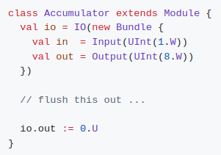
7.5 Sequential Circuit
https://github.com/ucb-bar/chisel-tutorial/wiki/The-Basics
Sequential Circuit
The following exercises can be found in your $TUT_DIR/src/main/scala/problems/ folder.
We will find that some parts of the tutorial files have been completed for you and the section that we need to complete is indicated in the file.
The solutions to each of these exercises can be found in the $TUT_DIR/src/main/scala/solutions/ folder.
The first tutorial problem is to write a sequential circuit that sums in values. You can find the template in $TUT_DIR/src/main/scala/problems/Accumulator.scala including a stubbed out version of the circuit:

Slide 16

7.5 Sequential Circuit
https://github.com/ucb-bar/chisel-tutorial/wiki/The-Basics
Sequential Circuit
and a complete tester that confirms that you have successfully designed the circuit in $TUT_DIR/src/test/scala/problems/Accumulator.scala.
Run:
This should fail until you complete the circuit implementing the accumulator.
Edit the src/main/scala/problems/Accumulator.scala source file and execute the run-problem.sh shell script until your circuit passes the tests.

Slide 17
End

