Slide 1

23 Taskflow and OpenTimer
Peter H. Chen

Slide 2
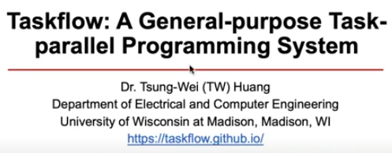
23 Taskflow and OpenTimer
https://www.youtube.com/watch?v=SB557WnWKEc&list=PLfrN7RIcMe6g2LBRJLTHTdhyj5s8ag0Rg&index=21
Taskflow and OpenTimer (0:00-0:54/1:02:41)
We discuss the OpenTimer based on ”Taskflow: A General-purpose Task-parallel Programming System”, by Dr. Tsung-Wei Huang.
Taskflow is a general purpose parallel programming library. We use Taskflow library to create the OpenTimer. OpenTimer is a timing analysis tool. We use Taskflow and OpenTimer for STA (Static Timing Analysis).
References:
1. https://taskflow.github.io/
2. https://tsung-wei-huang.github.io/papers/2022-tcad-taskflow.pdf
3. https://tsung-wei-huang.github.io/

Slide 3
23.1 Main Point

Slide 4
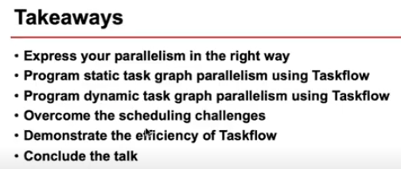
23.1 Main Point
https://www.youtube.com/watch?v=SB557WnWKEc&list=PLfrN7RIcMe6g2LBRJLTHTdhyj5s8ag0Rg&index=21
Main Point (0:55-1:40/1:02:41)
1. Run Parallel task in easy way
2. Task in Static Task Graph
3. Task Dynamic Task Graph
4. Task Scheduling
5. Taskflow efficiency
6. Conclusion

Slide 5
23.2 Parallel Computing

Slide 6
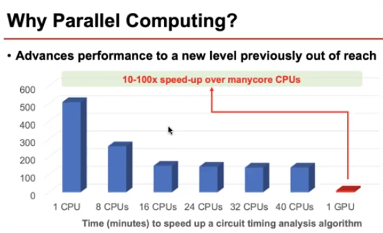
23.2 Parallel Computing
https://www.youtube.com/watch?v=SB557WnWKEc&list=PLfrN7RIcMe6g2LBRJLTHTdhyj5s8ag0Rg&index=21
Parallel Computing (1:41-2:00/1:02:41)
We can use multiple cores, we can reduce run time with parallel run several tasks.
GPUs are hardware logic gate for math/matrix computing. With GPUs, we can run 10-100 faster than CPU speed. We can benchmark the performance with STA (Static Timing Analysis).

Slide 7
23.3 CPU/GPU Accelerator

Slide 8
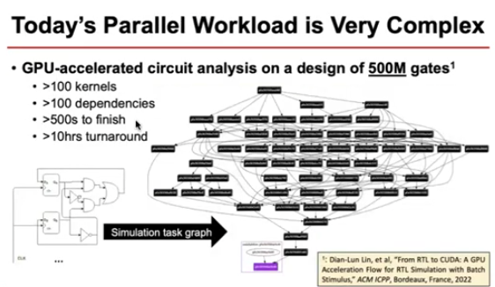
23.3 CPU/GPU Accelerator
https://www.youtube.com/watch?v=SB557WnWKEc&list=PLfrN7RIcMe6g2LBRJLTHTdhyj5s8ag0Rg&index=21
CPU/GPU Accelerator (2:01-2:49/1:02:41)
Below, we use NVIDIA GPUs as the accelerator to run a task.
CPU submit task to GPU for math calculation.
Taskflow convert the hardware circuit workload into the task graph model. Here, we have model GP (General Purpose) operation in a node and a dependency between GP (General Purpose) operation in an edge. We can see the computational graph can be very huge.
NVIDIA GPUs has
1. 500M gates
2. more than 100 kernels and
3. 100 dependencies.
4. The task take GPU over 500 seconds to run.
5. The total run time (turnaround time) is very long. The task takes GPU more than 10 hours turnaround time.

Slide 9
23.4 Parallel Programming

Slide 10
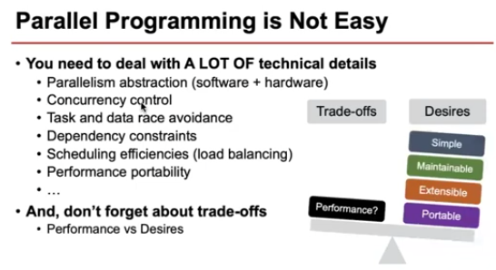
23.4 Parallel Programming
https://www.youtube.com/watch?v=SB557WnWKEc&list=PLfrN7RIcMe6g2LBRJLTHTdhyj5s8ag0Rg&index=21
Parallel Programming (2:50-3:36/1:02:41)
To write the parallel program, we need to consider below:
1. Parallel abstraction in software and hardware
2. concurrency control
3. Task and data race avoidance
4. Dependency constraints
5. efficient Scheduler (load balancing)
6. Portability in performance
7. We want to have simple, maintainable, and good performance for developers.

Slide 11
23.5 TGP (Task Graph Parallelism)

Slide 12
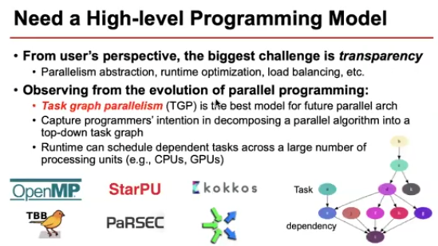
23.5 TGP (Task Graph Parallelism)
https://www.youtube.com/watch?v=SB557WnWKEc&list=PLfrN7RIcMe6g2LBRJLTHTdhyj5s8ag0Rg&index=21
TGP (Task Graph Parallelism) (3:37-4:49/1:02:41)
We need a high level programming solution, such as, TGP (Task Graph Parallelism), to handle all these technical details.
1. From applications perspective, they care about how fast we can can get all the running task done.
2. From users perspective, the biggest challenge is transparency. The challenges behind include the abstraction in parallelism, runtime optimization, load balancing, etc.
3. From the point view of parallel programming, we want to have TGP (Task Graph Parallelism) which is the best parallel algorithm.
4. TGP decomposes the application into a top-down task graph.
5. TGP runtime can schedule dependent tasks for a large number of processing units, such as, CPUs or GPUs.
6. In the right below diagram, there are several parallel programming frameworks, such as, OpenMP (Open Multi-Processing), StarPU (System for Task and Runtime Programming Utilization), PARSEC (Princeton Application Repository for Shared-mEmory Computer), Kokkos (Greek word for Kernel), etc.
Note:
PARSEC exequies NVIDIA or Intel GPU hardware and Windows environment.
https://support.parsec.app/hc/en-us

Slide 13
23.6 Current Tool Problem

Slide 14
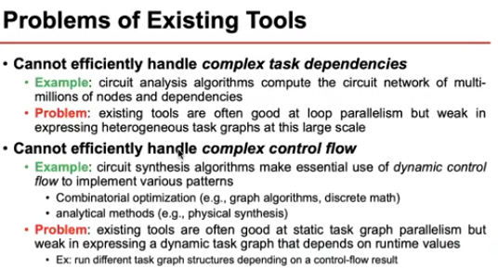
23.6 Current Tool Problem
https://www.youtube.com/watch?v=SB557WnWKEc&list=PLfrN7RIcMe6g2LBRJLTHTdhyj5s8ag0Rg&index=21
Current Tool Problem (4:50-6:54/1:02:41)
Current Tools have two problems in EDA application. EDA designs have huge network design with trillions of dependencies in circuit gates and dynamic control flow in gates synthesis.
1. Cannot handle task with dependencies: The current tools are good for parallelism but weak in processing task graphs with huge network design (with trillions of nodes and trillions of dependencies in logic gates relations).
2. Cannot handle complicated dynamic control flow in gate synthesis: In circuit syntheses, we have several dynamic tasks graphs during the runtime. We use dynamic control to implement combinatorial optimization (graph and discrete math) and analytical methods (physical syntheses, cell placement, wire routing, etc.). The current tools are good for static task graph but weak in dynamic/run-time task graph. We need to run several dynamic task graphs.

Slide 15
23.7 Taskflow: Static Graph Parallelism

Slide 16
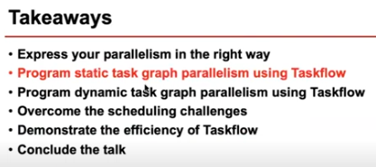
23.7 Taskflow: Static Graph Parallelism
https://www.youtube.com/watch?v=SB557WnWKEc&list=PLfrN7RIcMe6g2LBRJLTHTdhyj5s8ag0Rg&index=21
Taskflow: Static Graph Parallelism (6:55-7:08/1:02:41)
First, we talks how the Taskflow solve the static graph parallelism problem.

Slide 17
23.8 Taskflow: Hello World

Slide 18
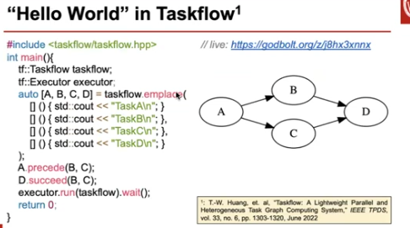
23.8 Taskflow: Hello World
https://www.youtube.com/watch?v=SB557WnWKEc&list=PLfrN7RIcMe6g2LBRJLTHTdhyj5s8ag0Rg&index=21
Taskflow: Hello World (7:09-8:55/1:02:41)
Below, we have tasks { A, B, C, D }. Here, we use a programming system called Taskflow to look at a static task.
For example, the “Hello World” example in Taskflow. We want to build a task graph that has 4 tasks { A, B, C, D}.
1. Task A has to run before Task B and Task C.
2. Task B and C can run in parallel.
3. When both Task B and Task C finish, Task D can start.
Below is how is look. Our system describes a computational test problem.
First, we create a testable object. Then, we create an executor that manages a set of worker threads and to schedule our tasks.
Then, we can emplace four cases {A, B, C, D} in C++ Lambda function object or other C++ object.
Once you have the task, you can use precede method or succeed method to relate the dependency between different tasks.
For example,
1. Task A has to precede Task B and Task C.
> A.precede (B. C)
2. Task D will need to run succeed Task B and task C.
> D.suceed (B, C)
3. Finally, we can submit our Taskflow to the executor
> executor.run (taskflow).wait()
The taskflow will optimize the execution of the code.

Slide 19
23.9 Install, Code, Compile, Run Taskflow

Slide 20
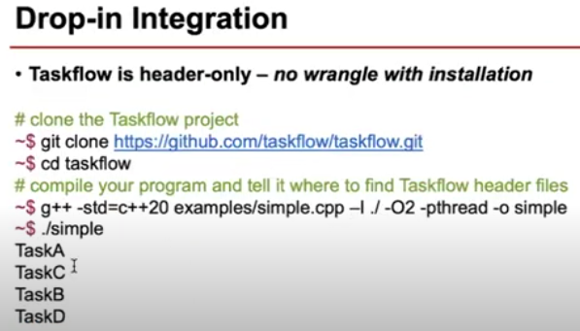
23.9 Install, Code, Compile, Run Taskflow
https://www.youtube.com/watch?v=SB557WnWKEc&list=PLfrN7RIcMe6g2LBRJLTHTdhyj5s8ag0Rg&index=21
Install, Code, Compile, Run Taskflow (8:56-9:00/1:02:41)
Below, we run the taskflow

Slide 21
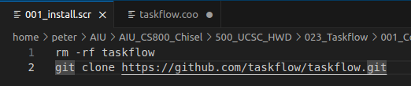
23.9 Install, Code, Compile, Run Taskflow
https://www.youtube.com/watch?v=SB557WnWKEc&list=PLfrN7RIcMe6g2LBRJLTHTdhyj5s8ag0Rg&index=21
Install Taskflow(9:01-9:05/1:02:41)
1. Install taskflow
> code 001_install.scr
1

Slide 22
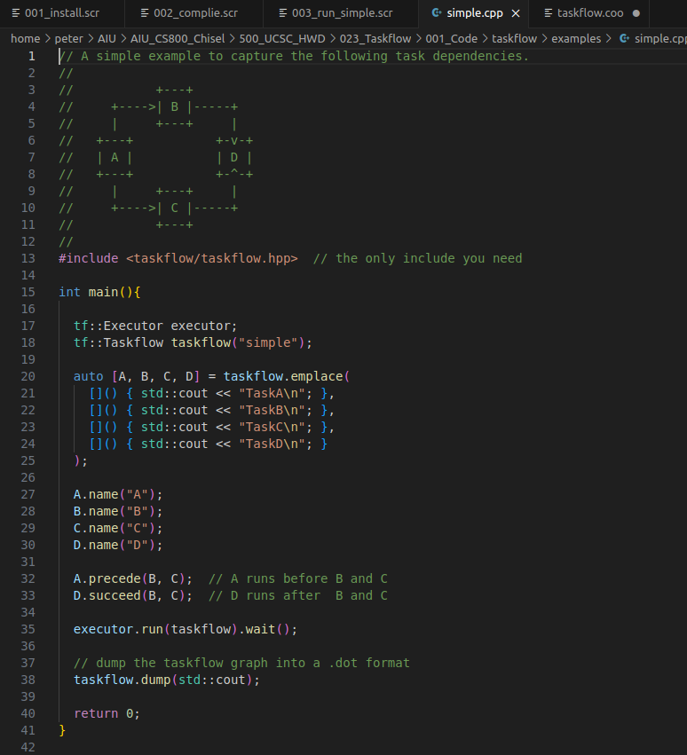
23.9 Install, Code, Compile, Run Taskflow
https://www.youtube.com/watch?v=SB557WnWKEc&list=PLfrN7RIcMe6g2LBRJLTHTdhyj5s8ag0Rg&index=21
Drop-in Integration (9:06-9:10/1:02:41)
1. Install taskflow
> code 001_install.scr
2. edit smple.cpp
> code taskflow/exmaples/simple.cpp
2

Slide 23
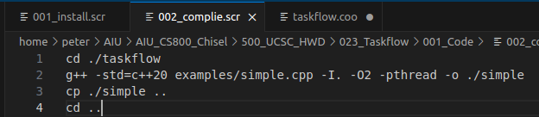


23.9 Install, Code, Compile, Run Taskflow
https://www.youtube.com/watch?v=SB557WnWKEc&list=PLfrN7RIcMe6g2LBRJLTHTdhyj5s8ag0Rg&index=21
Drop-in Integration (9:11-9:15/1:02:41)
1. Install taskflow
> code 001_install.scr
2. edit smple.cpp
> code taskflow/exmaples/simple.cpp
3. compile simple.cpp
> code 002_complie.scr
4. run simple
> code 003_run_simple.scr
5. ls
>> 001_install.scr
>> 002_comple.scr
>> 003_run_simple.scr
3
4
5

Slide 24
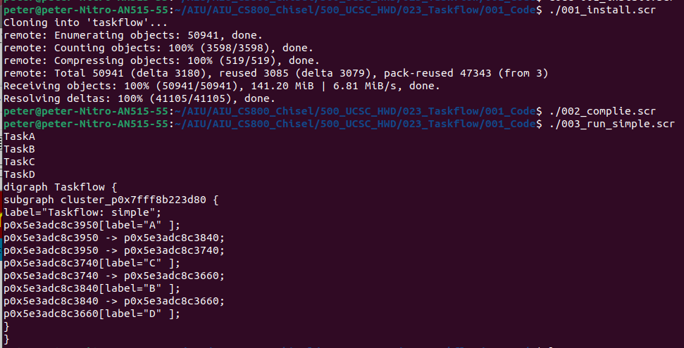
23.9 Install, Code, Compile, Run Taskflow
https://www.youtube.com/watch?v=SB557WnWKEc&list=PLfrN7RIcMe6g2LBRJLTHTdhyj5s8ag0Rg&index=21
Drop-in Integration (9:16-9:37/1:02:41)
6. run scripts:
> chmod 777 *.scr
> ./001_instsall.scr
> ./002_compile.scr
> ./003_run_simple.scr

Slide 25
23.10 Task Visualizer

Slide 26
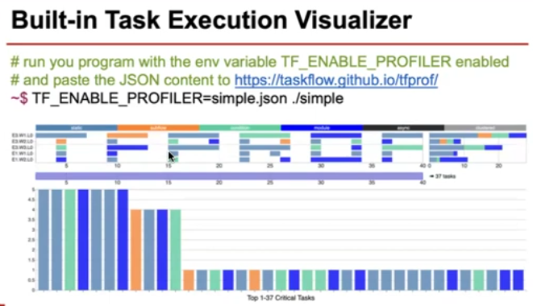
23.10 Task Visualizer
https://www.youtube.com/watch?v=SB557WnWKEc&list=PLfrN7RIcMe6g2LBRJLTHTdhyj5s8ag0Rg&index=21
Task Visualizer (9:38-10:20/1:02:41)
For visualization, we generate the profile of taskflow simple.cpp
> TF_ENABLE_PROFILER=simple.json ./simple
> cat simple.json

Slide 27
23.11 CTFG (Control Taskflow Graph) Programming

Slide 28
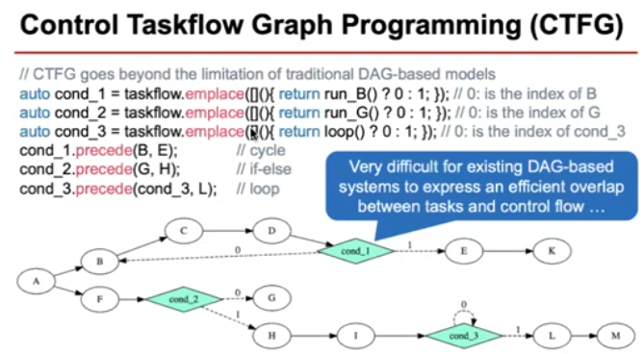
23.11 CTFG (Control Taskflow Graph) Programming
https://www.youtube.com/watch?v=SB557WnWKEc&list=PLfrN7RIcMe6g2LBRJLTHTdhyj5s8ag0Rg&index=21
CTFG (Control Taskflow Graph) Programming (10:21-11:49/1:02:41)
The CTFG (Control Taskflow Graph) Programming Model is the key innovation which is separated from the existing Taskflow system. The CTFG has some limitation because it is based on the Taskflow. Below, we have three control flows expressed in three green colors.
The green triangles in the below diagram have dependency. Conditional if-else, or iterative loop control are difficult for existing database system to extract the control flow.
In the green boxes of the diagram, we have conditional return for run_B, run_G, or loop().
In the green boxes of the diagram,
Condition 1 has index 0 for task B.
Condition 2 has index 0 for task G and index 1 for task H.
Condition 3 has index 0 for loop and 1 for task L.

Slide 29
23.12 Non-Deterministic Control of CTFG

Slide 30
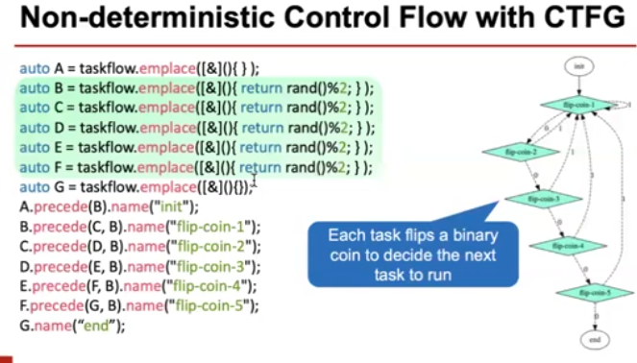
23.12 Non-Deterministic Control of CTFG
https://www.youtube.com/watch?v=SB557WnWKEc&list=PLfrN7RIcMe6g2LBRJLTHTdhyj5s8ag0Rg&index=21
Non-Deterministic Control of CTFG (Control Taskflow Graph) (11:50-13:48/1:02:41)
This example abstract 5 message cycles.
There are totally 5 green boxes. Each green task is a conditional task.
Each box can have edge with binary value to decide the next state.
We can to go to next state and go back, etc.

Slide 31
23.13 Existing Framework on Control Flow

Slide 32
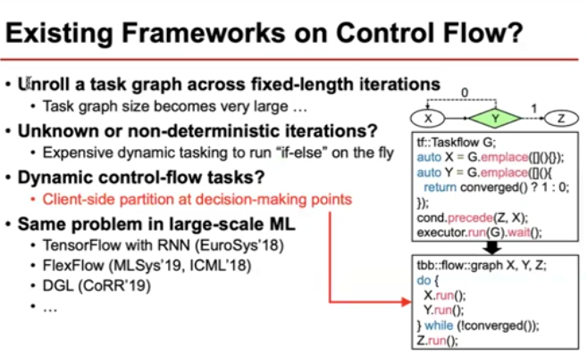
23.13 Existing Framework on Control Flow
https://www.youtube.com/watch?v=SB557WnWKEc&list=PLfrN7RIcMe6g2LBRJLTHTdhyj5s8ag0Rg&index=21
Exiting Framework on Control Flow (13:48-15:18/1:02:41)
We can
1. Unroll task graph.
2. Unknown/non-deterministic iteration
3. Dynamic control flow
4. large scale ML (Machine Learning), RNN (Recurrent Neural Network).

Slide 33
23.14 Compose Task

Slide 34
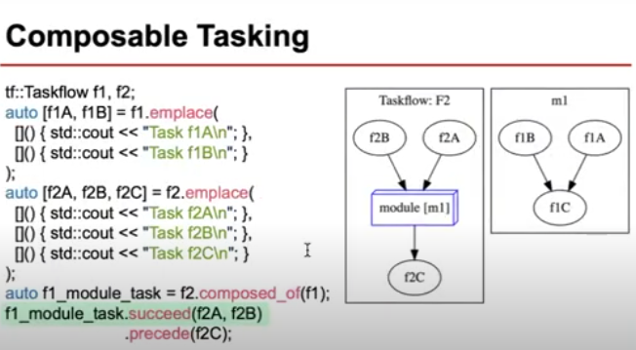
23.14 Compose Task
https://www.youtube.com/watch?v=SB557WnWKEc&list=PLfrN7RIcMe6g2LBRJLTHTdhyj5s8ag0Rg&index=21
Compose Task (15:19-16:33/1:02:41)
If we create multiple task flows, each flow represent a partition of power level of composition strategy.
This small tasks are easier to optimize at smaller scale.
We can assemble this partition task flow into a large taskflow graph and they can compose correctly and efficiently.
Below example, we have two tasks: task f2 and m1. Task f2 is composed of a module task m1 which describe another task flow m1 on the right. When we start taskflow f2, we will start running task f2b and task f2a. Then, we will run module task m1.\ which start another task flow described in task m1. Finally, it will stop at task f2C.

Slide 35
23.15 All Are Composable in Taskflow

Slide 36
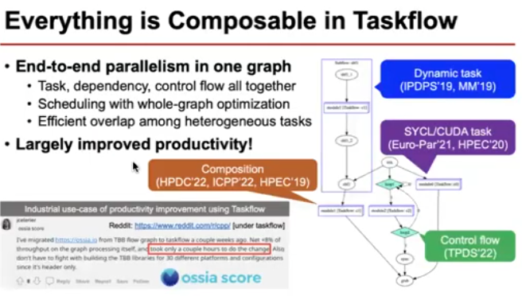
23.15 All Are Composable in Taskflow
https://www.youtube.com/watch?v=SB557WnWKEc&list=PLfrN7RIcMe6g2LBRJLTHTdhyj5s8ag0Rg&index=21
All Are Composable in Taskflow (16:34-17:32/1:02:41)
1. Everything (Task, dependency, control flow, etc.) are all composable in taskflow.
2. Schedule graph optimization
3. Efficient overlap and heterogeneous tasks.

Slide 37
23.15 Takeaways

Slide 38
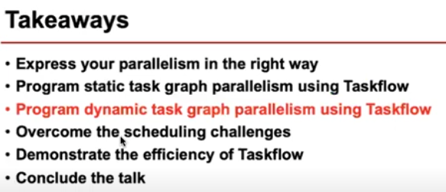
23.15 Takeaways
https://www.youtube.com/watch?v=SB557WnWKEc&list=PLfrN7RIcMe6g2LBRJLTHTdhyj5s8ag0Rg&index=21
Takeaways (17:33-17:57/1:02:41)
1. Parallelism
2. Static task graph
3. Dynamic Task Graph
4. Schedule
5. Efficient of taskflow
6. Conclusion
Now. We are going to look at more complicate problem: Dynamic Task Graph.

Slide 39
23.16 STGP (Static Task Graph Parallelism)

Slide 40
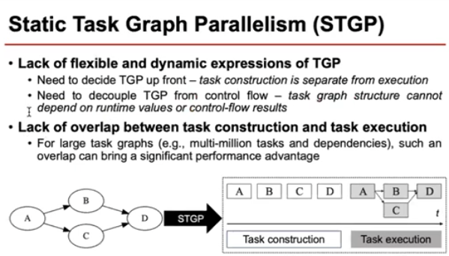
23.16 STGP (Static Task Graph Parallelism)
https://www.youtube.com/watch?v=SB557WnWKEc&list=PLfrN7RIcMe6g2LBRJLTHTdhyj5s8ag0Rg&index=21
STGP (Static Task Graph Parallelism) (17:58-19:23/1:02:41)
So far, we have talked the STGP (Static Task Graph Parallelism) problem, however, STGP does not have the power to change the structure during the run-time:
1. STGP is static and does not have flexibility of Dynamic Expression. Static Task Graph structure is fixed when we submit for tun time.
2. A lot of time, we need dynamic graph to improve the performance in run time. This can be a big problem when we have a large task graph, such as, EDA Hardware Verilog with multi-million dependencies of gate relationship.

Slide 41
23.17 Create Static Graph and Dependency

Slide 42
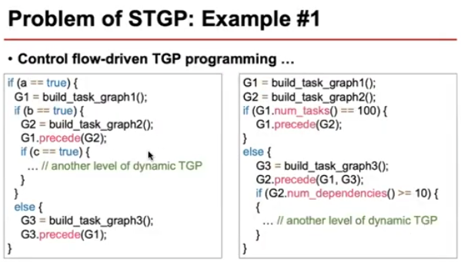
23.17 Create Static Graph and Dependency
https://www.youtube.com/watch?v=SB557WnWKEc&list=PLfrN7RIcMe6g2LBRJLTHTdhyj5s8ag0Rg&index=21
Create Static Graph and Dependency (19:24-20:58/1:02:41)
We look at some of the problem in STGP (Static Task Graph Parallelism).
Left below, we create type a graph G1, type b graph G2, and type c graph G3. We assign the running order based on boolean a, b, c.
Right below, we create G1, G2, G3 and then create the dependency based on attribute of objects G1, G2, G3.

Slide 43
23.19 Run Time Graph Creation

Slide 44
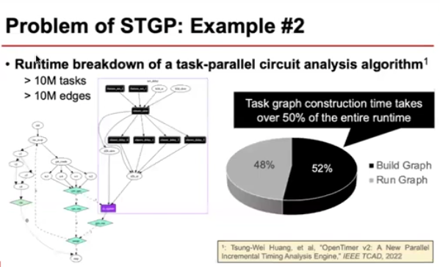
23.19 Run Time Graph Creation
https://www.youtube.com/watch?v=SB557WnWKEc&list=PLfrN7RIcMe6g2LBRJLTHTdhyj5s8ag0Rg&index=21
Run Time Graph Creation (20:59-21:58/1:02:41)
Below, we dynamically create the run time graph.

Slide 45
End

