Slide 1

17 Open Project Development
Peter H. Chen

Slide 2
17 Open Project Development
https://www.youtube.com/watch?v=3SD2S0PN7-c&list=PLfrN7RIcMe6g2LBRJLTHTdhyj5s8ag0Rg&index=17
Open Project Development (0:02-0:45/1:06:00)
We discuss Physical Design Optimization and Memory Design
Topics:
1. Setup: jupyter notebook, select scala, and run cells.
2.

Slide 3
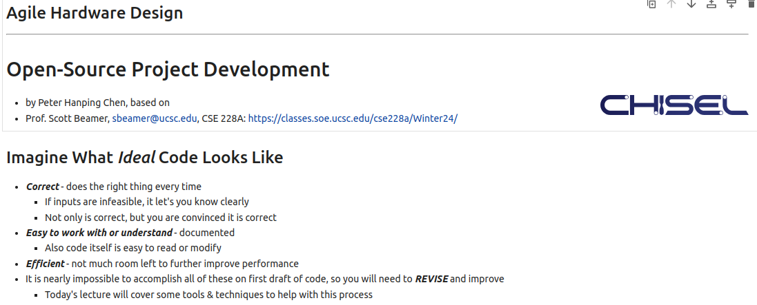
17 Open Project Development
https://www.youtube.com/watch?v=3SD2S0PN7-c&list=PLfrN7RIcMe6g2LBRJLTHTdhyj5s8ag0Rg&index=17
Open Project Development (1:40-3:37/1:06:00)
Code
1. Correct
2. Easy
3. Efficient

Slide 4
17.1 Plan

Slide 5
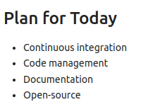
17.1 Plan
https://www.youtube.com/watch?v=3SD2S0PN7-c&list=PLfrN7RIcMe6g2LBRJLTHTdhyj5s8ag0Rg&index=17
Plan (3:38-3:55/1:06:00)
Today, we talk
1. Continuous Integration
2. Code Management
3. Documentation
4. Open-Source

Slide 6
17.2 CI (Continuous Integration)

Slide 7
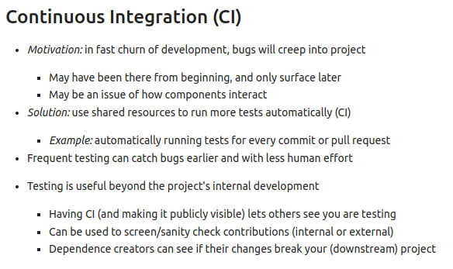
17.2 CI (Continuous Integration)
https://www.youtube.com/watch?v=3SD2S0PN7-c&list=PLfrN7RIcMe6g2LBRJLTHTdhyj5s8ag0Rg&index=17
CI (Continuous Integration) (3:56-8:23/1:06:00)
1. Automatic regression test
2. Frequent test
3. Internal/external/dependency test.
Q: What is code formatting?
Ans:
1. Code formatting refers to the arrangement and presentation of code in a consistent and organized manner.
2. Well-formatted documents enhance readability, comprehension, and clarity.

Slide 8
17.3 CI Setup

Slide 9
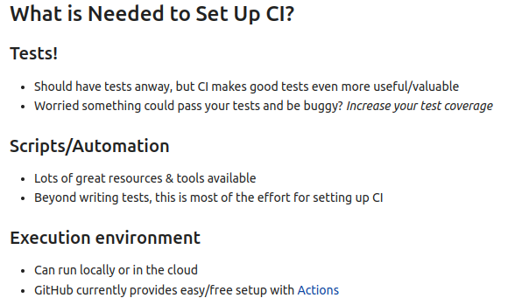
17.3 CI Setup
https://www.youtube.com/watch?v=3SD2S0PN7-c&list=PLfrN7RIcMe6g2LBRJLTHTdhyj5s8ag0Rg&index=17
CI Setup (8:24-10:35/1:06:00)
1. Test
2. Scrip Automation
3. Run, pull, push in GitHub Environment

Slide 10
17.4 Types of Test for CI

Slide 11
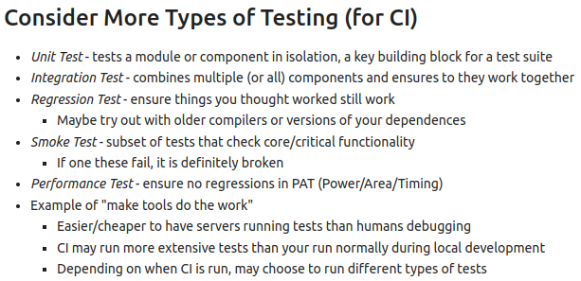
17.4 Types of Test for CI
https://www.youtube.com/watch?v=3SD2S0PN7-c&list=PLfrN7RIcMe6g2LBRJLTHTdhyj5s8ag0Rg&index=17
Types of Test for CI (10:36-20:05/1:06:00)
1. Unit: Module/Component
2. Integration Test:
3. Regression Test
4. Smoke Test: Special/critical test
5. Performance Test: PAT (Power/Area/Timing)
6. How to make test on GitHub?
https://resources.github.com/learn/pathways/automation/essentials/application-testing-with-github-actions/

Slide 12
17.5 Code Management

Slide 13
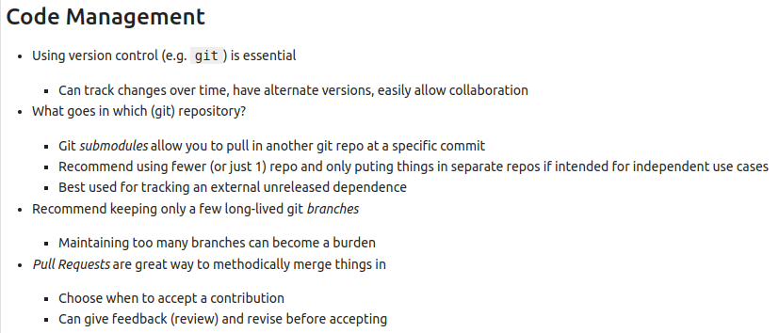
17.5 Code Management
https://www.youtube.com/watch?v=3SD2S0PN7-c&list=PLfrN7RIcMe6g2LBRJLTHTdhyj5s8ag0Rg&index=17
Code Management (20:06-28:23/1:06:00)
1. Version Control
2. Git Repository
3. Git Branch
4. Pull Request: Running Test
5. Next: Core Review, Push, and Merge.

Slide 14
17.6 Code Review

Slide 15
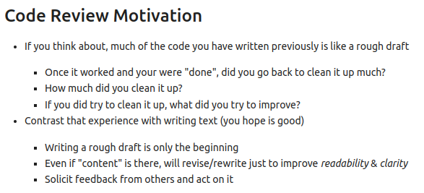
17.6 Code Review
https://www.youtube.com/watch?v=3SD2S0PN7-c&list=PLfrN7RIcMe6g2LBRJLTHTdhyj5s8ag0Rg&index=17
Code Review (28:24-30:23/1:06:00)
Review/Improve the Code before Push and Merge.

Slide 16
17.7 Code Review Summary

Slide 17
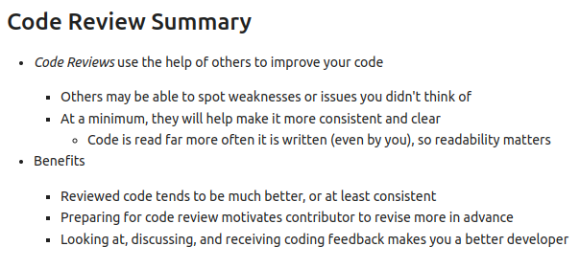
17.7 Code Review Summary
https://www.youtube.com/watch?v=3SD2S0PN7-c&list=PLfrN7RIcMe6g2LBRJLTHTdhyj5s8ag0Rg&index=17
Code Review Summary (30:24-34:05/1:06:00)
Review code for other developers.

Slide 18
17.8 Code Review Process

Slide 19
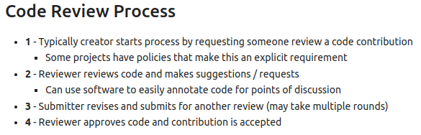
17.8 Code Review Process
https://www.youtube.com/watch?v=3SD2S0PN7-c&list=PLfrN7RIcMe6g2LBRJLTHTdhyj5s8ag0Rg&index=17
Code Review Process (34:06-38:52/1:06:00)
Review Code and reviewers approve the code.

Slide 20
17.9 Examine Code Review

Slide 21
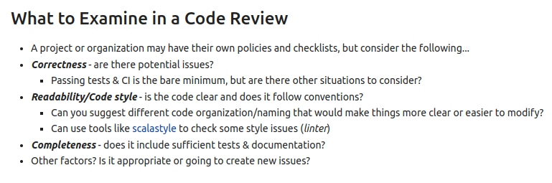
17.9 Examine Code Review
https://www.youtube.com/watch?v=3SD2S0PN7-c&list=PLfrN7RIcMe6g2LBRJLTHTdhyj5s8ag0Rg&index=17
Examine Code Review (38:53-44:20/1:06:00)
What to examine in code review?
1. Correctness
2. Readability
3. Completeness

Slide 22
17.10 Documentation

Slide 23
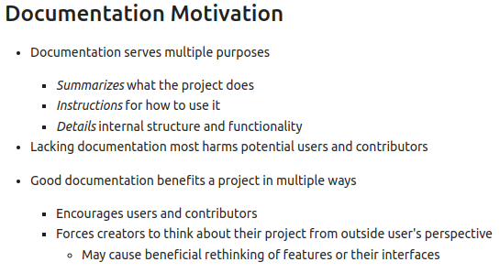
17.10 Documentation
https://www.youtube.com/watch?v=3SD2S0PN7-c&list=PLfrN7RIcMe6g2LBRJLTHTdhyj5s8ag0Rg&index=17
Documentation (44:21-47:15/1:06:00)
1. Summary
2. Guide/Instruction
3. Details

Slide 24
17.11 Other Documentation

Slide 25
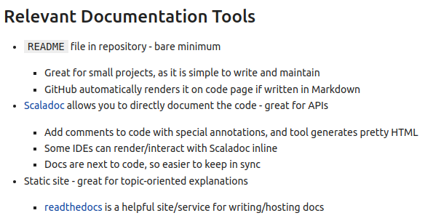
17.11 Other Documentation
https://www.youtube.com/watch?v=3SD2S0PN7-c&list=PLfrN7RIcMe6g2LBRJLTHTdhyj5s8ag0Rg&index=17
Other Documentation (47:16-51:00/1:06:00)
1. Readme
2. Scaladoc: /** ... */
3. Static Site

Slide 26
17.12 Document Content

Slide 27
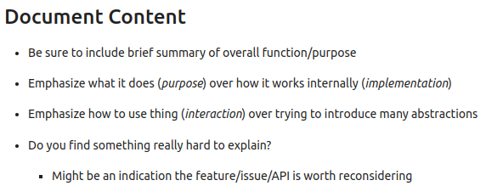
17.12 Document Content
https://www.youtube.com/watch?v=3SD2S0PN7-c&list=PLfrN7RIcMe6g2LBRJLTHTdhyj5s8ag0Rg&index=17
Document Content (51:01-52:37/1:06:00)
1. Summary
2. Purpose
3. Abstraction
4. Explanation
5. Feature/issues/API

Slide 28
17.13 Why Open-Source?

Slide 29
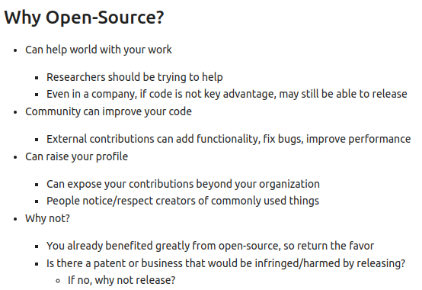
17.13 Why Open-Source?
https://www.youtube.com/watch?v=3SD2S0PN7-c&list=PLfrN7RIcMe6g2LBRJLTHTdhyj5s8ag0Rg&index=17
Why Open-Source? (52:38-55:37/1:06:00)
1. Help World
2. Community improve your code
3. Improve your profile
4. Get help from Open-Source
5. Improve your business, patent invention through improvement

Slide 30
17.14 Open-Source Ingredient

Slide 31
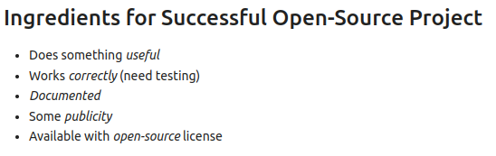
17.14 Open-Source Ingredient
https://www.youtube.com/watch?v=3SD2S0PN7-c&list=PLfrN7RIcMe6g2LBRJLTHTdhyj5s8ag0Rg&index=17
Open-Source Ingredient (55:38-56:41/1:06:00)
1. Does something useful
2. Correct
3. Document
4. Public
5. Available with Open-Source License.

Slide 32
17.15 Open-Source License

Slide 33
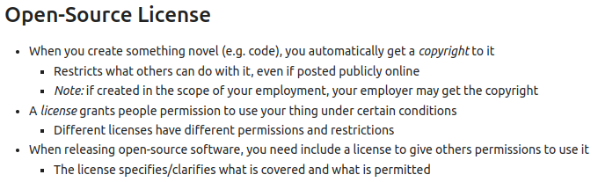
17.15 Open-Source License
https://www.youtube.com/watch?v=3SD2S0PN7-c&list=PLfrN7RIcMe6g2LBRJLTHTdhyj5s8ag0Rg&index=17
Open-Source License (56:42-57:47/1:06:00)
1. Copyright
2. License grant
3. Give Permission to other to use.

Slide 34
17.16 Open-Source Feature

Slide 35
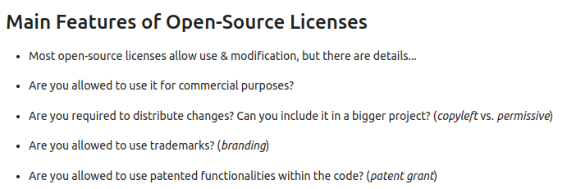
17.16 Open-Source Feature
https://www.youtube.com/watch?v=3SD2S0PN7-c&list=PLfrN7RIcMe6g2LBRJLTHTdhyj5s8ag0Rg&index=17
Open-Source Feature (57:48-58:47/1:06:00)
1. Use and modification
2. Allowed for commercial purpose?
3. Distribution change?
4. Allowed to use trademark?
5. Patent grant?

Slide 36
End

