Slide 1

1.41 FIFO IO

Slide 2
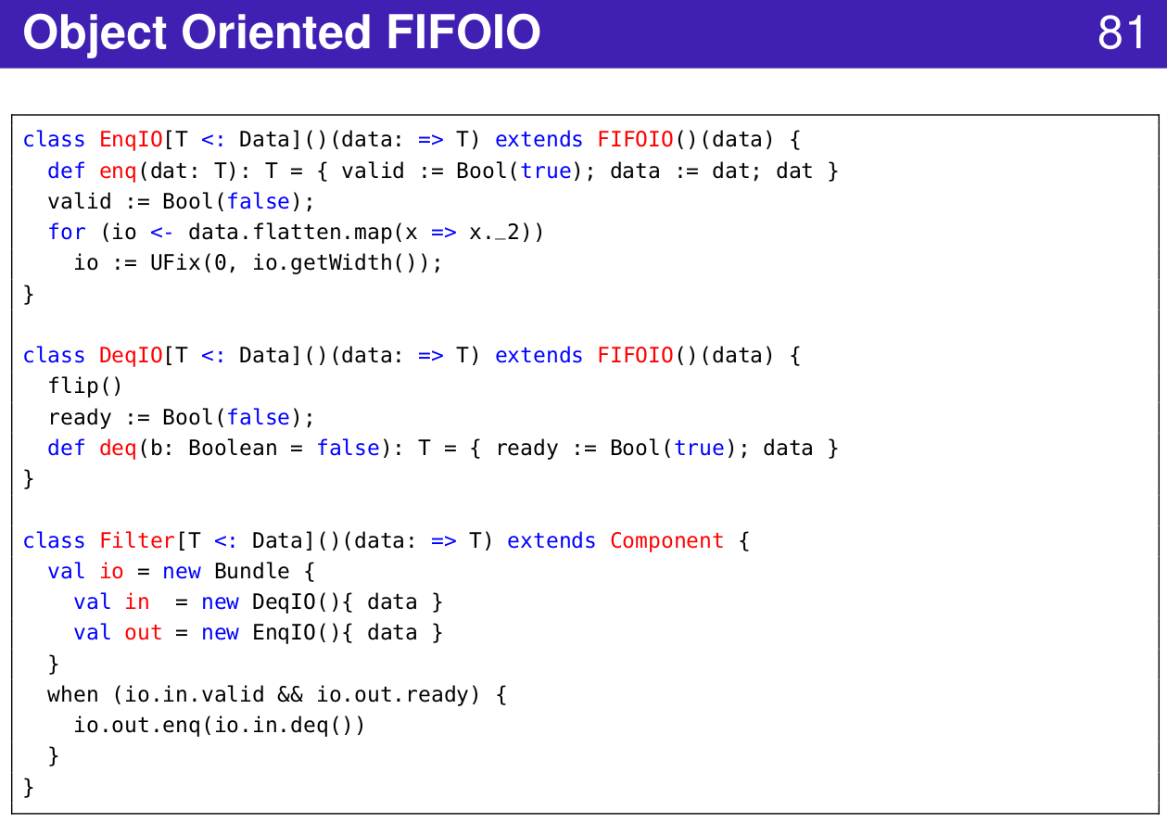
1.41 FIFO IO
https://www.youtube.com/watch?v=hIySOmvYY3Q&list=PLlu0CT-JnSasfpk8tq1ZDiE2G0AK1BhOg&index=3
FIFO IO (20:44-21:03/49:25)

Slide 3
1.42 Router

Slide 4
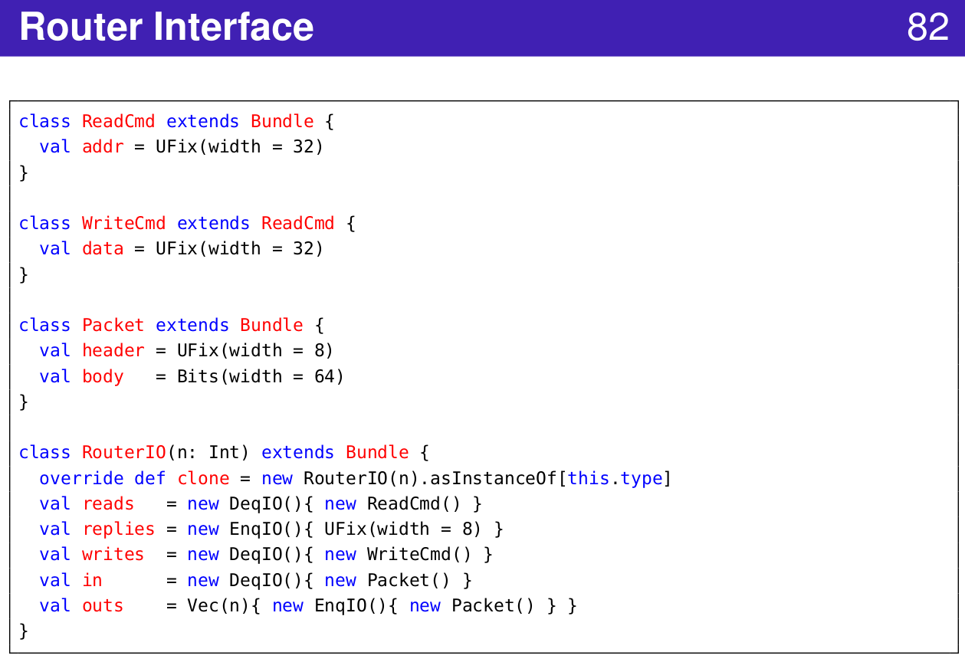
1.42 Router
https://www.youtube.com/watch?v=hIySOmvYY3Q&list=PLlu0CT-JnSasfpk8tq1ZDiE2G0AK1BhOg&index=3
Router Interface (20:44-21:03/49:25)

Slide 5
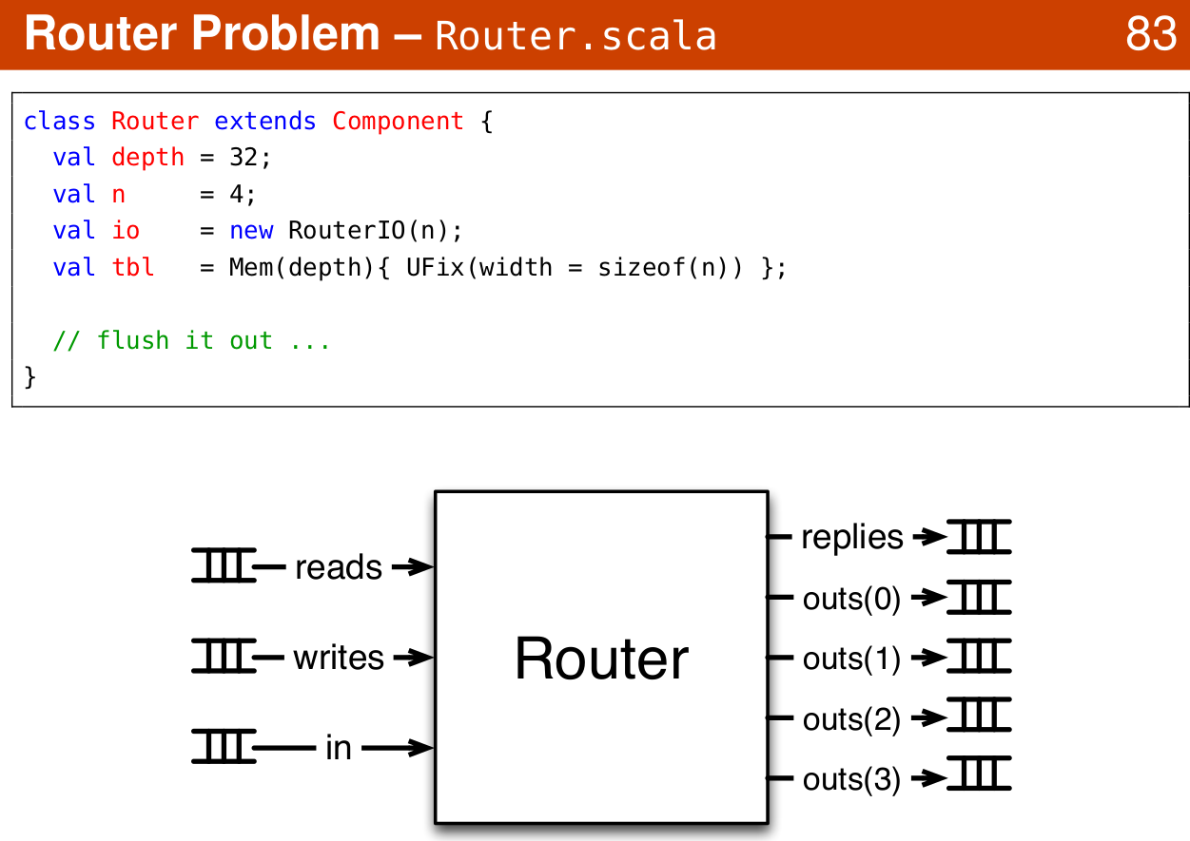
1.42 Router
https://www.youtube.com/watch?v=hIySOmvYY3Q&list=PLlu0CT-JnSasfpk8tq1ZDiE2G0AK1BhOg&index=3
Router Example (20:44-21:03/49:25)

Slide 6
1.43 Advanced Topics

Slide 7
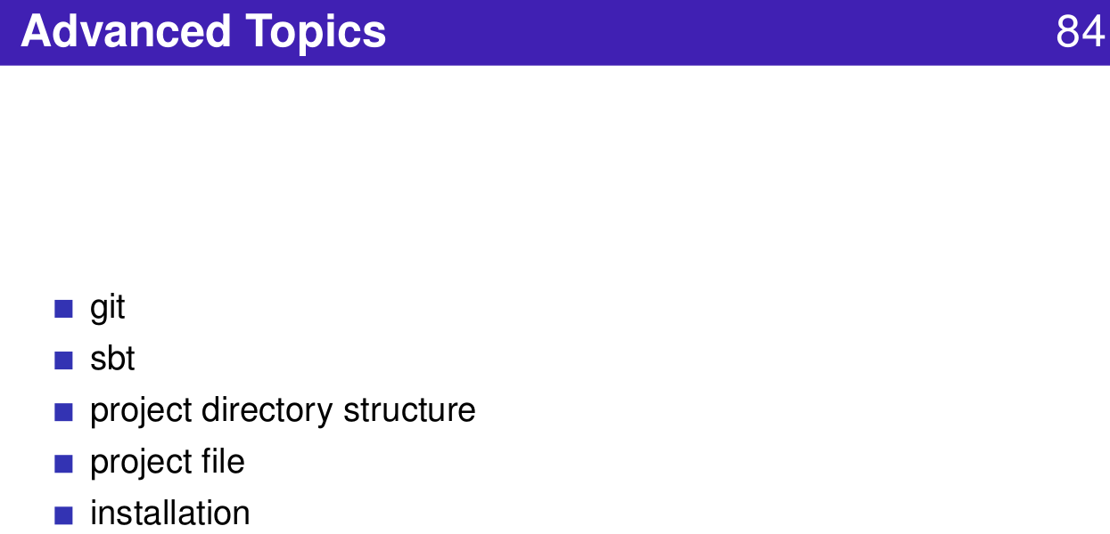
1.43 Advanced Topics
https://www.youtube.com/watch?v=hIySOmvYY3Q&list=PLlu0CT-JnSasfpk8tq1ZDiE2G0AK1BhOg&index=3
Advanced Topics (20:44-21:03/49:25)

Slide 8
1.44 GIT

Slide 9
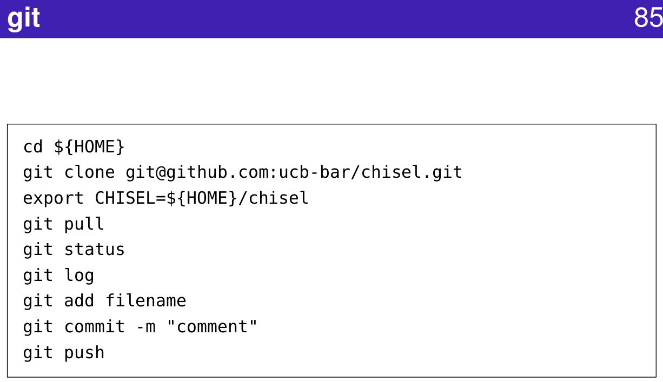
1.44 GIT
https://www.youtube.com/watch?v=hIySOmvYY3Q&list=PLlu0CT-JnSasfpk8tq1ZDiE2G0AK1BhOg&index=3
GIT (20:44-21:03/49:25)

Slide 10
1.45 SBT

Slide 11
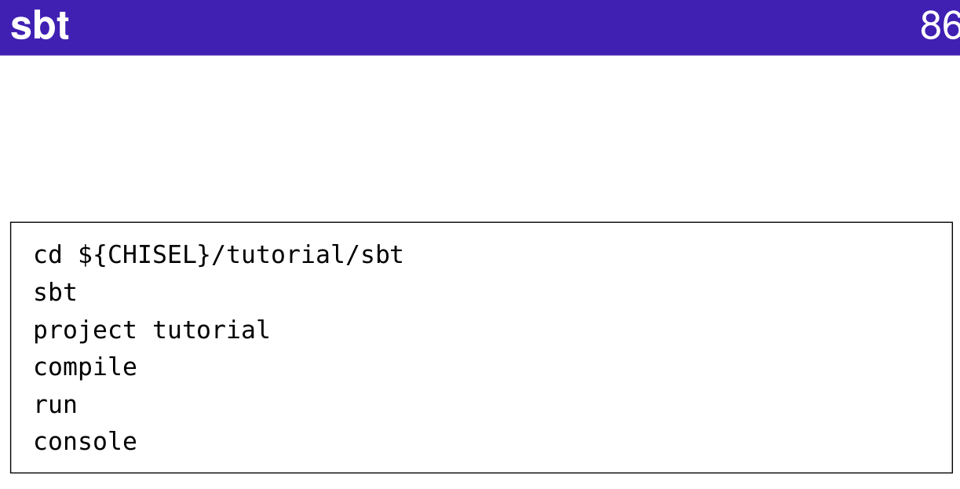
1.45 SBT
https://www.youtube.com/watch?v=hIySOmvYY3Q&list=PLlu0CT-JnSasfpk8tq1ZDiE2G0AK1BhOg&index=3
SBT (20:44-21:03/49:25)
SBT (Scala Build Tool)

Slide 12
1.46 Chisel Directory Structure

Slide 13
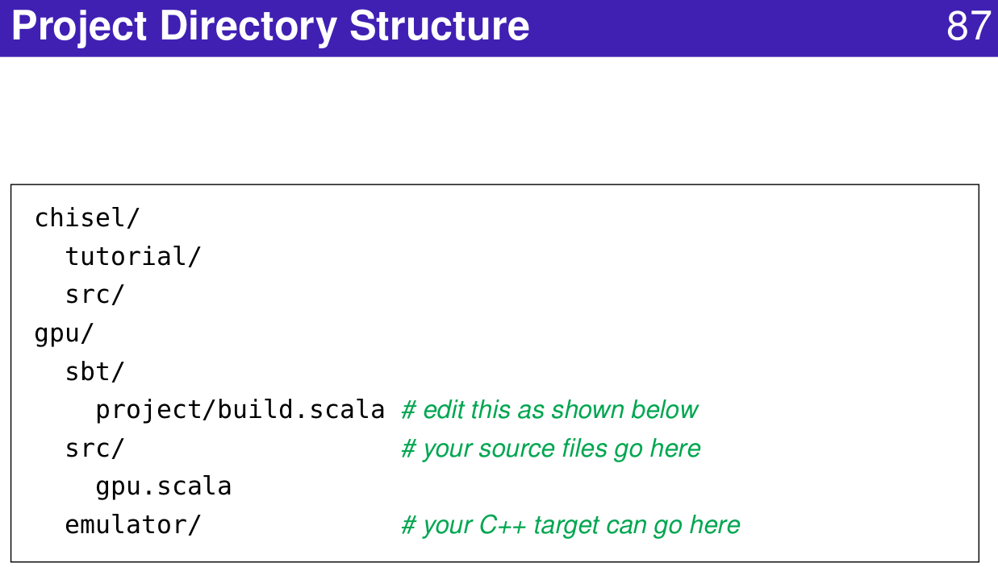
1.46 Chisel Directory Structure
https://www.youtube.com/watch?v=hIySOmvYY3Q&list=PLlu0CT-JnSasfpk8tq1ZDiE2G0AK1BhOg&index=3
Project Directory Structure (20:44-21:03/49:25)

Slide 14
1.47 Chisel Project File

Slide 15
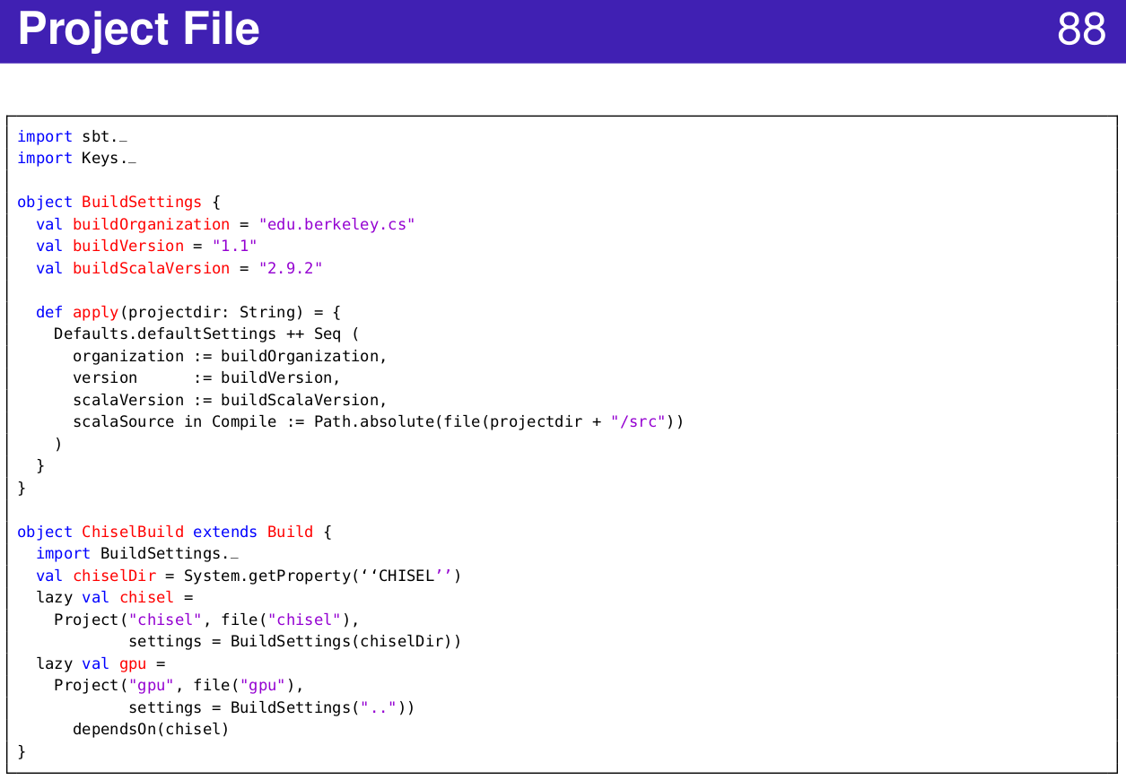
1.47 Chisel Project File
https://www.youtube.com/watch?v=hIySOmvYY3Q&list=PLlu0CT-JnSasfpk8tq1ZDiE2G0AK1BhOg&index=3
Project File (20:44-21:03/49:25)

Slide 16
1.48 Chisel Installation

Slide 17
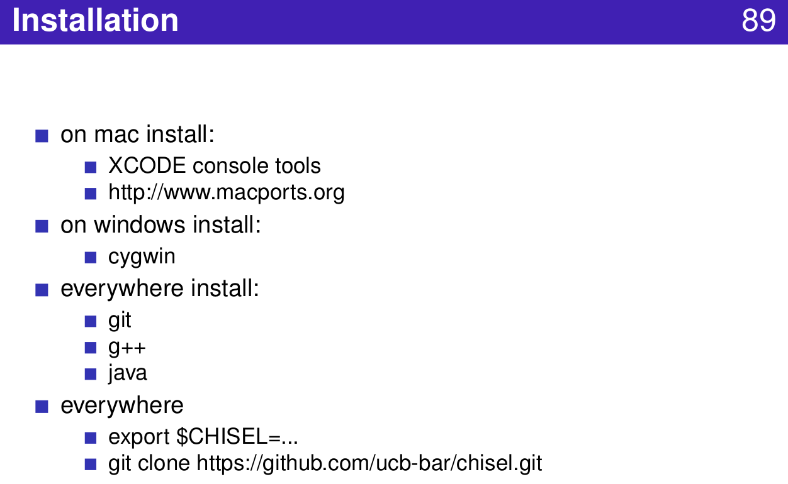
1.48 Chisel Installation
https://www.youtube.com/watch?v=hIySOmvYY3Q&list=PLlu0CT-JnSasfpk8tq1ZDiE2G0AK1BhOg&index=3
Installation (20:44-21:03/49:25)

Slide 18
1.49 Chisel Project

Slide 19
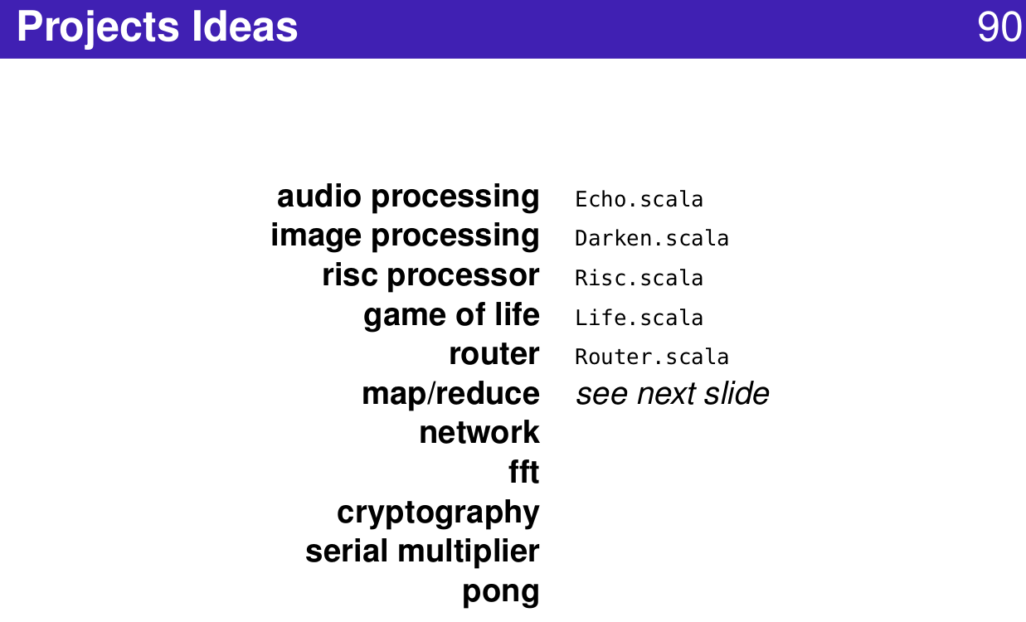
1.49 Chisel Project
https://www.youtube.com/watch?v=hIySOmvYY3Q&list=PLlu0CT-JnSasfpk8tq1ZDiE2G0AK1BhOg&index=3
Projects (20:44-21:03/49:25)

Slide 20
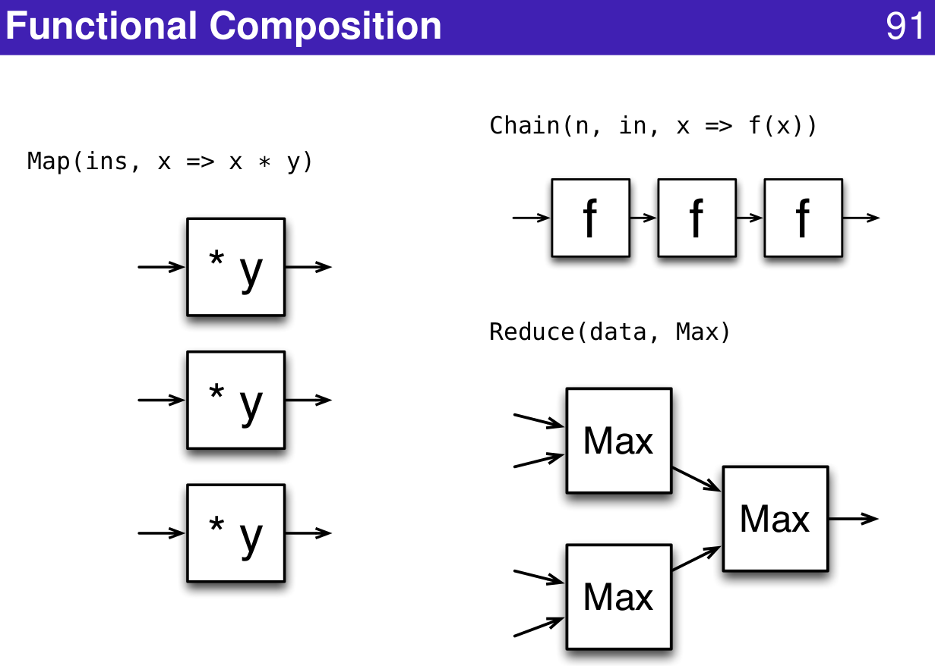
1.49 Chisel Project
https://www.youtube.com/watch?v=hIySOmvYY3Q&list=PLlu0CT-JnSasfpk8tq1ZDiE2G0AK1BhOg&index=3
Functional Composition (20:44-21:03/49:25)

Slide 21
1.50 Chisel Community

Slide 22
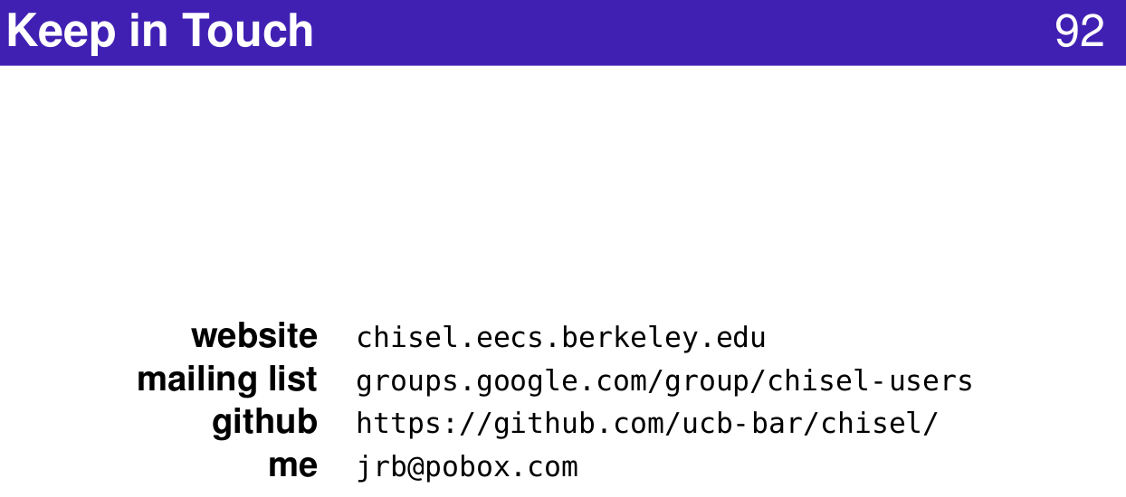
1.50 Chisel Community
https://www.youtube.com/watch?v=hIySOmvYY3Q&list=PLlu0CT-JnSasfpk8tq1ZDiE2G0AK1BhOg&index=3
Community (20:44-21:03/49:25)

Slide 23
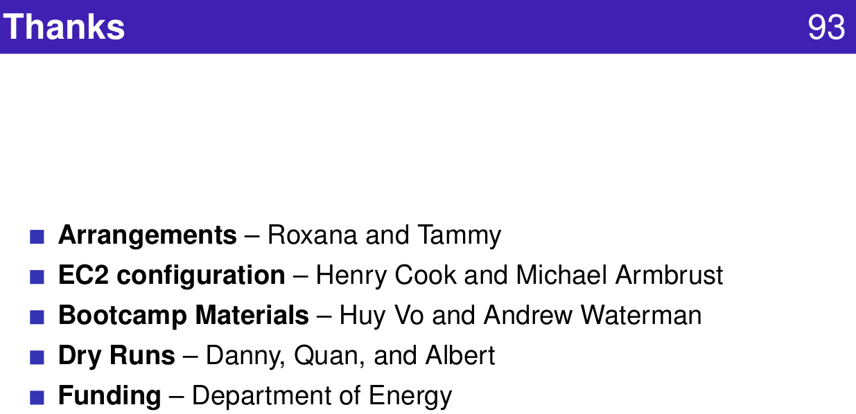
1.50 Chisel Community
https://www.youtube.com/watch?v=hIySOmvYY3Q&list=PLlu0CT-JnSasfpk8tq1ZDiE2G0AK1BhOg&index=3
Funding (20:44-21:03/49:25)

Slide 24
End

