Slide 1

0.5 Compile/Run Scala
Peter H. Chen

Slide 2
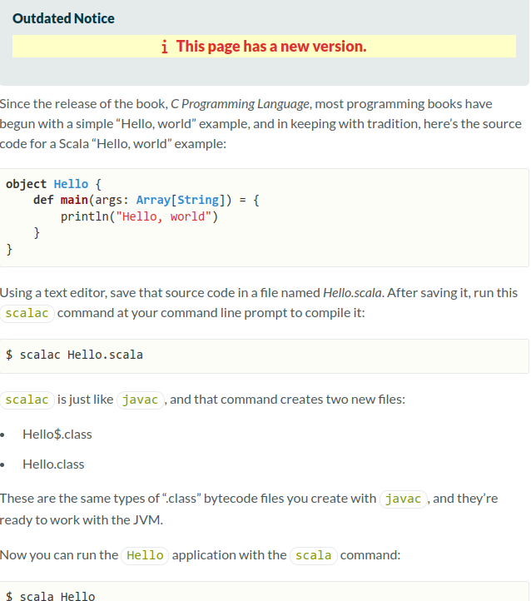
0.5 Compile/Run Scala
https://docs.scala-lang.org/overviews/scala-book/hello-world-1.html
Compile/Run Scala

Slide 3
0.5.1 Edit Hello.scala

Slide 4
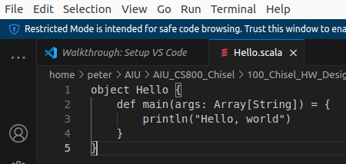
0.5.1 Edit Hello.scala
https://docs.scala-lang.org/overviews/scala-book/hello-world-1.html
Edit Hello.scala
> code Hello.scala

Slide 5
0.5.2 Compile Scala

Slide 6
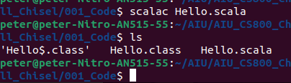
0.5.2 Compile Scala
https://docs.scala-lang.org/overviews/scala-book/hello-world-1.html
Compile Scala
> scalac Hello.scala
> ls
>> Hello.class Hello.scala

Slide 7
0.5.3 Run Scala

Slide 8

0.5.3 Run Scala
https://docs.scala-lang.org/overviews/scala-book/hello-world-1.html
Run Scala
> scala Hello
>> Hello, world

Slide 9
End

