Slide 1

3 Basics
Peter H. Chen

Slide 2
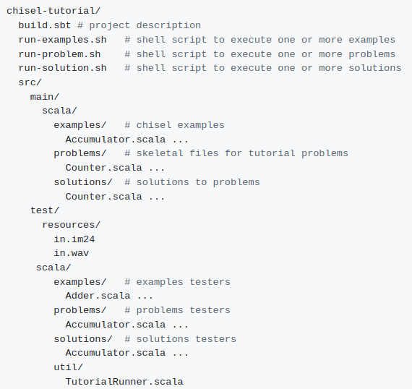
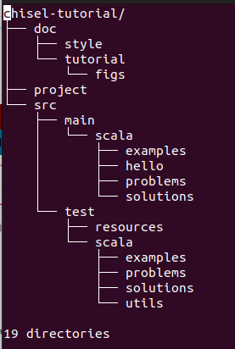
3 Basics
https://github.com/ucb-bar/chisel-tutorial/wiki/The-Basics
Basics
Below is the files/directory structure of Chisel (Constructing Hardware in Scala Language).
> sudo apt-get install tree
> tree -d chisel-tutorial > chisel_dir.log
> vim chisel_dir.log

Slide 3
3 Basics
https://github.com/ucb-bar/chisel-tutorial/wiki/The-Basics
Basics
There are:
1. Three scripts: run-problem.sh, run-solution.sh, and run-examples.sh
2. Two directories main and directory test.
3. Chisel source files are problems, and solutions directories.
4. The problems contains the UC Berkeley class assignment to be implemented.
5. The solutions contains the solution of the problems.
6. The examples are more complicate examples.
7. build.sbt file contains the build configuration information used to specify what version of Chisel to make your project.

Slide 4
End

