Slide 1

2 Hello Chisel
Peter H. Chen

Slide 2
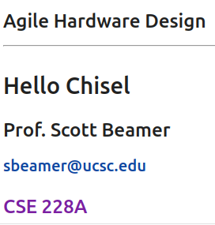
2 Hello Chisel
https://www.youtube.com/watch?v=9GD6PROUlWw&list=PLfrN7RIcMe6g2LBRJLTHTdhyj5s8ag0Rg&index=2
Hello Chisel (0:00-0:20/53:20)
We discuss Hello Scala/Chisel.
Topics:
1. Setup: Start Jupyter Notebook, select Scala interpreter, run all cells.
2. Scala Language: Literals, Inference, Declaration, operation, etc.
3. Chisel Tool Flow:
  3.1 Input Scala, Scala Compiler,
  3.2 Input Chisel Library, Generator, Generate ASIC Verilog and FPGA Circuit
3. Chisel Libraries: Chisel library is embedded under inside the Scala language.
4. Chisel Languages: Chisel Type, Chisel Operator,
5. Build and Test Simple Chisel Module: Chisel Design and Generate Verilog.
6. Chisel Backend Flow:
  6.1 Scala Simulation,
  6.2 FIRRTL (Flexible Intermediate Representation of Register Transfer Level), Verilog Generator.
7. Chisel Test: Poke, Peek, Expect

Slide 3
2.1 Test UCB Configuration

Slide 4
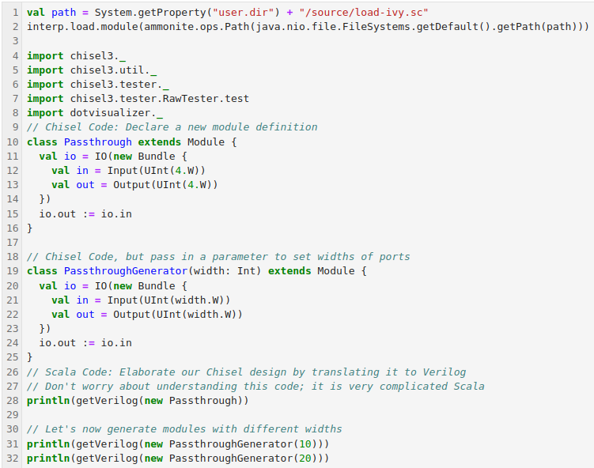
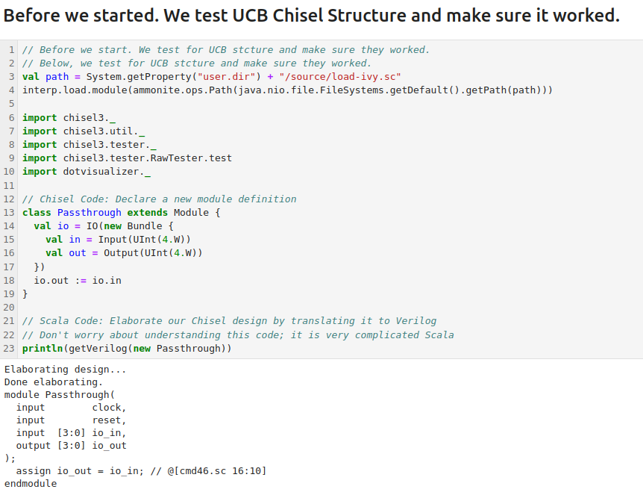
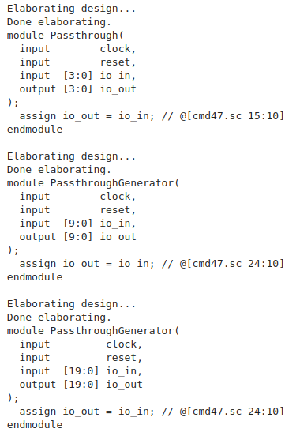
2.1 Test UCB Configuration
https://www.youtube.com/watch?v=9GD6PROUlWw&list=PLfrN7RIcMe6g2LBRJLTHTdhyj5s8ag0Rg&index=2
Test UCB Configuration (0:21-0:22/53:20)
Before, we started. We make sure the the UCB Chisel and configuration and make sure the dependencies work as we expected.

Slide 5
2.2 Jupyter Notebook

Slide 6
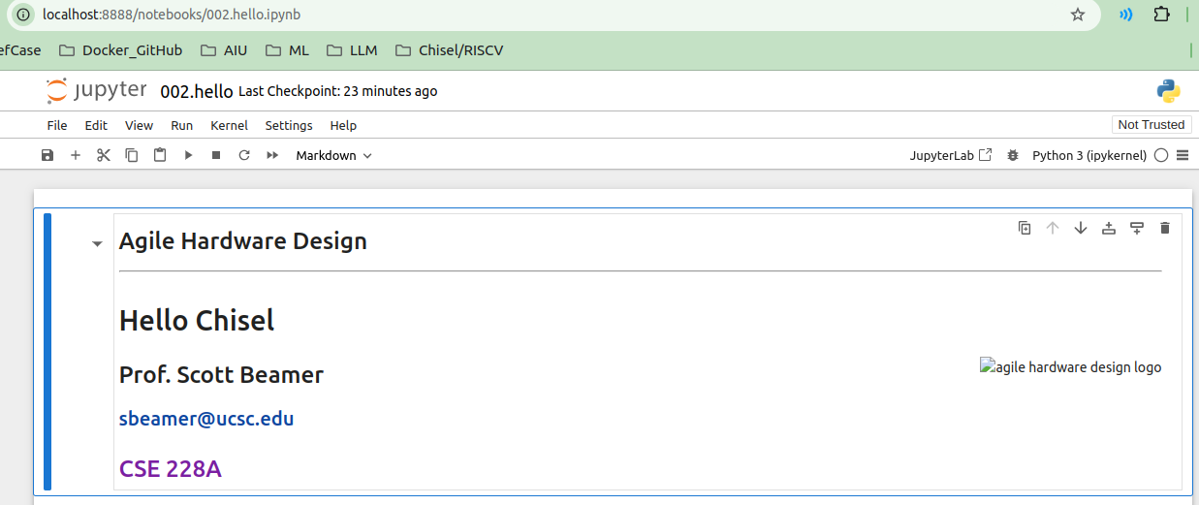
2.2 Jupyter Notebook
https://www.youtube.com/watch?v=9GD6PROUlWw&list=PLfrN7RIcMe6g2LBRJLTHTdhyj5s8ag0Rg&index=2
Jupyter Notebook (0:23-0:24/53:20)
1. Use below commands to install Jupyter Notebook.
> sudo apt-get update
> sudo apt-get install python3
> sudo apt-get install python3-pip
> sudo pip3 install jupyter
2. Use below command to bring up jupyter notebook,
> jupyter notebook 002.hello.ipynb
2

Slide 7
2.3 Binder Server

Slide 8
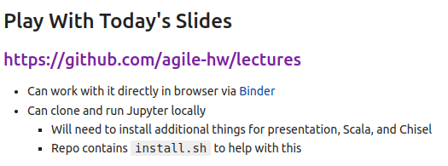
2.3 Binder Server
https://www.youtube.com/watch?v=9GD6PROUlWw&list=PLfrN7RIcMe6g2LBRJLTHTdhyj5s8ag0Rg&index=2
Binder Server (0:25-1:32/53:20)
We can install Jupyter notebook and run locally and can run jupyter notebook in the cloud as well.
We can register the binder.com and use server with a service called binder. It is free but slower.
Run server binder, what is binder?
1. "Binder" refers to a tool that allows users to easily access and run interactive computing environments like Jupyter notebooks directly from a web browser, essentially providing a way to share reproducible code by creating a link to a specific version of a repository that anyone can open and execute without needing to set up their own environment locally.
2. Binder is automatically disconnect if you don’t use for several minutes. Make sure you save your work if you don’t use binder.
https://mybinder.org/

Slide 9
2.4 Plan

Slide 10
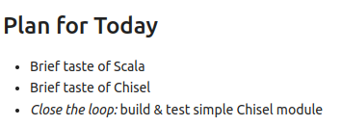
2.4 Plan
https://www.youtube.com/watch?v=9GD6PROUlWw&list=PLfrN7RIcMe6g2LBRJLTHTdhyj5s8ag0Rg&index=2
Plan (1:33-1:52/53:20)
We talks
1. Scala
2. Chisel
3. Build and Test Simple Chisel Module: Entire Design Process is Close Loop.

Slide 11
2.5 Scala Language

Slide 12
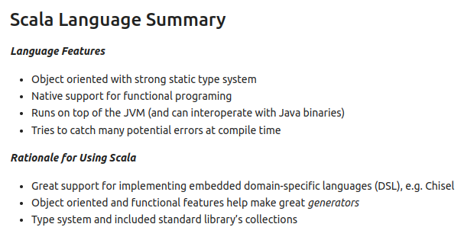

2.5 Scala Language
https://www.youtube.com/watch?v=9GD6PROUlWw&list=PLfrN7RIcMe6g2LBRJLTHTdhyj5s8ag0Rg&index=2
Scala Language (1:53-4:11/53:20)
Scala release in 2004. It is a mature language. Scala is Java descendant language.
Scala Language is
1. C/C++/Java based language
2. Strong type,
3. Object-Oriented Design,
4. Functional Programming.
5. Use JVM (Java Virtual Machine) as interpreter
6. Catch Error in compile time. Especially in Functional Programming.
Why Chisel Choose Scala for implementation?
1. Scala support embedded DSL (Domain-Specific Language), such as, Chisel.
2. Scala has OOD (Object Oriented Design)) and FP (Functional Programming)
3. Scala has Standard Library Collections

Slide 13
2.6 Run Scala

Slide 14
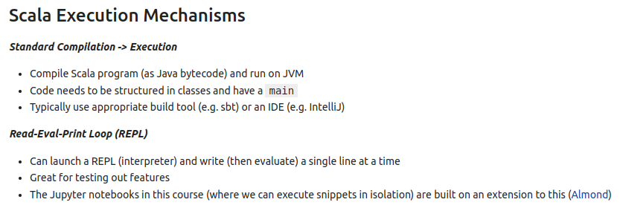
2.6 Run Scala
https://www.youtube.com/watch?v=9GD6PROUlWw&list=PLfrN7RIcMe6g2LBRJLTHTdhyj5s8ag0Rg&index=2
Run Scala (4:12-6:32/53:20)
We run Scala with followings:
1. Compile and run on JVM
2. main program with defined classes
3. Typically, we use SBT (Simple Build Tool) to build or IDE (intelliJ).
In Compile time, we use REPL (Read, Eval, Print, Loop)
1. Launch REPL (interpreter) and write (evaluate) a single line at a time.
2. REPL is good for Testing
3. We use Jupyter Notebook for REPL with Almond extension.

Slide 15
2.7 Scala Literal

Slide 16
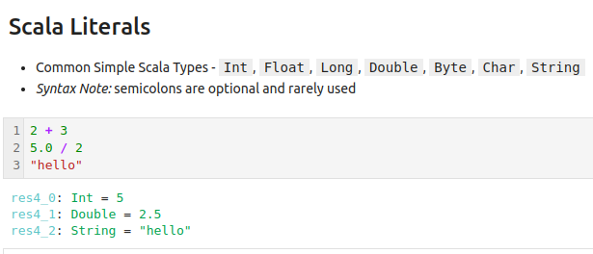
2.7 Scala Literal
https://www.youtube.com/watch?v=9GD6PROUlWw&list=PLfrN7RIcMe6g2LBRJLTHTdhyj5s8ag0Rg&index=2
Scala Literal (5:12-8:13/53:20)
How to run Scala with Almond in the Jupyter Notebook?
Interactive Computing with Jupyter and Almond:
https://www.youtube.com/watch?v=DLdJ4EFqkf8
Run on the right

Slide 17
2.8 Scala Type Inference

Slide 18
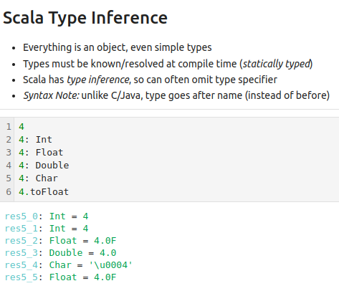
2.8 Scala Type Inference
https://www.youtube.com/watch?v=9GD6PROUlWw&list=PLfrN7RIcMe6g2LBRJLTHTdhyj5s8ag0Rg&index=2
Scala Type Inference (8:14-9:59/53:20)
All variables are object.
Object types must be pass the compilation.
Scala has type inference. The type inference can be omitted in type specifier.
Note:
In Scala, type is specified after the name. It is different from C/C++/Java.
Run as below.

Slide 19
2.9 Declare Scala Variable

Slide 20
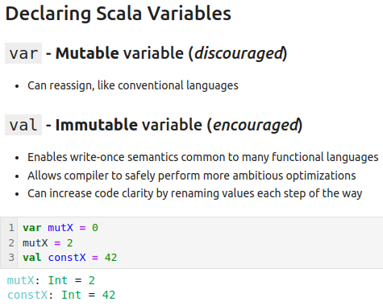
2.9 Declare Scala Variable
https://www.youtube.com/watch?v=9GD6PROUlWw&list=PLfrN7RIcMe6g2LBRJLTHTdhyj5s8ag0Rg&index=2
Declare Scala Variable (10:00-17:14/53:20)
We have two types:
a. var: Mutable variable and
b. val: Immutable variable.
In Functional Programming, we prefer to use val (immutable variable).
1. Scala will give you error if you want to change value of val (immutable variable).
2. We can assign several different constant variables with val.

Slide 21
2.10 Chisel Embedded in Scala

Slide 22
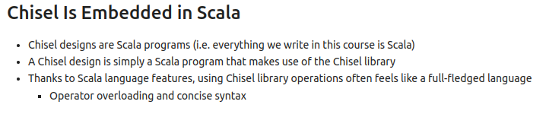
2.10 Chisel Embedded in Scala
https://www.youtube.com/watch?v=9GD6PROUlWw&list=PLfrN7RIcMe6g2LBRJLTHTdhyj5s8ag0Rg&index=2
Chisel Embedded in Scala (17:15-19:56/53:20)
Chisel is a language embedded in Scala.
When you write Chisel program, actually, you are writing the Scala program.
A Chisel Program is simply a Scala Program with the Chisel Library.
Then, we write the output of the Verilog program.
1. Chisel code is exactly same as the Scala code as blow.

Slide 23
2.11 Chisel Tool Flow
Peter H. Chen=

Slide 24
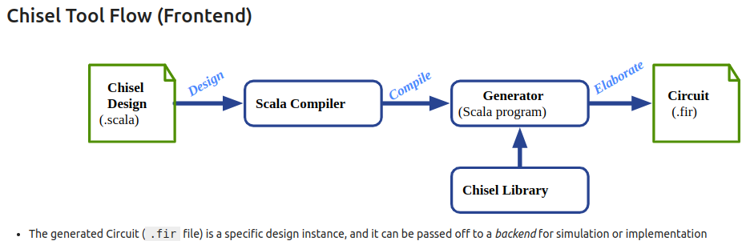
2.11 Chisel Tool Flow
https://www.youtube.com/watch?v=9GD6PROUlWw&list=PLfrN7RIcMe6g2LBRJLTHTdhyj5s8ag0Rg&index=2
Chisel Tool Flow (19:57-21:27/53:20)
1. We have one or many chisel design files, for example, main.scala.
2. We use Scala compiler to compile design file, main.scala
4. We input the Chisel component Library
4. Chisel generate the circuit (*.Fir)
5. Circuit (*.fir) is the FIRRTL program.
6. Circuit (*.fir) I the implement circuit and can be used for simulation.

Slide 25
2.12 Load Chisel Library

Slide 26
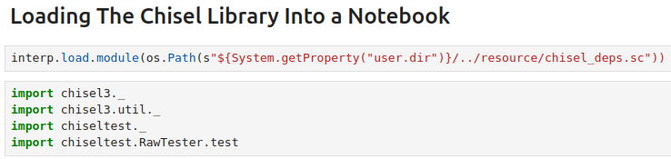
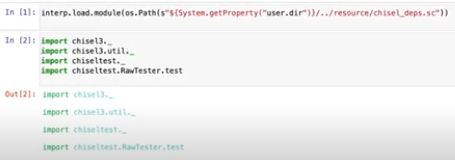
2.12 Load Chisel Library
https://www.youtube.com/watch?v=9GD6PROUlWw&list=PLfrN7RIcMe6g2LBRJLTHTdhyj5s8ag0Rg&index=2
Load Chisel Library (21:28-21:59/53:20)
Load Chisel Library into the Jupyter Notebook.
We will work on this behind in another class.

Slide 27
2.13 Chisel Type

Slide 28
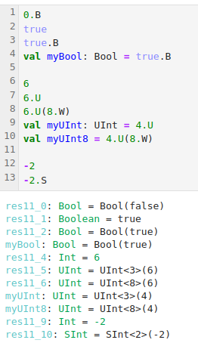
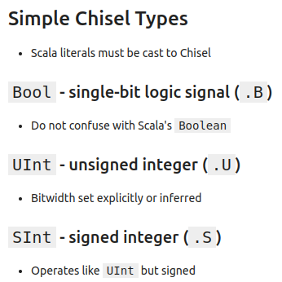
2.13 Chisel Type
https://www.youtube.com/watch?v=9GD6PROUlWw&list=PLfrN7RIcMe6g2LBRJLTHTdhyj5s8ag0Rg&index=2
Chisel Type (22:00-28:25/53:20)
We only look at very simple type.
1. Boolean
2. Integer
3. Integer/Signed Integer

Slide 29
2.14 Chisel Operator

Slide 30
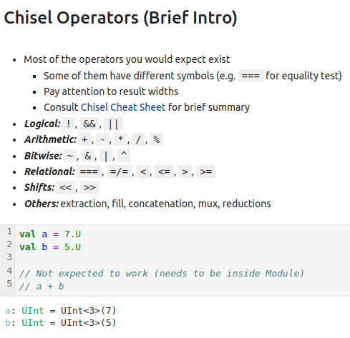
2.14 Chisel Operator
https://www.youtube.com/watch?v=9GD6PROUlWw&list=PLfrN7RIcMe6g2LBRJLTHTdhyj5s8ag0Rg&index=2
Chisel Operator (28:26-29:11/53:20)
Operators:
1. Logical
2. Arithmetic
3. Bitwise
4. Relational
5. Shift
6. Others: extraction, fill, concatenation, Mux, reduction

Slide 31
2.15 First Chisel Module

Slide 32
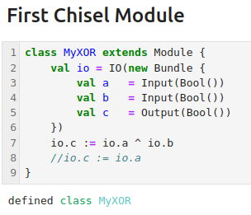
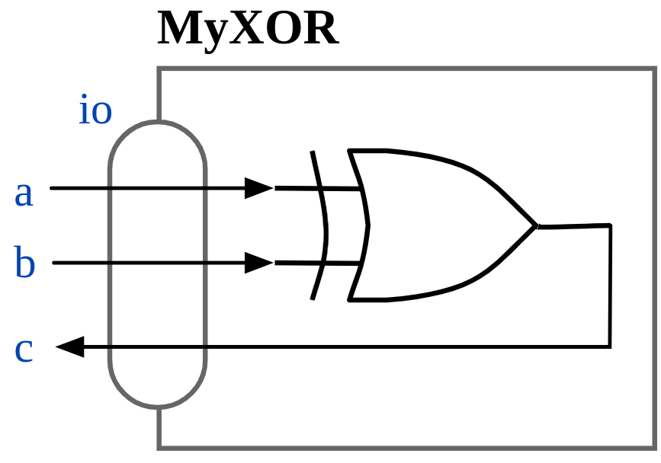
2.15 First Chisel Module
https://www.youtube.com/watch?v=9GD6PROUlWw&list=PLfrN7RIcMe6g2LBRJLTHTdhyj5s8ag0Rg&index=2
First Chisel Module (29:12-33:11/53:20)
We have
1. IO for the Module.
2. operator

Slide 33
2.16 Generate Design

Slide 34
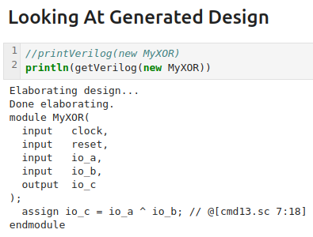
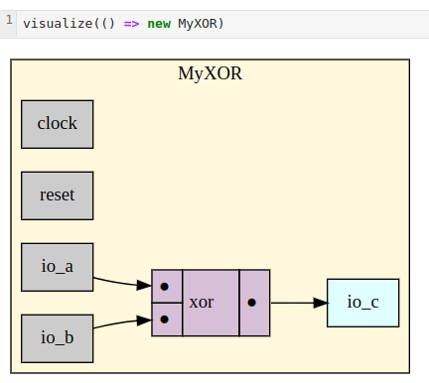
2.16 Generate Design
https://www.youtube.com/watch?v=9GD6PROUlWw&list=PLfrN7RIcMe6g2LBRJLTHTdhyj5s8ag0Rg&index=2
Generate Design (33:12-42:15/53:20)
After we finish the design and simulation, we can generate the Design in Verilog.
1. getVerilog()
2. println (getVerilog())
Below, we have one “clock”. We can have multiple clocks.
Questions:
1. How Chisel report “Single/port are not match”?
2. How Chisel handle “Non-Blocking in Verilog”?
3. How Chisel shift the clock domain?
Ans:
Internal Chisel is very complicated, we only talk simple usage in Chisel.
Chisel can handle mixed signals (Analog/Digital).
Register by default is positive register.

Slide 35
2.17 Chisel Backend Flow

Slide 36
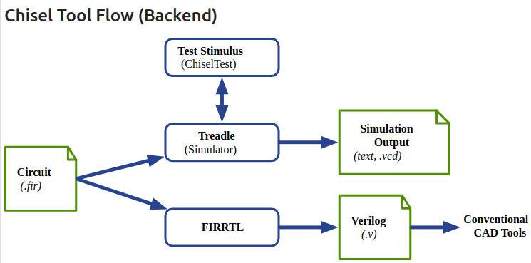
2.17 Chisel Backend Flow
https://www.youtube.com/watch?v=9GD6PROUlWw&list=PLfrN7RIcMe6g2LBRJLTHTdhyj5s8ag0Rg&index=2
Chisel Backend Flow (42:48-45:00/53:20)
In the frontend, Chisel produce the circuit (*.fir).
In the backend,
1. Chisel does the simulation
2. FIRRTL produce the synthesized RTL (Register Transfer Level) Verilog for CAD Tool production.

Slide 37
2.18 ChiselTest

Slide 38
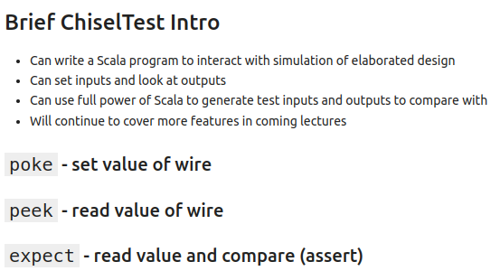
2.18 ChiselTest
https://www.youtube.com/watch?v=9GD6PROUlWw&list=PLfrN7RIcMe6g2LBRJLTHTdhyj5s8ag0Rg&index=2
ChiselTest (45:01-46:25/53:20)
ChiselTest:
1. Interactive simulation
2. Set inputs and look Outputs
3. Generate Test inputs and outputs

Slide 39
2.19 Run ChiselTest

Slide 40
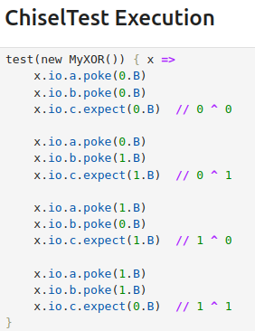
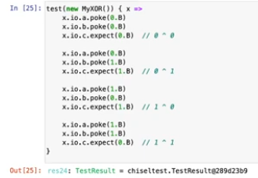
2.19 Run ChiselTest
https://www.youtube.com/watch?v=9GD6PROUlWw&list=PLfrN7RIcMe6g2LBRJLTHTdhyj5s8ag0Rg&index=2
Run ChiselTest (46:26-48:00/53:20)
Run ChiselTest:
Show pass Result

Slide 41
2.20 Chisel Version

Slide 42
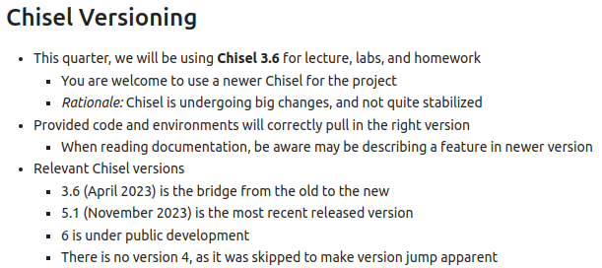


2.20 Chisel Version
https://www.youtube.com/watch?v=9GD6PROUlWw&list=PLfrN7RIcMe6g2LBRJLTHTdhyj5s8ag0Rg&index=2
Chisel Version (48:01-53:20/53:20)
Chisel is changing version in development.
Chisel 3 is around 2023.
Chisel stable version is 3.6.

Slide 43
End

