Slide 1

17 Open Project Development
Peter H. Chen

Slide 2
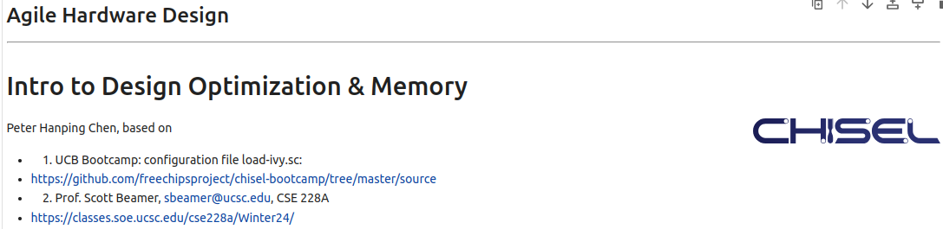
17 Open Project Development
https://www.youtube.com/watch?v=3SD2S0PN7-c&list=PLfrN7RIcMe6g2LBRJLTHTdhyj5s8ag0Rg&index=17
Open Project Development (0:00-0:01/1:06:00)
We used UCB bootcamp configuration file (load_ivy.sc)
source/load-ivy.sc (https://github.com/freechipsproject/chisel-bootcamp)

Slide 3
17 Open Project Development
https://www.youtube.com/watch?v=3SD2S0PN7-c&list=PLfrN7RIcMe6g2LBRJLTHTdhyj5s8ag0Rg&index=17
Open Project Development (0:02-0:45/1:06:00)
We discuss Physical Design Optimization and Memory Design
Topics:
1. Setup: jupyter notebook, select scala, and run cells.
2.

Slide 4
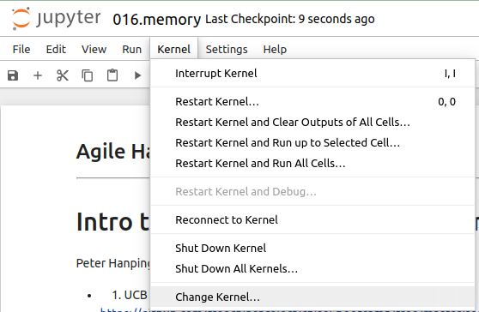
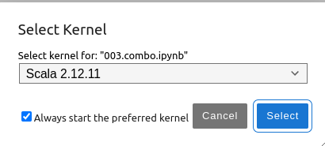
17 Open Project Development
https://www.youtube.com/watch?v=3SD2S0PN7-c&list=PLfrN7RIcMe6g2LBRJLTHTdhyj5s8ag0Rg&index=17
Open Project Development (0:03-1:08/1:06:00)
We discuss Chisel Collection.
> jupyter notebook 017.memory.ipynb > Kernel > Change Kernel … > Select Scala2.21.22
> Run All Cells

Slide 5
17.1 Plan

Slide 6
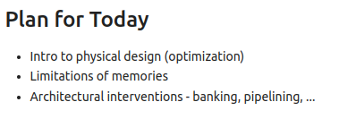
17.1 Plan
https://www.youtube.com/watch?v=3SD2S0PN7-c&list=PLfrN7RIcMe6g2LBRJLTHTdhyj5s8ag0Rg&index=17
Plan (1:09-1:25/1:06:00)
Today, we talk
1. Physical design optimization.
2. Memory limitation
3. Architectural intervention.

Slide 7
End

