Slide 1

12 Example
Peter H. Chen

Slide 2
12 Example
https://github.com/ucb-bar/chisel-tutorial?tab=readme-ov-file
Example
Below 18 tests: “./run-example.sh all”.
1. ShiftRegister: Shift Register
2. EnableShiftRegister: Enable (Set/reset) Sift Register.
3. SimpleALU: Simple ALU (Arithmetic Logic Unit) operand and operator
4. Adder4: 4 bits adder.
5. HiLoMultiplier: Extract Hi byte and Low byte output of 16 * 16 bit Multiplier.
6. GCD: GCD (Greatest Common Divisor) of input a and input b.
7. Stack: Stack of Push, Pop operation with enable, Data in, Data Out,
8. VecSearch: Input Vector and pattern, output the index of match pattern.
9. Darken (Become black): Shift input one bit to left.
10. FullAdder: Input a, b, carry in, output sum and carry out.
11. Combinational: Combinational Circuit with addition.
12. Life: For each 9x9 cells, set the neighbor data in the delta window.
13. Parity: Check input vector is odd or even.
13. Risc: Reduce Instruction Set Computer
15. ResetShiftRegister: Reset Shift Register
16. LogShifter: Record of a shifter
17. Tbl: Input address and output Table Data.
18. ByteSelector: Extract the selector byte.
19. Adder: n-bits adder with carry in and carry out.
20. Functionality: Functionality operation.
Totally, we have 20 tests.

Slide 3
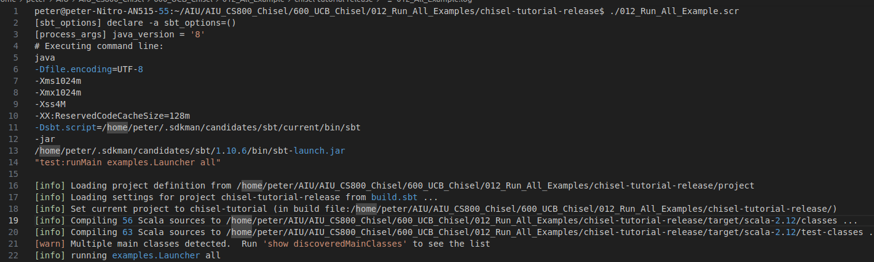
12 Example
https://github.com/ucb-bar/chisel-tutorial?tab=readme-ov-file
Example
Below 18 tests: “./run-example.sh all”.

Slide 4
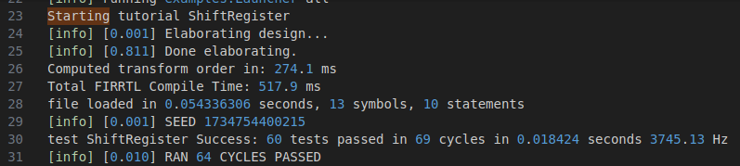
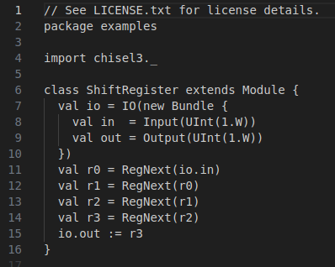
12 Example
https://github.com/ucb-bar/chisel-tutorial?tab=readme-ov-file
Example
Test 1: ShiftRegister

Slide 5
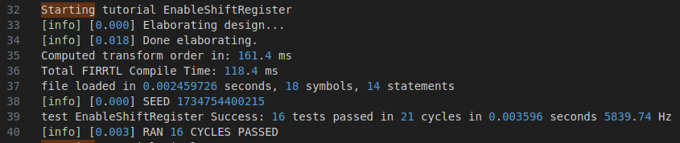
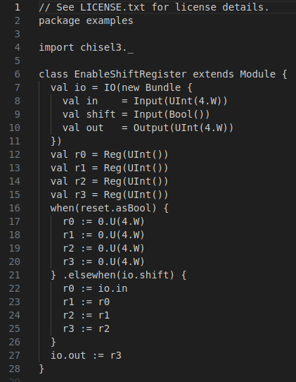
12 Example
https://github.com/ucb-bar/chisel-tutorial?tab=readme-ov-file
Example
Test 2: EnableShiftRegister

Slide 6
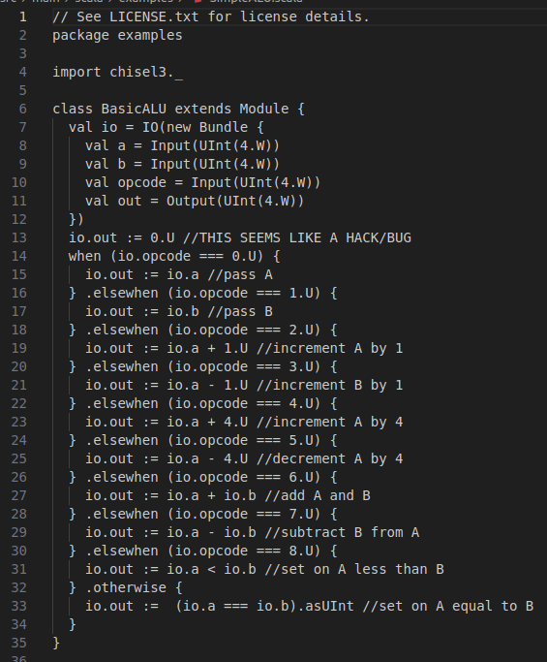
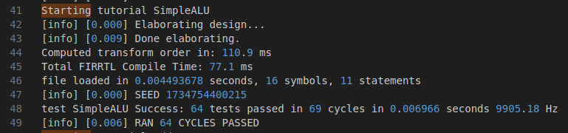
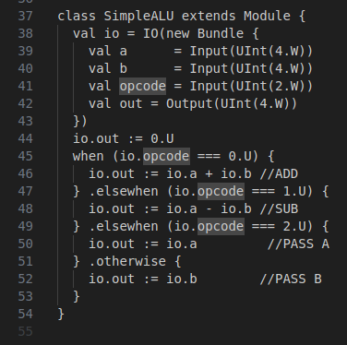
12 Example
https://github.com/ucb-bar/chisel-tutorial?tab=readme-ov-file
Example
Test 3: SimpleALU

Slide 7
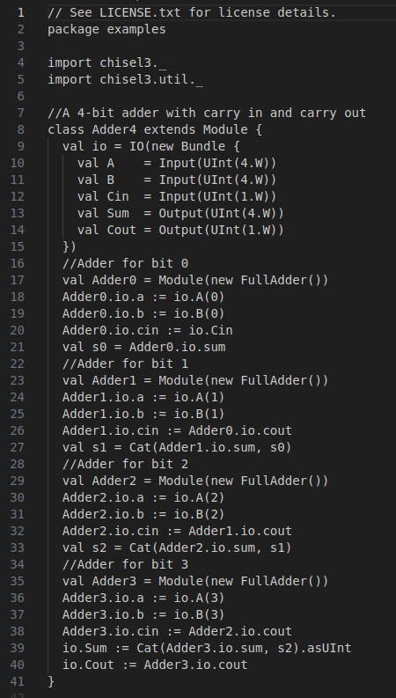
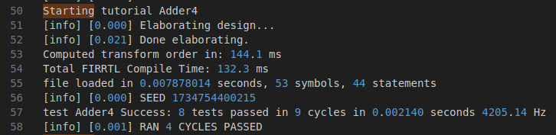
12 Example
https://github.com/ucb-bar/chisel-tutorial?tab=readme-ov-file
Example
Test 4: Adder4

Slide 8
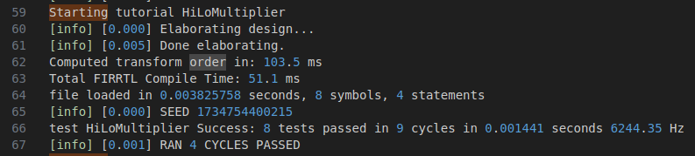
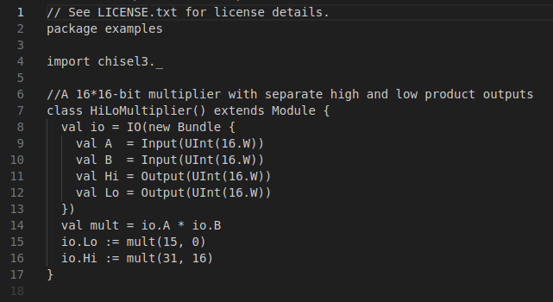
12 Example
https://github.com/ucb-bar/chisel-tutorial?tab=readme-ov-file
Example
Test 5: HiLoMultiplier

Slide 9
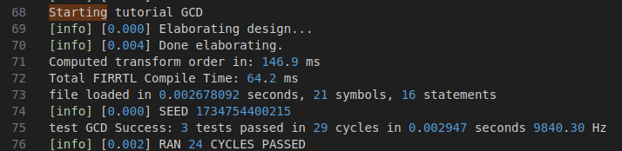
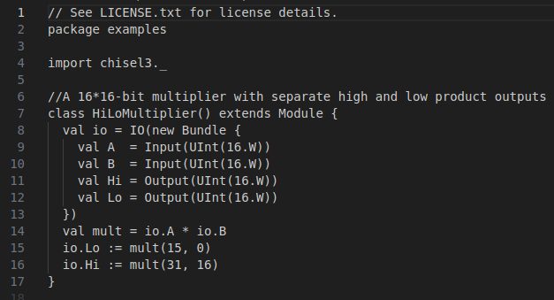
12 Example
https://github.com/ucb-bar/chisel-tutorial?tab=readme-ov-file
Example
Test 6: GCD

Slide 10
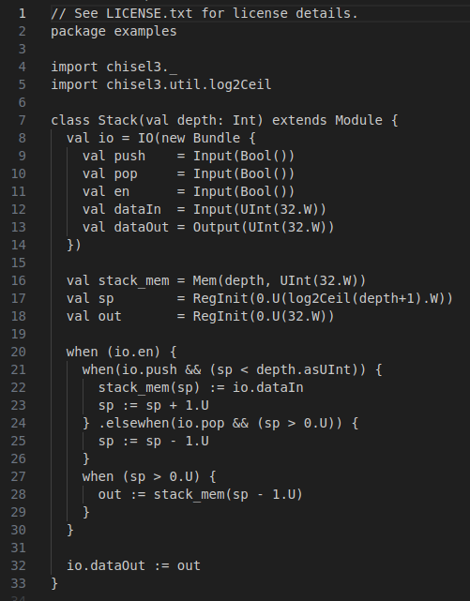
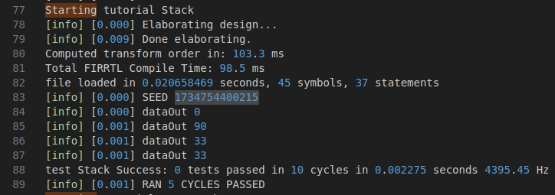
12 Example
https://github.com/ucb-bar/chisel-tutorial?tab=readme-ov-file
Example
Test 7: Stack

Slide 11
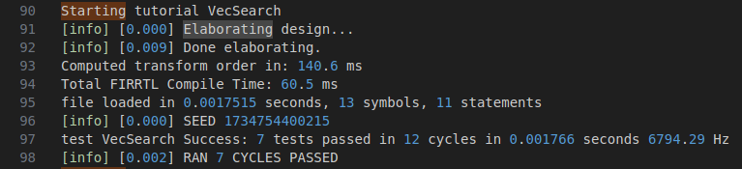
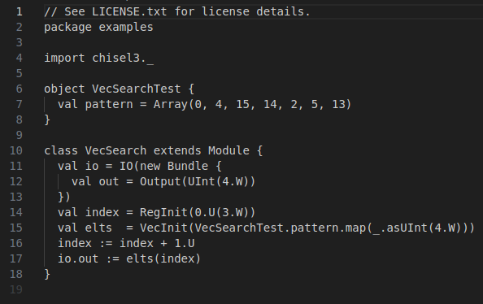
12 Example
https://github.com/ucb-bar/chisel-tutorial?tab=readme-ov-file
Example
Test 8: VecSearch

Slide 12
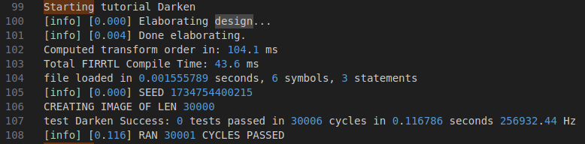
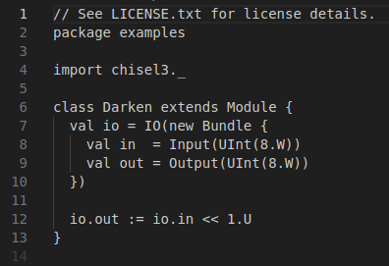
12 Example
https://github.com/ucb-bar/chisel-tutorial?tab=readme-ov-file
Example
Test 9: Darken
Darken (Become black) in the context of a "shift one bit left" operation refers to a bitwise manipulation where you move all the binary digits (bits) in a number one position to the left, essentially doubling its value, with any empty spaces on the right being filled with zeros; it's essentially a "left shift" operation by one position, often used in programming to quickly multiply a number by 2.

Slide 13
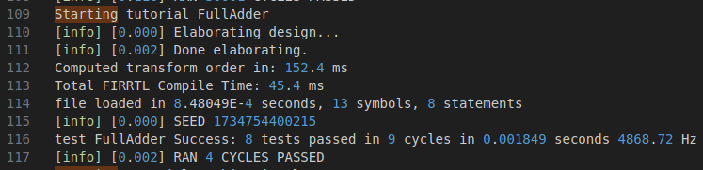
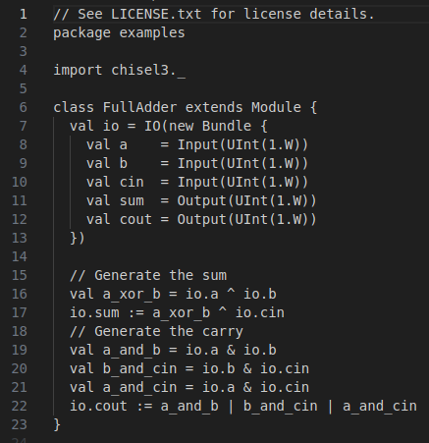
12 Example
https://github.com/ucb-bar/chisel-tutorial?tab=readme-ov-file
Example
Test 10: FullAdder

Slide 14
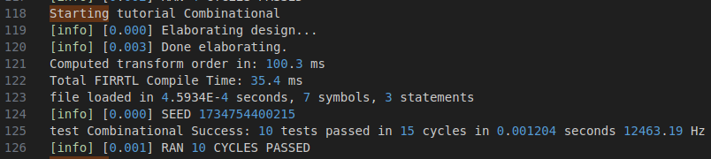
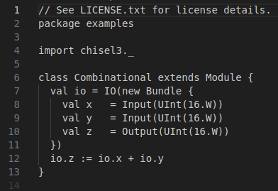
12 Example
https://github.com/ucb-bar/chisel-tutorial?tab=readme-ov-file
Example
Test 11: Combinational

Slide 15
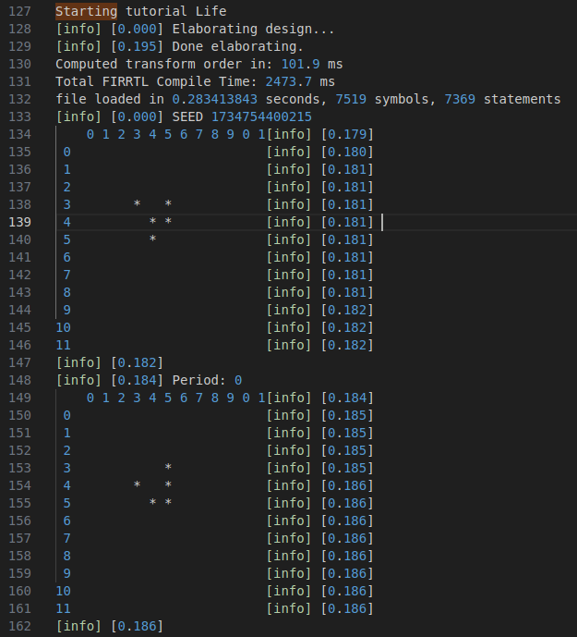
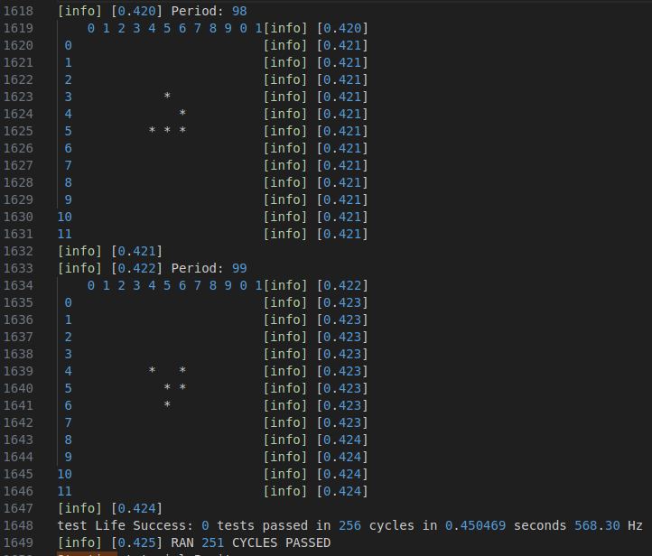
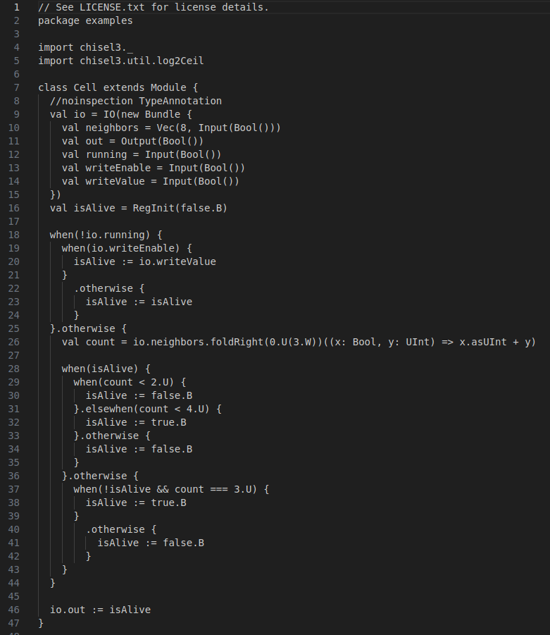
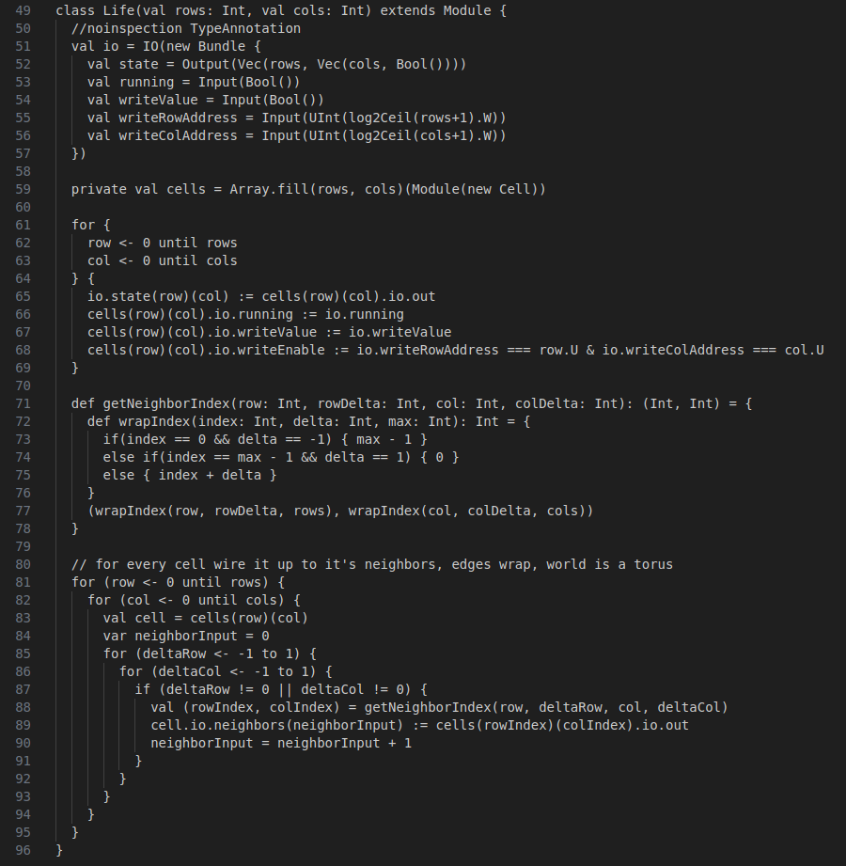
12 Example
https://github.com/ucb-bar/chisel-tutorial?tab=readme-ov-file
Example
Test 12: Life
Period 0-99

Slide 16
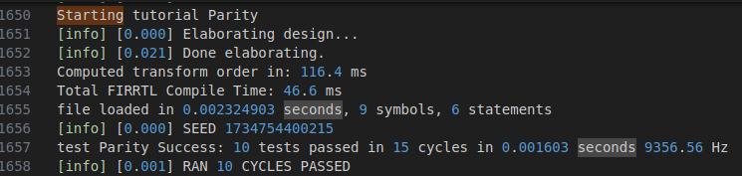
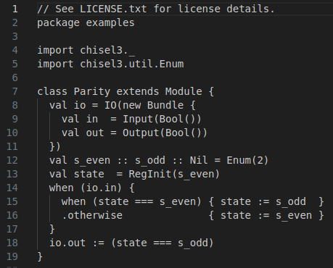
12 Example
https://github.com/ucb-bar/chisel-tutorial?tab=readme-ov-file
Example
Test 13: Parity

Slide 17
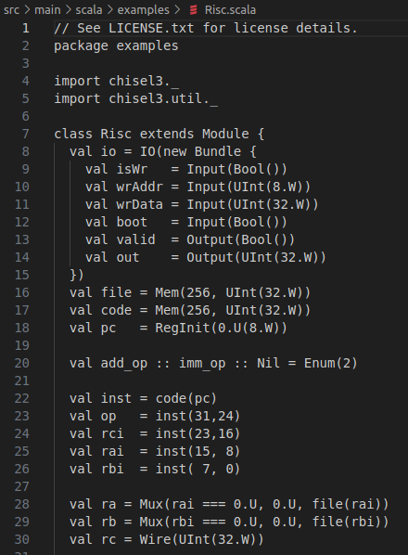
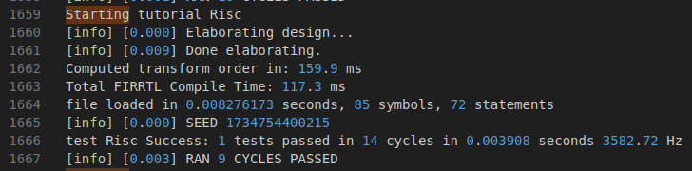
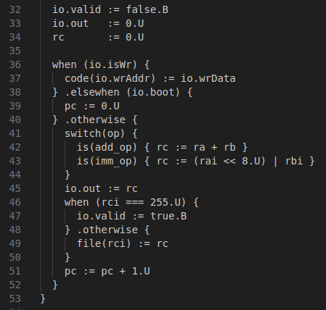
12 Example
https://github.com/ucb-bar/chisel-tutorial?tab=readme-ov-file
Example
Test 14: Risc

Slide 18
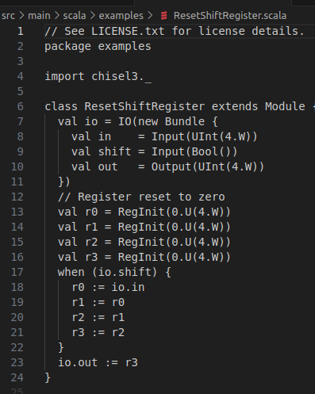
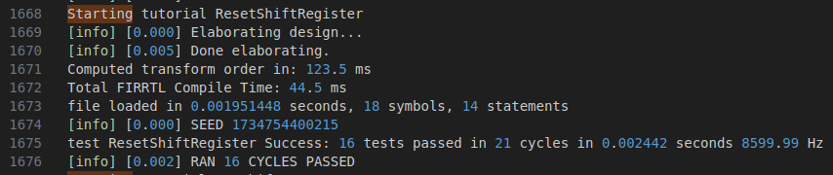
12 Example
https://github.com/ucb-bar/chisel-tutorial?tab=readme-ov-file
Example
Test 15: ResetShiftRegister

Slide 19
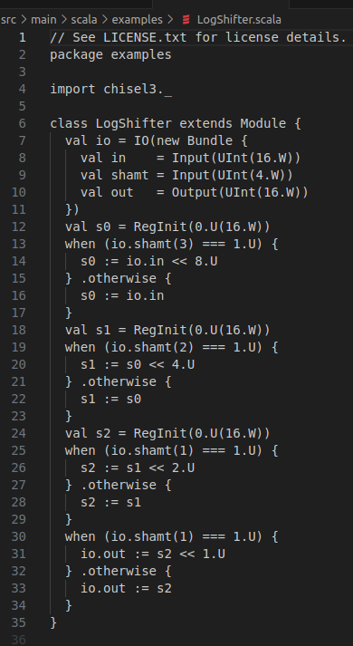
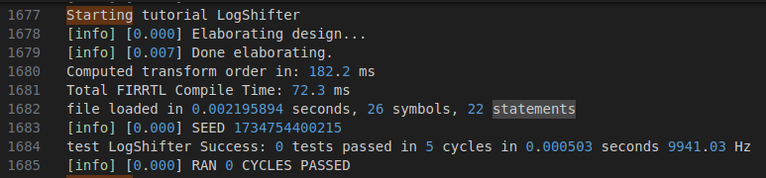
12 Example
https://github.com/ucb-bar/chisel-tutorial?tab=readme-ov-file
Example
Test 16: LogShifter

Slide 20
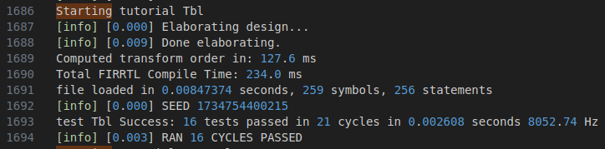
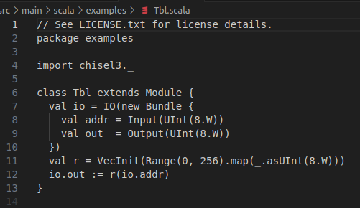
12 Example
https://github.com/ucb-bar/chisel-tutorial?tab=readme-ov-file
Example
Test 17: Tbl

Slide 21
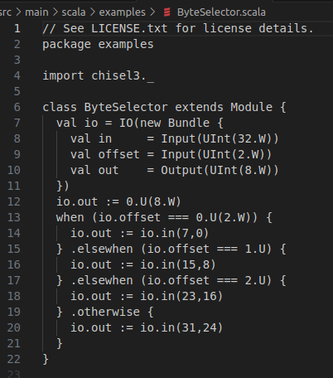
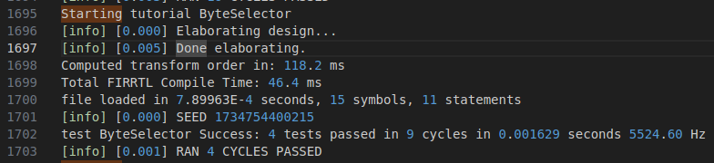
12 Example
https://github.com/ucb-bar/chisel-tutorial?tab=readme-ov-file
Example
Test 18: ByteSelector

Slide 22
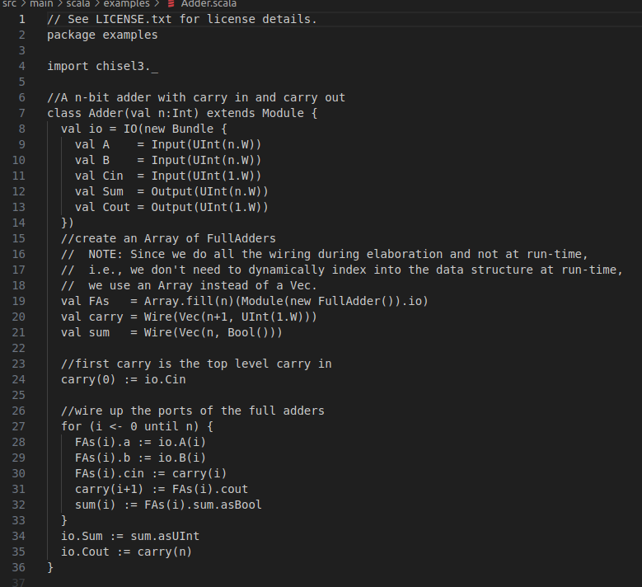
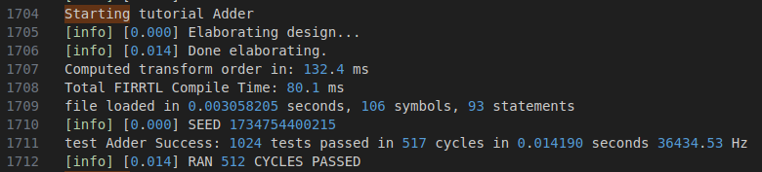
12 Example
https://github.com/ucb-bar/chisel-tutorial?tab=readme-ov-file
Example
Test 19: Adder

Slide 23
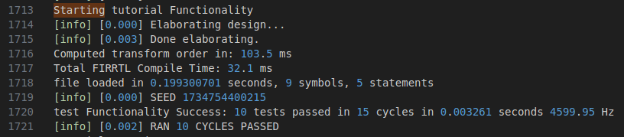
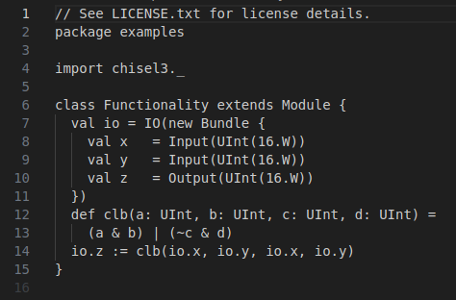
12 Example
https://github.com/ucb-bar/chisel-tutorial?tab=readme-ov-file
Example
Test 20: Functionality

Slide 24
12 Example
https://github.com/ucb-bar/chisel-tutorial?tab=readme-ov-file
Example
Total test 20.

Slide 25
End

