Slide 1

0.6 Install/Run Scala with SBT
Peter H. Chen

Slide 2
0.6 Install/Run Scala with SBT
https://www.youtube.com/watch?v=eIhIg1ccZUQ&t=5s
Compile/Run Scala with SBT (0:00-0:01/57:27)
We discuss the how to Run Scala/Chisel with SBT. Run Scala with SBT is the essential for Scala Developer.
1. Install SDK
2. Install JDK with SDK
3. Install Scala
4. Install SBT
5. Compile/Run Scala with SBT (Scala Build Tool or Simple Build Tool).
6. We run with Hands-on practice

Slide 3
0.6.1 Install SDK

Slide 4
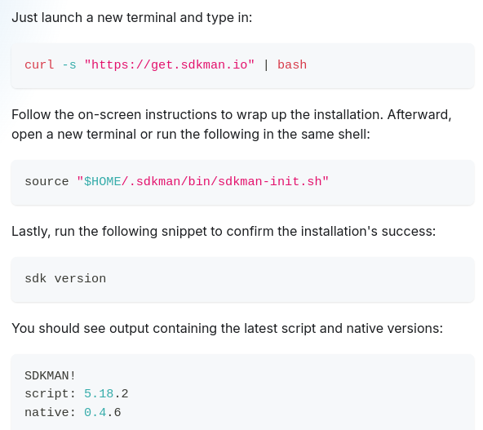


0.6.1 Install SDK
https://github.com/ucb-bar/chisel-tutorial?tab=readme-ov-file
Install SDK (0:01-0:02/57:27)
Get SDK from URL and then setup.
1. > curl -s "https://get.sdkman.io" | bash # CURL (Copy URL): Clone sdkman from URL
2. > source "$HOME/.sdkman/bin/sdkman-init.sh"
https://sdkman.io/install
1
2

Slide 5
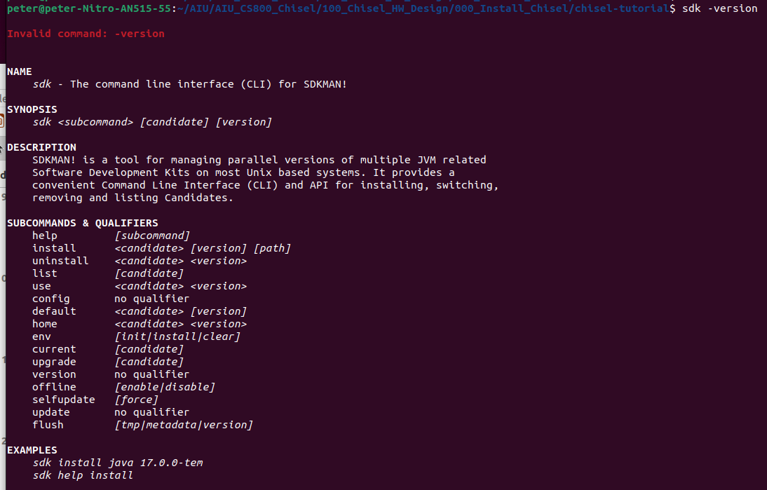
0.1 Install SDK
https://github.com/ucb-bar/chisel-tutorial?tab=readme-ov-file
Install SDK (0:03-0:04/57:27)
3. > sdk version
4. > sdk -version
man.io/install
3
4

Slide 6
0.6.2 Install JDK with SDK

Slide 7
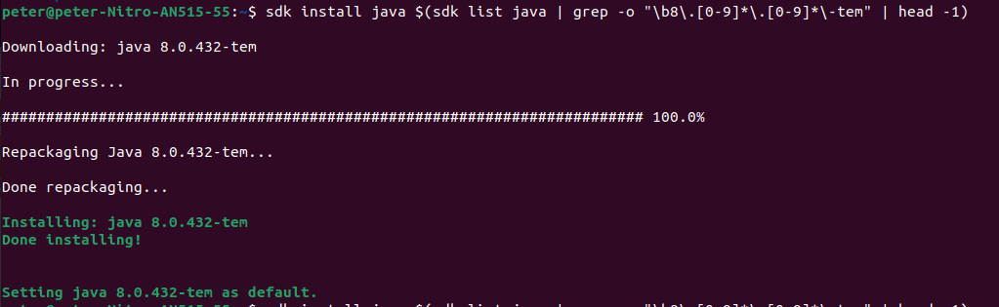


0.6.2 Install JDK with SDK
https://github.com/ucb-bar/chisel-tutorial?tab=readme-ov-file
Install JDK with SDK (0:05-0:06/57:27)
1. Use SDK to install JDK
> sdk install java $(sdk list java | grep -o "\b8\.[0-9]*\.[0-9]*\-tem" | head -1)
2. Check Java Compiler version:
> javac -version
>> javac 1.8.0_432 # Java 1.8 or Java 8
3. Check JVM (JVM is part of JRE) version
> java -version
>> openjdk version “1.8._432”
>> OpenJDK Runtime Environment (JRE): 1.8
>> OpenJDK 64-bit Server VM (JVM)
https://www.scala-sbt.org/release/docs/Installing-sbt-on-Linux.html
1
2
3

Slide 8
0.6.3 Install Scala

Slide 9
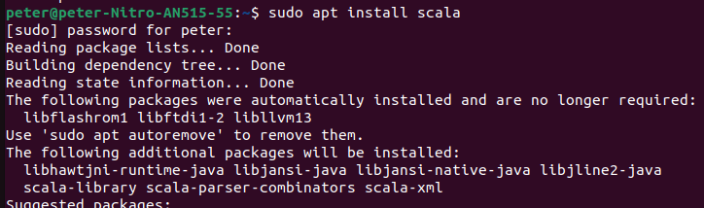
0.6.3 Install Scala
https://medium.com/beeranddiapers/installing-scala-on-ubuntu-7a4b14d26bdc
Install Scala (0:07-0:08/57:27)
1. Install Scala.
> sudo apt install scala
2. Check scala version
> scala -version
>> Scala code runner version 2.11.12
https://medium.com/beeranddiapers/installing-scala-on-ubuntu-7a4b14d26bdc
1
2

Slide 10
0.6.4 Install SBT

Slide 11
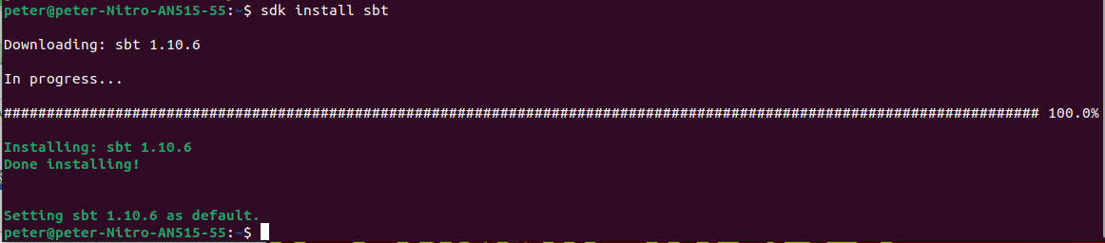
0.6.4 Install SBT
https://github.com/ucb-bar/chisel-tutorial?tab=readme-ov-file
Install Scala (0:09-0:10/57:27)
Install SBT:
> sdk install sbt
https://www.scala-sbt.org/release/docs/Installing-sbt-on-Linux.html

Slide 12

0.6.4 Install SBT
https://github.com/ucb-bar/chisel-tutorial?tab=readme-ov-file
Install Scala (0:11-1:40/57:27)
After we install SBT, we can check sbt version
> sbt -version
https://www.scala-sbt.org/release/docs/Installing-sbt-on-Linux.html

Slide 13
0.6.5 Compile/Run Scala with SBT

Slide 14

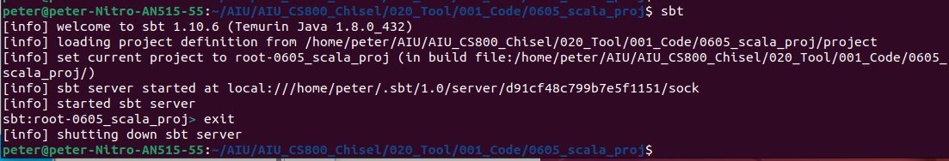
0.6.5 Compile/Run Scala with SBT
https://medium.com/beeranddiapers/installing-scala-on-ubuntu-7a4b14d26bdc
Compile/Run Scala with SBT (1:41-1:42/57:27)
Open Ubuntu Terminal
1. Create a Project Folder
> mkdir 0601_scala_proj
> cd 0601_scala_proj
2. start SBT shell
> sbt
>> sbt:root-0605_scala_proj> # Note: there are two folders created, i.e., project folder and target folder
3. sbt:root-0605_scala_proj> exit
>>
1
2
3

Slide 15


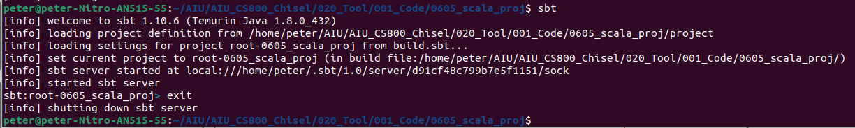
0.6.5 Compile/Run Scala with SBT
https://medium.com/beeranddiapers/installing-scala-on-ubuntu-7a4b14d26bdc
Compile/Run Scala with SBT (1:43-3:27/57:27)
1. Use any editor to edit file “build.sbt”
> vi build.sbt
>> scalaVersion := “2.13.8” # Note: scalaVersion has uppercase ‘V”. Scala Version is used in Compilation
Save the file
2. Start sbt
> sbt
sbt command will load the appropriate libraries to setup the project. It will create a bunch of folder, such as, project and target.
3. sbt:root-0605_Scala_Proj > exit
Q: What kind of information can be added in build.sbt?
Ans: e.g., scalaVersion
1
2
3

Slide 16
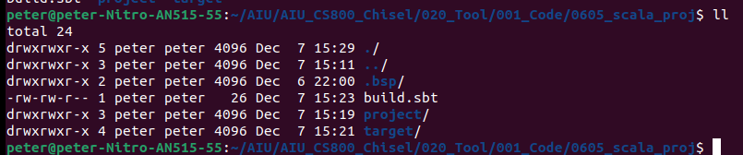
0.6.5 Compile/Run Scala with SBT
https://medium.com/beeranddiapers/installing-scala-on-ubuntu-7a4b14d26bdc
Compile/Run Scala with SBT (3:28-3:50/57:27)
1. > ll
We see the detailed information of folder project and folder target
The target folder contains all the binaries that will be compiled by the scala compiler.
The project folder contains the additional files for sbt. For example, if you want to customize sbt in any way.
1

Slide 17

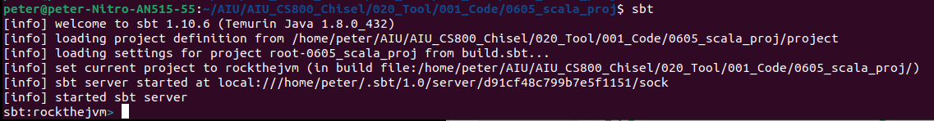
0.6.5 Compile/Run Scala with SBT
https://medium.com/beeranddiapers/installing-scala-on-ubuntu-7a4b14d26bdc
Compile/Run Scala with SBT (3:51-4:45/57:27)
Now, we want to add more information in build.sbt
1. > vi build.sbt
>> scalaVersion := “2.13.8” // Scala Version
>> version := “1.0” // Entire project version
>> name := “rockthejvm” // Project Name: Rock the JVM
>> organization := “com.rockthejvm” // Company name
2. > sbt
1
2

Slide 18
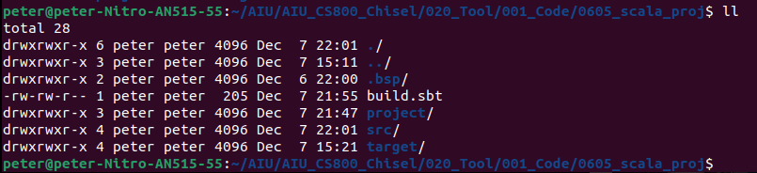
0.6.5 Compile/Run Scala with SBT
https://medium.com/beeranddiapers/installing-scala-on-ubuntu-7a4b14d26bdc
Compile/Run Scala with SBT (4:46-5:15/57:27)
We need to make the /src/main/scala and src/test/scala
1.
> mkdir -p src/main/scala # Make parent folder for scala source files
> mkdir -p src/test/scala # Make parent folder for test files
2. ll
Project
src
main
test
scala
scala
1
2

Slide 19
0.6.5 Compile/Run Scala with SBT
https://medium.com/beeranddiapers/installing-scala-on-ubuntu-7a4b14d26bdc
Compile/Run Scala with SBT (5:16-5:45/57:27)
1.
> cd project
> ll
2.
> cat build.properties
>> sbt.version=1.10.6

Slide 20
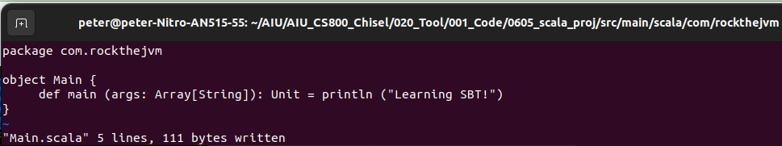
0.6.5 Compile/Run Scala with SBT
https://medium.com/beeranddiapers/installing-scala-on-ubuntu-7a4b14d26bdc
Project
Compile/Run Scala with SBT (5:46-6:45/57:27)
1. > cd src/main/scala
2. > mkdir -p com/rockthejvm
3.
> cd $_
Now, we are in the path: src/main/scala/com/rockthejvm:
> vi Main.scala.
src
main
test
scala
scala
com
com
rockthejvm
rockthejvm
2
3

Slide 21
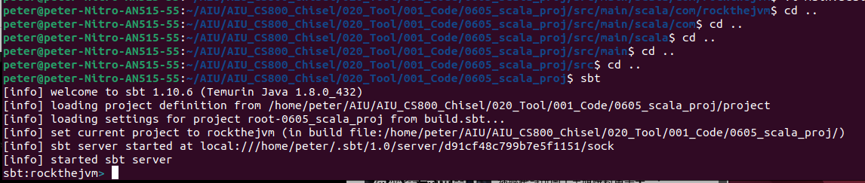
0.6.5 Compile/Run Scala with SBT
https://medium.com/beeranddiapers/installing-scala-on-ubuntu-7a4b14d26bdc
Compile/Run Scala with SBT (5:46-6:45/57:27)
1. Go back to project directory
> cd ../../../../..
2. We are at scala_proj
scala_proj > sbt
1
2

Slide 22
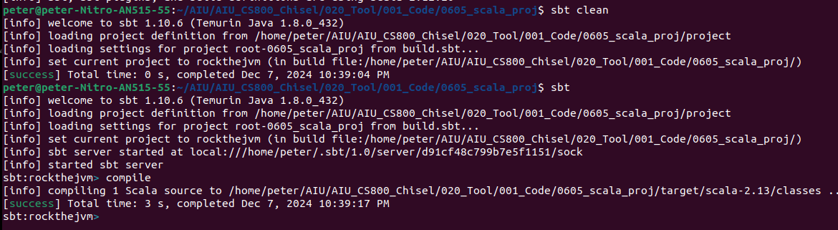
0.6.5 Compile/Run Scala with SBT
https://medium.com/beeranddiapers/installing-scala-on-ubuntu-7a4b14d26bdc
Compile/Run Scala with SBT (6:46-7:05/57:27)
1. compile
> sbt clean
> sbt
> Sbt:rockthejvmj > compile

Slide 23
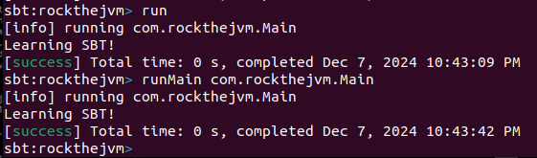
0.6.5 Compile/Run Scala with SBT
https://medium.com/beeranddiapers/installing-scala-on-ubuntu-7a4b14d26bdc
Compile/Run Scala with SBT (7:06-7:20/57:27)
run
1.
> Sbt:rockthejvmj > run
2.
> Sbt:rockthejvmj > runMain com.rockthejvm.Main

Slide 24
0.6.5 Compile/Run Scala with SBT
https://medium.com/beeranddiapers/installing-scala-on-ubuntu-7a4b14d26bdc
Compile/Run Scala with SBT (7:21-9:17/57:27)
We can use Automatically recompile (~compile) whenever we have changed in com/rockthejvm/Main.scala.
1.
> ~compile

Slide 25
0.6.6 Library Dependency

Slide 26
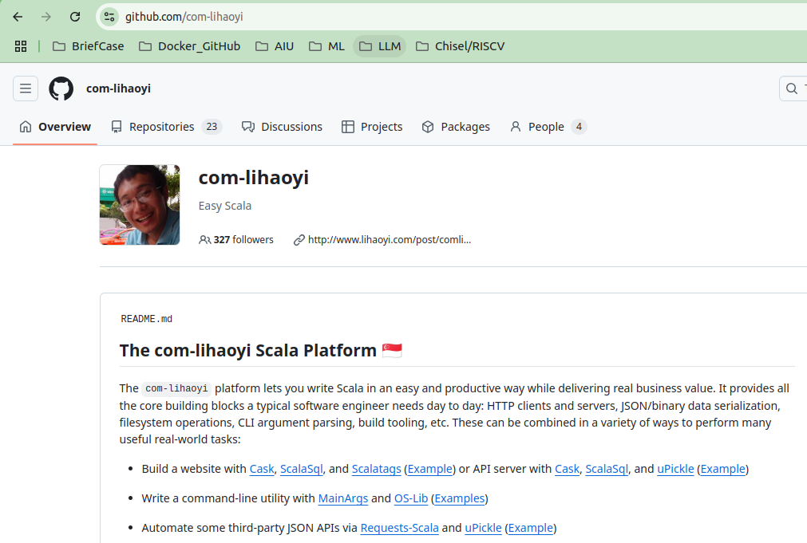
0.6.6 Library Dependency
https://medium.com/beeranddiapers/installing-scala-on-ubuntu-7a4b14d26bdc
Library Dependency (9:18-10:17/57:27)
Add Library Dependency.
> code build.sbt
Here, We define a library dependency.
https://github.com/com-lihaoyi. The library name is "fansi"
The version is 0.4.0. defined in the Maven central library and Maven also save in the target directory in binaries. The Maven library will make sure for sbt to start the Project.

Slide 27
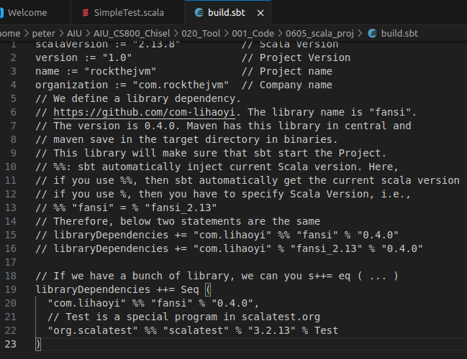
0.6.6 Library Dependency
https://medium.com/beeranddiapers/installing-scala-on-ubuntu-7a4b14d26bdc
Library Dependency (10:18-11:17/57:27)
Below, we explain %% and %:
1. %%: We use “%%” for sbt automatically to inject the current version of scala library.
2. If you use %, then you have to specify Scala Version, therefore, %% "fansi" is same as % "fansi_2.13"
So, below two statements are the same
> libraryDependencies += "com.lihaoyi" %% "fansi" % "0.4.0"
> libraryDependencies += "com.lihaoyi" % "fansi_2.13" % "0.4.0".
1
2
3
3. If we have a bunch of library, we can you s++= eq ( ... )
3. > libraryDependencies ++= Seq (
> "com.lihaoyi" %% "fansi" % "0.4.0",
> // Test is a special Program for scalatest
> “org.scalatest” %% “scalatest” % “3.2.13” % Test)

Slide 28
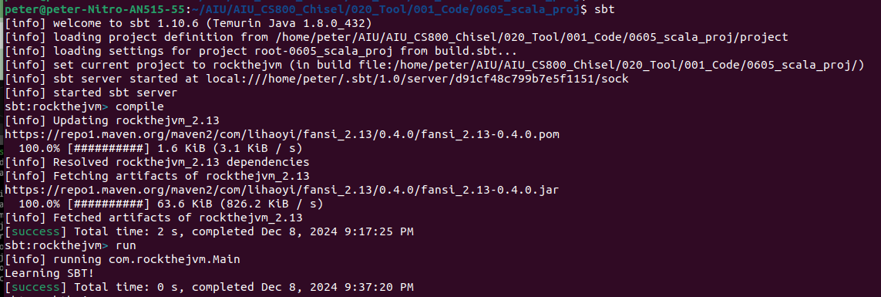
0.6.6 Library Dependency
https://medium.com/beeranddiapers/installing-scala-on-ubuntu-7a4b14d26bdc
Library Dependency (10:18-11:38/57:27)
Now, we start SBT and then compile the code again.
1. > sbt
2. sbt:reckthejvm > compile
3. sbt:reckthejvm > run
1
2
3

Slide 29
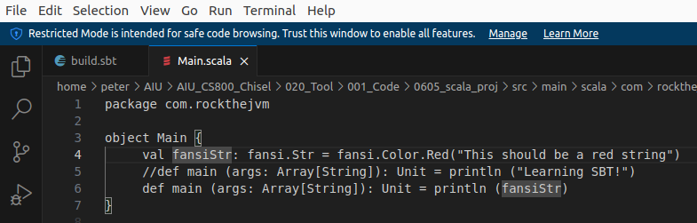
0.6.6 Library Dependency
https://medium.com/beeranddiapers/installing-scala-on-ubuntu-7a4b14d26bdc
Library Dependency (11:39-12:30/57:27)
Now, we want to use the fansi library
In the File: Project/src/main/scala/com/rockthejvm/Main.scala
We define the fansiStr
> object Main {
> val fansiStr: fansi.Str = fansi.Color.Red("This should be a red string")
> //def main (args: Array[String]): Unit = println ("Learning SBT!")
> def main (args: Array[String]): Unit = println (fansiStr)
> }

Slide 30
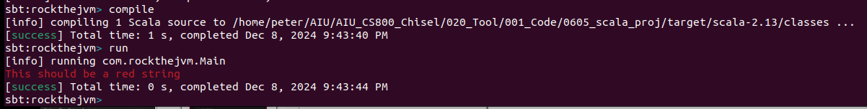
0.6.6 Library Dependency
https://medium.com/beeranddiapers/installing-scala-on-ubuntu-7a4b14d26bdc
Library Dependency (12:31-14:20/57:27)
Compile and Run fansiStr:
1. sbt:rockthejvm > compile
2. sbt:rockthejvm > run
1
2

Slide 31
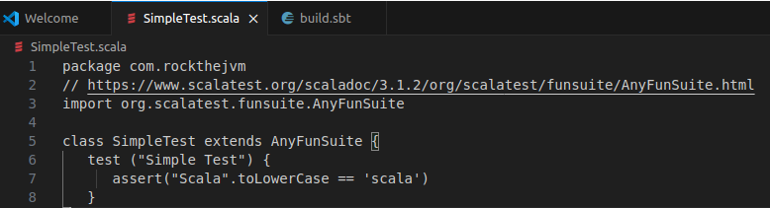
0.6.6 Library Dependency
https://medium.com/beeranddiapers/installing-scala-on-ubuntu-7a4b14d26bdc
Library Dependency (14:21-15:20/57:27)
> project
> mkdir -p
1. Add the simple test program SimpleTest.scala
> code
> open file src/test/scala/com/rockthejvm/SimpleTest.scala
2.
> import the package org.scalatest.funsuite.AnyFunSuite
3. Add the
> assert (“Scala”.toLowerCase == ‘scala’)
2
3

Slide 32
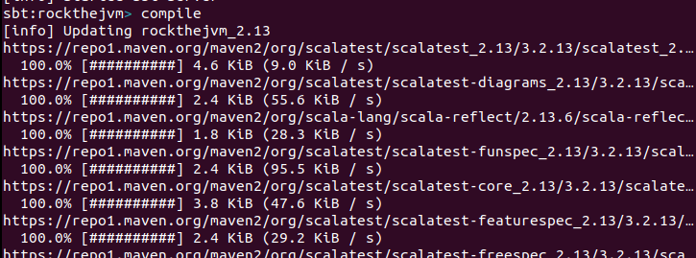
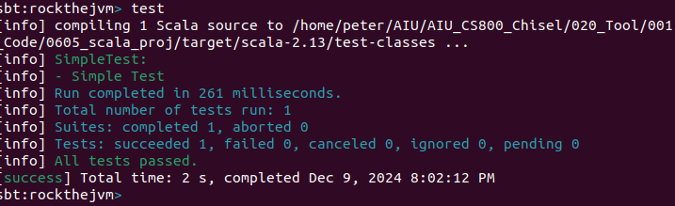
0.6.6 Library Dependency
https://medium.com/beeranddiapers/installing-scala-on-ubuntu-7a4b14d26bdc
Library Dependency (14:21-17:10/57:27)
1. Compile all the src and test again
> compile
2. Test the SimpleTest.scala
> test
3. We can see “All tests passed”.
1
2
3

Slide 33
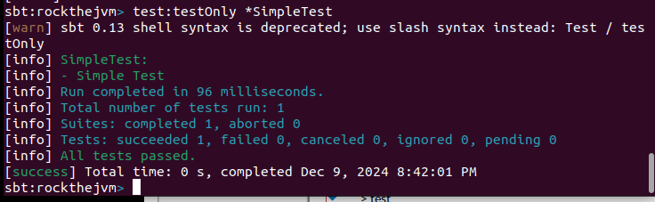
0.6.6 Library Dependency
https://medium.com/beeranddiapers/installing-scala-on-ubuntu-7a4b14d26bdc
Library Dependency (17:11-17:40/57:27)
1. Select some of tests with *SimpleTest
> test:testOnly *SimpleTest
2. Test all tests under the test directory
> test
This will run all the tests in the test folder.
3. You also can use
> sbt test
Under the command line.
1

Slide 34
0.6.7 SBT Batch Mode

Slide 35
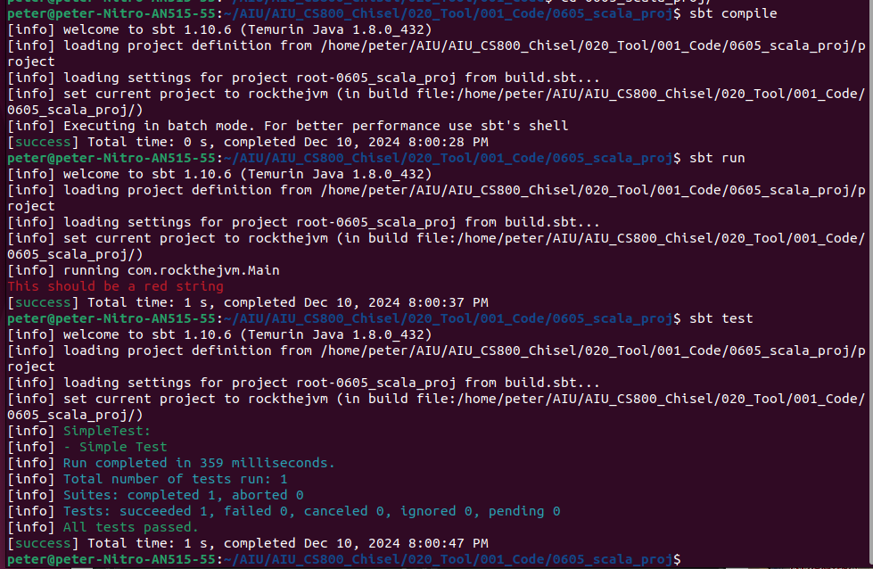
0.6.7 SBT Batch Mode
https://medium.com/beeranddiapers/installing-scala-on-ubuntu-7a4b14d26bdc
SBT Batch Mode (17:41-18:34/57:27)
Batch mode is very useful for tool integration and automation.
We can run batch mode without go inside the SBT Shell.
1. Batch Compile:
Proj> sbt compile
2. Batch Run
Proj> sbt run
3. Batch Test
proj > sbt test
1
2
3

Slide 36
0.6.8 Multi Module Project

Slide 37
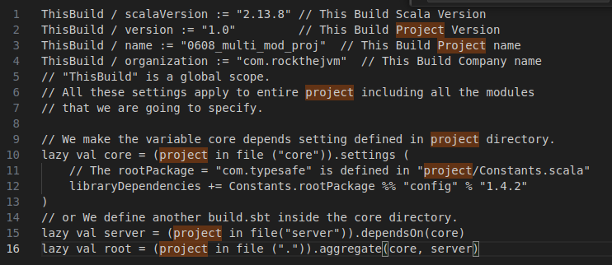
0.6.8 Multi Module Project
https://medium.com/beeranddiapers/installing-scala-on-ubuntu-7a4b14d26bdc
Multi Module Project (18:35-21:00/57:27)
1. We create another folder multi_module_Proj:
2. Create global variable “ThisBuild”
> ThisBuild / scalaVersion := "2.13.8" // This Build Scala Version
> ThisBuild / version := "1.0" // This Build Project Version
> ThisBuild / name := "0608_multi_mod_proj" // This Build Project name
> ThisBuild / organization := "com.rockthejvm" // This Build Company name
// "ThisBuild" is a global scope.
// All these settings apply to entire project including all the modules
// that we are going to specify.
3. Create folders
// Lazy evaluation improve the performance.
// project in file: regular scala. in is a method.
// project is global available data structure.
// "core" is a subdirectory in project. sbt will create "core" directory for us.
> lazy val core = (project in file ("core"))
> lazy val server = (project in file("server"))
> lazy val root = (project in file (".")).aggregate(core, server)
2
3

Slide 38
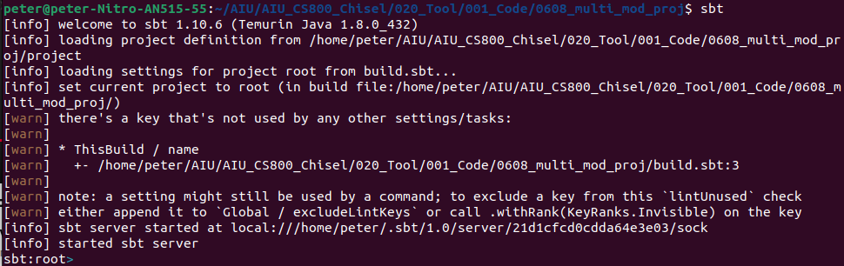
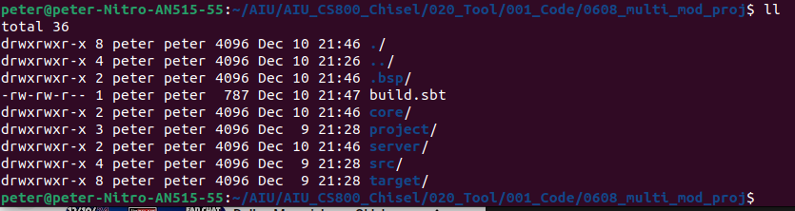
0.6.8 Multi Module Project
https://medium.com/beeranddiapers/installing-scala-on-ubuntu-7a4b14d26bdc
Multi Module Project (21:01-22:22/57:27)
1. run build.sbt
> sbt
2. We can see the directory “core” and directory “server” are created under current directory.
> ll
Inside the core and server directories, we can add more information.
1
2
2

Slide 39
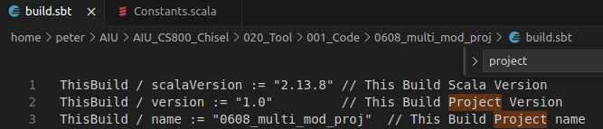
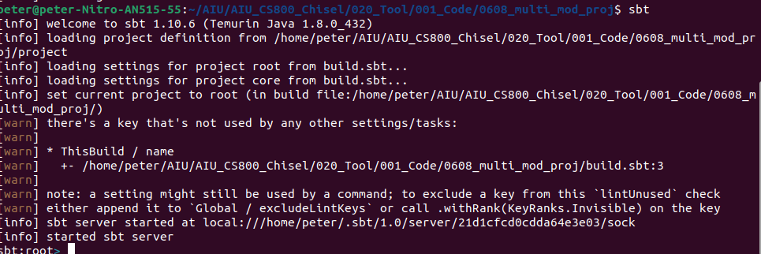
0.6.8 Multi Module Project
https://medium.com/beeranddiapers/installing-scala-on-ubuntu-7a4b14d26bdc
Multi Module Project (22:23-24:20/57:27)
1. We define the library dependency under core/build.sbt.
2. Run SBT under the root project.
> cd .. // go back the root
> 0608_proj > sbt
We can see both root and core are defined.
1
2

Slide 40
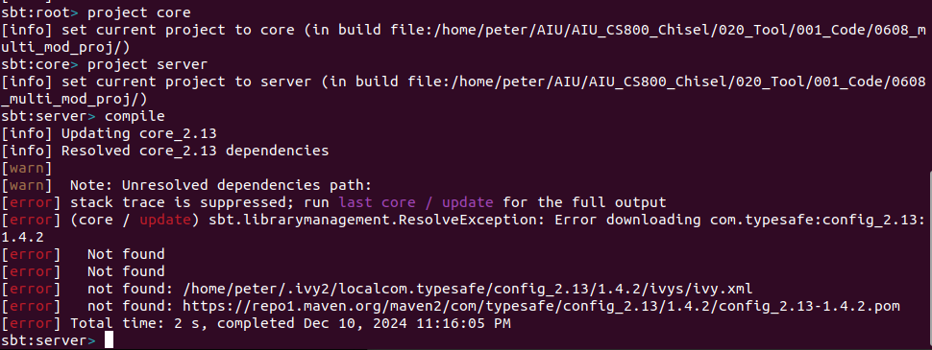
0.6.8 Multi Module Project
https://medium.com/beeranddiapers/installing-scala-on-ubuntu-7a4b14d26bdc
Multi Module Project (24:20-25:00/57:27)
We can
1. > project core
Go to the core directory
2. > project server
Go to the server directory
We can compile in each of the directory.
3. Server > ~compile
1
2
3

Slide 41
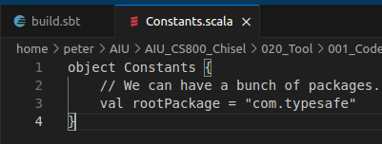
0.6.8 Multi Module Project
https://medium.com/beeranddiapers/installing-scala-on-ubuntu-7a4b14d26bdc
Multi Module Project (25:01-26:10/57:27)
We remove the build.sbt (or rename build.sbt to build.sbt.back) under the core because we prefer to build.sbt under the root project.
In the 0608_multi_project/project directory, we add file “Constants.scala”.
1. We define
> object Constants {
> val rootPackage = “com.typesafe”
> }

Slide 42
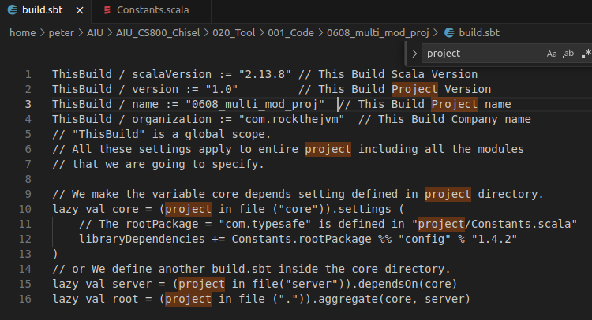
0.6.8 Multi Module Project
https://medium.com/beeranddiapers/installing-scala-on-ubuntu-7a4b14d26bdc
Multi Module Project (26:11-26:39/57:27)
In the 0608_multi_project/build.sbt, we define the libraryDependencies
> lazy val core = (project in file (“core”).settings (
> libraryDependencies += Constants.rootPackage %% “config” % “1..4.1”
> lazy val server = (project in file("server")).dependsOn(core)
> lazy val root = (project in file (".")).aggregate(core, server)
>)

Slide 43
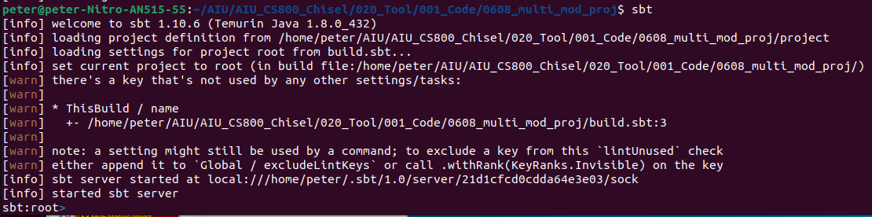
0.6.8 Multi Module Project
https://medium.com/beeranddiapers/installing-scala-on-ubuntu-7a4b14d26bdc
Multi Module Project (26:40-27:10/57:27)
The Constants defined in the project directory will be available in SBT.
If we run
> sbt
The project directory define constants and remove the complexity of SBT.

Slide 44
End

