Slide 1

4.3 Add/Delete Statement in AST
Peter H. Chen

Slide 2
4.3 Add/Delete Statement in AST
https://github.com/freechipsproject/chisel-bootcamp
Add/Delete Statement in AST
We discuss Add/Delete Statement in Chisel and AST Traverse
Topics:
1. Setup: Jupyter notebook and select scala interpreter.
2. Add Statement: Add Statement in Chisel, traverse the AST (Abstract Syntax Tree), use DoPrim and Def Node() API to add statement to FIRRTL.
3. Delete Statement: Delete Statement in chisel, traverse the AST (Abstract Syntax Tree), use DoPrim and Def Node() API to remove statement from FIRRTL.
4. Add a Primop: Chisel to be implement/Discussed.
5. Swap a Statement: Chisel to be implemented/Discussed.

Slide 3
4.3.1 Setup

Slide 4
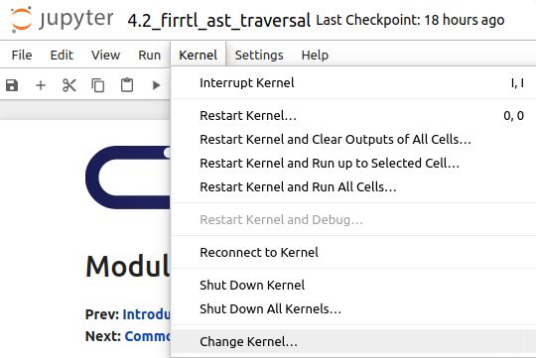
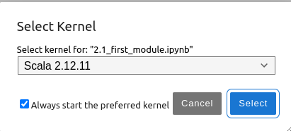
4.3.1 Setup
https://github.com/freechipsproject/chisel-bootcamp
Setup
1. Change folder to chisel-bootcamp. If you want to work on your working space, copy image folder and source folder to your working directory.
> cd chisel-bootcamp
2. Start Jupyter notebook
> jupyter notebook 4.3_firrtl_ast_traversal.ipynb
3. Select the scala interpreter: > Kernel > Change Kernel… >Scala 2.12.11
3

Slide 5
4.3.2 Add Statement

Slide 6
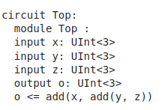
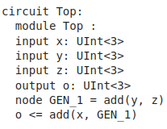
4.3.2 Add Statement
https://github.com/freechipsproject/chisel-bootcamp
Add Statement
1. Suppose we want to write a pass that splits nested DoPrim expressions, thus transforming this:

Slide 7
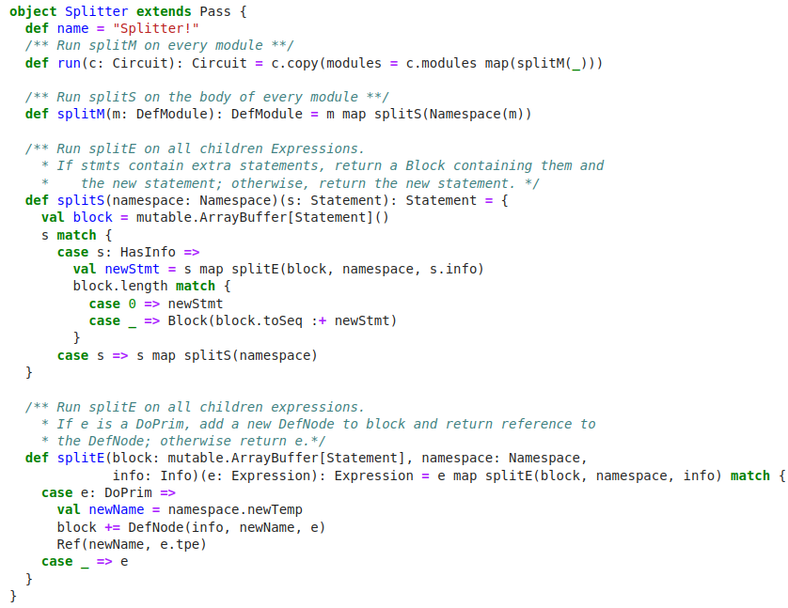
4.3.2 Add Statement
https://github.com/freechipsproject/chisel-bootcamp
Add Statement
1. We first need to traverse the AST to every Statement and Expression.
2. Then, when we see a DoPrim, we need to add a new DefNode to the module's body and insert a reference to that DefNode in place of the DoPrim.
3. Here, the code implements this (and preserves the Info token).
Note: Namespace is a utility function located in Namespace.scala.

Slide 8
4.3.3 Delete Statement

Slide 9
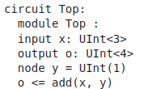
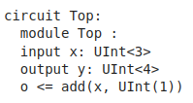
4.3.3 Delete Statement
https://github.com/freechipsproject/chisel-bootcamp
Delete Statement
1. Suppose we want to write a pass that inlined all DefNodes whose value is a literal, thus transforming this:

Slide 10
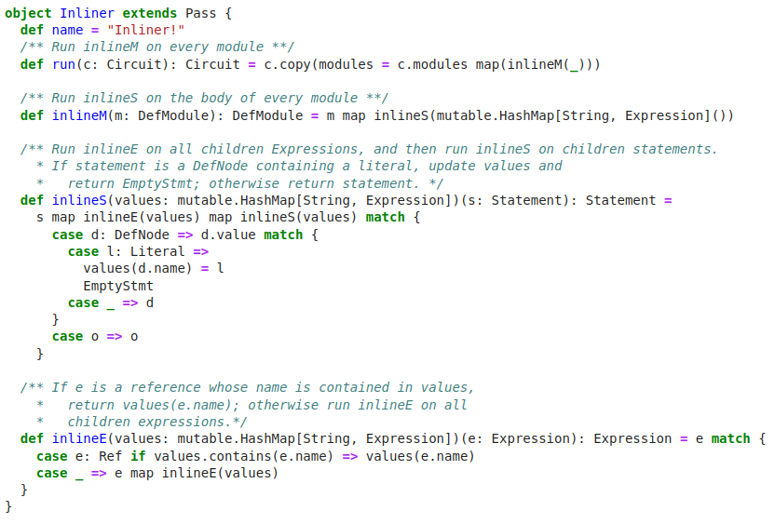
4.3.3 Delete Statement
https://github.com/freechipsproject/chisel-bootcamp
Delete Statement
1. We first need to traverse the AST to every Statement and Expression.
2. Then, when we see a DefNode pointing to a Literal, we need to store it into a hashmap and return an EmptyStmt (thus deleting that DefNode).
3. Then, whenever we see a reference to the deleted DefNode, we must insert the corresponding Literal.

Slide 11
4.3.4 Add Primop

Slide 12
4.3.4 Add Primop
https://github.com/freechipsproject/chisel-bootcamp
Add Primpop
To be discussed in future.

Slide 13
4.3.5 Swap Statement

Slide 14
4.3.5 Swap Statement
https://github.com/freechipsproject/chisel-bootcamp
Swap Statement
To be discussed in future.

Slide 15
End

