Slide 1

3.1 Parameter
Peter H. Chen

Slide 2
3.1 Parameter
https://github.com/freechipsproject/chisel-bootcamp
Parameter
We discuss Parameter in Chisel.
Topics:

Slide 3
2.6.1 Setup

Slide 4
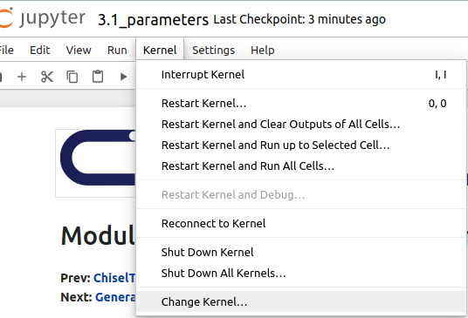
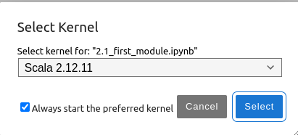
2.6.1 Setup
https://github.com/freechipsproject/chisel-bootcamp
Setup
1. Change folder to chisel-bootcamp. If you want to work on your working space, copy image folder and source folder to your working directory.
> cd chisel-bootcamp
2. Start Jupyter notebook
> jupyter notebook 3.1_parameter.ipynb
3. Select the scala interpreter: > Kernel > Change Kernel… >Scala 2.12.11
3

Slide 5
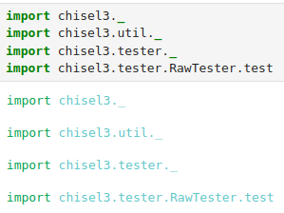
2.6.1 Setup
https://github.com/freechipsproject/chisel-bootcamp
Setup
1. Scala uses maven to setup path to with for source folder for Scala Libraries and get Scala Property.
2. import chisel3 library, utility, tester harness (horse controller), and test interface function.
3. The import chisel3.tester.RawTester.test brings in version of test (…).

Slide 6
2.6.2 Parameter Passing

Slide 7
2.6.2 Parameter Passing
https://github.com/freechipsproject/chisel-bootcamp
Parameter Passing
1. Chisel provides powerful constructs for writing hardware generators.
2. Generators are programs that take some circuit parameters and produce a circuit description.
3. In this section, we'll start with discussing how Chisel generators get their parameters.

Slide 8
2.6.4 Parameter Passed in Scala Class

Slide 9
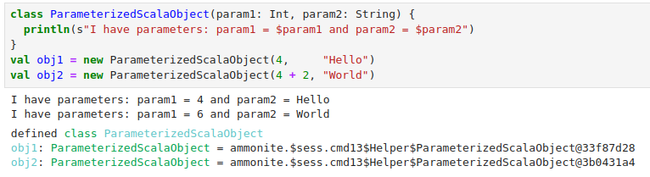
2.6.3 Parameter Passed in Scala Class
https://github.com/freechipsproject/chisel-bootcamp
Example: Parameter Passed in Scala Class
1. Below, we look at how to pass parameters for Scala Object.
2. We will see how the parameter pass in Chisel Modules which is similar to Scala class.
3. Below example, we create two objects: obj1 and obj2.
4. We pass in different parameters “Hello” and “World”
5. We see different print out..

Slide 10
2.6.4 Parameter Passed in Chisel Class

Slide 11
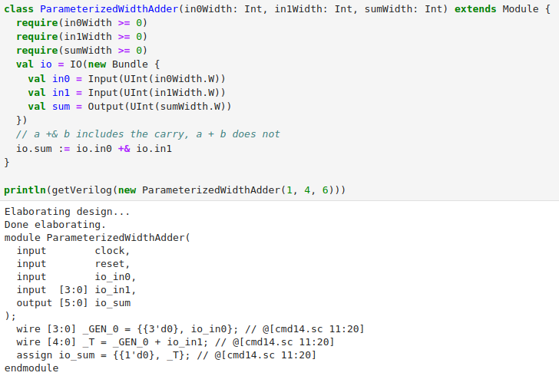
2.6.4 Parameter Pass in Chisel Class
https://github.com/freechipsproject/chisel-bootcamp
Example: Parameter Pass in Chisel Class with require () and assert ()
1. Parameter Passing in Chisel class is similar to Parameter passing in Scala Class.
2. The parameter in Chisel contains widths of inputs and outputs.
3. Below example, we pass input 0 width 1, input 1 width 4, and sum width 6.
4. We add input 0 and input 1 and output into sum.
5. We Generate the Hardware Verilog code based on different passed in parameters.
6. Below, we have require(...) statements.
7. The require (...) are used pre-elaboration/pre-compiled assertions.
8. The require (...) are useful when your generator only works with certain parameterization or when some parameterization are mutually exclusive or validation.
9. Here, the require (...) checks that widths are non-negative.
10. Note: There is also a separate construct assert (…). The assert (…) are used for simulation-time assertion.

Slide 12
2.6.5 Parameter Sorting

Slide 13
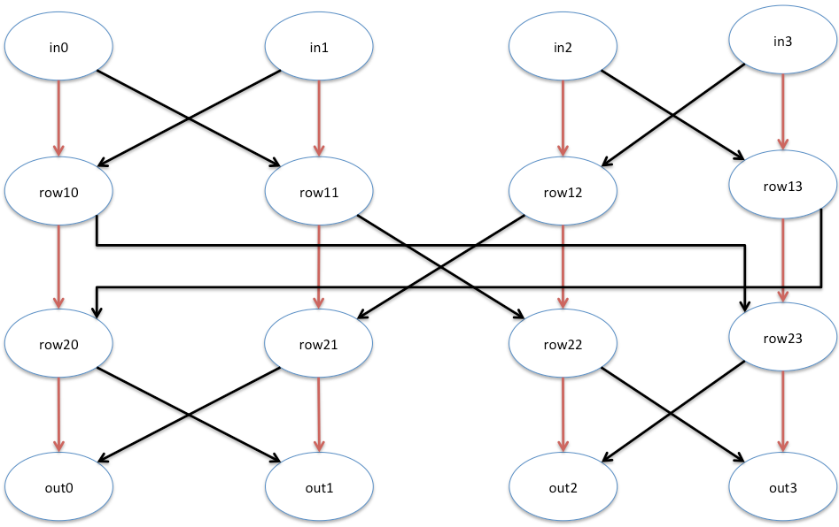
2.6.5 Parameter Sorting
https://github.com/freechipsproject/chisel-bootcamp
Parameter Sorting
We saw the below diagram in section 2.3 for sort with 4-input.
In the below example, we fix the width of IO and control the passing parameter of descending or ascending.

Slide 14
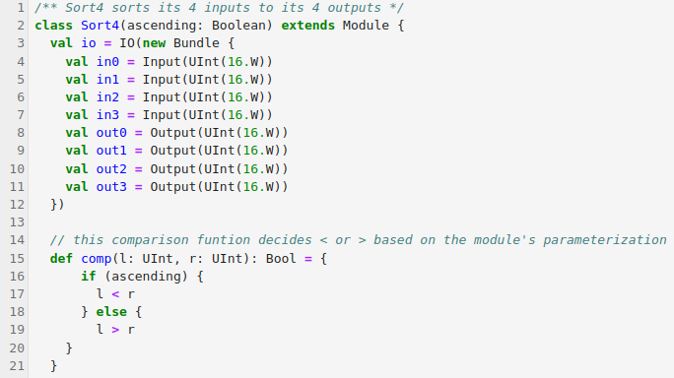
2.6.5 Parameter Sorting
https://github.com/freechipsproject/chisel-bootcamp
Parameter Sorting
Class Sort4 Code:
1. Define inputs: in0, in1, in2, in3.
2. Define outputs: out0, out1, out2, out3.
3. define comp (comparison) function:
if ascending, then l < r,
If descending, then l > r.

Slide 15

2.6.5 Parameter Sorting
https://github.com/freechipsproject/chisel-bootcamp
Parameter Sorting
Class Sort4 Code:

Slide 16
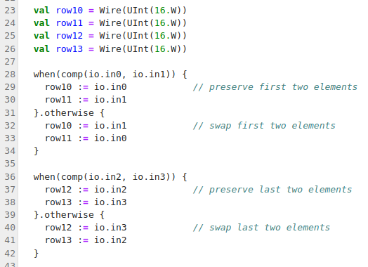
2.6.5 Parameter Sorting
2
3
https://github.com/freechipsproject/chisel-bootcamp
1
Parameter Sorting
Class Sort4 Code:
1. Define wires: row10, row11, row12, and row 13.
2. If in0 < in1, then {
row10 = in0
row11 = in1
} else if in0 > in1 {
row10 = in1
row11 = in0
}
3. If in2 < in3, then {
…
} else if in2 > in3 {
…
}
1
2
3

Slide 17
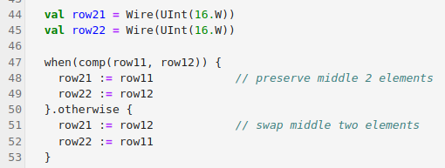
2.6.5 Parameter Sorting
https://github.com/freechipsproject/chisel-bootcamp
2
Parameter Sorting
Class Sort4 Code:
1. Define wires: row21, row22.
2. If row11 < row12, then {
row21 = row11
row22 = row12
} else if row11 > row12 {
row21 = row12
row22 = row11
}
1
1
2

Slide 18
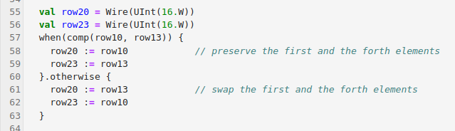
2.6.5 Parameter Sorting
https://github.com/freechipsproject/chisel-bootcamp
Parameter Sorting
Class Sort4 Code:
1. Define wires: row20, row23.
2. if (row 10 < row 13), then {
row20 = row10
row23 = row13
} else if (row10 > row13) then {
row20 = row13
row23 = row10
}

Slide 19
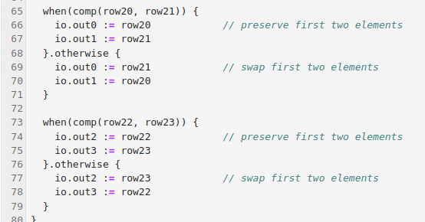
2.6.5 Parameter Sorting
https://github.com/freechipsproject/chisel-bootcamp
Parameter Sorting
Class Sort4 Code:
1. if (row 20 < row21), then {
out0 = row20
row1 = row2
} else if (row20 > row21) then {
row0 = row20
row1 = row21
}
2. if (row 22 < row23), then {
out2 = row22
row3 = row23
} else if (row22 > row23) then {
row2 = row22
row3 = row23
}
1
2
1
2

Slide 20
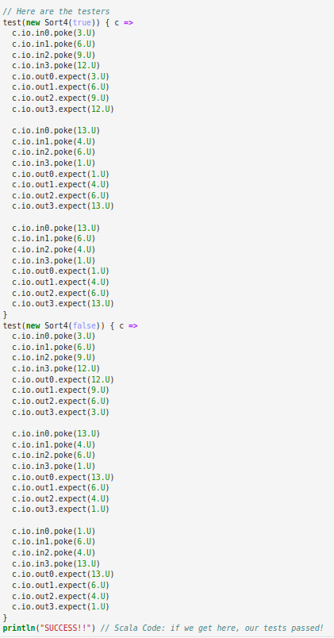
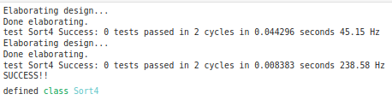
2.6.5 Parameter Sorting
https://github.com/freechipsproject/chisel-bootcamp
Parameter Sorting
Sort4 tester code:

Slide 21
2.6.6 Map and Get

Slide 22
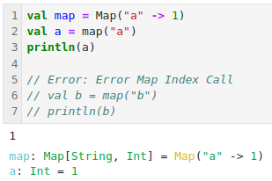
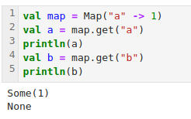
2.6.6 Map and Get
https://github.com/freechipsproject/chisel-bootcamp
Map and Get
Sometimes we have function returns a value and sometimes does not.
When we use map and return none, we get error. In this case, we need to use get () instead of map ().
Below are the code example.
Change map() into get() to fix error.

Slide 23
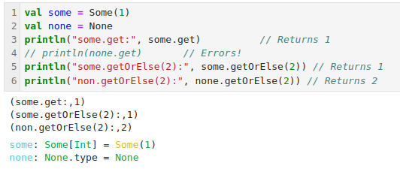
2.6.6 Map and Get
https://github.com/freechipsproject/chisel-bootcamp
get () and getOrElse ()
Chisel provides functions for Some() and None ().
Use get() and getOrElse() to prevent the errors.

Slide 24
2.6.7 Default Parameter

Slide 25
2.6.7 Default Parameter
https://github.com/freechipsproject/chisel-bootcamp
Default Parameter
1. When objects or functions have a lot of parameters, it can be tedious and error-prone to fully specify them all the time.
2. In section 1, you were introduced to named arguments and parameter defaults.
3. Sometimes, a parameter doesn't have a good default value. Option can be used with a default value of None in these situations.

Slide 26
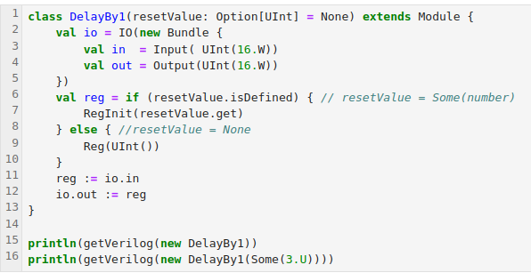
2.6.7 Default Parameter
https://github.com/freechipsproject/chisel-bootcamp
Default Parameter
1. Example: Optional Reset
2. The following shows a block that delays its input by one clock cycle.
3. If resetValue = None, which is the default, the register will have no reset value and be initialized to garbage.
4. This avoids the common but ugly case of using values outside the normal range to indicate "none", like using -1 as the reset value to indicate that this register is not reset.

Slide 27
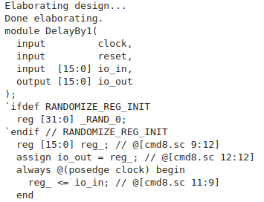
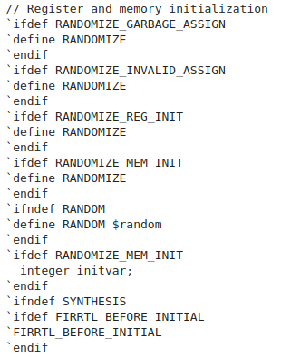
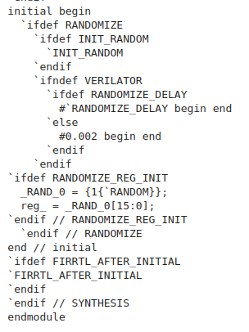
2.6.7 Default Parameter
https://github.com/freechipsproject/chisel-bootcamp
Default Parameter
println(getVerilog(new DelayBy1))

Slide 28
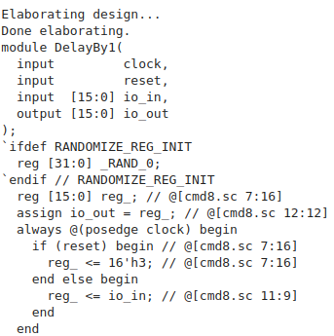
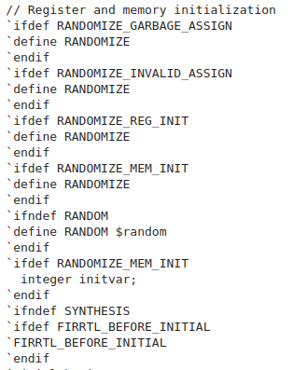
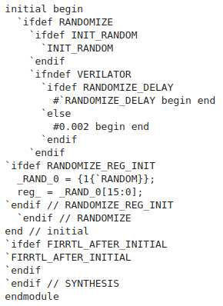
2.6.7 Default Parameter
https://github.com/freechipsproject/chisel-bootcamp
Default Parameter
println(getVerilog(new DelayBy1(Some(3.U))))

Slide 29
2.6.8 Match and Case

Slide 30
2.6.8 Match and Case
https://github.com/freechipsproject/chisel-bootcamp
Match and Case
The Scala matching concept is used throughout Chisel and needs to be part of any Chisel programmer's basic understanding.
Scala provides the match operator which supports:
1. Simple testing for alternatives, something like a C switch statement
2. More complex testing of ad-hoc combinations of values
3. Taking actions based on the type of a variable when its type is unknown or under-specified, for example when
  3.1 variable is taken from a heterogeneous list val mixedList = List(1, "string", false)
  3.2 or variable is known to be a member of a super-class but not which specific sub-class it is.
Extraction of sub strings of a string that are specified with a regular expression

Slide 31
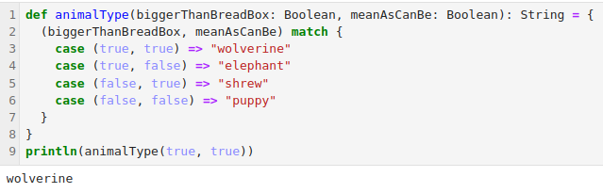
2.6.8 Match and Case
https://github.com/freechipsproject/chisel-bootcamp
Match and Case
Example: Multiple Value Matching
The match operator checks possible values and for each case returns a string. A couple of things to note:
Each code block that follows a => operator continues until it reaches either the ending brace of the match or the next case statement.
A match is searched in the order of the case statements, once a case statement has been matched, no other checks against other case statements are made.
The use of underscore as a wildcard, to handle any value not found.

Slide 32
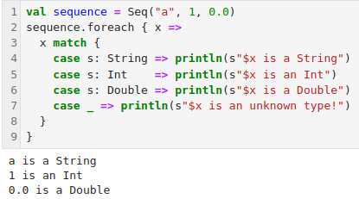
2.6.8 Match and Case
https://github.com/freechipsproject/chisel-bootcamp
Match and Case
Example: Type Matching

Slide 33
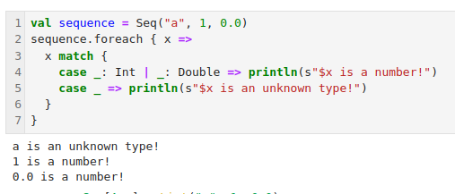
2.6.8 Match and Case
https://github.com/freechipsproject/chisel-bootcamp
Match and Case
Example: Multiple Type Matching

Slide 34
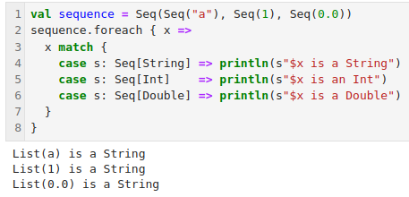
2.6.8 Match and Case
https://github.com/freechipsproject/chisel-bootcamp
Match and Case
Example: Type Matching and Erasure (擦除)
Below example matches the first case statement, because the [String], [Int], and [Double] polymorphic types are erased, and the case statements are actually matching on just a Seq.

Slide 35
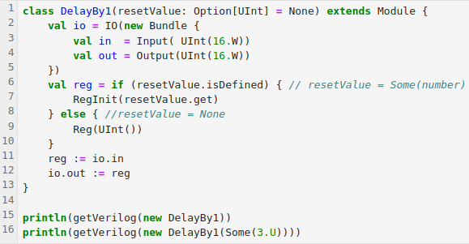
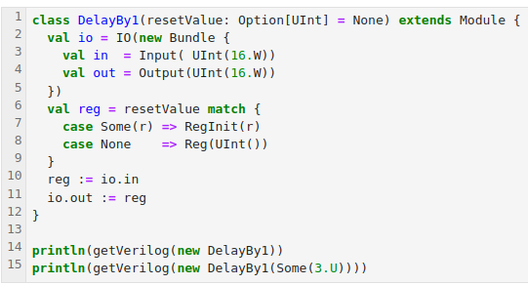
2.6.8 Match and Case
https://github.com/freechipsproject/chisel-bootcamp
Match and Case
Example: Reset Matching
1. Below, we use match instead of if/else
2. If resetValue = None, which is the default, the register will have no reset value and be initialized to garbage.
3. This avoids the common but ugly case of using values outside the normal range to indicate "none", like using -1 as the reset value to indicate that this register is not reset.

Slide 36
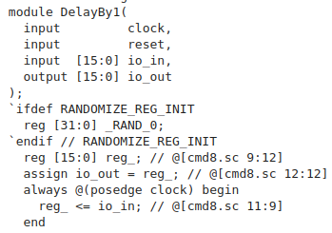
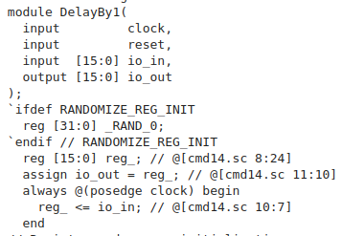
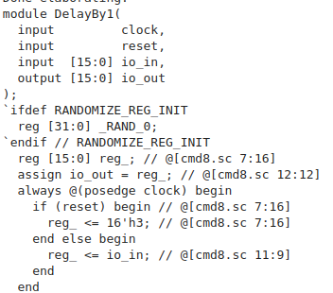
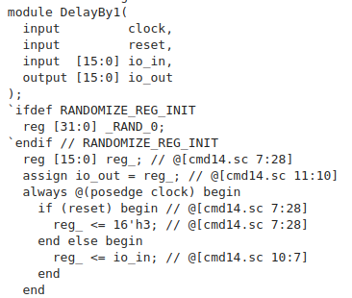
2.6.8 Match and Case
https://github.com/freechipsproject/chisel-bootcamp
Match and Case
Example: Reset Matching
1. Below, we use match instead of if/else
2. If resetValue = None, which is the default, the register will have no reset value and be initialized to garbage.
3. This avoids the common but ugly case of using values outside the normal range to indicate "none", like using -1 as the reset value to indicate that this register is not reset.

Slide 37
2.6.9 IO Field

Slide 38
2.6.9 IO Field
https://github.com/freechipsproject/chisel-bootcamp
IO Field
1. Sometimes we want IOs to be optionally included or excluded.
2. Maybe there's some internal state that's nice to be able to look at for debugging, but you want to hide it when the generator is being used in a system.
3. Maybe your generator has some inputs that don't need to be connected in every situation because there is a sensible default.

Slide 39
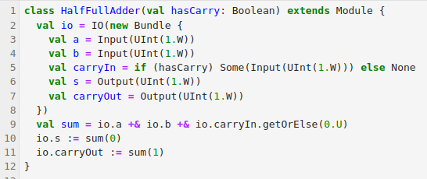
2.6.9 IO Field
https://github.com/freechipsproject/chisel-bootcamp
IO Field
1. Example: Optional IO with Option
2. Optional bundle fields are one way to get this functionality.
3. In the following example, we show a one-bit adder that optionally takes in a carry.
4. If the carry is included, io.carryIn will have type Some[UInt] and be included in the IO bundle.
5. If the carry is not included, io.carryIn will have type None and will be excluded from the IO bundle.

Slide 40
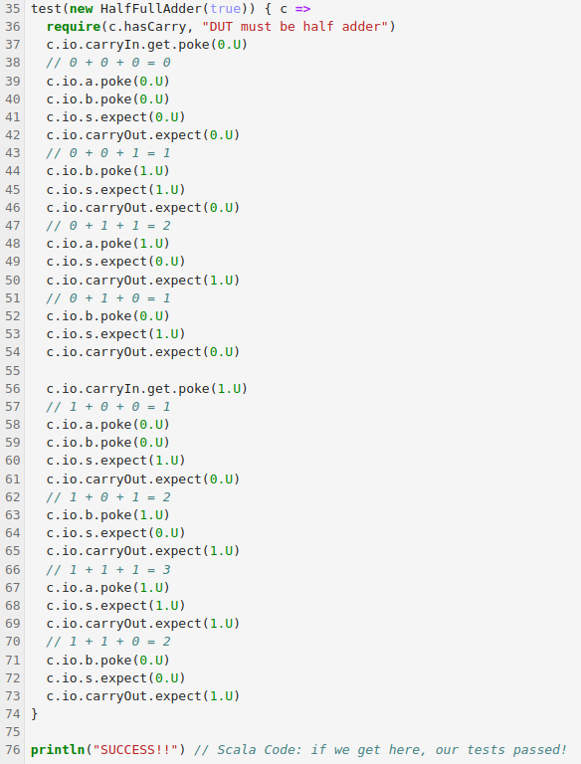
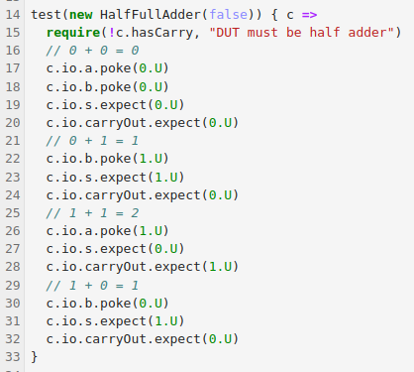
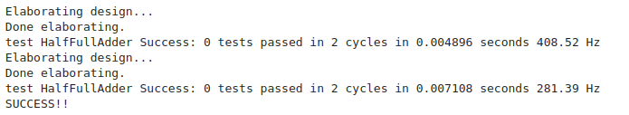
2.6.9 IO Field
https://github.com/freechipsproject/chisel-bootcamp
IO Field
Example: Optional IO with Option

Slide 41
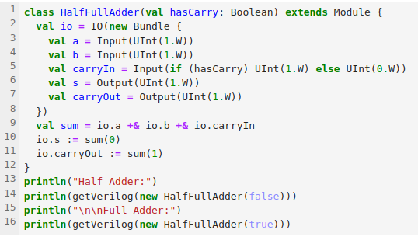
2.6.9 IO Field
https://github.com/freechipsproject/chisel-bootcamp
IO Field
1. Example: Optional IO with Zero-Width Wires
2. Another way to achieve similar functionality to Options is with zero-width wires.
3. Chisel types are allowed to have widths of zero.
4. An IO with width zero is pruned from the emitted Verilog, and anything that tries to use the value of a zero-width wire gets a constant zero.
5. If zero is a sensible default value, zero-width wires can be nice because they obviate the need for matching on an option or calling getOrElse.

Slide 42
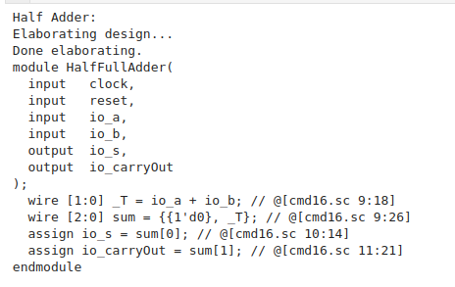
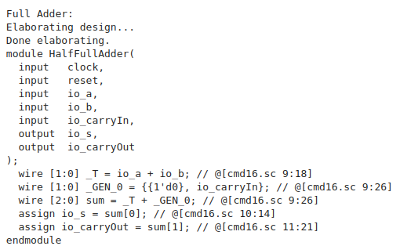
2.6.9 IO Field
https://github.com/freechipsproject/chisel-bootcamp
IO Field
Verilog Results:

Slide 43
2.6.10 Implicit

Slide 44
2.6.10 Implicit
https://github.com/freechipsproject/chisel-bootcamp
Implicit
1. There are often times when your program requires a lot of code.
2. To handle this use case, Scala introduced the notion of implicit, which allow the compiler to do some simplification for you.

Slide 45
2.6.10 Implicit
https://github.com/freechipsproject/chisel-bootcamp
Implicit Arguments
1. At times, your code will require accessing a top-level variable of some sort from deep within a series of function calls.
2. Instead of manually threading this variable through every function call, you can use implicit arguments to do it for you.

Slide 46
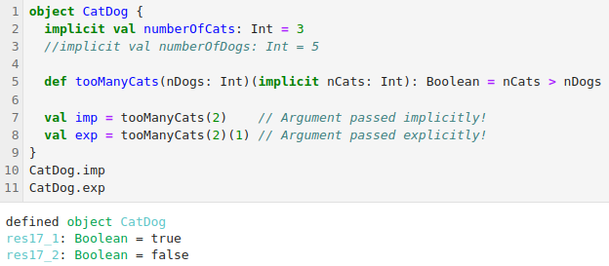
2.6.10 Implicit
https://github.com/freechipsproject/chisel-bootcamp
Example: Implicit Cats
1. Below, we define an implicit value numberOfCats.
2. In a given scope, there can only be one implicit value of a given type.
3. Then, we define a function that takes two argument lists; the first is any explicit parameters, and the second are any implicit parameters.
4. When we call tooManyCats, we either omit the second implicit argument list (letting the compiler find it for us), or explicitly provide an argument (which can be different than the implicit value).
5. The following are ways implicit arguments can fail:
6. Two or more implicit values of a given type are defined in a scope
7. If the compiler cannot find an implicit value necessary for a function call

Slide 47
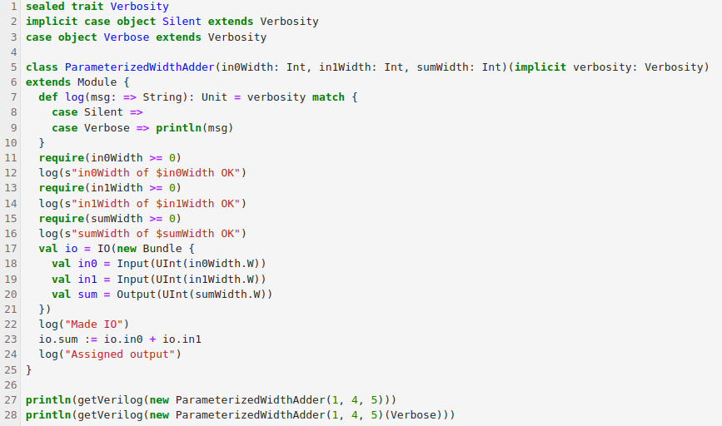
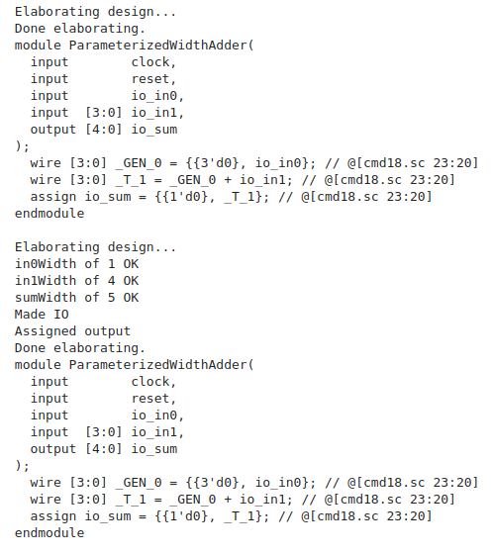
2.6.10 Implicit
https://github.com/freechipsproject/chisel-bootcamp
Example: Implicit Logging
Below, we use implicit arguments “concise” instead of “verbose” for Chisel generator.

Slide 48
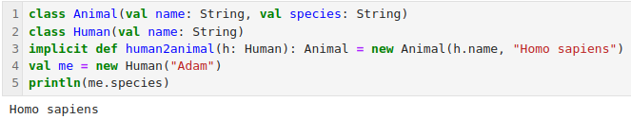
2.6.10 Implicit
https://github.com/freechipsproject/chisel-bootcamp
Example: Implicit Conversions
1. Implicit functions (also known as implicit conversions) are used to reduce codes.
2. They are used to automatically convert one Scala object into another.
3. Example: Implicit Conversion
4. Below, we have two classes, Animal and Human.
5. Animal has a species field, but Human does not.
6. However, by implementing an implicit conversion, we can call species on a Human.
7. Generally, implicit can make your code confusing and do not recommend to use implicit.

Slide 49
2.6.11 Exercise: Generator Parameterization

Slide 50
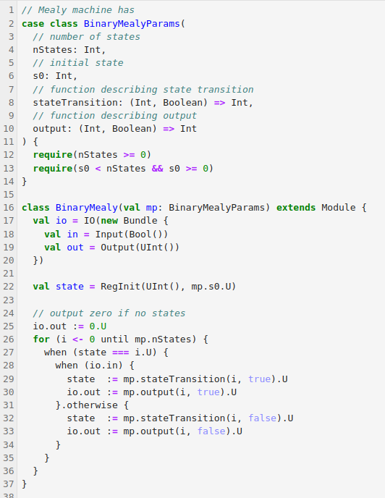
2.6.11 Exercise: Generator Parameterization
https://github.com/freechipsproject/chisel-bootcamp
Exercise: Generator Parameterization
Below, a generator for a 1-bit input Mealy machine.
Example: Mealy Machine
1. We can make our own parametrization of the Mealy machine generator and
2. Write our own tests in the code block.

Slide 51
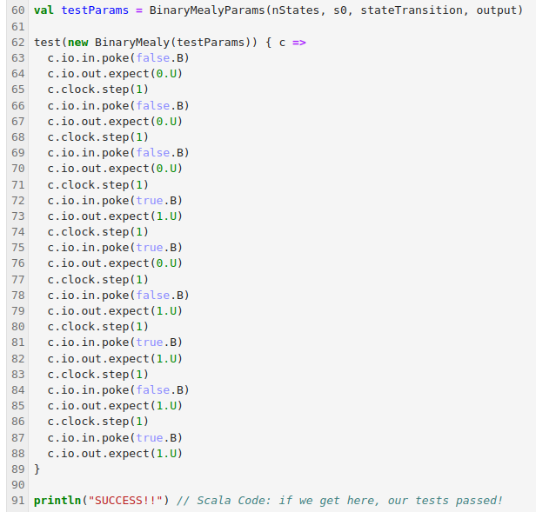
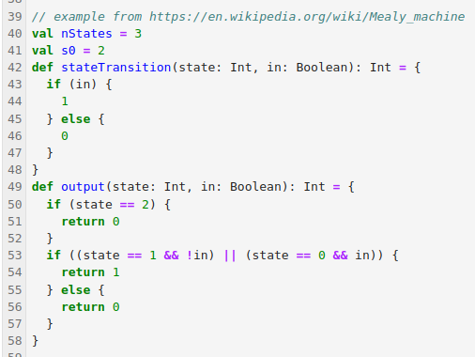
2.6.11 Exercise: Generator Parameterization
https://github.com/freechipsproject/chisel-bootcamp
Exercise: Generator Parameterization

Slide 52
End

