Slide 1

12 Functional Programming: Pattern Match
Peter H. Chen

Slide 2
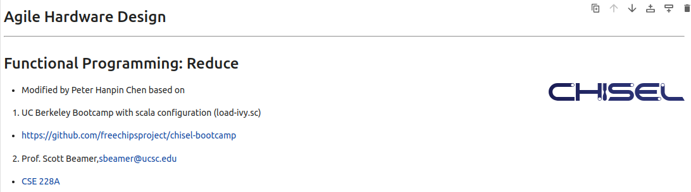
12 Functional Programming: Pattern Match
https://www.youtube.com/watch?v=zlYkaS63UY8&list=PLfrN7RIcMe6g2LBRJLTHTdhyj5s8ag0Rg&index=12
Functional Programming: Pattern Match (0:00-0:01/1:01:02)
We used UCB bootcamp configuration file (load_ivy.sc)
source/load-ivy.sc (https://github.com/freechipsproject/chisel-bootcamp)

Slide 3
12 Functional Programming: Pattern Match
https://www.youtube.com/watch?v=zlYkaS63UY8&list=PLfrN7RIcMe6g2LBRJLTHTdhyj5s8ag0Rg&index=12
Functional Programming: Pattern Match (0:02-0:03/1:01:02)
We discus the Functional Programming in map, foreach, and zip. New, we talk about the reduce and fold.
Topics:
1. Setup: jupyter notebook, select scala, and run cells.
2. reduce and fold: fold has foldLeft and foldRight. fold is lower level than reduce.
3. Class Reducer: We change the for loop into map, zip with Index, foldLeft, foldRigh, reduce and get the same Verilog and simulation result.
4. Class One-Hot Priority Encoder: Use map, zip, reduce to replace the for loop.
5. Class XBar (Crossbar): It has unknown error in Verilog Generator, not ready yet.

Slide 4
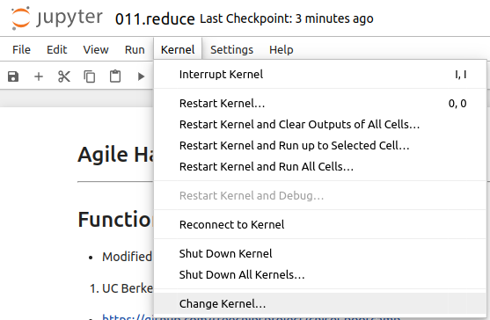
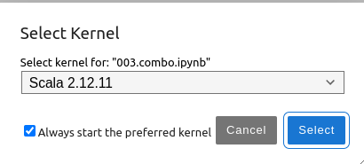
12 Functional Programming: Pattern Match
https://www.youtube.com/watch?v=zlYkaS63UY8&list=PLfrN7RIcMe6g2LBRJLTHTdhyj5s8ag0Rg&index=12
Functional Programming: Pattern Match (0:03-0:18/1:01:02)
We discuss Chisel Collection.
> jupyter notebook 006.combo.ipynb > Kernel > Change Kernel … > Select Scala2.21.22
> Run All Cells

Slide 5
11.1 Plan

Slide 6
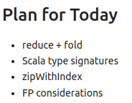
11.1 Plan
https://www.youtube.com/watch?v=zlYkaS63UY8&list=PLfrN7RIcMe6g2LBRJLTHTdhyj5s8ag0Rg&index=12
Plan (0:19-1:51/1:01:02)
In the last discussion, we use map, foreach, and zip to replace the for loop.
Today, we discuss reduce, fold, etc.

Slide 7
11.2 Import Chisel Library

Slide 8
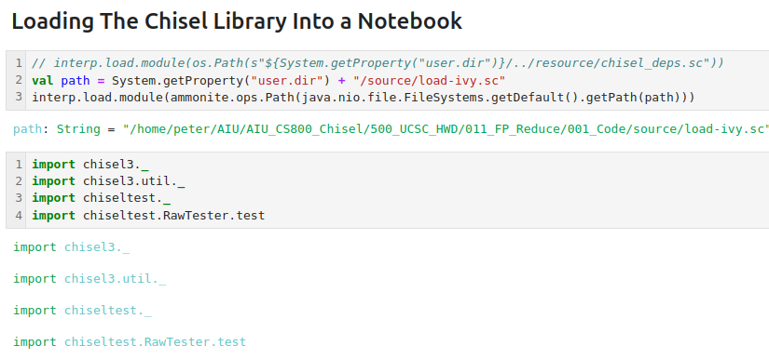
11.2 Import Chisel Library
https://www.youtube.com/watch?v=zlYkaS63UY8&list=PLfrN7RIcMe6g2LBRJLTHTdhyj5s8ag0Rg&index=12
Import Chisel Library (1:52-1:57/1:01:02)

Slide 9
End

