Slide 1

6 Create Project
Peter H. Chen

Slide 2
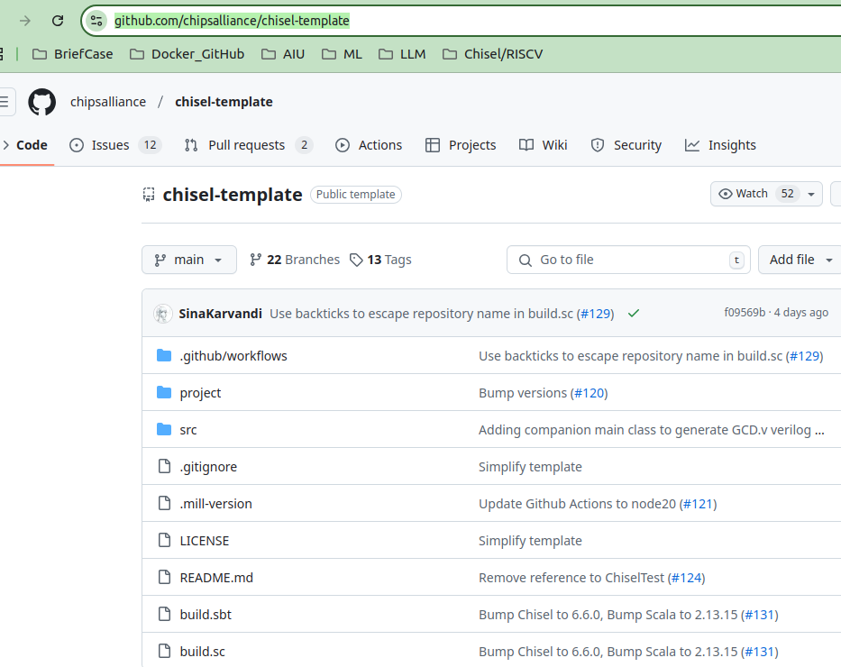
6 Create Project
https://github.com/ucb-bar/chisel-tutorial/wiki/Creating-Your-Own-Project
Create Project
We discuss how to create our own project from scratch.
In order to create your own projects from scratch, we need to the followings:
1. Create a directory,
2. Create Chisel source file,
3. Create an optional tester,
4. Create a build.sbt configuration file.
5. Clone the chisel-template repo: https://github.com/chipsalliance/chisel-template
This chisel template repo contains a minimal project template.
Follow the instructions on that repo's README.
5

Slide 3
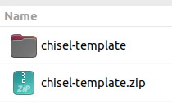
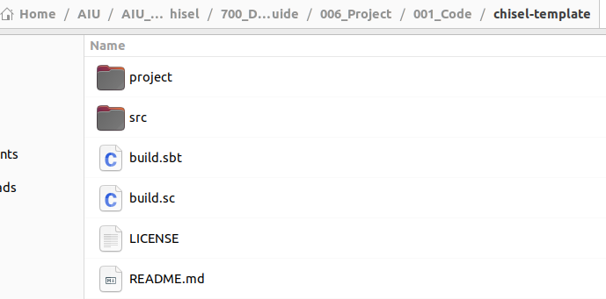
6 Create Project
https://github.com/chipsalliance/chisel-template
Chisel-template
Below, we download the chisel-template.zip.
Unzip the template file. We see the README.md

Slide 4
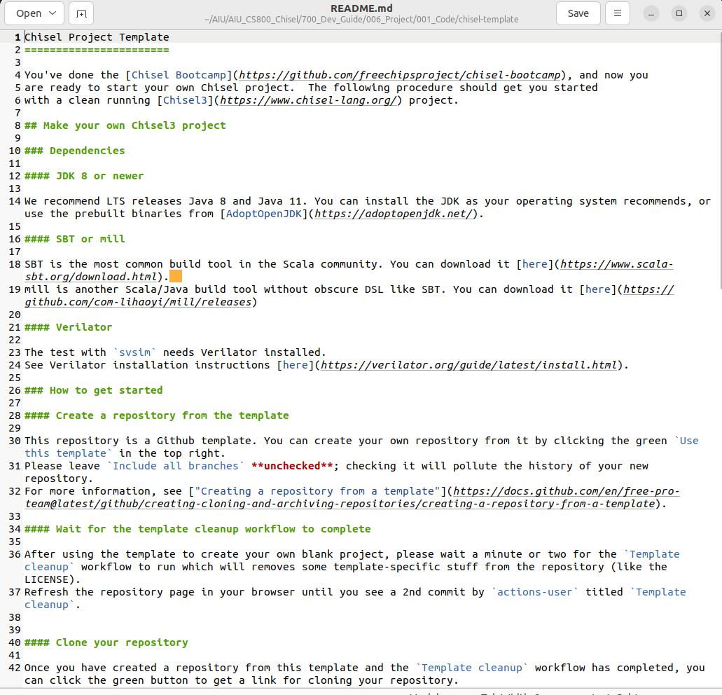
6 Create Project
https://github.com/chipsalliance/chisel-template
Chisel-template
Double click to open README.md

Slide 5
6 Create Project
https://github.com/chipsalliance/chisel-template
Create Project
1. We have done the Chisel Bootcamp:
https://github.com/freechipsproject/chisel-bootcamp
2. Now, we are ready to start our own Chisel project.
3. The following procedure should get you started with a clean running Chisel3 project.

Slide 6
6.1 Make Chisel3 Project

Slide 7
6.1 Make Chisel3 Project
https://github.com/chipsalliance/chisel-template
Make Chisel3 Project
Dependencies
JDK 8 or newer
  Get SDK from URL and then setup.
  1. > curl -s "https://get.sdkman.io" | bash # CURL (Copy URL): Clone sdkman from URL
  2. > source "$HOME/.sdkman/bin/sdkman-init.sh"
  3. > sdk version
  4. > sdk -version
  https://sdkman.io/
  Below, we use SDK to install JDK
  5. > sdk install java $(sdk list java | grep -o "\b8\.[0-9]*\.[0-9]*\-tem" | head -1)
  https://www.scala-sbt.org/release/docs/Installing-sbt-on-Linux.html

Slide 8
6.1 Make Chisel3 Project
https://github.com/chipsalliance/chisel-template
Make Chisel3 Project
Dependencies
SBT
  SBT is the most common build tool in the Scala community. You can download it here.
  https://www.scala-sbt.org/download/
  1. Install Scala.
  > sudo apt install scala
  2. Check scala version
  > scala -version
  >> Scala code runner version 2.11.12
  Install SBT:
  > sdk install sbt
  After we install SBT, we can check sbt version
  > sbt -version

Slide 9
6.1 Make Chisel3 Project
https://github.com/chipsalliance/chisel-template
Make Chisel3 Project
Dependencies
Verilator
  The test with svsim (SystemVerilog Simulator) needs Verilator installed. See Verilator installation instructions here.
  https://www.chisel-lang.org/api/latest/svsim/index.html
  https://verilator.org/guide/latest/install.html
  1. > apt-get install verilator # On Ubuntu

Slide 10
End

