Slide 1

1 Scala Introduction
Peter H. Chen

Slide 2
1 Scala Introduction
https://github.com/freechipsproject/chisel-bootcamp
Scala Introduction
We have installed all the tools for Scala using Jupyter Notebook. Now, we discuss Scala based on 1_intro_to_scala.ipynb.
Topics:
1. Run Jupyter Notebook for Scala.

Slide 3
1.1 Run Jupyter Notebook for Scala

Slide 4

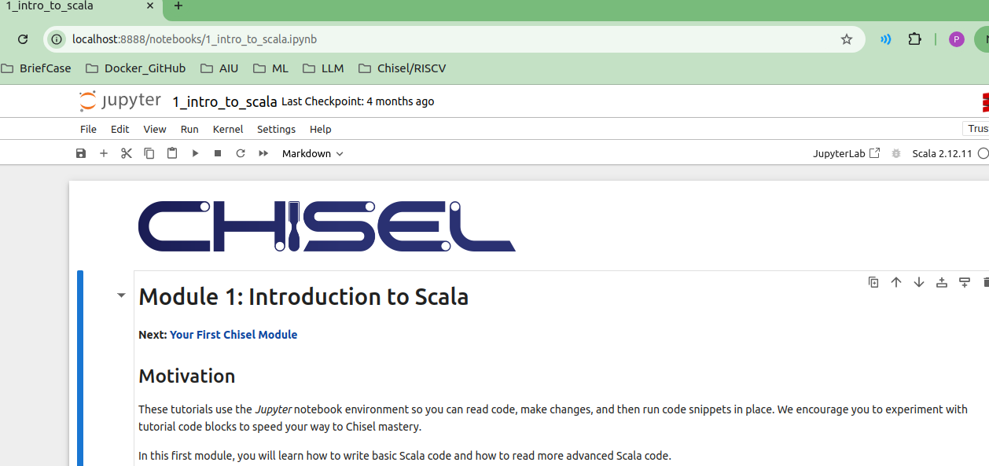
1.1 Run Jupyter Notebook for Scala
https://github.com/freechipsproject/chisel-bootcamp
Run Jupyter Notebook for Scala
1. Start Jupyter Note for 1_intro_to_scala.ipynb
> jupyter notebook 1_intro_to_scala.ipynb
2. We have jupyter notebook display 1_intro_to_scala.ipynb
1
2

Slide 5
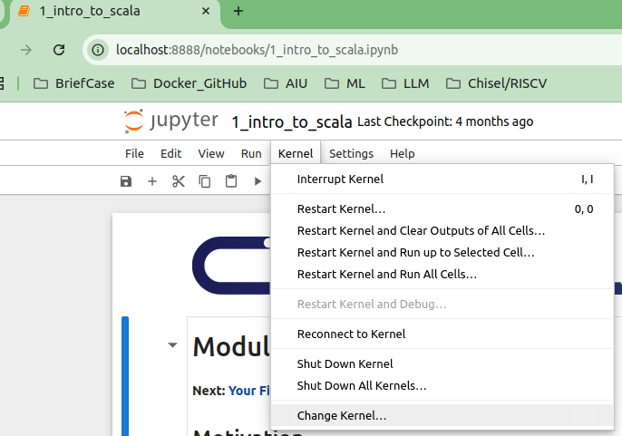
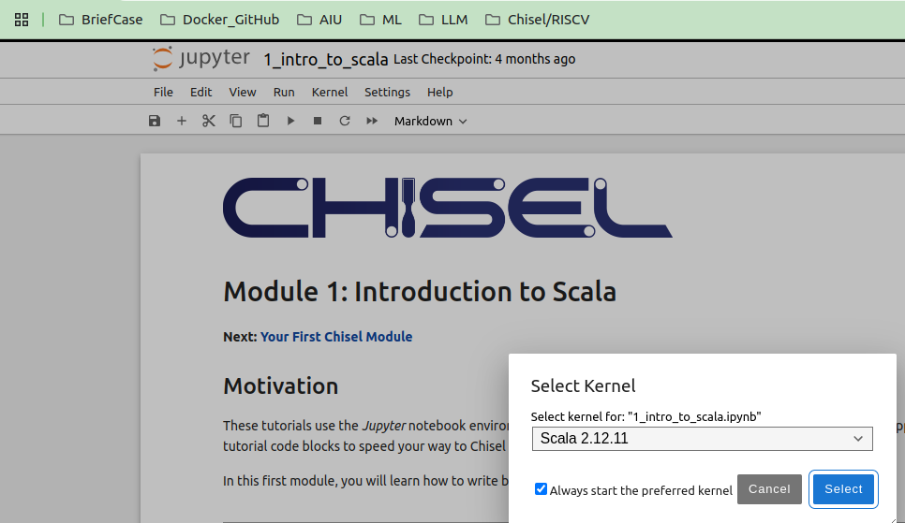
1.1 Run Jupyter Notebook for Scala
https://github.com/freechipsproject/chisel-bootcamp
Run Jupyter Notebook for Scala
1. Change Interpreter Kernel
> Kernel > Change Kernel...
2. Select “Scala 2.12.11”:
> kernel > Change Kernel …
1
2

Slide 6
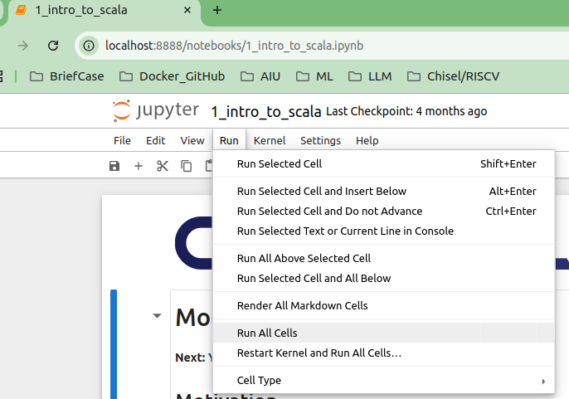
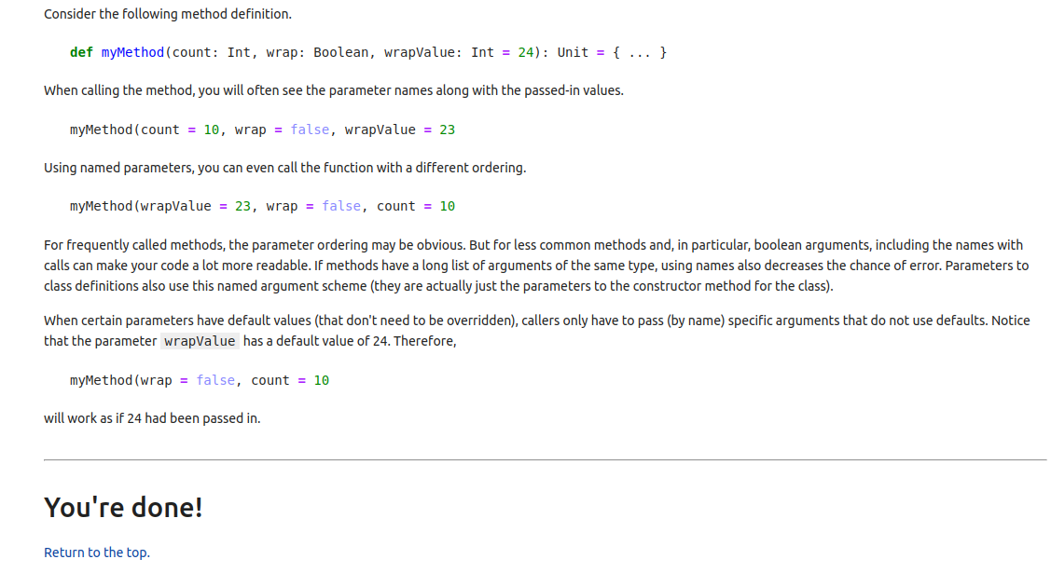
1.1 Run Jupyter Notebook for Scala
https://github.com/freechipsproject/chisel-bootcamp
Run Jupyter Notebook for Scala
1. Run > Run All Cells
2. Scroll to the end. We saw “You’ve done!”
1
2

Slide 7
1.2 Understand Scala

Slide 8
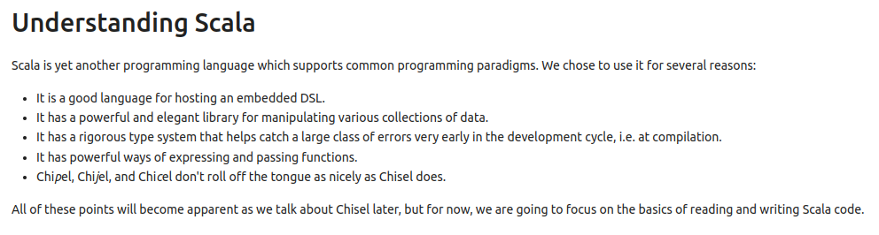
1.2 Understand Scala
https://github.com/freechipsproject/chisel-bootcamp
Understand Scala
1. Scala is a programming language which supports common programming paradigms.
2. We chose to use it for several reasons:
  It is a good language for hosting an embedded DSL (Domain-Specific Language).
  It has a powerful and elegant library for manipulating various collections of data.
  It has a rigorous type system that helps catch a large class of errors very early in the development cycle, i.e. at compilation.
  It has powerful ways of expressing and passing functions.
  We use the name Chisel (Constructing Hardware in Scala Embedded Language) which is easier to pronounce than Chipel, Chijel, Chicel, etc..
3. We are going to focus on the basics of reading and writing Scala code.

Slide 9
1.3 Variable and Constant

Slide 10
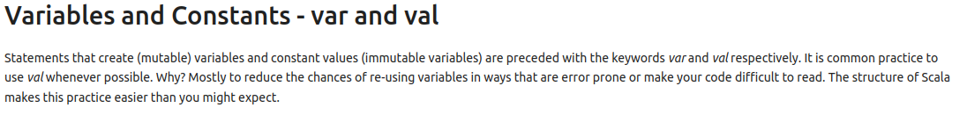
1.3 Variable and Constant
https://github.com/freechipsproject/chisel-bootcamp
Variable and Constant
1. Scala collections systematically distinguish between mutable (var) and immutable (val) collections.
2. A mutable variable is declared with “var” key word. This means you can change, add, or remove elements of a collection as a side effect.
3. An immutable variable is declare with val keyword. Immutable variable is constant and never change.
https://docs.scala-lang.org/overviews/scala-book/two-types-variables.html

Slide 11
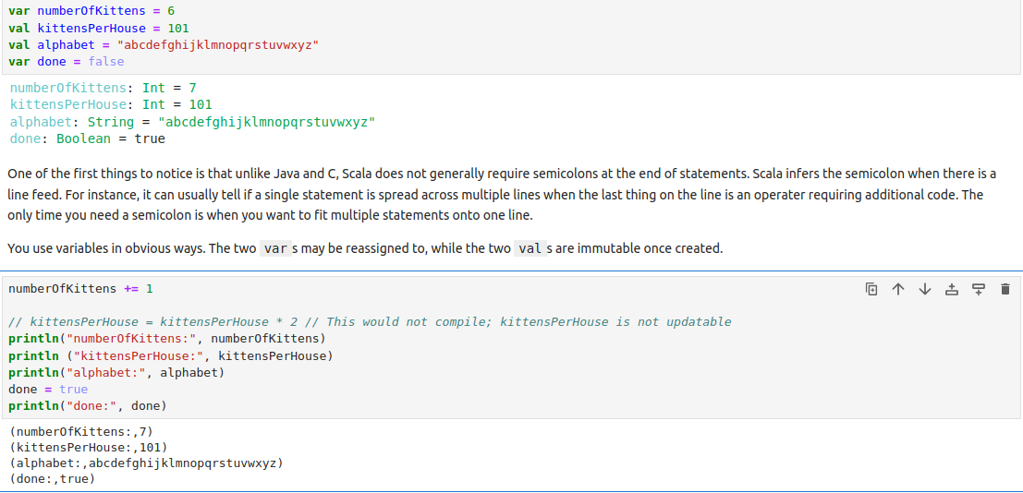
1.3 Variable and Constant
https://github.com/freechipsproject/chisel-bootcamp
Variable and Constant
Example:
// In Java or Python, we declare new variables a below. They are ambiguous in data type.
> String s = "hello";
> int i = 42;
> Person p = new Person("Joel Fleischman");
// In Scala, we have to explicity declare the val (immutable constant) and var (mutable variable).
> val s = "hello" // immutable
> var i = 42 // mutable
> val p = new Person("Joel Fleischman") // Immutable
https://docs.scala-lang.org/overviews/scala-book/two-types-variables.html

Slide 12
1.3 Variable and Constant
https://github.com/freechipsproject/chisel-bootcamp
Variable and Constant
Below is example of how to use val (immutable constant) and var (mutable variable).

Slide 13
1.4 Conditional

Slide 14
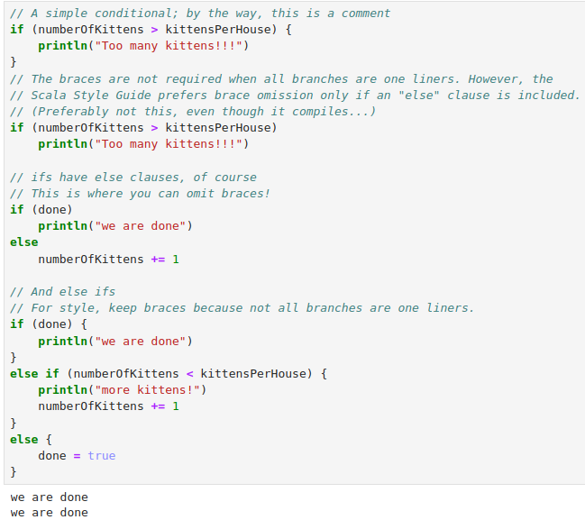
1.4 Conditional
https://github.com/freechipsproject/chisel-bootcamp
Conditional
Scala implements conditionals like other programming languages with if, else if, else.

Slide 15
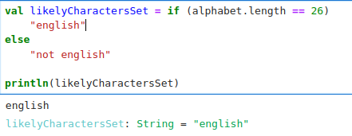
1.4 Conditional
https://github.com/freechipsproject/chisel-bootcamp
Conditional
1. In Scala, an "if" conditional returns a value.
What is that value? It's given by the last line of the selected branch.
It's quite powerful, particularly when used to initialize values in functions and classes. It looks like:
Note:
We created a constant likelyCharactersSet whose value is conditionally determined at runtime.

Slide 16
1.5 Method (Function)

Slide 17
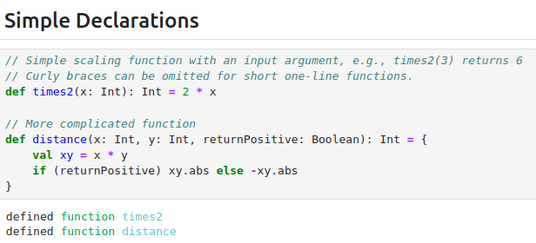
1.5 Method (Function)
https://github.com/freechipsproject/chisel-bootcamp
Method (Function)
1. Method (Function) is defined with the keyword def.
2. Function arguments (or parameters) are specified in a comma separated list that specifies the name of the argument, its type, and optionally a default value for it.
3. Method (Function) Return types should be specified for clarity.
4. Scala functions can have empty any arguments (empty parentheses).
5. Below are simple Function declarations:

Slide 18
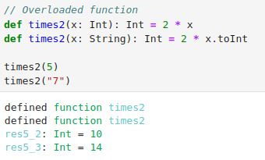
1.5 Method (Function)
https://github.com/freechipsproject/chisel-bootcamp
Method (Function)
Below, the functions are overloaded.
The overloaded function matched the parameter type and select which function to use.

Slide 19
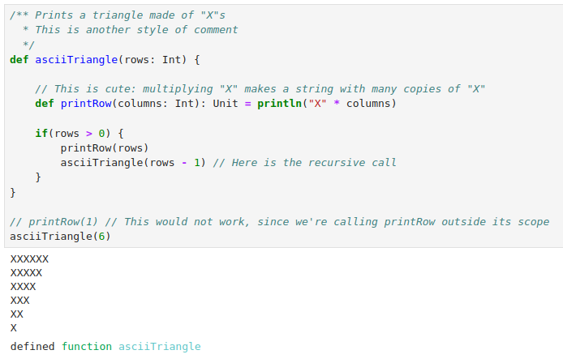
1.5 Method (Function)
https://github.com/freechipsproject/chisel-bootcamp
Method (Function)
We can use
1. recursively call function itself.
2. nested the functions in the loop.
Below is a recursive example:
If rows > 1, we will recursive call asciiTriangle (reduce rows by 1).

Slide 20
1.6 List

Slide 21
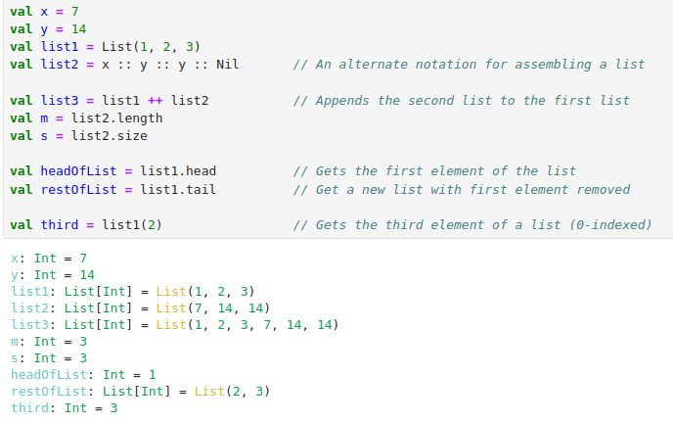
1.6 List
https://github.com/freechipsproject/chisel-bootcamp
List
1. Scala implements a variety of aggregate or sequence objects.
2. Lists are a lot like arrays but support additional operations for appending and extracting.

Slide 22
1.7 For Loop

Slide 23



1.7 For Loop
https://github.com/freechipsproject/chisel-bootcamp
For Loop
1. Scala has a for statement and it works like traditional for statements.
2. You can iterate over a range of values.
We can use until instead of to for iterating from 0 to 6 (7 is not included).
Add a by to increment by some fixed amount. The following prints out the even integers between 0 and 10.

Slide 24
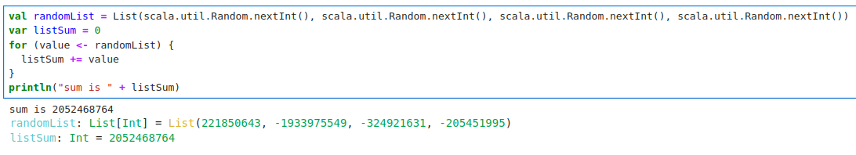
1.7 For Loop
https://github.com/freechipsproject/chisel-bootcamp
For Loop
1. If we have a collection of some kind and we want to visit all of the elements, we can use for as an iterator, as in Java and Python.
2. Here we make a list of 4 random integers and then sum them.

Slide 25
1.8 Package and Import

Slide 26
1.8 Package and Import
https://github.com/freechipsproject/chisel-bootcamp
Package and Import
> package mytools
> class Tool1 { ... }
When externally referencing code defined in a file containing the above lines, one should use:
> import mytools.Tool1
Note:
1. The package name should match the directory hierarchy.
This is not mandatory, but failing to abide by this guideline can produce some unusual and difficult to diagnose problems.
2. Package names by convention are lower case and do not contain separators like underscores.
This sometimes makes good descriptive names difficult.
One approach is to add a layer of hierarchy, e.g. package good.tools. Do your best.
Chisel itself plays some games with the package names that do not conform to these rules.

Slide 27
1.8 Package and Import
https://github.com/freechipsproject/chisel-bootcamp
Package and Import
1. As shown above, import statements inform the compiler that you are using some additional libraries.
2. Some common imports you will use when programming in Chisel are:
> import chisel3._
> import chisel3.iotesters.{ChiselFlatSpec, Driver, PeekPokeTester}
Note:
1. The first imports all the classes and methods in the chisel3 package; the underscore here works as a wildcard.
2. The second imports specific classes from the chisel3.iotesters package.

Slide 28
1.9 Object Oriented Language

Slide 29
1.9 Object Oriented Language
https://github.com/freechipsproject/chisel-bootcamp
Object Oriented Language
Scala is object oriented. Object Oriented language has the following features:
1. Variables are objects.
2. Constants in the sense of Scala's val declarative are also objects.
3. Even literal values are objects.
4. Even functions themselves are objects. More on this later.
5. Objects are instances of classes.
6. In fact, in just about every way that matters in Scala, the object in Objected Oriented will be called an instance.
7. In defining classes, the programmer specifies:
8. The data (val, var) associated with the class.
9. The operations, called methods or functions, that instances of the class can perform.
10. Classes can extend other classes.
11. The class being extended is the superclass; the extendee is the subclass.
12. In this case, the subclass inherits the data and methods from the superclass.
13. There are many useful but controlled ways in which a class may extend or override inherited properties.
14. Classes may inherit from traits. Think of traits as lightweight classes that allow specific, limited ways of inheriting from more than one superclass.
15. Singleton: We can have only one instance once for class/design pattern. The singletons are called instances.

Slide 30
1.10 Class Example

Slide 31
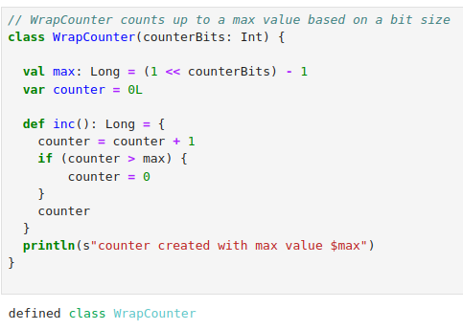
1.10 Class Example
https://github.com/freechipsproject/chisel-bootcamp
Class Example

Slide 32
End

