Slide 1

7 Decouple
Peter H. Chen

Slide 2
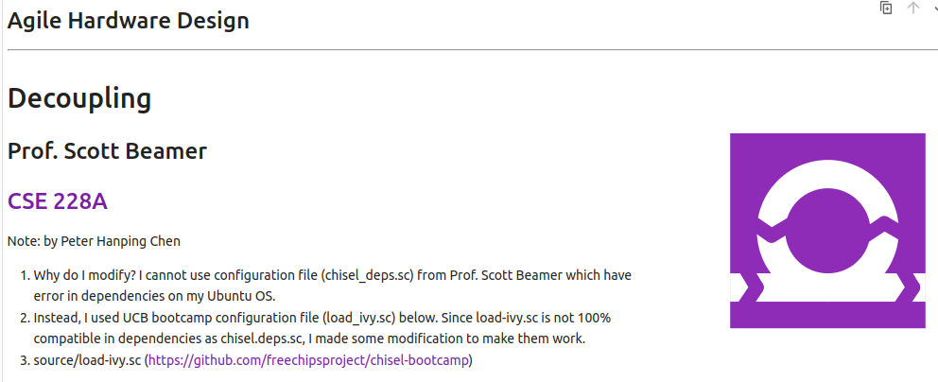
7 Decouple
https://www.youtube.com/watch?v=2-CH4v2iHCc&list=PLfrN7RIcMe6g2LBRJLTHTdhyj5s8ag0Rg&index=7
Decouple (0:00-0:30/59:20)
Note: by Peter Hanping Chen
1. Why do I modify?
I cannot use configuration file (chisel_deps.sc) from Prof. Scott Beamer which have error in dependencies on my Ubuntu OS.
2. Instead, I used UCB bootcamp configuration file (load_ivy.sc) below.
Since load-ivy.sc is not 100% compatible in dependencies as chisel.deps.sc, I made some modification to make them work.
3. source/load-ivy.sc (https://github.com/freechipsproject/chisel-bootcamp)

Slide 3
7 Decouple
https://www.youtube.com/watch?v=2-CH4v2iHCc&list=PLfrN7RIcMe6g2LBRJLTHTdhyj5s8ag0Rg&index=7
Decouple (0:31-0:50/59:20)
Before, we have one module. Right now, we have multiple modules,
How do we decouple the modules?
Topics:
1. Setup: jupyter notebook, select scala, and run cells
2.

Slide 4
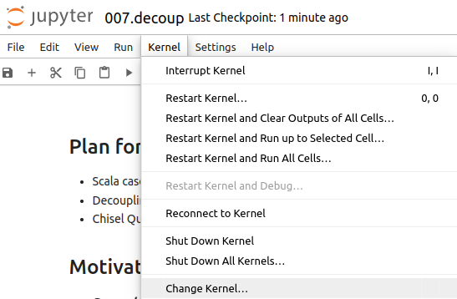
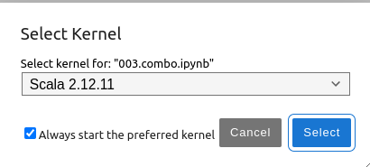
7 Decouple
https://www.youtube.com/watch?v=2-CH4v2iHCc&list=PLfrN7RIcMe6g2LBRJLTHTdhyj5s8ag0Rg&index=7
Decouple (0:51-1:00/59:20)
We discuss Chisel Collection.
> jupyter notebook 006.combo.ipynb > Kernel > Change Kernel … > Select Scala2.21.22
> Run All Cells

Slide 5
6.1 Plan

Slide 6
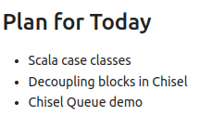
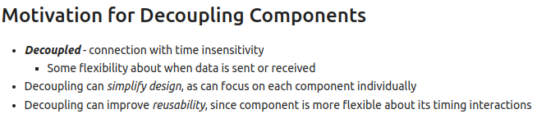
6.1 Plan
https://www.youtube.com/watch?v=2-CH4v2iHCc&list=PLfrN7RIcMe6g2LBRJLTHTdhyj5s8ag0Rg&index=7
Plan (1:01-1:29/59:20)

Slide 7
6.2 Import Chisel Library

Slide 8
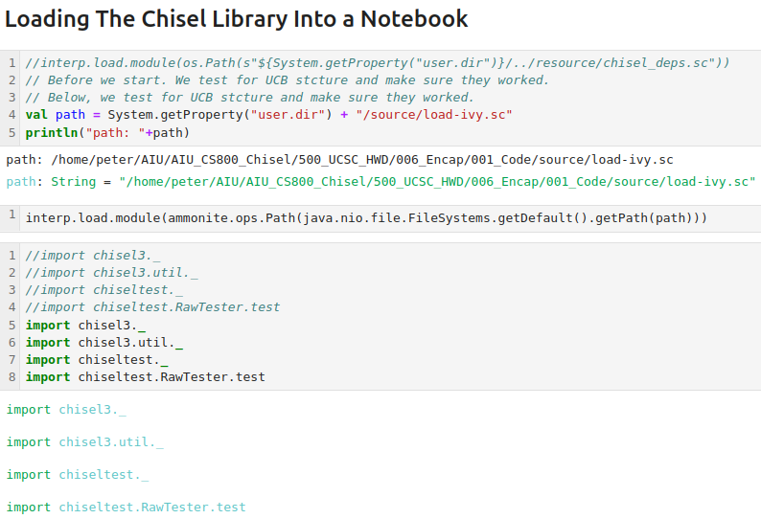
6.2 Import Chisel Library
https://www.youtube.com/watch?v=2-CH4v2iHCc&list=PLfrN7RIcMe6g2LBRJLTHTdhyj5s8ag0Rg&index=7
Import Chisel Library (1:30-2:00/59:20)

Slide 9
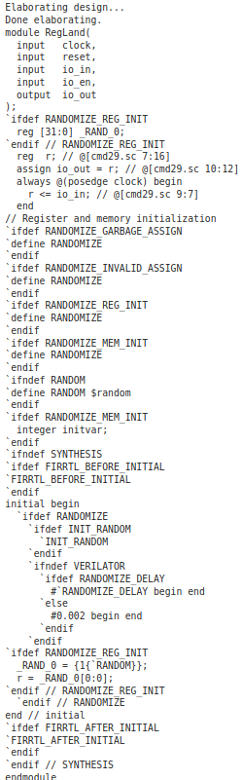
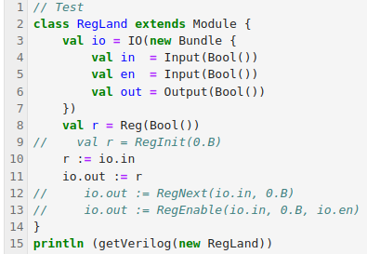
6.2 Import Chisel Library
https://www.youtube.com/watch?v=2-CH4v2iHCc&list=PLfrN7RIcMe6g2LBRJLTHTdhyj5s8ag0Rg&index=7
Import Chisel Library (2:01-2:31/59:20)
Test

Slide 10
6.3 Scala Case Class

Slide 11
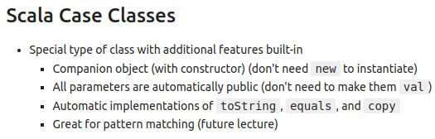
6.3 Scala Case Class
https://www.youtube.com/watch?v=2-CH4v2iHCc&list=PLfrN7RIcMe6g2LBRJLTHTdhyj5s8ag0Rg&index=7
Scala Case Class (2:32-3:00/59:20)
Case class is a special class.
The Scala compiler generates
1. Well-designed
2. immutable data class for us
3. Internal methods: such as, toString, equals, hashCode, copy, etc.

Slide 12
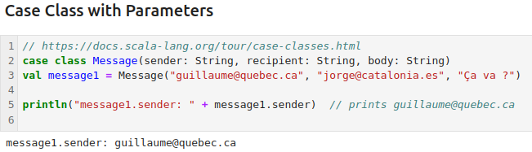
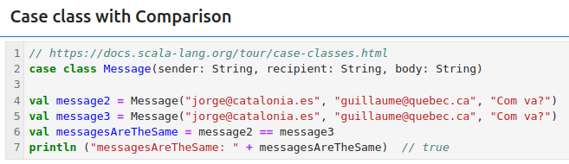
6.3 Scala Case Class
https://www.youtube.com/watch?v=2-CH4v2iHCc&list=PLfrN7RIcMe6g2LBRJLTHTdhyj5s8ag0Rg&index=7
Scala Case Class Example (3:01-3:30/59:20)
1. Case Class Parameter
2. Case Class Comparison

Slide 13
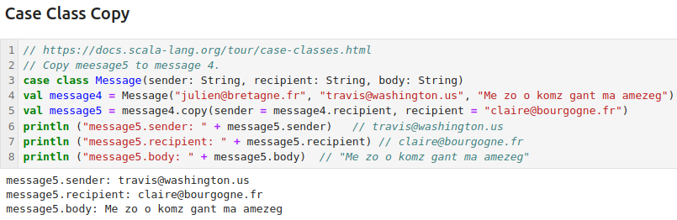
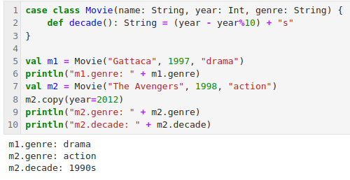
6.3 Scala Case Class
https://www.youtube.com/watch?v=2-CH4v2iHCc&list=PLfrN7RIcMe6g2LBRJLTHTdhyj5s8ag0Rg&index=7
Scala Case Class Example (3:31-5:54/59:20)
1. Case Class copy example
2. Class Class movie example.

Slide 14
6.4 Case Class Parameter

Slide 15
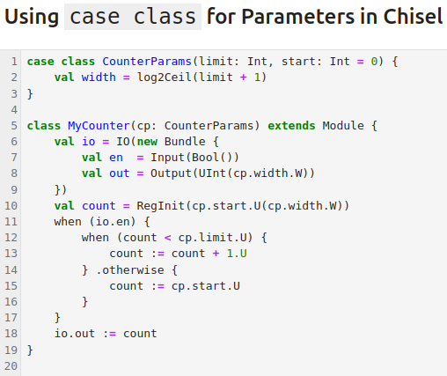
6.4 Case Class Parameter
https://www.youtube.com/watch?v=2-CH4v2iHCc&list=PLfrN7RIcMe6g2LBRJLTHTdhyj5s8ag0Rg&index=7
Case Class Parameter (5:55-6:00/59:20)
We pass in
1. Parameter limit is required.
2. The starting point with default value = 0.

Slide 16
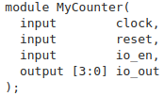
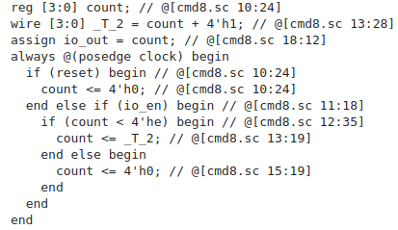
6.4 Case Class Parameter
https://www.youtube.com/watch?v=2-CH4v2iHCc&list=PLfrN7RIcMe6g2LBRJLTHTdhyj5s8ag0Rg&index=7
Case Class Parameter (6:01-7:00/59:20)
We pass in
1. limit = 14.
2. The starting point with default value = 0.

Slide 17
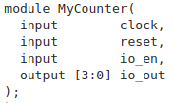
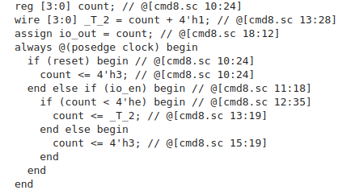
6.4 Case Class Parameter
https://www.youtube.com/watch?v=2-CH4v2iHCc&list=PLfrN7RIcMe6g2LBRJLTHTdhyj5s8ag0Rg&index=7
Case Class Parameter (7:01-10:23/59:20)
1. We pass in limit = 14 and starting point with start = 3.
2. Compare the Limit = 14 (default start = 0)
1
2

Slide 18
6.5 Handshake Protocol

Slide 19
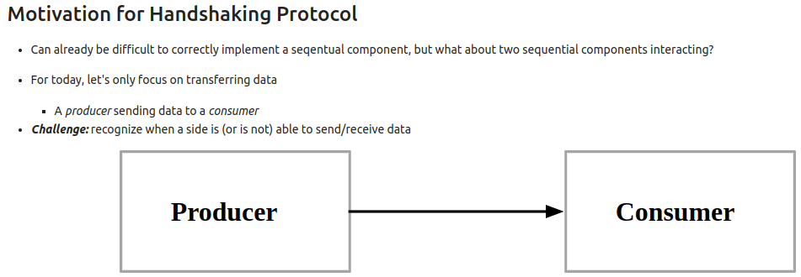
6.5 Handshake Protocol
https://www.youtube.com/watch?v=2-CH4v2iHCc&list=PLfrN7RIcMe6g2LBRJLTHTdhyj5s8ag0Rg&index=7
Handshake Protocol (10:24-12:05/59:20)
We have multiple blocks, we want to passed the parameters from one block to other blocks.
We have homework to do that.
How do we do that?

Slide 20
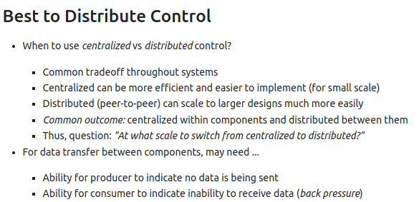
6.5 Handshake Protocol
https://www.youtube.com/watch?v=2-CH4v2iHCc&list=PLfrN7RIcMe6g2LBRJLTHTdhyj5s8ag0Rg&index=7
Handshake Protocol (10:06-15:33/59:20)
1. Centralized the control is easier.
2. Distributed the control between blocks is harder; however, distributed control is much easier for scale up to larger system.

Slide 21
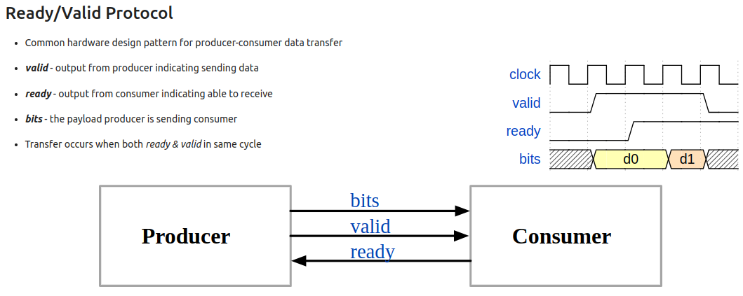
6.5 Handshake Protocol
https://www.youtube.com/watch?v=2-CH4v2iHCc&list=PLfrN7RIcMe6g2LBRJLTHTdhyj5s8ag0Rg&index=7
Handshake Protocol (15:34-21:21/59:20)
1. Below, we have producer to consumer. We send multiple bits from producer.
2. When producer is sending out two signals: One is data bits n(d0, d1) and another one is valid signal (set to 1 and set out).
3. When the consumer receive the data (d0, d1), the consumer send ready signal back.
4. When the producer receive the ready signal from consumer, the valid signal is set to 0.
5. The transit data diagram is as below.
6. In the standard library, we have no control to turn off the power.
5
2
4
3

Slide 22
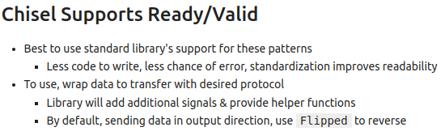
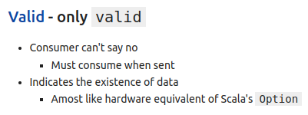
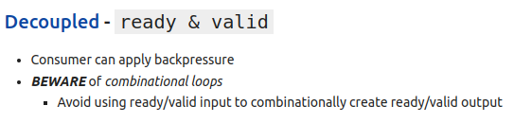
6.5 Handshake Protocol
https://www.youtube.com/watch?v=2-CH4v2iHCc&list=PLfrN7RIcMe6g2LBRJLTHTdhyj5s8ag0Rg&index=7
Handshake Protocol (21:22-26:43/59:20)
Chisel supports Ready and Valid signals.
We use the Chisel standard library to do the Ready/Valid signal handshake.
Be careful when we use the combinational loop (Producer/Consumer) of input ready/valid with output ready/valid. We should decouple the ready/ready in the input and output.

Slide 23
6.6 Loop Counter Example

Slide 24
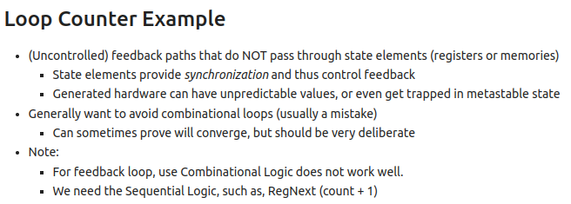
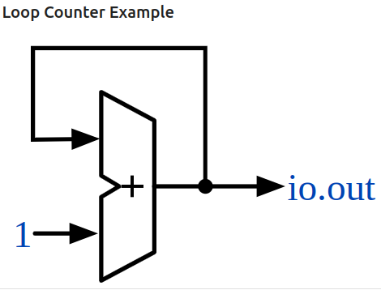
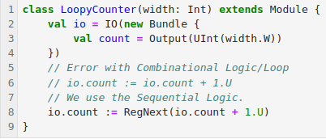
6.6 Loop Counter Example
https://www.youtube.com/watch?v=2-CH4v2iHCc&list=PLfrN7RIcMe6g2LBRJLTHTdhyj5s8ag0Rg&index=7
Loop Counter Example (26:44-27:21/59:20)
In the below diagram
1. Input 1 and output count
2. Output count feedback to input, then add 1, and then output.
Here, we use RegNext to step the clock.
The combinational logic does not make hardware. We need the sequential logic with RegNext ().

Slide 25


6.6 Loop Counter Example
https://www.youtube.com/watch?v=2-CH4v2iHCc&list=PLfrN7RIcMe6g2LBRJLTHTdhyj5s8ag0Rg&index=7
Loop Counter Example (27:22-28:27/59:20)
Print the Verilog.

Slide 26
6.7 Sender Valid Example

Slide 27
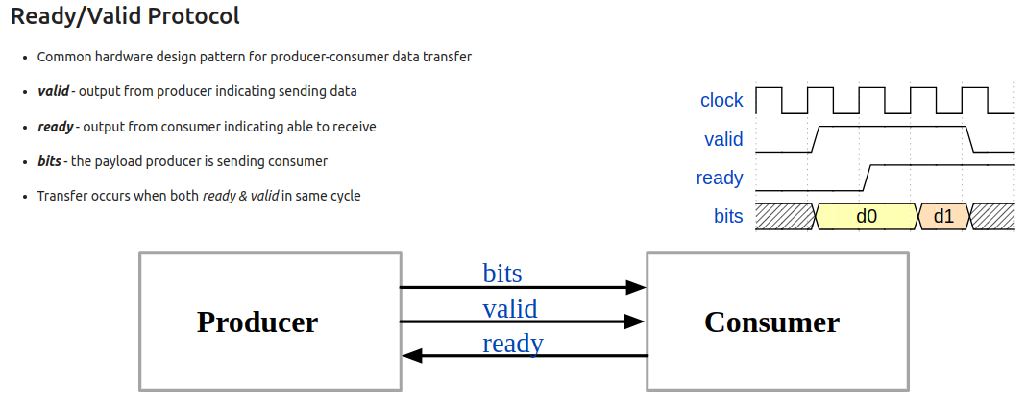
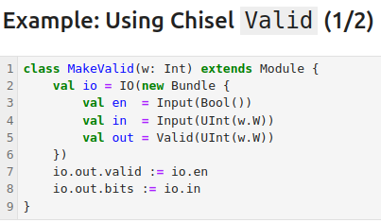
6.7 Sender Valid Example
https://www.youtube.com/watch?v=2-CH4v2iHCc&list=PLfrN7RIcMe6g2LBRJLTHTdhyj5s8ag0Rg&index=7
Sender Valid Example (28:28-29:20/59:20)
This is a state machine.
1. There is combinational path from ready to valid in Producer
2. There is combinational path from valid to ready in Consumer.
We have enable in the input and valid in the output.

Slide 28
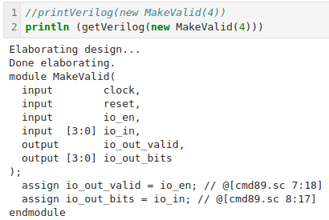
6.7 Sender Valid Example
https://www.youtube.com/watch?v=2-CH4v2iHCc&list=PLfrN7RIcMe6g2LBRJLTHTdhyj5s8ag0Rg&index=7
Sender Valid Example (29:21-29:24/59:20)
Here is the hardware output.

Slide 29
6.8 Receiver Valid Example

Slide 30
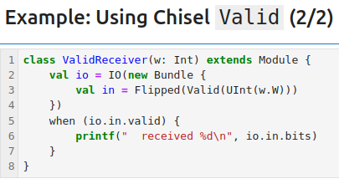
6.8 Receiver Valid Example
https://www.youtube.com/watch?v=2-CH4v2iHCc&list=PLfrN7RIcMe6g2LBRJLTHTdhyj5s8ag0Rg&index=7
Receiver Valid Example (29:25-29:55/59:20)
1. In the Consumer (Receiver), we use Flipped to get the input bits.
2. When the io.in.valid is true, then we print the received data.

Slide 31
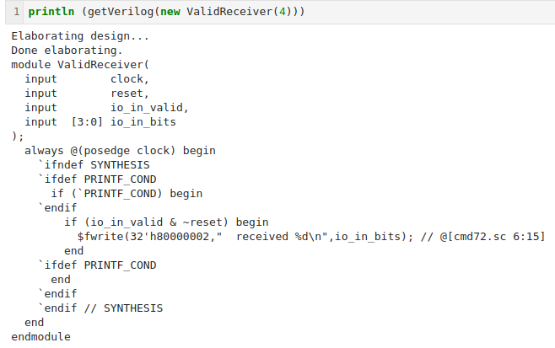
6.8 Receiver Valid Example
https://www.youtube.com/watch?v=2-CH4v2iHCc&list=PLfrN7RIcMe6g2LBRJLTHTdhyj5s8ag0Rg&index=7
Receiver Valid Example (29:56-30:30/59:20)
Verify the Verilog hardware code.

Slide 32
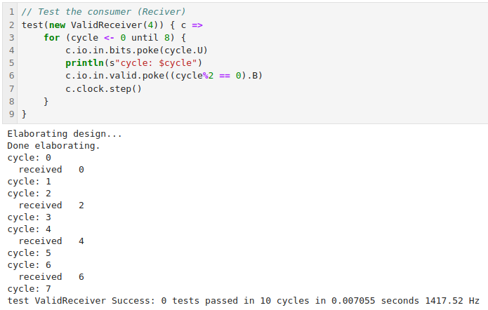
6.8 Receiver Valid Example
https://www.youtube.com/watch?v=2-CH4v2iHCc&list=PLfrN7RIcMe6g2LBRJLTHTdhyj5s8ag0Rg&index=7
Receiver Valid Example (30:31-34:36/59:20)
1. We then run the simulation.
2. Verify the waveform.

Slide 33
6.9 Chisel Decoupled

Slide 34
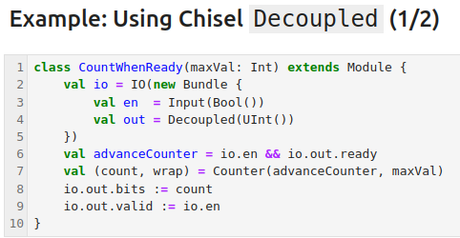
6.9 Chisel Decoupled
https://www.youtube.com/watch?v=2-CH4v2iHCc&list=PLfrN7RIcMe6g2LBRJLTHTdhyj5s8ag0Rg&index=7
Chisel Decoupled (34:37-35:22/59:20)
Decouple add valid and ready.
1. We use the Chisel Counter Library.
2. The output bits (count) and output valid (enable) to the receiver.
1
2

Slide 35

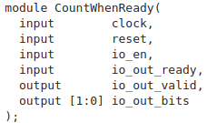
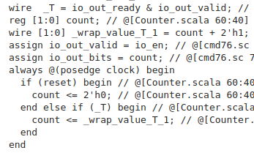
6.9 Chisel Decouple
https://www.youtube.com/watch?v=2-CH4v2iHCc&list=PLfrN7RIcMe6g2LBRJLTHTdhyj5s8ag0Rg&index=7
Chisel Decouple (35:23-36:11/59:20)
We print the Verilog.

Slide 36
6.10 Decoupled Helper Function

Slide 37
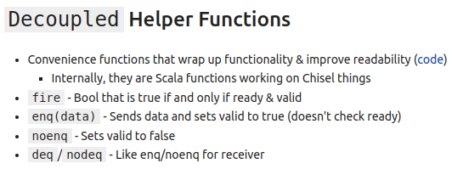
6.10 Decoupled Helper Function
https://www.youtube.com/watch?v=2-CH4v2iHCc&list=PLfrN7RIcMe6g2LBRJLTHTdhyj5s8ag0Rg&index=7
Decoupled Helper Function (36:12-37:22/59:20)
1. The Decoupled have some convenience function to improve readability.
2. fire: ready and valid
3. enq (sender): Send data and set valid
4. noenq (Sender): Set valid to false.
5. deq/nodeq (Receiver): Similar to enq/noenq, set valid to true/false at the receiver.

Slide 38
6.11 Use Chisel Decoupled

Slide 39
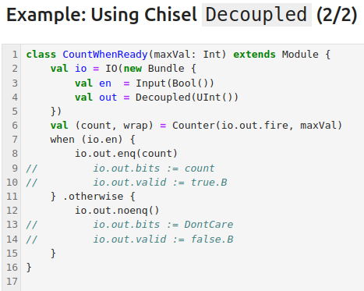
6.11 Use Chisel Decoupled
https://www.youtube.com/watch?v=2-CH4v2iHCc&list=PLfrN7RIcMe6g2LBRJLTHTdhyj5s8ag0Rg&index=7
Use Chisel Decoupled (37:23-38:22/59:20)
Sender: fire, enq, noenq.

Slide 40
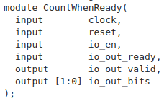

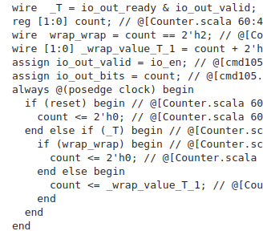
6.11 Use Chisel Decoupled
https://www.youtube.com/watch?v=2-CH4v2iHCc&list=PLfrN7RIcMe6g2LBRJLTHTdhyj5s8ag0Rg&index=7
Use Chisel Decoupled (38:23-39:20/59:20)
Print Verilog Code with Chisel Decoupled.
Code is same as without using Chisel Decoupled.

Slide 41
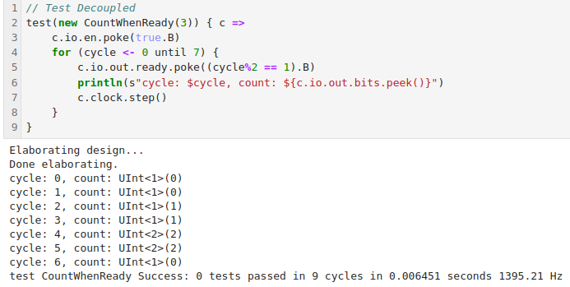
6.11 Use Chisel Decoupled
https://www.youtube.com/watch?v=2-CH4v2iHCc&list=PLfrN7RIcMe6g2LBRJLTHTdhyj5s8ag0Rg&index=7
Use Chisel Decoupled (39:21-39:35/59:20)
Test Chisel Decoupled.

Slide 42
6.12 Use Queue

Slide 43
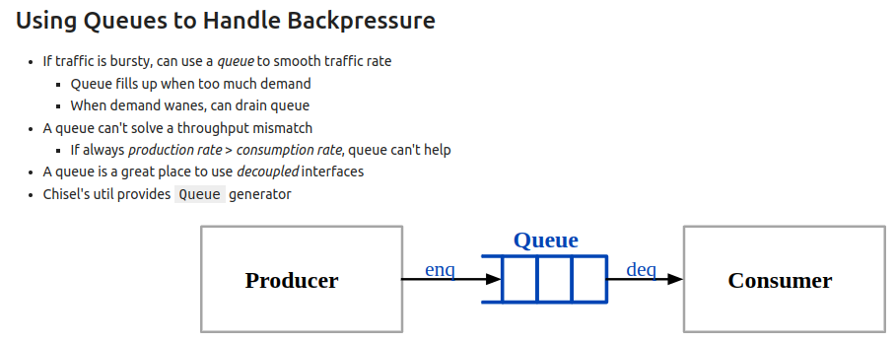
6.12 Use Queue
https://www.youtube.com/watch?v=2-CH4v2iHCc&list=PLfrN7RIcMe6g2LBRJLTHTdhyj5s8ag0Rg&index=7
Use Queue (39:36-41:35/59:20)
1. Chisel util provide Queue Generator.
2. Use enq to fill data
3. Use deq to pick data.

Slide 44
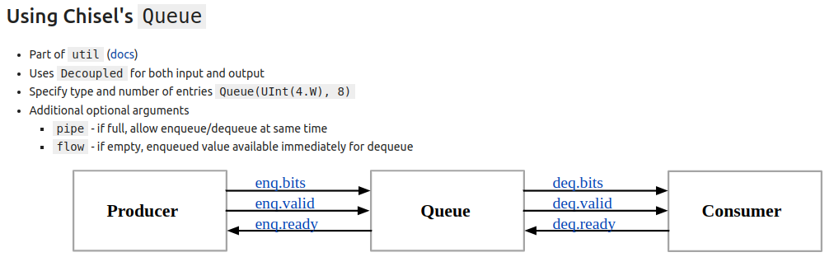
6.12 Use Queue
https://www.youtube.com/watch?v=2-CH4v2iHCc&list=PLfrN7RIcMe6g2LBRJLTHTdhyj5s8ag0Rg&index=7
Use Queue (41:36-42:30/59:20)
1. Below, we have 6 signals.
2. pipe: if full, we can use enqueue/dequeue same time.
3. flow: if empty, we can use enqueue/dequeue same time.

Slide 45
6.13 Queue Example

Slide 46
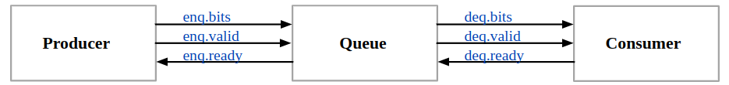
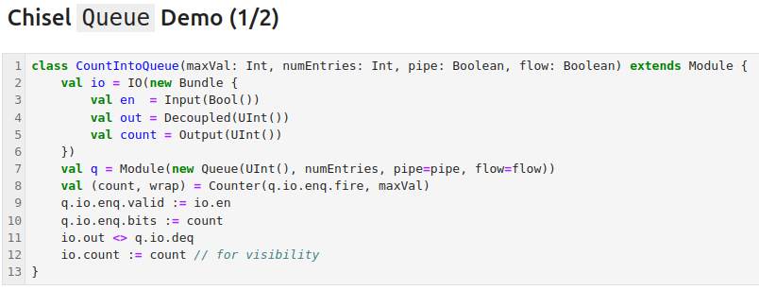
6.13 Queue Example
https://www.youtube.com/watch?v=2-CH4v2iHCc&list=PLfrN7RIcMe6g2LBRJLTHTdhyj5s8ag0Rg&index=7
Queue Example (42:31-47:50/59:20)
We have Queue for Counter.
The Counter generate the input and output.
The Producer and Consumer are inside the Counter.
The Queuing theory can be implemented as below.

Slide 47
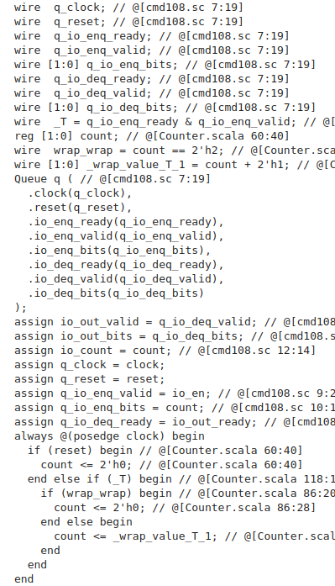
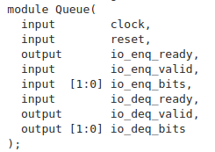
6.13 Queue Example
https://www.youtube.com/watch?v=2-CH4v2iHCc&list=PLfrN7RIcMe6g2LBRJLTHTdhyj5s8ag0Rg&index=7
Queue Example (47:51-47:57/59:20)
Print Verilog

Slide 48
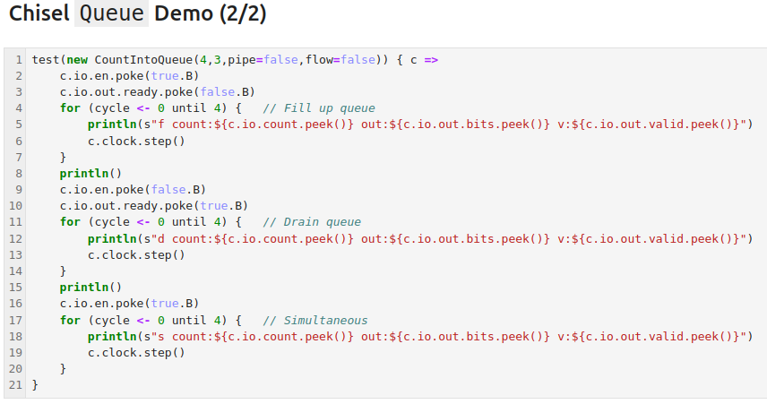
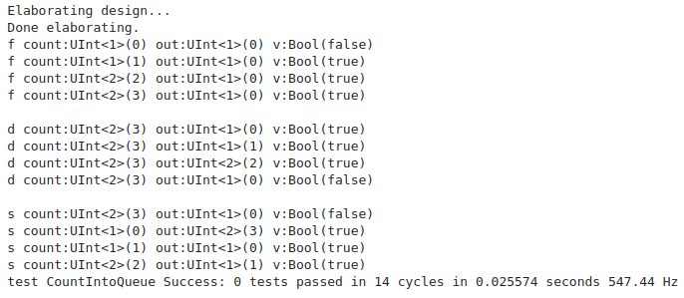
6.13 Queue Example
https://www.youtube.com/watch?v=2-CH4v2iHCc&list=PLfrN7RIcMe6g2LBRJLTHTdhyj5s8ag0Rg&index=7
Queue Example (47:58-59:20/59:20)
Below, we have three phases.
1. Phase 1: Fill data in Queue
2. Phase 2: Take data out of queue.
3. Run Simulation

Slide 49
End

