Slide 1

11 Functional Programming: Reduce
Peter H. Chen

Slide 2
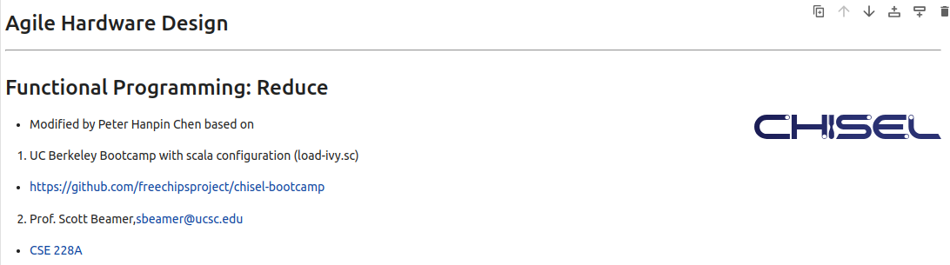
11 Functional Programming: Reduce
https://www.youtube.com/watch?v=B_1bD5LnlII&list=PLfrN7RIcMe6g2LBRJLTHTdhyj5s8ag0Rg&index=11
Functional Programming: Reduce (0:00-0:01/54:59)
We used UCB bootcamp configuration file (load_ivy.sc)
source/load-ivy.sc (https://github.com/freechipsproject/chisel-bootcamp)

Slide 3
11 Functional Programming: Reduce
https://www.youtube.com/watch?v=B_1bD5LnlII&list=PLfrN7RIcMe6g2LBRJLTHTdhyj5s8ag0Rg&index=11
Functional Programming: Reduce (0:02-0:03/54:59)
We discus the Functional Programming in map, foreach, and zip. New, we talk about the reduce and fold.
Topics:
1. Setup: jupyter notebook, select scala, and run cells.
2. reduce and fold: fold has foldLeft and foldRight. fold is lower level than reduce.
3. Class Reducer: We change the for loop into map, zip with Index, foldLeft, foldRigh, reduce and get the same Verilog and simulation result.
4. Class One-Hot Priority Encoder: Use map, zip, reduce to replace the for loop.
5. Class XBar (Crossbar): It has unknown error in Verilog Generator, not ready yet.

Slide 4
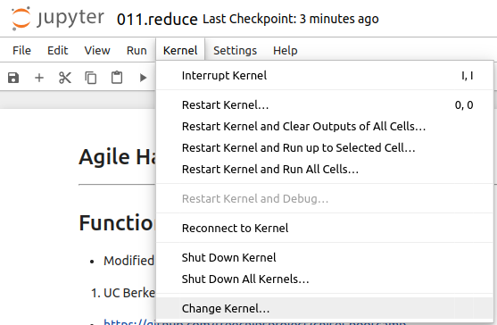
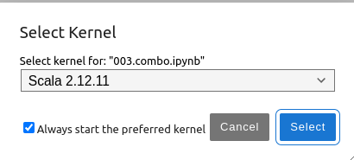
11 Functional Programming: Reduce
https://www.youtube.com/watch?v=B_1bD5LnlII&list=PLfrN7RIcMe6g2LBRJLTHTdhyj5s8ag0Rg&index=11
Functional Programming: Reduce (0:03-0:18/54:59)
We discuss Chisel Collection.
> jupyter notebook 006.combo.ipynb > Kernel > Change Kernel … > Select Scala2.21.22
> Run All Cells

Slide 5
11.1 Plan

Slide 6
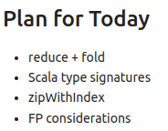
11.1 Plan
https://www.youtube.com/watch?v=B_1bD5LnlII&list=PLfrN7RIcMe6g2LBRJLTHTdhyj5s8ag0Rg&index=11
Plan (0:19-1:51/54:59)
In the last discussion, we use map, foreach, and zip to replace the for loop.
Today, we discuss reduce, fold, etc.

Slide 7
11.2 Import Chisel Library

Slide 8
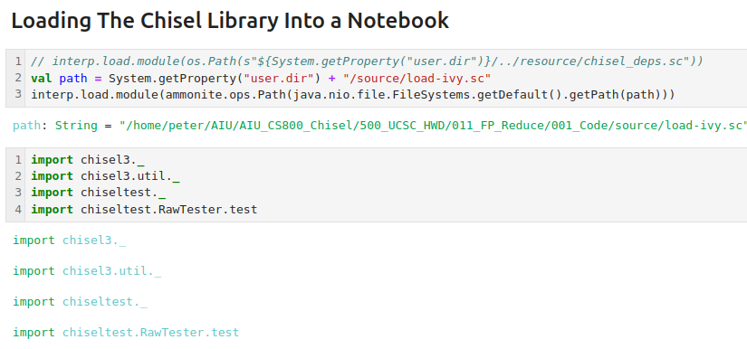
11.2 Import Chisel Library
https://www.youtube.com/watch?v=B_1bD5LnlII&list=PLfrN7RIcMe6g2LBRJLTHTdhyj5s8ag0Rg&index=11
Import Chisel Library (1:52-1:57/54:59)

Slide 9
11.3 Use reduce and fold

Slide 10
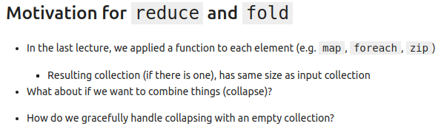
11.3 Use reduce and fold
https://www.youtube.com/watch?v=B_1bD5LnlII&list=PLfrN7RIcMe6g2LBRJLTHTdhyj5s8ag0Rg&index=11
Use reduce and fold (1:57-2:32/54:59)
Last time, we discussed map, foreach, etc zip.
We will continue to discuss the reduce and fold.

Slide 11
11.4 Scala reduce

Slide 12
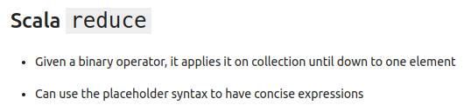
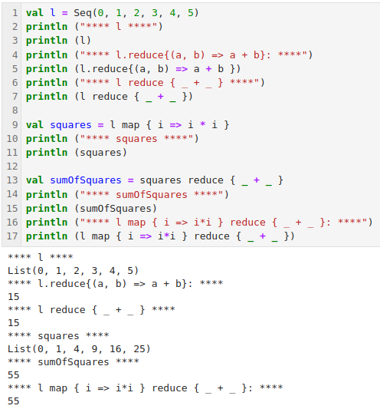
11.4 Scala reduce
https://www.youtube.com/watch?v=B_1bD5LnlII&list=PLfrN7RIcMe6g2LBRJLTHTdhyj5s8ag0Rg&index=11
Scala reduce (2:33-5:54/54:59)
We are given a collection l = {0, 1, 2, 3, 4, 5}
We have a binary operator for reduce operation.
Here, we have example of Seq tuple.
We use
> l.reduce { (a, b) => a + b })
> l.reduce { _ + _ }
To add all the tuple together.
We use map to multiple them
> l map { i => i * I }
We do both of them in one line
> l map { i => i * i } reduce { _ + _ }

Slide 13
11.5 Arbiter with FP (map/reduce)

Slide 14
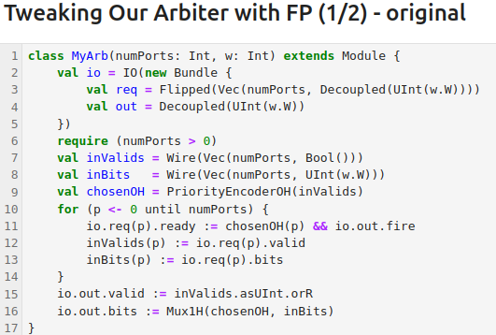
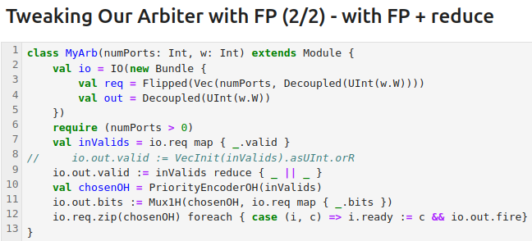
11.5 Arbiter with FP (map/reduce)
https://www.youtube.com/watch?v=B_1bD5LnlII&list=PLfrN7RIcMe6g2LBRJLTHTdhyj5s8ag0Rg&index=11
Arbiter with FP (map/reduce) (5:55-8:23/54:59)
We improve Arbiter with Functional Programming for reduce.
1. We set the valid flag with reduce { _ || _ }
2. We replace the for loop into map.
3. We replace the for loop with zip and foreach.

Slide 15
11.6 How to Reduce on 0 Elements?

Slide 16
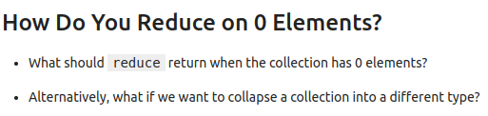
11.6 How to Reduce on 0 Elements?
https://www.youtube.com/watch?v=B_1bD5LnlII&list=PLfrN7RIcMe6g2LBRJLTHTdhyj5s8ag0Rg&index=11
How to Reduce on 0 Elements (8:24-9:09/54:59)
When we have few elements to reduce, we have to constraint the output type same as the input type.
Scala use foldLeft() interface to collapse the elements of collections, i.e., handle the reduce on 0 elements.

Slide 17
11.7 Scala foldLeft

Slide 18
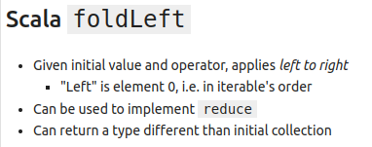
11.7 Scala foldLeft
https://www.youtube.com/watch?v=B_1bD5LnlII&list=PLfrN7RIcMe6g2LBRJLTHTdhyj5s8ag0Rg&index=11
Scala foldLeft (9:10-9:30/54:59)
Q. What is foldLeft?
Ans:
1. foldLeft() method is a member of TraversableOnce trait.
2. foldLeft() is used to collapse elements of collections.
3. foldLeft() navigates elements from Left to Right order.
4. foldLeft() is primarily used in recursive functions and prevents stack overflow exceptions.
5. foldLeft() is used to implement the reduce and used to handle the 0 elements.
Q. What is trait?
Ans:
1. Traits are used to share interfaces and fields between classes.
2. Traits are similar to Java 8's interfaces.

Slide 19
11.8 foldLeft vs. foldRight

Slide 20
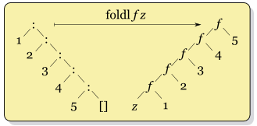
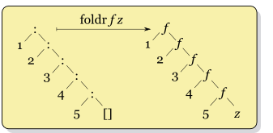
11.8 foldLeft vs. foldRight
https://www.youtube.com/watch?v=B_1bD5LnlII&list=PLfrN7RIcMe6g2LBRJLTHTdhyj5s8ag0Rg&index=11
foldLeft vs. foldRight (9:31-12:20/54:59)
Q. What is fold?
In Functional Programming, fold (or reduce) is a family of HOF (Higher Order Function) to process data structure in some order to build a return value .
A fold deals with two things:
1. a combining function, and
2. a data structure, typically a list of elements.
The fold then proceeds to combine elements of the data structure using the function in some systematic way.
For instance, we might want to use a hypothetical function fold to write:
> fold (+) [1,2,3,4,5]
which would result in 1 + 2 + 3 + 4 + 5, which is 15.
We fold from zero (z), 1, 2, etc. We have fold left and fold right as below.
https://wiki.haskell.org/Fold
foldLeft: Fold from left to right
foldRight: Fold from Right to Left

Slide 21
11.9 Scala Code: foldLeft

Slide 22
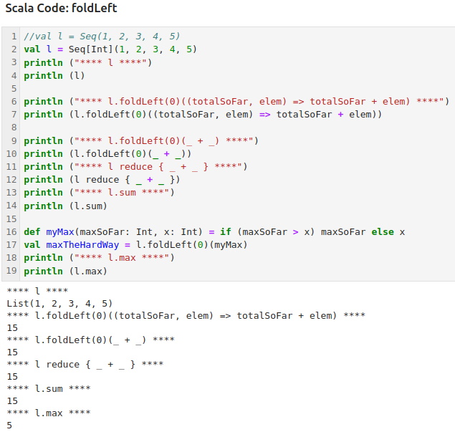
11.9 Scala Code: foldLeft and reduce
https://www.youtube.com/watch?v=B_1bD5LnlII&list=PLfrN7RIcMe6g2LBRJLTHTdhyj5s8ag0Rg&index=11
Scala foldLeft and reduce (12:01-13:30/54:59)
Scala Code for foldLeft and reduce.

Slide 23
11.10 Visualize foldLeft vs. foldRight

Slide 24
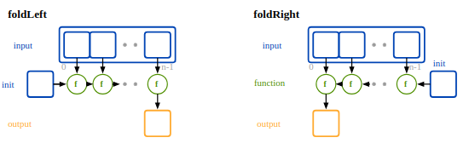
11.10 Visualize foldLeft vs. foldRight
https://www.youtube.com/watch?v=B_1bD5LnlII&list=PLfrN7RIcMe6g2LBRJLTHTdhyj5s8ag0Rg&index=11
Visualize foldLeft vs. foldRight (13:31-15:48/54:59)
Visualize foldLeft and foldRight.
foldLeft: We fold from left to right.
foldRight: We fold from right to left.

Slide 25
11.11 Curry Functions in Scala

Slide 26
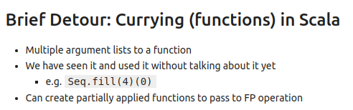
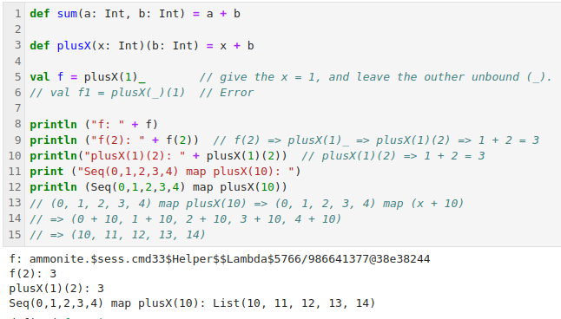
11.11 Curry Functions in Scala
https://www.youtube.com/watch?v=B_1bD5LnlII&list=PLfrN7RIcMe6g2LBRJLTHTdhyj5s8ag0Rg&index=11
Curry Functions in Scala (15:49-20:43/54:59)
We have multiple argument lists to a function, such as, seq (4)(0).
We fill the Seq list
> Seq.fill(4)(0)

Slide 27
11.12 Scala Function Signature

Slide 28
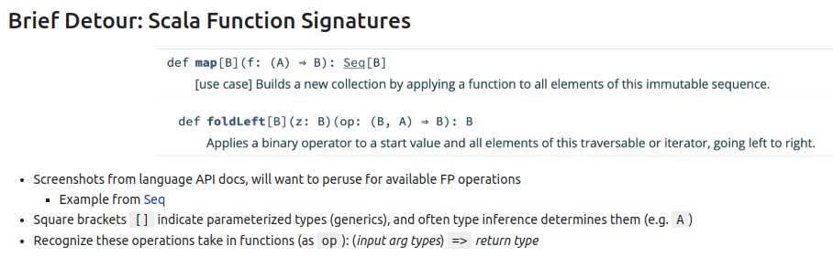
11.12 Scala Function Signature
https://www.youtube.com/watch?v=B_1bD5LnlII&list=PLfrN7RIcMe6g2LBRJLTHTdhyj5s8ag0Rg&index=11
Scala Function Signature (20:44-23:00/54:59)
Q. What is Function Signature
Ans: A "function signature" is the complete description of a function, including unique function name, parameter types, and the type of value returns.
Below, we specify Input type, output type

Slide 29
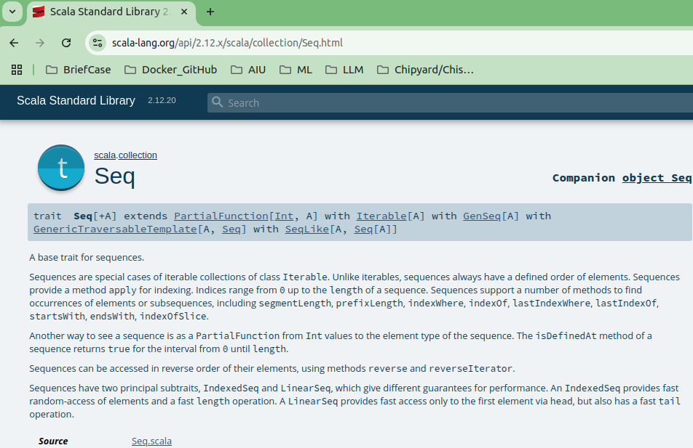
11.12 Scala Function Signature
https://www.youtube.com/watch?v=B_1bD5LnlII&list=PLfrN7RIcMe6g2LBRJLTHTdhyj5s8ag0Rg&index=11
Scala Function Signature (23:01-26:21/54:59)
For example: Seq ()
Check all the description of Seq().

Slide 30
11.13 reduce vs fold

Slide 31
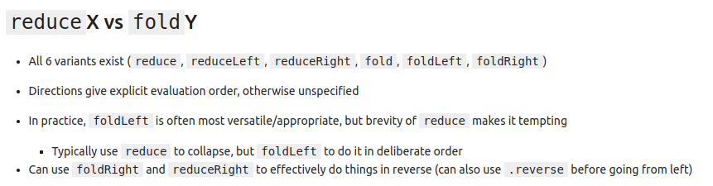
11.13 reduce vs fold
https://www.youtube.com/watch?v=B_1bD5LnlII&list=PLfrN7RIcMe6g2LBRJLTHTdhyj5s8ag0Rg&index=11
reduce vs fold (26:22-29:25/54:59)
Q. What is difference between reduce and fold?
Ans:
1. In functional programming, "fold" and "reduce" are essentially synonymous, representing the same core concept of applying a function cumulatively to a sequence of values, resulting in a single value.
2. However, the term "fold" is often used in languages Haskell, while "reduce" is more common in languages like JavaScript, Scala, and Python.
reduce has 3 variant: reduce, reduceLeft, reduceRight
fold has 3 variants: fold, foldLeft, foldRight.
foldLeft is most flexible.

Slide 32
11.14 Example: reduce

Slide 33
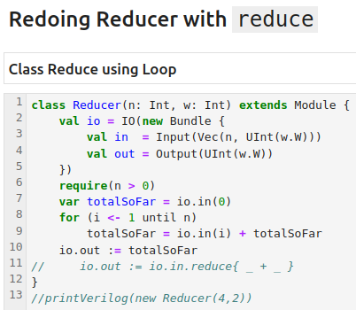
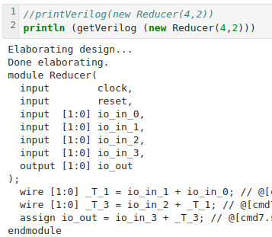
11.14 Example: reduce
https://www.youtube.com/watch?v=B_1bD5LnlII&list=PLfrN7RIcMe6g2LBRJLTHTdhyj5s8ag0Rg&index=11
Example: reduce (29:26-29:30/54:59)
Class Reducer using Loop.

Slide 34
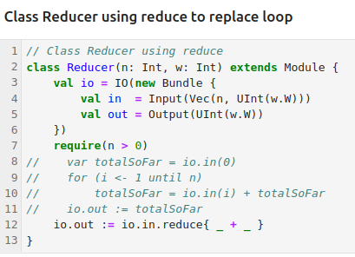
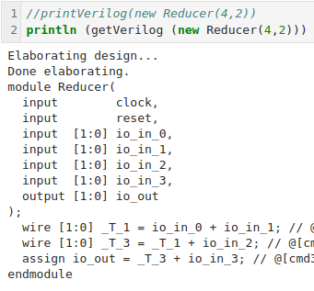
11.14 Example: reduce
https://www.youtube.com/watch?v=B_1bD5LnlII&list=PLfrN7RIcMe6g2LBRJLTHTdhyj5s8ag0Rg&index=11
Example: reduce (29:31-31:12/54:59)
Class Reducer using reduce.
We use one line “reduce” instead of looping.

Slide 35
11.15 Example: foldLeft

Slide 36
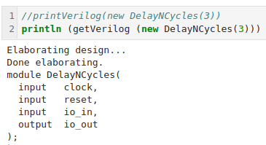
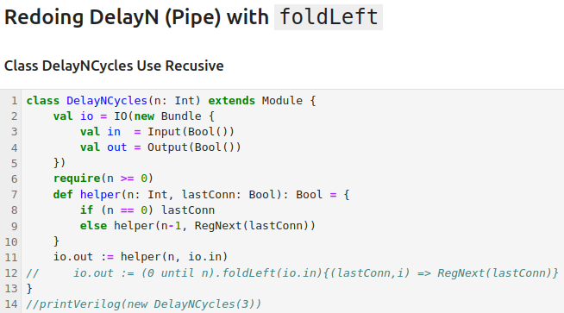
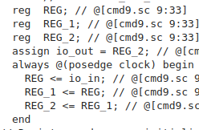
11.15 Example: foldLeft
https://www.youtube.com/watch?v=B_1bD5LnlII&list=PLfrN7RIcMe6g2LBRJLTHTdhyj5s8ag0Rg&index=11
Example: foldLeft (31:13-31:35/54:59)
Use Recursive call.

Slide 37
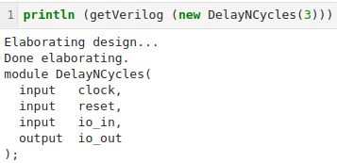
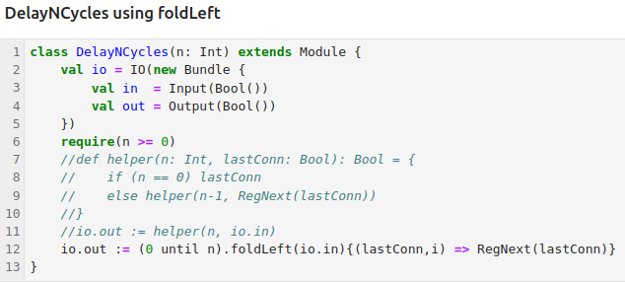
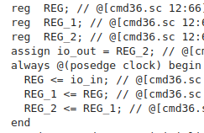
11.15 Example: foldLeft
https://www.youtube.com/watch?v=B_1bD5LnlII&list=PLfrN7RIcMe6g2LBRJLTHTdhyj5s8ag0Rg&index=11
Example: foldLeft (31:46-37:17/54:59)
We can use foldLeft. Just one Line of code.
Initial input is io.in.
We have the lastConn parameter on the fly.

Slide 38
11.16 Scala: zipWithIndex

Slide 39
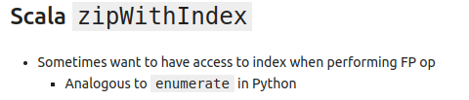
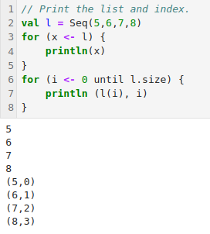
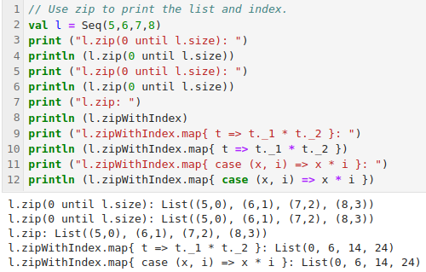
11.16 Scala: zipWithIndex
https://www.youtube.com/watch?v=B_1bD5LnlII&list=PLfrN7RIcMe6g2LBRJLTHTdhyj5s8ag0Rg&index=11
Scala: zipWithIndex (37:18-40:34/54:59)
Below,
1. we print the value with index.
2. We can have zipWithIndex to print.
1
2

Slide 40
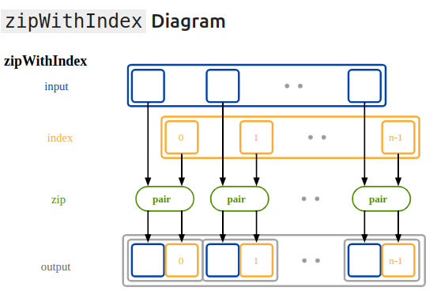
11.17 Scala: zipWithIndex
https://www.youtube.com/watch?v=B_1bD5LnlII&list=PLfrN7RIcMe6g2LBRJLTHTdhyj5s8ag0Rg&index=11
Scala: zipWithIndex Diagram (40:35-40:47/54:59)

Slide 41
11.17 FP for One-Hot Priority Encoder

Slide 42
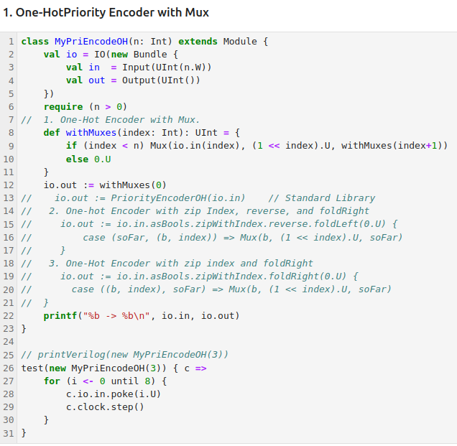
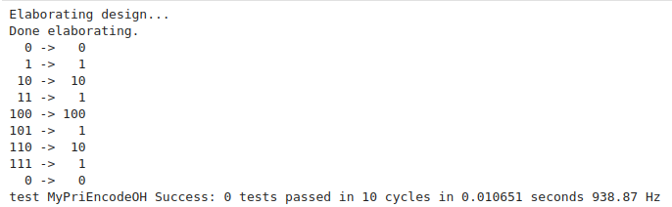
11.17 FP for One-Hot Priority Encoder
https://www.youtube.com/watch?v=B_1bD5LnlII&list=PLfrN7RIcMe6g2LBRJLTHTdhyj5s8ag0Rg&index=11
One-Hot Priority Encoder with Mux (40:48-42:10/54:59)
Before, we use mux for One-Hot Priority Encoder.

Slide 43
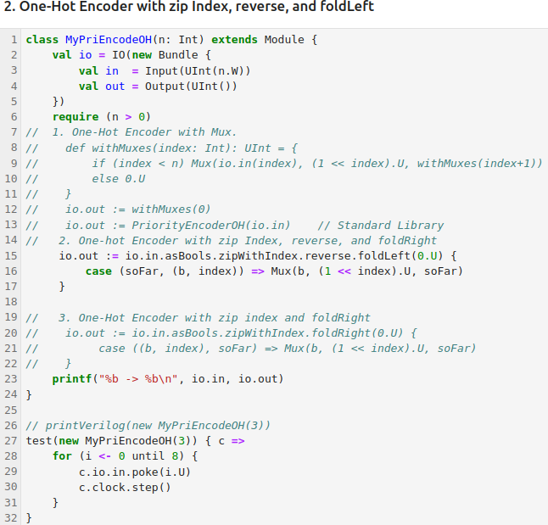
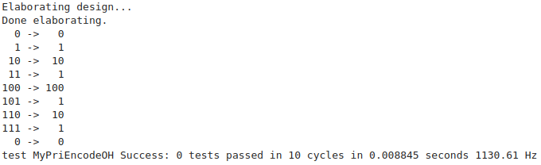
11.17 FP for One-Hot Priority Encoder
https://www.youtube.com/watch?v=B_1bD5LnlII&list=PLfrN7RIcMe6g2LBRJLTHTdhyj5s8ag0Rg&index=11
One-Hot Priority Encoder with zip Index, reverse, and foldLeft (42:11-44:00/54:59)
Now, we use map/reduce to replace the Mux.
We have index. We use zipWithIndex with reverse and foldLeft to loop through the Mux.

Slide 44
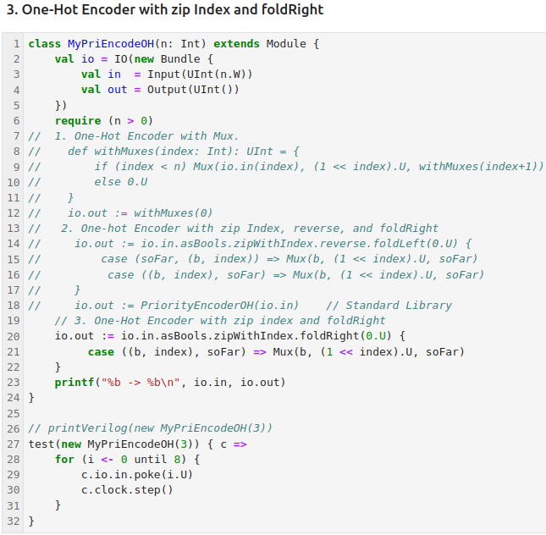
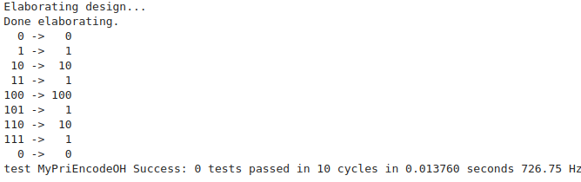
11.17 FP for One-Hot Priority Encoder
https://www.youtube.com/watch?v=B_1bD5LnlII&list=PLfrN7RIcMe6g2LBRJLTHTdhyj5s8ag0Rg&index=11
FP for One-Hot Priority Encoder (44:01-45:05/54:59)
If we don’t want to use reverse,
1. We can remove the reverse
2. Change foldLeft to foldRight().

Slide 45
11.18 FP for XBar

Slide 46
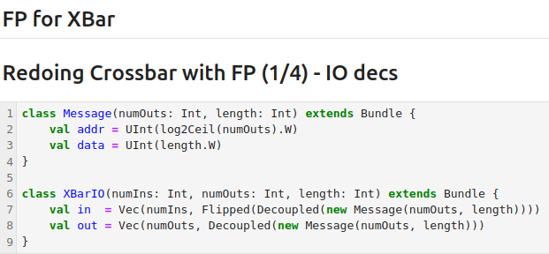
11.18 FP for XBar
https://www.youtube.com/watch?v=B_1bD5LnlII&list=PLfrN7RIcMe6g2LBRJLTHTdhyj5s8ag0Rg&index=11
FP for XBar (45:06-45:37/54:59)
Now, we look at XBar (Cross Bar).
The original XBar is as below.

Slide 47
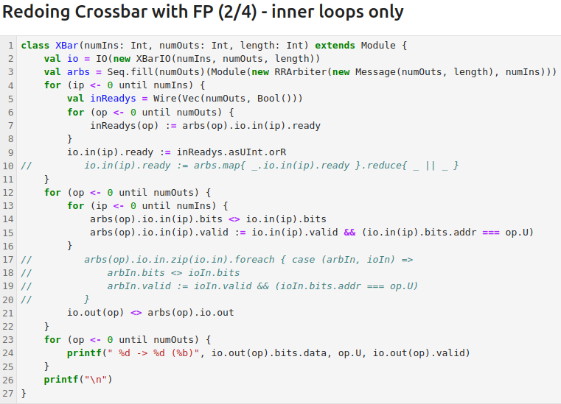
11.18 FP for XBar
https://www.youtube.com/watch?v=B_1bD5LnlII&list=PLfrN7RIcMe6g2LBRJLTHTdhyj5s8ag0Rg&index=11
Inner Loop Only (45:38-46:16/54:59)
We have two ports loop
1. > for (ip <- 0 until numIns)
2. > for (op <- 0 until numOuts)

Slide 48
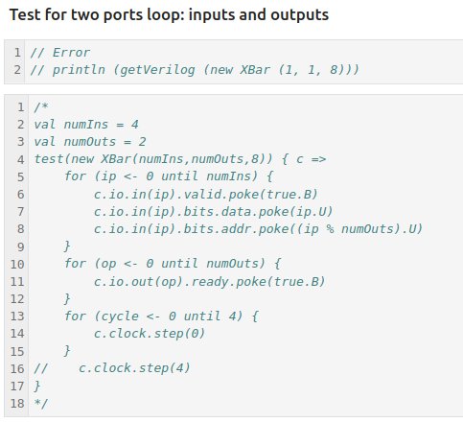
11.18 FP for XBar
https://www.youtube.com/watch?v=B_1bD5LnlII&list=PLfrN7RIcMe6g2LBRJLTHTdhyj5s8ag0Rg&index=11
Inner Loop Only (46:17-47:18/54:59)
Need to investigate more why not working.

Slide 49
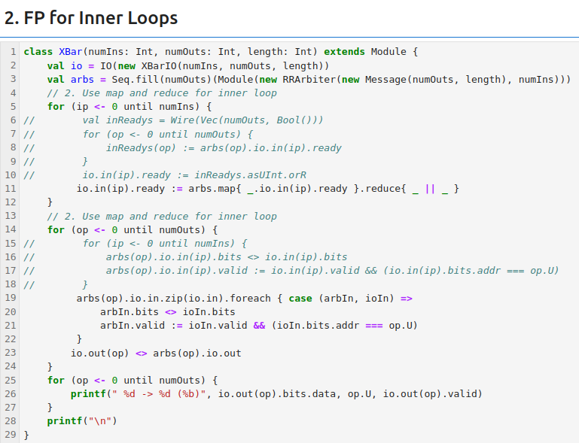
11.18 FP for XBar
https://www.youtube.com/watch?v=B_1bD5LnlII&list=PLfrN7RIcMe6g2LBRJLTHTdhyj5s8ag0Rg&index=11
FP Inner Loop Only (46:17-47:18/54:59)

Slide 50
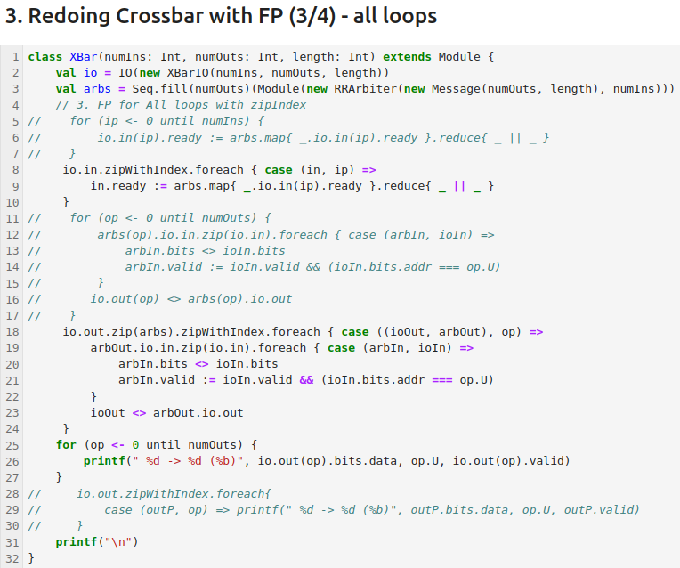
11.18 FP for XBar
https://www.youtube.com/watch?v=B_1bD5LnlII&list=PLfrN7RIcMe6g2LBRJLTHTdhyj5s8ag0Rg&index=11
FP all Loop (46:19-53:10/54:59)
Use zip Index.

Slide 51
11.19 Summary

Slide 52
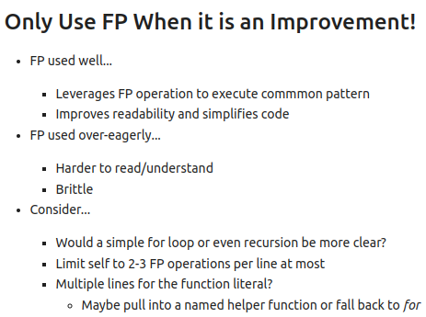
11.19 Summary
https://www.youtube.com/watch?v=B_1bD5LnlII&list=PLfrN7RIcMe6g2LBRJLTHTdhyj5s8ag0Rg&index=11
FP all Loop (53:11-54:49/54:59)
FP is a feature and not a requirement.

Slide 53
End

