Slide 1

7 Memory
Peter H. Chen

Slide 2
7 Memory
https://github.com/ucb-bar/chisel-tutorial/wiki/Conditional-Assignments-and-Memories
Memory
We discuss how to write Memory in Chisel with conditional and Assignments.
Topics:
1. Conditional Register Updates
2. when ... .elsewhen clause
3. when ... .otherwise clause
4. The unless clause
5. Combinational/Conditional Assignment
6. Read Only Memory
7. Read Write Memory
8. Basic Memory Instantiation
9. Synchronous vs. Asynchronous Memory Read
10. Memory Write Ports
11. Memory Read Ports
12. Memory Example
13. Load/Search Memory

Slide 3
7.1 Conditional Register Updates

Slide 4
7.1 Conditional Register Updates
https://github.com/ucb-bar/chisel-tutorial/wiki/Conditional-Assignments-and-Memories
Conditional Register Updates
1. As shown earlier, conditional register updates are performed with the when block which takes a Bool value or some boolean expression to evaluate.
2. In this section we more fully explore how to use this when conditional update structure
3. If a when block is used by itself, Chisel will assume that if the condition for the when block doesn’t evaluate to true, there is no update to the register value.
4. However, most of the time we don’t want to limit ourselves to a single conditional.
5. Thus in Chisel we use .elsewhen and .otherwise statements to select between multiple possible register updates as shown in the following sections.

Slide 5
7.2 The when … .elsewhen Clause

Slide 6

7.2 The when ... .elsewhen Clause
https://github.com/ucb-bar/chisel-tutorial/wiki/Conditional-Assignments-and-Memories
The when … .elsewhen Clause
1. When specifying a conditional update, we may want to check several conditions which we want to check in some order.
2. To do this for register updates, we use a when ... .elsewhen structure.
3. This is analogous to an if... else if control structure in sequential programming.
4. As with else if clauses, as many .elsewhen statements can be chained together in a single when block.
5. The general structure thus looks like:

Slide 7
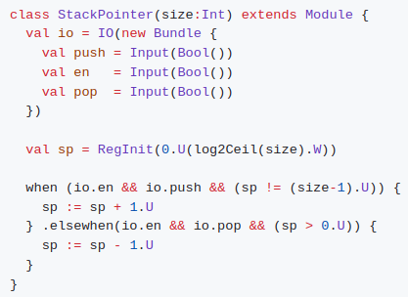
7.2 The when … .elsewhen Clause
https://github.com/ucb-bar/chisel-tutorial/wiki/Conditional-Assignments-and-Memories
The when … .elsewhen Clause
1. An example of this statement in action is shown in the following implementation of a simple stack pointer.
2. Suppose, we need to maintain a pointer that keeps track of the address of the top of a stack.
3. Given a signal pop that decrements the stack pointer address by 1 entry and a signal push that increments the stack pointer address by 1 entry, the implementation of just the pointer would look like the following:
Note:
In this implementation, the push signal has higher priority over the pop signal as it appears earlier in the when block.

Slide 8
7.3 The when … .otherwise Clause

Slide 9
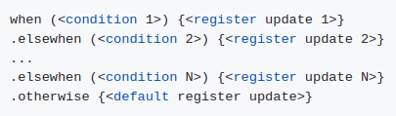
7.3 The when … .otherwise Clause
https://github.com/ucb-bar/chisel-tutorial/wiki/Conditional-Assignments-and-Memories
The when … .otherwise Clause
1. In order to specify a default register update value if all the conditions in the when block fail to trigger, we use an .otherwise clause.
2. The .otherwise clause is analogous to the else case that completes an if ... else block.
3. The .otherwise statement must occur last in the when block.
The general structure for the complete when block now looks like:

Slide 10
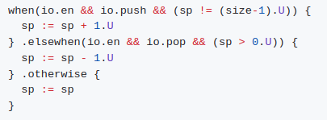
7.3 The when … .otherwise Clause
https://github.com/ucb-bar/chisel-tutorial/wiki/Conditional-Assignments-and-Memories
The when … .otherwise Clause
1. In the previous example, we could add a default statement which just assigns sp to the current value of sp.
The block would then look like:
The explicit assignment to preserve the value of sp is redundant in this case but it captures the point of the .otherwise statement.

Slide 11
7.4 The unless Clause

Slide 12

7.4 The unless Clause
https://github.com/ucb-bar/chisel-tutorial/wiki/Conditional-Assignments-and-Memories
The unless Clause
1. To complement the when statement, Chisel also supports an unless statement.
2. The unless statement is a conditional assignment that triggers only if the condition is false.
The general structure for the unless statement is:

Slide 13
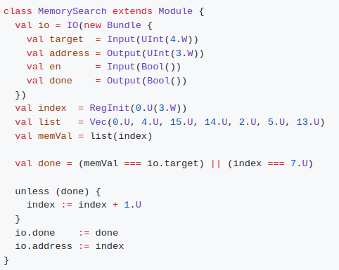
7.4 The unless Clause
https://github.com/ucb-bar/chisel-tutorial/wiki/Conditional-Assignments-and-Memories
The unless Clause
1. For example, suppose we want to do a simple search of the contents of memory and determine the address that contains some number.
2. Since we don’t know how long the search will take, the module will output a done signal when it is finished and until then, we want to continue to search memory.
3. The Chisel code for the module would look like:
In the right example, we limit the size of the memory to 8 entries and use a vector of literals to create a read only memory.
Note:
1. The unless statement is used to terminate the iteration if it see that the done signal is asserted.
2. Otherwise, it will continue to increment the index in memory until it finds the value in target or reaches the last index in the memory (7).

Slide 14
7.5 Combinational/Conditional Assignment

Slide 15
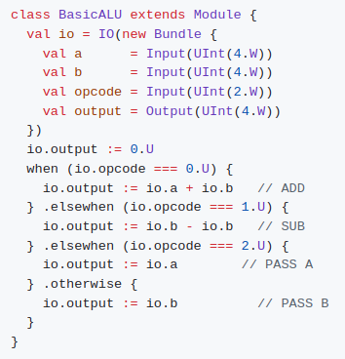
7.5 Combinational/Conditional Assignment
https://github.com/ucb-bar/chisel-tutorial/wiki/Conditional-Assignments-and-Memories
Combinational/Conditional Assignment
1. We can also use the when .elsewhen .otherwise block to define combinational values that may take many values.
2. For example, the following Chisel code show how to implement a basic arithmetic unit with 4 operations: add, subtract, and pass.
3. In this example, we check the opcode to determine which operation to perform and conditionally assign the output.
Note:
The Combinational Conditional Assignment can easily be easily expanded to check many different conditions for more complicated arithmetic units or combinational blocks.

Slide 16
7.6 Read Only Memories

Slide 17


7.6 Read Only Memories
https://github.com/ucb-bar/chisel-tutorial/wiki/Conditional-Assignments-and-Memories
Read Only Memories
1. To instantiate read only memories in Chisel, we use a vector of constant literals.
2. For example, in order to instantiate an 4 entry read only memory with the values 0 to 3, the definition would look like the following:
The width of the Vec is width of the widest argument.
Note:
1. We need to specify the type of literal in the ... braces following the literals.
2. Accessing the values in the read only memory is the same as accessing an entry in a Vec.
3. For example, to access the 2nd entry of the memory we would use:

Slide 18
7.7 Read/Write Memories

Slide 19
7.7 Read/Write Memories
https://github.com/ucb-bar/chisel-tutorial/wiki/Conditional-Assignments-and-Memories
Read/Write Memories
Chisel contains a primitive for memories called Mem.
Using the Mem class it is possible to construct multi-ported memory that can be synchronous or asynchronous read.

Slide 20
7.8 Basic Memory Instantiation

Slide 21


7.8 Basic Memory Instantiation
https://github.com/ucb-bar/chisel-tutorial/wiki/Conditional-Assignments-and-Memories
Basic Memory Instantiation
1. The Mem construction takes a memory size and a data type which it is composed of.
2. The general declaration structure looks like:
Where corresponds to the number of entries of are in the memory.
For instance, if you wanted to create a 128 entry memory of 32 bit UInt types, you would use the following instantiation:
Note:
When constructing a memory in Chisel, the initial value of memory contents cannot be specified.
Therefore, you should never assume anything about the initial contents of your Mem class.

Slide 22
7.9 Synchronous vs. Asynchronous Memory Read

Slide 23


7.9 Synchronous vs. Asynchronous Memory Read
https://github.com/ucb-bar/chisel-tutorial/wiki/Conditional-Assignments-and-Memories
Synchronous vs. Asynchronous Memory Read
1. It is possible to specify either synchronous or asynchronous read behavior.
2. For instance, if we wanted an asynchronous read 128 entry memory of 32 bit UInt types, we would use the following definition:
Likewise, if we wanted a synchronous read 128 entry memory of 32 bit UInt types, we use a seqMem object:

Slide 24
7.10 Memory Write Ports

Slide 25

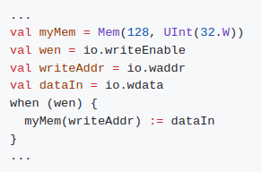
7.10 Memory Write Ports
https://github.com/ucb-bar/chisel-tutorial/wiki/Conditional-Assignments-and-Memories
Memory Write Ports
1. To add write ports to the Mem, we use a when block to allow Chisel to infer a write port.
2. Inside the when block, we specify the location and data for the write transaction.
3. In general, adding a write port requires the following definition:
Where refers to the entry number in the memory to write to.
Note 1:
1. We use the reassignment operator := when writing to the memory.
2. For example, suppose we have a 128 entry memory of 32 bit UInt types.
3. If we wanted to write a 32 bit value dataIn to the memory at location writeAddr if the write enable signal wen is true, our Chisel code would look like:
Note 2:
What is behavior of multiple write port?

Slide 26
7.11 Memory Read Ports

Slide 27
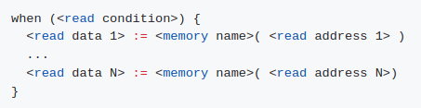
7.11 Memory Read Ports
https://github.com/ucb-bar/chisel-tutorial/wiki/Conditional-Assignments-and-Memories
Memory Read Ports
1. Depending on the type of read behavior specified, the syntax for adding read ports to Mem in Chisel is slightly different for asynchronous read and synchronous read memories.
2. Asynchronous Read Ports For asynchronous read memories, adding read ports to the memory simply amounts to placing an assignment inside a when block with some trigger condition.
3. If you want Chisel to infer multiple read ports, simply add more assignments in the when definition.
The general definition for read ports is thus:

Slide 28
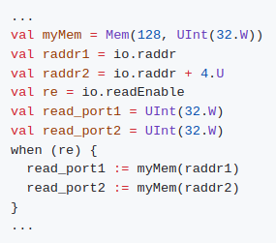
7.11 Mmeory Read Ports
https://github.com/ucb-bar/chisel-tutorial/wiki/Conditional-Assignments-and-Memories
Memory Read Ports
For instance, if you wanted a 128 entry memory of 32 bit UInt values with two asynchronous read ports, with some read enable re and reads from addresses raddr1 and raddr2, we would use the following when block definition:
Note:
The type and width of the read_port1 and read_port2 should match the type and width of the entries in the Mem.

Slide 29
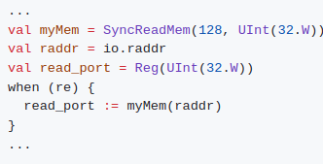
7.11 Memory Read Ports
https://github.com/ucb-bar/chisel-tutorial/wiki/Conditional-Assignments-and-Memories
Memory Read Ports
1. Synchronous Read Ports In order to add synchronous read ports to the Chisel Mem class, Chisel requires that the output from the memory be assigned to a Reg type.
2. Like the asynchronous read port, a synchronous read assignment must occur in a when block.
The general structure for the definition of a synchronous read port is as follows:

Slide 30
7.12 Memory Example

Slide 31
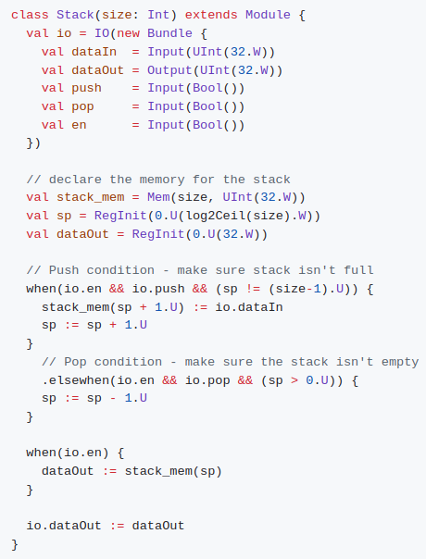
7.12 Memory Example
https://github.com/ucb-bar/chisel-tutorial/wiki/Conditional-Assignments-and-Memories
Memory Example
1. Here is example of using a memory by implementing a stack.
1. Suppose we would like to implement a stack that takes two signals push and pop where push tells the stack to push an input dataIn to the top of the stack, and pop tells the stack to pop off the top value from the stack.
2. Furthermore, an enable signal en disables pushing or popping if not asserted.
3. Finally, the stack should always output the top value of the stack.
Note:
1. Since the module is parametrized to be have size entries, in order to correctly extract the minimum width of the stack pointer sp we take the log2Ceil(size).
2. This takes the base 2 logarithm of size and rounds up.

Slide 32
7.13 Load/Search Memory Problem

Slide 33
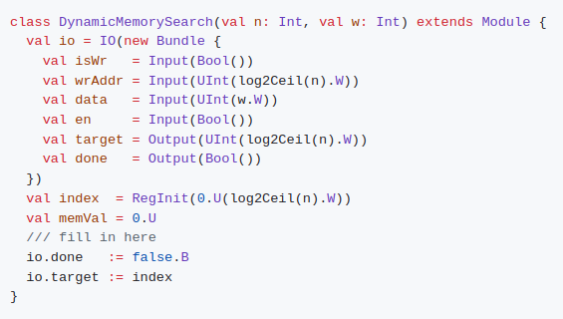
7.13 Load/Search Memory Problem
https://github.com/ucb-bar/chisel-tutorial/wiki/Conditional-Assignments-and-Memories
Load/Search Memory Problem
In this assignment, write a memory module that supports loading elements and searching based on the following template:
Note 1:
The Load/Search Memory Problem can be found in:
$TUT_DIR/src/main/scala/problems/DynamicMemorySearch.scala.
Note 2:
The solution can be found in:
$TUT_DIR/src/main/scala/solutions/DynamicMemorySearch.scala.
How it support size and width parameters n and w and how the address width is computed from the size. Run

Slide 34

7.13 Load/Search Memory Problem
https://github.com/ucb-bar/chisel-tutorial/wiki/Conditional-Assignments-and-Memories
Load/Search Memory Problem
Run and modify the circuit until all passed.

Slide 35

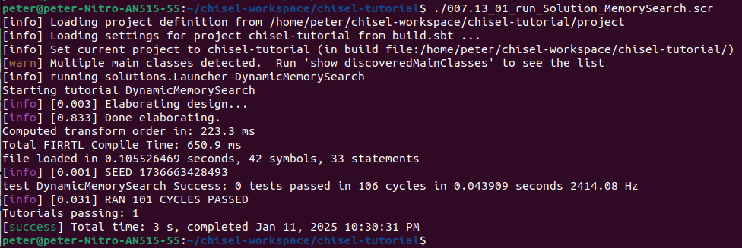
7.13 Load/Search Memory Problem
https://github.com/ucb-bar/chisel-tutorial/wiki/Conditional-Assignments-and-Memories
Load/Search Memory Problem
1. ./007.13_01_run_Solution_MemorySearch.scr
>> ./run-solution.sh DynamicMemorySearch
2. Result
1
2

Slide 36
End

