Slide 1

8.1 Digital Design with Chisel/FIRRTL
Peter H. Chen

Slide 2

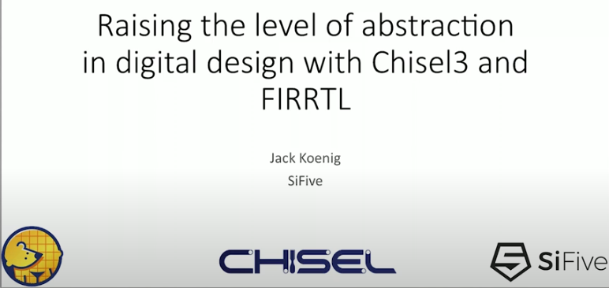
8.1 Digital Design with Chisel/FIRRTL
https://www.youtube.com/watch?v=4FCZLrauDcE&list=PLlu0CT-JnSasfpk8tq1ZDiE2G0AK1BhOg&index=8
Digital Design with Chisel/FIRRTL (0:00-0:45/26:23)
This Digital Design with Chisel/FIRRTL discussion is summarized from ORConf (Open SouRce Conference), 2018.

Slide 3
8.2 Why Do We Use Chisel?

Slide 4

8.2 Why Do We Use Chisel?
https://www.youtube.com/watch?v=4FCZLrauDcE&list=PLlu0CT-JnSasfpk8tq1ZDiE2G0AK1BhOg&index=8
Why Do We Use Chisel? (0:45-0:46/26:23)
UC Berkeley students worked at UC Berkeley Project before 2015.

Slide 5
8.3 SiFive

Slide 6
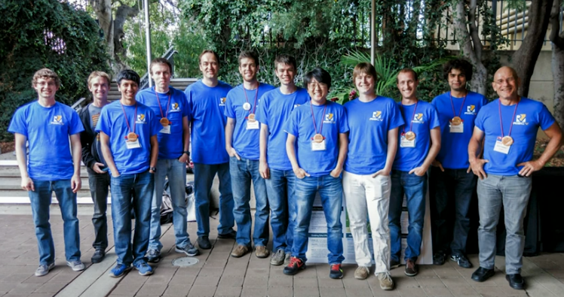
8.3 SiFive
https://www.youtube.com/watch?v=4FCZLrauDcE&list=PLlu0CT-JnSasfpk8tq1ZDiE2G0AK1BhOg&index=8
SiFive (0:47-1:07/26:23)
12 graduate students from UC Berkeley started SiFive around 2015.

Slide 7
8.4 SoC Taped Out

Slide 8
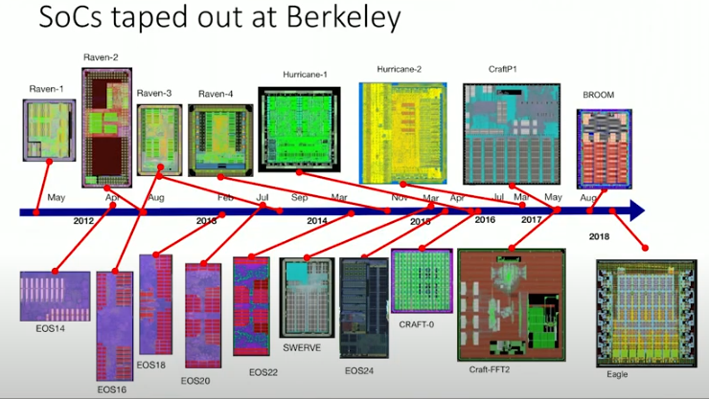
8.4 SoC Taped Out
https://www.youtube.com/watch?v=4FCZLrauDcE&list=PLlu0CT-JnSasfpk8tq1ZDiE2G0AK1BhOg&index=8
Soc Tapped Out (1:07-1:43/26:23)
SiFive build a lot of chips from 2015 to 2018 (conference at 2018).
The Digital Design chips with Chisel/FIRRTL tapped out.
SiFive started at EOS14-x, SWERVE, CRAFT-x, Eagle, etc.

Slide 9
8.5 How To Do SoC?

Slide 10

8.5 How TO Do SoC?
https://www.youtube.com/watch?v=4FCZLrauDcE&list=PLlu0CT-JnSasfpk8tq1ZDiE2G0AK1BhOg&index=8
How To Do SoC? (1:44-1:45/26:23)
Very difficult to do Hardware Design.

Slide 11
8.6 Agile Hardware Design

Slide 12
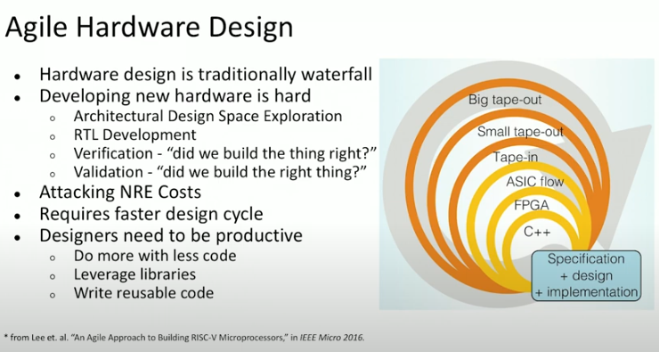
8.6 Agile Hardware Design
https://www.youtube.com/watch?v=4FCZLrauDcE&list=PLlu0CT-JnSasfpk8tq1ZDiE2G0AK1BhOg&index=8
Agile Hardware Design (1:46-3:46/26:23)
“An Agile Approach to building RISC-V Microprocessors,” Yunsup Lee, et al, IEEE Macro 2016.
1. Traditional Hardware Design: Traditional Waterfall style Hardware Design take too long and cost a lot of man effort.
2. Hard to do
3. Reduce NRE (Non-Recurring Engineering) cost: Agile approach to reduce the cost for one-time cost to research, design develop, test a new product/product enhancement.
4. Fast Cycle
5. Designers need to be Productive

Slide 13
8.7 Parameterization

Slide 14
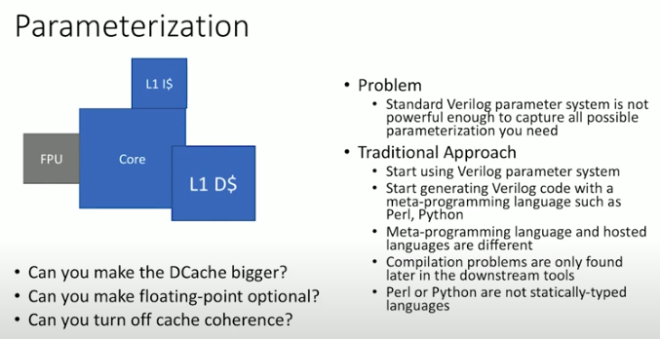
8.7 Parameterization
https://www.youtube.com/watch?v=4FCZLrauDcE&list=PLlu0CT-JnSasfpk8tq1ZDiE2G0AK1BhOg&index=8
Parameterization (3:47-5:20/26:23)
Problem with traditional approach:
Change something (size, function, coherence, etc.) by parameters.

Slide 15
8.8 Chisel

Slide 16
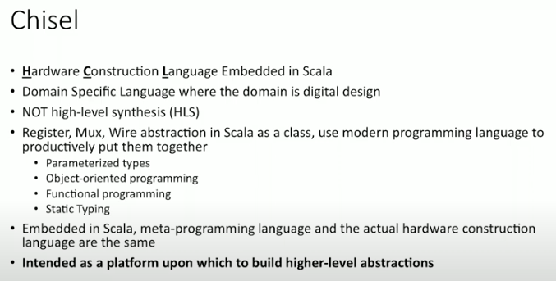
8.8 Chisel
https://www.youtube.com/watch?v=4FCZLrauDcE&list=PLlu0CT-JnSasfpk8tq1ZDiE2G0AK1BhOg&index=8
Chisel (5:21-7:00/26:23)
Chisel: HCL (Hardware Construction Language) Embedded in Scala. We called Construction Language because the it is fundamentally different from Behavioral Model in Verilog. Verilog is a software get synthesized by a very restricted tools, such as, Synopsys Design Compiler. Chisel is not like Verilog.
Chisel is a DSL (Domain Specific Language) where the domain is the Digital Design.
Chisel is NOT a HLS (High Level Synthesis).
Hardware design is much like the Register, Mux, and Wire abstraction in Scala as a class.
We then put them together with Scala language. Scala provides:
  Parameterized Types
  OOD (Object Oriented Programming)
  Functional Programming
  Static Typing
Chisel is embedded in Scala. Meta language/hardware construction language are the same. Registers and Muxes are primitives which are classes and objects in Scala.
Chisel is a platform which build higher-level abstraction.

Slide 17
8.9 Other HCL/HDL

Slide 18
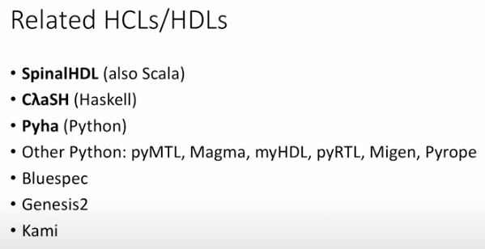
8.9 Other HCL/HDL
https://www.youtube.com/watch?v=4FCZLrauDcE&list=PLlu0CT-JnSasfpk8tq1ZDiE2G0AK1BhOg&index=8
Other HCL/HDL (7:01-7:28/26:23)
There are some other HCL (Hardware Construction Language) and HDL (Hardware Description Language):
  SpinalHDL: Scala based HDL, generate the hardware circuit.
  ClaSH: a Functional Description Language
  Pyha: Python-based HDL (Hardware Description Language)
  PyMTL: Python Multi-Level Hardware language
  Migen: Python-based Automation for VLSI Design.

Slide 19
8.10 Decouple Design from Implementation

Slide 20
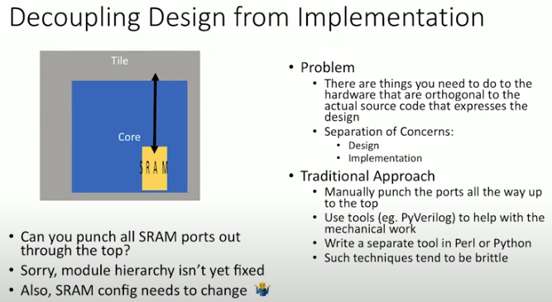
8.10 Decouple Design from Implementation
https://www.youtube.com/watch?v=4FCZLrauDcE&list=PLlu0CT-JnSasfpk8tq1ZDiE2G0AK1BhOg&index=8
Decouple Design from Implementation (7:29-9:23/26:23)
We have Core and SRAM. They both need to be changed. We want to decouple them.

Slide 21
End

