Slide 1

8.11 Build Compiler
Peter H. Chen

Slide 2
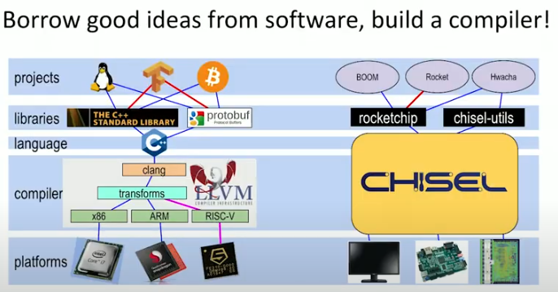
8.11 Build Compiler
https://www.youtube.com/watch?v=4FCZLrauDcE&list=PLlu0CT-JnSasfpk8tq1ZDiE2G0AK1BhOg&index=8
Build Compiler (9:23-10:11/26:23)
Chisel: We borrow all the good ideas from software and build a compiler called Chisel to combine all the features together. Chisel is very fit for ISA (Instruction Set Architecture).
In parameterization example we discuss later, we have 3 cores, devices SPI (Serial Peripheral Interface) and PWM (Pulse-Width Modulation). we want to add an UART (Universal Asynchronous Receiver/Transmitter) to increase the width of address field.

Slide 3
8.12 FIRRTL

Slide 4
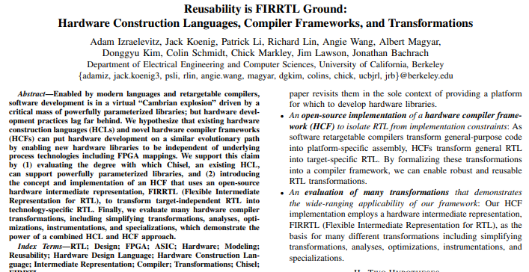
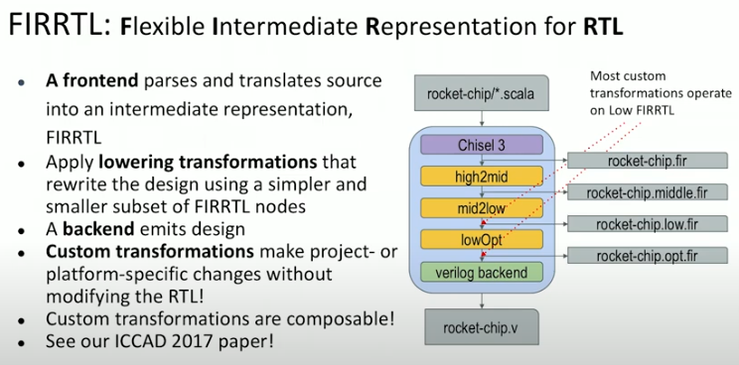
8.12 FIRRTL
https://www.youtube.com/watch?v=4FCZLrauDcE&list=PLlu0CT-JnSasfpk8tq1ZDiE2G0AK1BhOg&index=8
FIRRTL (10:12-11:03/26:23)
FIRRTL (Flexible Intermediate Representation for RTL)
1. FIRRTL does a frontend parse and translation into an Intermediate Representation (FIR) and Final RTL.
2. FIRRTL generates High, Middle, low level FIR.
3. FIRRTL generates final backend RTL Verilog.
4. FIRRTL can change FIR without modify the RTL.
5. Compose all FIR transformation and RTL Verilog together.
6. See ICCAD 2017 paper: “Reliability is FIRRTL Ground: Hardware Construction Languages, Compiler Frameworks, and Transformations”, by Adam Izaelevitz, et al.

Slide 5
8.13 Ecosystem

Slide 6
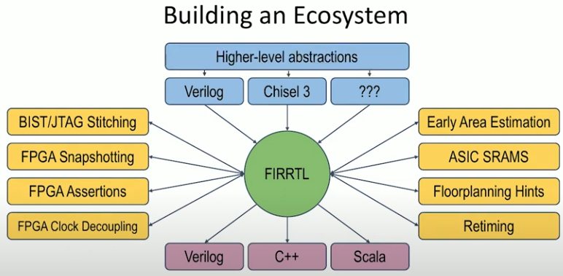
8.13 Ecosystem
https://www.youtube.com/watch?v=4FCZLrauDcE&list=PLlu0CT-JnSasfpk8tq1ZDiE2G0AK1BhOg&index=8
Ecosystem (11:04-12:02/26:23)
Below, we chisel3 compiled with LLVM: We have Verilog, lots of custom transforms, including Berkeley RISCV, Intel x86, ARM, FPGA, ASIC/RTL Verilog, etc.
Some outside group write some transformation.
FIRRTL can emit Verilog, C++, and Scala.
We can run C++ for simulation, Verilator for Verilog verification, and Scala interpreter as well.
We also have high-level abstraction. Our area is Chisel, but we also allow some other platforms to interoperate.

Slide 7
8.14 Parameterization++

Slide 8
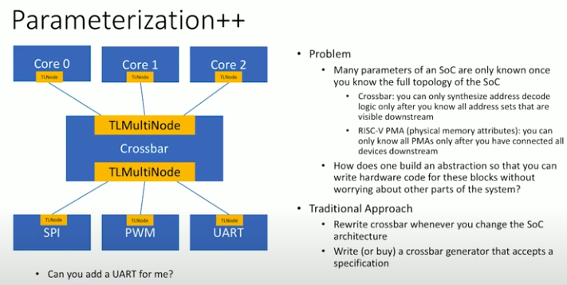
8.14 Parameterization++
https://www.youtube.com/watch?v=4FCZLrauDcE&list=PLlu0CT-JnSasfpk8tq1ZDiE2G0AK1BhOg&index=8
Parameterization++ (12:03-14:22/26:23)
Below, we discuss about the parameterization++.
For example, we have 3 cores which fit to the crossbar for address to physical memory. We have the devices SPI (Serial Peripheral Interface) and PWM (Pulse-Width Modulation)
We want to add an UART (Universal Asynchronous Receiver/Transmitter) to increase the width of address field.
We only need to know the topology. Chisel need to know more information for core in your cache. We can do the top down design. All we need is to add the information to instantiate the design.
We need to know the address of the crossbar for the physical memory of SoC.
It is better than traditional approach that we need to rewrite the crossbar for memory address for SoC.

Slide 9
8.15 Diplomacy

Slide 10
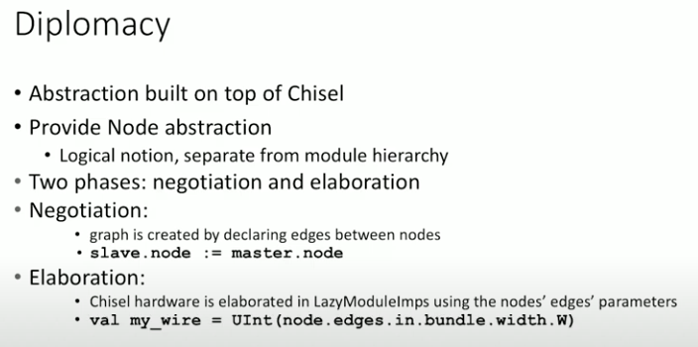
8.15 Diplomacy
https://www.youtube.com/watch?v=4FCZLrauDcE&list=PLlu0CT-JnSasfpk8tq1ZDiE2G0AK1BhOg&index=8
Diplomacy (12:03-15:06/26:23)
Below, we discuss about the Diplomacy (外交).
1. Diplomacy is not part of Chisel, diplomacy is a Scala library on top of the chisel.
2. Diplomacy provide the Node Abstraction.
Chisel does the two phases to translate the diplomacy abstraction information into Chisel: Negotiation and Elaboration.

Slide 11
8.16 Negotiation

Slide 12
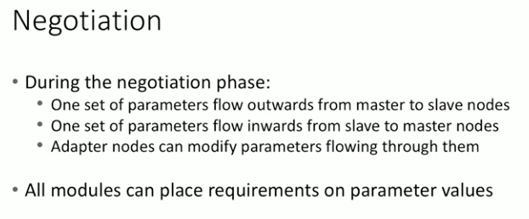
8.16 Negotiation
https://www.youtube.com/watch?v=4FCZLrauDcE&list=PLlu0CT-JnSasfpk8tq1ZDiE2G0AK1BhOg&index=8
Negotiation (15:07-15:55/26:23)
Basic Description of parameter from Master to Slave Node.

Slide 13
8.17 Top-Down Parameter

Slide 14
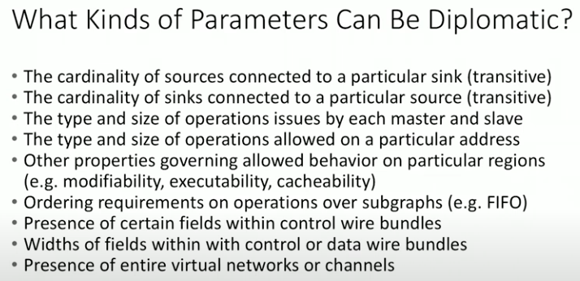
8.17 Top-Down Parameter
https://www.youtube.com/watch?v=4FCZLrauDcE&list=PLlu0CT-JnSasfpk8tq1ZDiE2G0AK1BhOg&index=8
Top-Down Parameter (15:56-16:33/26:23)
What kind of parameter between from top to down module.

Slide 15
8.18 Diplomacy Graph

Slide 16
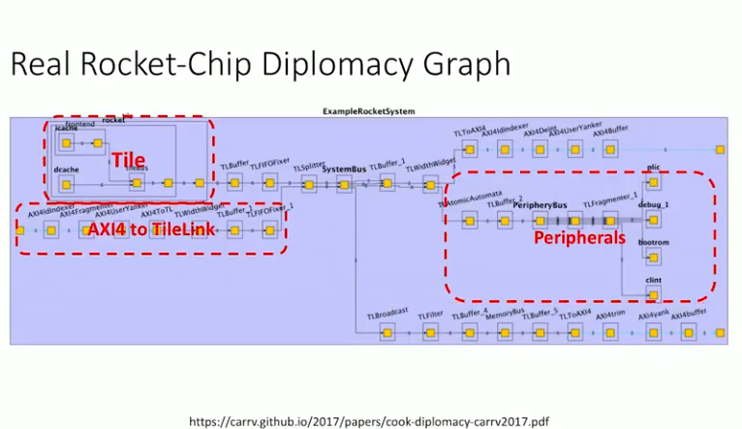
8.18 Diplomacy Graph
https://www.youtube.com/watch?v=4FCZLrauDcE&list=PLlu0CT-JnSasfpk8tq1ZDiE2G0AK1BhOg&index=8
Diplomacy Graph (16:34-17:02/26:23)
Rocket-Chip Diplomacy Graph for parameters.
The graph includes several pieces: Tile, AXI4 to TileLink, TileLink to AXI4, Peripherals.
Information is needed for the Tile.
Information comes to Physical Memory or to the address ranges that the peripherals are using.
The diplomacy makes all information is easy to verify,

Slide 17
8.19 Parameterization/Decouple Design

Slide 18
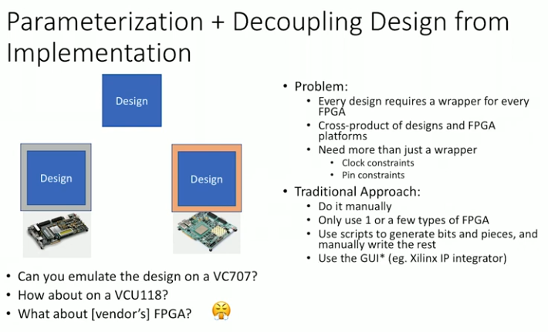
8.19 Parameterization/Decouple Design
https://www.youtube.com/watch?v=4FCZLrauDcE&list=PLlu0CT-JnSasfpk8tq1ZDiE2G0AK1BhOg&index=8
Parameterization/Decouple Design to Implementation (17:03-18:46/26:23)
We use parametrization/decouple the design to implementation (VC707, VCU118, FPGA, etc)

Slide 19
8.20 FPGA Shell

Slide 20
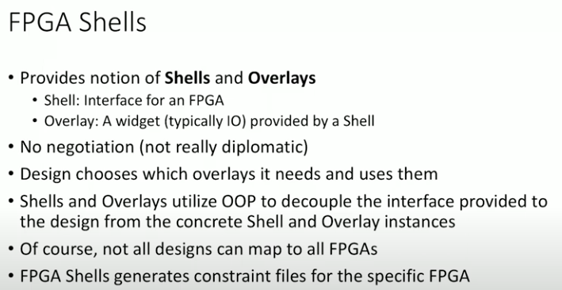
8.20 FPGA Shell
https://www.youtube.com/watch?v=4FCZLrauDcE&list=PLlu0CT-JnSasfpk8tq1ZDiE2G0AK1BhOg&index=8
FPGA Shell (18:47-19:55/26:23)
FPGA Shell provides Shell and Overlay.
1. Shell: Interface to FPGA
2. Overlay: IO provided by a Shell (Interface of FPGA)

Slide 21
End

