Slide 1

8.21 Community
Peter H. Chen

Slide 2
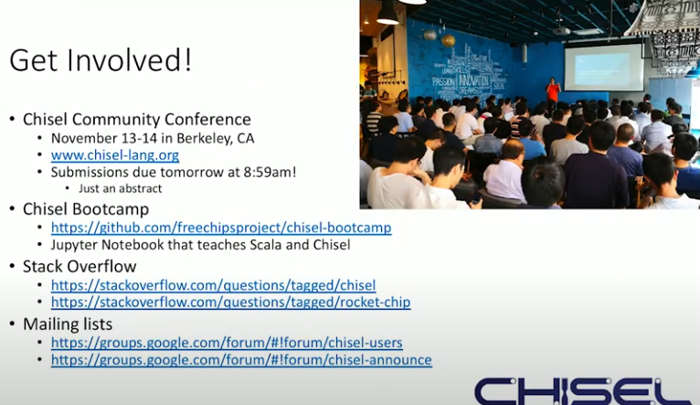
8.21 Community
https://www.youtube.com/watch?v=4FCZLrauDcE&list=PLlu0CT-JnSasfpk8tq1ZDiE2G0AK1BhOg&index=8
Community (19:56-22:55/26:23)
1. Chisel Community Conference
2. Chisel Bootcamp
3. Stack Overflow
4. Mailing Lists
5. SiFive Web site

Slide 3
8.22 Question and Answer

Slide 4
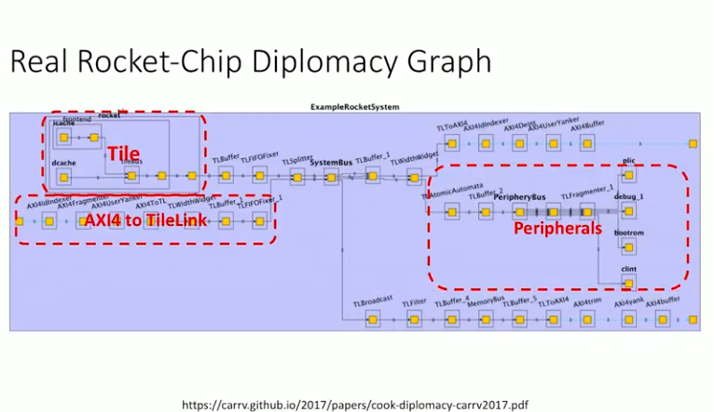
8.22 Question and Answer
https://www.youtube.com/watch?v=4FCZLrauDcE&list=PLlu0CT-JnSasfpk8tq1ZDiE2G0AK1BhOg&index=8
Question and Answer (19:56-25:00/26:23)
Person 1:
How to put different IRs (Intermediate Representation) into your project?
Ans: We have different vendor libraries
Person 2:
1. Chisel support Formal Verificaiton?
Ans: We have good library for it.
2. We have different Clocks for different peripheral:
Ans: FPGA uses different PLLs for different resource for different clock domain.

Slide 5
8.22 Question and Answer
https://www.youtube.com/watch?v=4FCZLrauDcE&list=PLlu0CT-JnSasfpk8tq1ZDiE2G0AK1BhOg&index=8
Question and Answer (25:01-26:23/26:23)
Person 1:
How to integrate Verilog into your design?
Ans:
Integrate different Verilog is fine.
Person 2:
How to do Verification of DFT (Design for Testability)?
Ans:
We integrate the vendor library for DFT.

Slide 6
End

