Slide 1

1 Interlocution: Lab 1
Peter H. Chen

Slide 2
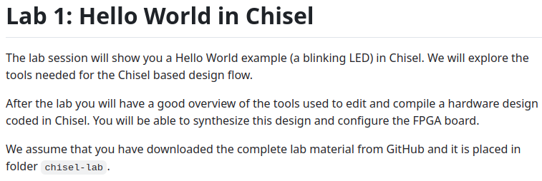
1 Introduction: Lab 1
https://github.com/schoeberl/chisel-lab/tree/master/lab1
Lab 1
The lab session will show you a Hello World example (a blinking LED) in Chisel.
We will explore Chisel based design flow.
After the lab you will have a good overview of the tools used to edit and compile a hardware design coded in Chisel.
You will be able to synthesize this design and configure the FPGA board.

Slide 3
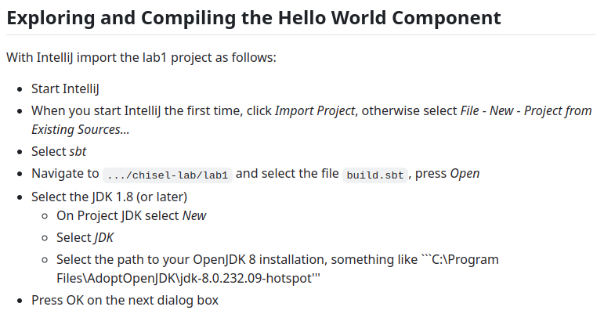
1 Introduction: Lab 1
https://github.com/schoeberl/chisel-lab/tree/master/lab1
Hello World
1. Start IntelliJ: When you start IntelliJ the first time, click Import Project, otherwise select File - New - Project from Existing Sources…
2. Select sbt: Navigate to .../chisel-lab/lab1 (On Ubuntu, path is ~/AIU/AIU_CS800_Chisel/050_ChiselBool/001_Intro/001_Lab/lab1) and select the file build.sbt, press Open
3. Select the JDK 1.8 (or later)
4. On Project JDK select New > Select JDK
5. Select the path to your OpenJDK 8 installation, something like “C:\Program Files\AdoptOpenJDK\jdk-8.0.232.09-hotspot” (on Ubuntu, path is /home/peter/.sdkman/candidates/java/current/bin/javac or java)
6. Press OK on the next dialog box

Slide 4
End

