Slide 1

19 DSE (Design Space Exploration)
Peter H. Chen

Slide 2
19 DSE (Design Space Exploration)
https://www.youtube.com/watch?v=DoBQkMFBdR8&list=PLfrN7RIcMe6g2LBRJLTHTdhyj5s8ag0Rg&index=21
DSE (Design Space Exploration) (0:00-0:05/53:15)
We discuss DSE (Design Space Exploration) for Hardware Design.
Topics:
1. DVFS (Dynamic Voltage Frequency Scaling): We can use Chisel for Verilog Simulation or Aladdin,/Gem5 Architectural Simulator (Chip Statistics)
2. Static Power and Dynamic Power
3. DSE (Design Space Exploration): We can use Hypermapper from Stanford University or OpenTuner
4. PAT Pareto Frontier of CPU/Memory/GPU
5. PT Pareto Frontier of Core Design

Slide 3
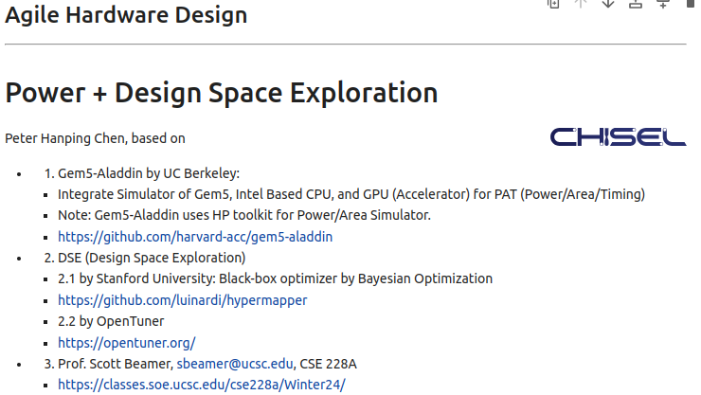
19 DSE (Design Space Exploration)
https://www.youtube.com/watch?v=DoBQkMFBdR8&list=PLfrN7RIcMe6g2LBRJLTHTdhyj5s8ag0Rg&index=21
DSE (Design Space Exploration) (0:06-0:30/53:15)
We discuss the DSE (Design Space Exploration) based on:
1. Gem5-Aladdin by UC Berkeley:
  Integrate Simulator of Gem5, Intel Based CPU, and GPU (Accelerator) for PAT (Power/Area/Timing)
  Note: Gem5-Aladdin uses HP toolkit for Power/Area Simulator.
  https://github.com/harvard-acc/gem5-aladdin
2. DSE (Design Space Exploration)
  2.1 by Stanford University: Black-box optimizer by Bayesian Optimization
  https://github.com/luinardi/hypermapper
  2.2 by OpenTuner
  https://opentuner.org/
3. Prof. Scott Beamer, sbeamer@ucsc.edu, CSE 228A
  https://classes.soe.ucsc.edu/cse228a/Winter24/

Slide 4
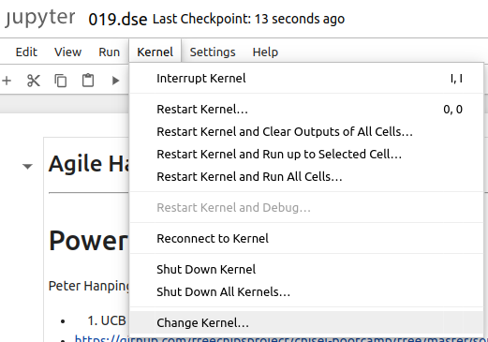
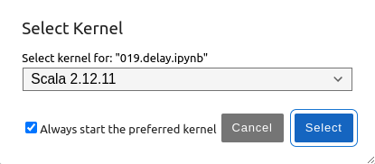
19 DSE (Design Space Exploration)
https://www.youtube.com/watch?v=DoBQkMFBdR8&list=PLfrN7RIcMe6g2LBRJLTHTdhyj5s8ag0Rg&index=21
DSE (Design Space Exploration) (0:31-0:42/53:15)
Setup Scala 2.12.11:
> jupyter notebook 019.dse.ipynb
Kernel > Change Kernel ,,, > Select Scala 2.12.11
Run > Run All Cells

Slide 5
19.1 Plan

Slide 6
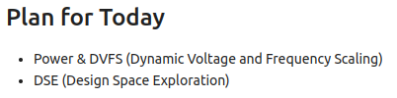
19.1 Plan
https://www.youtube.com/watch?v=DoBQkMFBdR8&list=PLfrN7RIcMe6g2LBRJLTHTdhyj5s8ag0Rg&index=21
Plan (0:43-0:54/53:15)
Today, we talk about DSE (Design Space Exploration)
1. Power & DVFS (Dynamic Voltage and Frequency Scaling)
2. DSE (Design Space Exploration): We add the parameters for design optimization.

Slide 7
19.2 Power Optimization for Chip Design

Slide 8
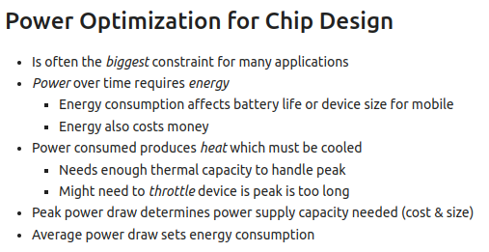
19.2 Power Optimization for Chip Design
https://www.youtube.com/watch?v=DoBQkMFBdR8&list=PLfrN7RIcMe6g2LBRJLTHTdhyj5s8ag0Rg&index=21
Power Optimization for Chip Design (0:55-8:57/53:15)
High performance is the most important we want.
Power is energy and is holding back the performance. We also need to concerned about energy.
What is the impact of energy? We all use the mobile device. The battery has fixed amount of energy. How long of the battery going to last?
1. If we can make hardware design more energy efficient well, we can increase the battery life.
2. If device is more energy efficient, we can shrink the the battery size and make device smaller and lighter.
Obviously, energy is really important for mobile phone. For data center, we pay the energy cost. If we have green energy concern, we want to reduce energy consumption.
If you consume too much power, your device can be overheat and damage the device. There is also limitation to cool down the device.
So, power is a issue if the device is too hot to operate. There is a constraint for peak power operation.
The iPhone has SoC, Screen, battery, a bunch of other chips.
If we have small peak power, new have smaller power consumption for all devices.
We also have smaller heat consumption.
Smaller power consumption is a good motivation.
Data center consumes Mega Watts. We want the constant power consumption. Big power surge causes the power outage/shutdown.

Slide 9
19.3 Power Calculation

Slide 10
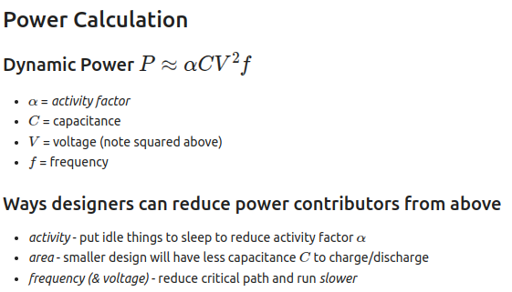
19.3 Power Calculation
https://www.youtube.com/watch?v=DoBQkMFBdR8&list=PLfrN7RIcMe6g2LBRJLTHTdhyj5s8ag0Rg&index=21
Power Calculation (8:58-14:58/53:15)
How to calculate the power consumption?
Power has static power and dynamic power.
1. Static power is power that voltage is fixed.
2. Dynamic power is proportional to Capacitance, Switching Voltage, frequency, and activity factor.
For the inverter, the charging and discharging of capacitor.
For logic gates, memories, and registers, we input logic from 0 to 1 to make the voltage to go up. We input logic from 1 to 0 to discharge the voltage to zero.
The designer
1. Control the activity to sleep to reduce activity,
2. Make the area small, and
3. Reduce critical path (delay) and run slower to reduce power.

Slide 11
19.4 Save Power: Power/Clock Gating

Slide 12
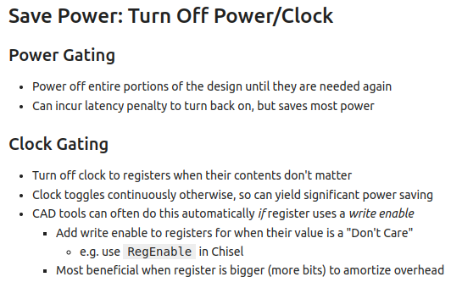
19.4 Save Power: Power/Clock Gating
https://www.youtube.com/watch?v=DoBQkMFBdR8&list=PLfrN7RIcMe6g2LBRJLTHTdhyj5s8ag0Rg&index=21
Save Power: Power/Clock Gating (14:59-20:20/53:15)
1. Power Gating: Turn off Power
2. Clock Gating:
If register uses write enable to turn on the clock and write disable to turn off the clock.
The activity factor is used to calculate the dynamic clock power.

Slide 13
19.5 Static/Dynamic Power

Slide 14
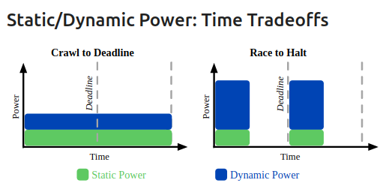
19.5 Static/Dynamic Power
https://www.youtube.com/watch?v=DoBQkMFBdR8&list=PLfrN7RIcMe6g2LBRJLTHTdhyj5s8ag0Rg&index=21
Static/Dynamic Power (20:21-22:05/53:15)
How do I manage the power even I do not use the circuit?
1. Left: Turn off the dynamic power.
2. Right: Turn on the dynamic power.
Q1: What is “Crawl to deadline?”
Ans: "Crawl to deadline" refers to a period must complete the crawling process. It is related to delay direction. If a crawl process is not completed within the deadline, it leads to incomplete ans slower.
Q2: What is “Race to Halt?”
Ans: "Race to halt" is a power-saving technique used in computers and other electronic devices to minimize energy consumption by running at high speed to complete tasks quickly and then entering a low-power state. This strategy, sometimes called "Race-to-Sleep" or "Race-to-Dark," aims to maximize time spent in a low-power state to reduce overall energy usage.

Slide 15
19.6 Save Power: Run Slower

Slide 16
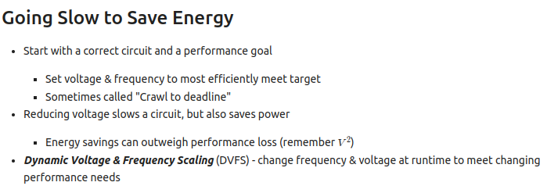
19.6 Save Power: Run Slower
https://www.youtube.com/watch?v=DoBQkMFBdR8&list=PLfrN7RIcMe6g2LBRJLTHTdhyj5s8ag0Rg&index=21
Save Power: Run Slower (22:06-23:17/53:15)
1. Use efficient power. Will slow the performance: Crawl to Deadline. If I have mobile device, I turn off the screen. It is a Crawl to deadline.
2. Reduce the voltage level.
3. Change frequency to slower.

Slide 17
19.6 Save Power: Run Faster

Slide 18
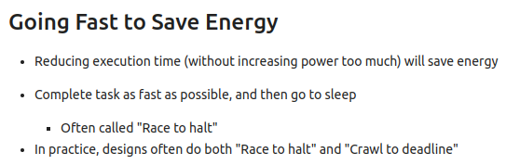
19.6 Save Power: Run Faster
https://www.youtube.com/watch?v=DoBQkMFBdR8&list=PLfrN7RIcMe6g2LBRJLTHTdhyj5s8ag0Rg&index=21
Save Power: Run Faster (23:18-28:10/53:15)
1. Reduce the run time (Increase the power level but run shorter time).
2. Complete task as soon as possible and then go to sleep: Race to Halt.
3. We can use both slow and fast to save power.

Slide 19
19.7 Design Space

Slide 20
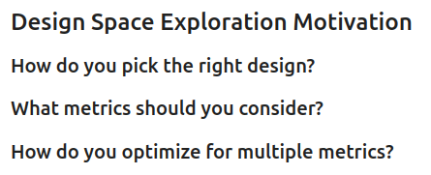
19.7 Design Space
https://www.youtube.com/watch?v=DoBQkMFBdR8&list=PLfrN7RIcMe6g2LBRJLTHTdhyj5s8ag0Rg&index=21
Design Space (28:11-29:30/53:15)
1. How to do design with right parameters?
2. What metrics should we use?
3. How to do optimization for multiple metrics?

Slide 21
19.8 Design Space Metrics

Slide 22
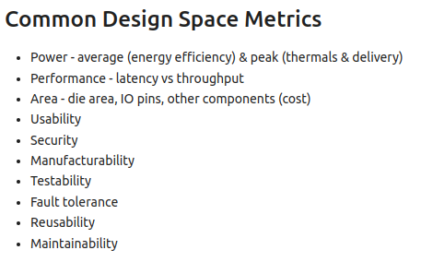
19.8 Design Space Metrics
https://www.youtube.com/watch?v=DoBQkMFBdR8&list=PLfrN7RIcMe6g2LBRJLTHTdhyj5s8ag0Rg&index=21
Design Space Metrics (29:31-32:58/53:15)
1. Average Power
2. Performance: Latency and throughput
3. Area: Area, IO Pins, cost
4. Usability
5. Security
6. Manufacturability
7. Testability
8. Fault Tolerance
9. Re-usability
10. Maintainability

Slide 23
19.9 Design Space Parameter

Slide 24
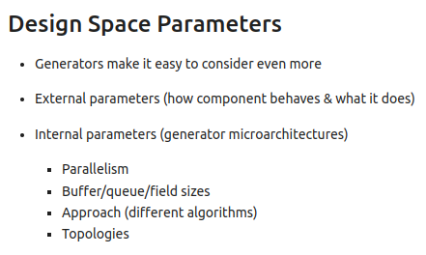
19.9 Design Space Parameter
https://www.youtube.com/watch?v=DoBQkMFBdR8&list=PLfrN7RIcMe6g2LBRJLTHTdhyj5s8ag0Rg&index=21
Design Space Parameter (32:59-33:58/53:15)
1. Generators for different design
2. External Parameter
3. Internal Parameter: Micro-architecture

Slide 25
19.10 Select Design Space

Slide 26
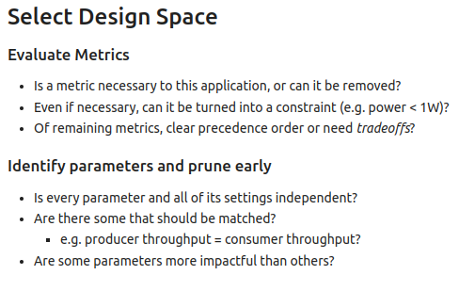
19.10 Select Design Space
https://www.youtube.com/watch?v=DoBQkMFBdR8&list=PLfrN7RIcMe6g2LBRJLTHTdhyj5s8ag0Rg&index=21
Select Design Space (33:59-35:58/53:15)
How do we reduce the Parameters of Design?
Determine which parameter is the most critical one?
Some of them maybe equivalent. We remove some of the parameters.
1. Evaluate Metrics:
2. Prune Parameters

Slide 27
19.11 Explore Design Space

Slide 28
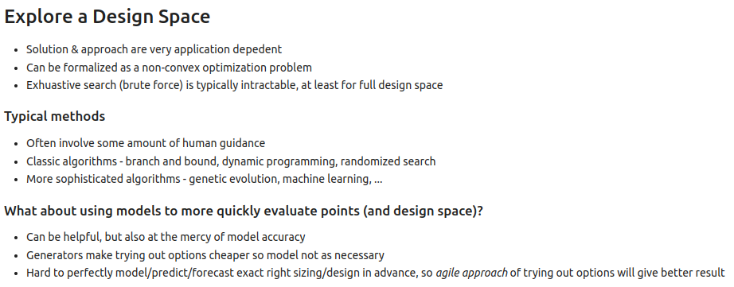
19.11 Explore Design Space
https://www.youtube.com/watch?v=DoBQkMFBdR8&list=PLfrN7RIcMe6g2LBRJLTHTdhyj5s8ag0Rg&index=21
Explore Design Space (35:59-40:32/53:15)
1. Typical Methods: algorithms, genetic evolution, machine learning, etc.
2. Model the design to get the optimal result.

Slide 29
19.12 Matrix Multiplication: Design Space Exploration

Slide 30
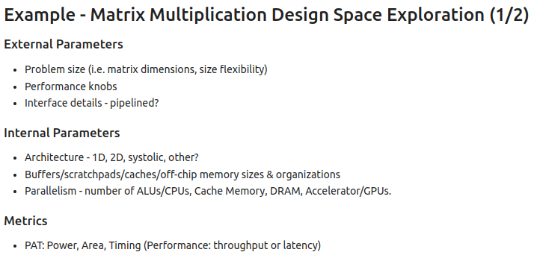
19.12 Matrix Multiplication: Design Space Exploration
https://www.youtube.com/watch?v=DoBQkMFBdR8&list=PLfrN7RIcMe6g2LBRJLTHTdhyj5s8ag0Rg&index=21
Matrix Multiplication: Design Space Exploration (40:33-42:00/53:15)
1. External Parameter: matrix dimension, pipeline
2. Internal Parameter: 1-D, 2-D, buffer, number of ALUs/CPUs, Cache Memory, DRAM, Accelerator/GPUs.
3. Metrics: PAT [Power, Area, Timing (Performance: Throughput or latency)]

Slide 31
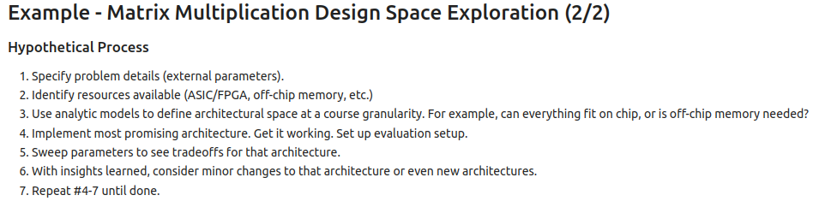
19.12 Matrix Multiplication: Design Space Exploration
https://www.youtube.com/watch?v=DoBQkMFBdR8&list=PLfrN7RIcMe6g2LBRJLTHTdhyj5s8ag0Rg&index=21
Matrix Multiplication: Design Space Exploration (42:01-45:31/53:15)
1. Specify Problem
2. Resource: ASIC, FPGA, IO (GPU, external memory), etc.
3. Model
4. architecture
5. Parameter
6. Architecture
7. Repeat 4 to 7.

Slide 32
19.13 Pareto Frontier

Slide 33
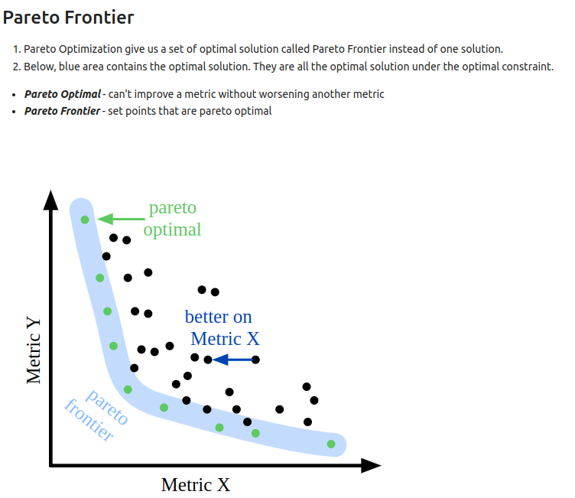
19.13 Pareto Frontier
https://www.youtube.com/watch?v=DoBQkMFBdR8&list=PLfrN7RIcMe6g2LBRJLTHTdhyj5s8ag0Rg&index=21
Pareto Frontier (45:32-48:52/53:15)
Pareto Optimization give us a set of optimal solution called Pareto Frontier instead of one solution.
Below, blue area contains the optimal solution. They are all the optimal solution under the optimal constraint.

Slide 34
19.14 Pareto Frontier of CPU/Memory/GPU

Slide 35
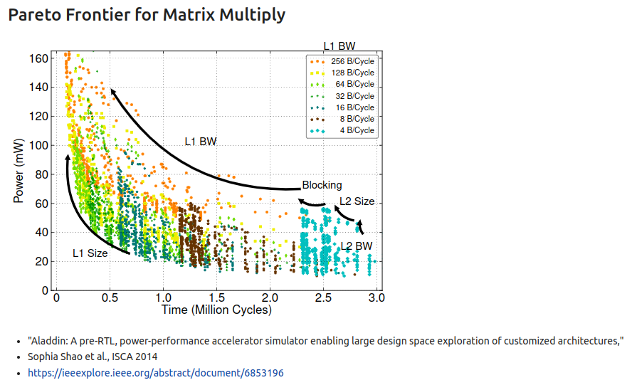
19.14 Pareto Frontier of CPU/Memory/GPU
https://www.youtube.com/watch?v=DoBQkMFBdR8&list=PLfrN7RIcMe6g2LBRJLTHTdhyj5s8ag0Rg&index=21
Pareto Frontier of CPU/Memory/GPU (48:53-52:54/53:15)
Aladdin Pareto Frontier for CPU Bandwidth (Speed), Memory, Accelerator/GPU.
Below are millions of tests which selected the important parameters from trillions of cases.
The constraint is PAT (Power, Area, and Timing), Without the Chisel and Hypermapper, we cannot know the behavior of our design.

Slide 36
19.15 Power/Timing of Core Design

Slide 37
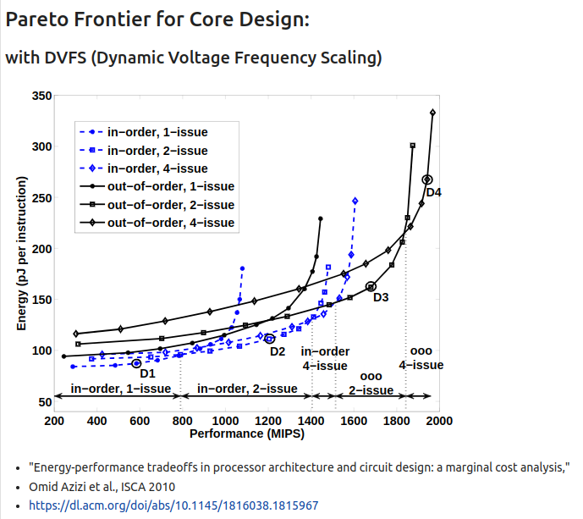
19.15 Power/Timing of Core Design
https://www.youtube.com/watch?v=DoBQkMFBdR8&list=PLfrN7RIcMe6g2LBRJLTHTdhyj5s8ag0Rg&index=21
Power/Timing of Core Design (52:55-53:15/53:15)
We have the core design. We know the Power and Timing of the Core Design.

Slide 38
End

