Slide 1

4 Mux4
Peter H. Chen

Slide 2
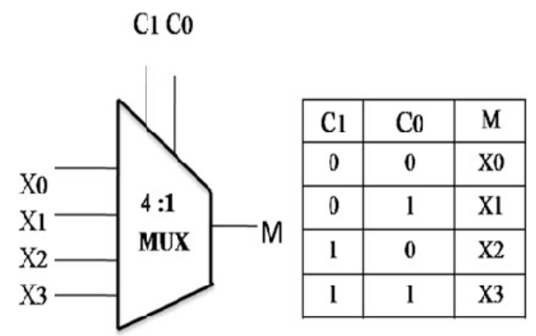
4 Mux4
https://github.com/ucb-bar/chisel-tutorial?tab=readme-ov-file
Mux4
Mux4 logic table as below.

Slide 3
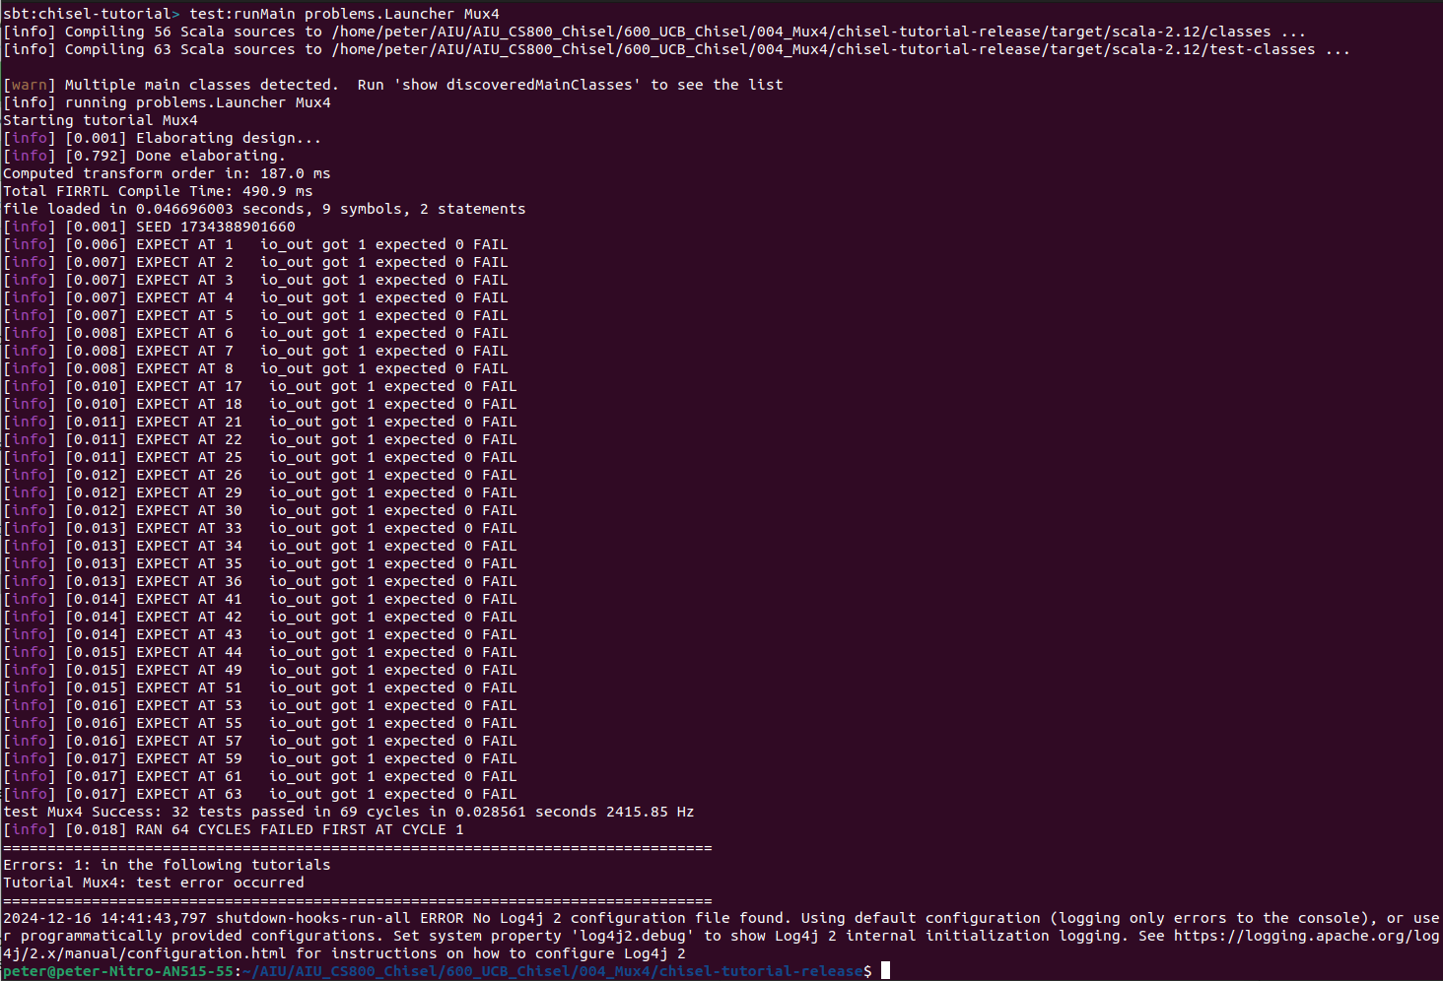
4 Mux4
https://github.com/ucb-bar/chisel-tutorial?tab=readme-ov-file
Mux4
Command Mode:
> sbt:chisel-tutorial> test:runMain problems.Launcher Mux4

Slide 4
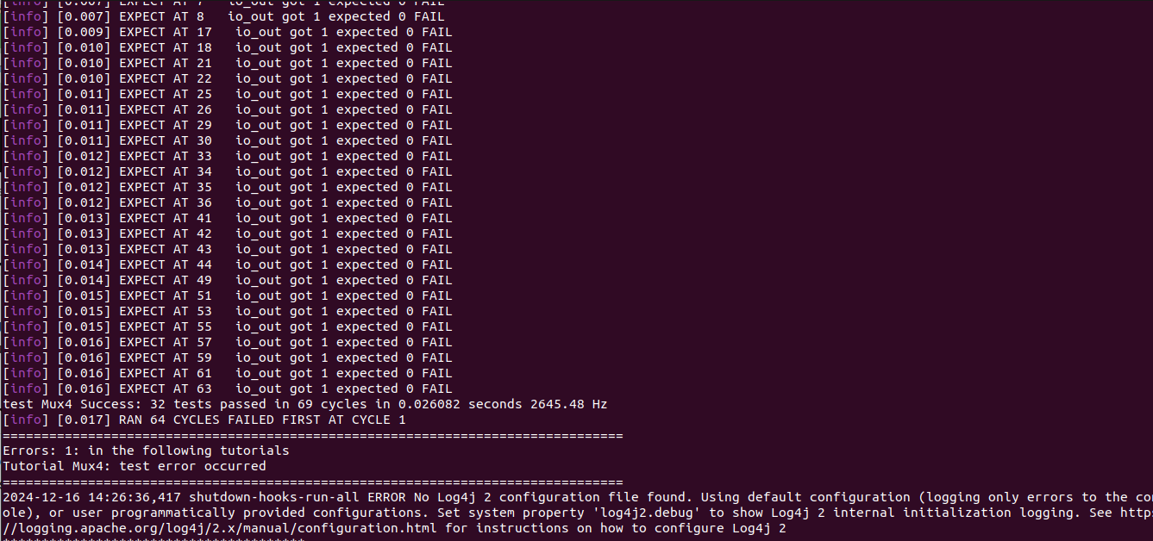
4 Mux4
https://github.com/ucb-bar/chisel-tutorial?tab=readme-ov-file
Mux4
Two problems here:
1. There are FAIL Messages (32/69), 37 cases FAILED
2. There is a configuration error: No log4j configuration file
1
2

Slide 5
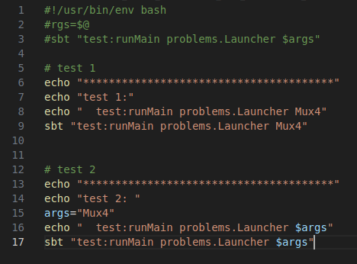
4 Mux4
https://github.com/ucb-bar/chisel-tutorial?tab=readme-ov-file
Mux4
> code run-problem_mux4.sh

Slide 6
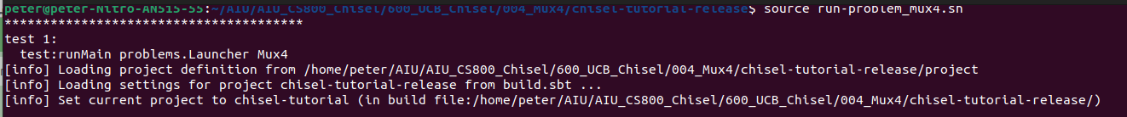
4 Mux4
https://github.com/ucb-bar/chisel-tutorial?tab=readme-ov-file
Mux4
> source run-problem_muax4.sh
Two problems here:
1. There are FAIL Messages (32/69), 37 cases FAILED
2. There is a configuration error: No log4j configuration file
1
2

Slide 7
4.1 Mux4Tests.scala

Slide 8
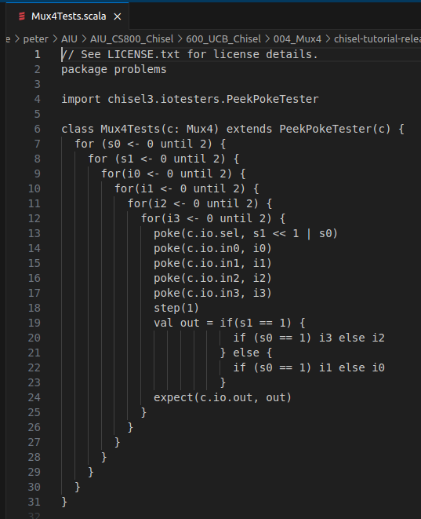
4.1 Mux4Tests.scala
https://github.com/ucb-bar/chisel-tutorial?tab=readme-ov-file
Mux4Tests.scala
In the src/test/scala/problems directory:
Here, we do scala test for Mux4: Mau4Tests.scala.

Slide 9
4.2 Apache Log4j Configuration File

Slide 10
4.2 Apache Log4j Configuration File
https://github.com/ucb-bar/chisel-tutorial?tab=readme-ov-file
Apache Log4j Configuration File
https://logging.apache.org/log4j/2.x/manual/configuration.html
The Log4J is a logging made by Apache.
Configuration file
Using a configuration file is the most popular and recommended approach for configuring Log4j Core.
The Log4 uses Java Maven configuration. Later on, we will see how to check the configuration file and how Log4j Core uses it.

Slide 11
End

