Slide 1

3.5 OOP
Peter H. Chen

Slide 2
3.5 OOP
https://github.com/freechipsproject/chisel-bootcamp
OOP (Object-Oriented Programming)
We discuss Scala/Chisel OOP (Object-Oriented Programming)
Topics:
1. Setup: Select Scala interpreter for Jupyter Notebook and run.
2. Scala OOP: a. Abstract classes, b. Traits, c. Objects, d. Companion Objects, e. Case Class
3. Scala Abstract Class/Example
4. Trait (特征) Class/Example: Trait is similar to abstract class but differences: a. trait class can inherit from multiple traits, b. trait class cannot have constructor parameters
5. Object/Example: Object is for constant value.
6. Companion Object/Example: A class and an object use the same name and defined in the same file.
7. Case Class: Case class is similar to a regular class, but with built-in features for modeling data and pattern matching, including automatic generation of equals(), hashCode(), toString(), and a companion object with an apply() and unapply() method.
8. Inheritance in Chisel: Hardware function inherited from based class Module, All IOs inherited from based class Bundle, all Data Type inherited from based class Data.
9. Gray Encode/Decoder Example: Code Inherited from Module. Will discussed more logic in later on exercise.

Slide 3
3.5.1 Setup

Slide 4
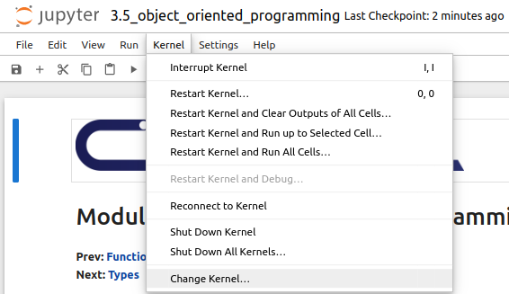
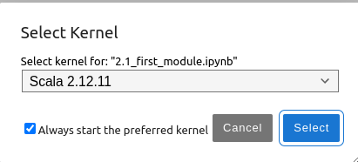
3.5.1 Setup
https://github.com/freechipsproject/chisel-bootcamp
Setup
1. Change folder to chisel-bootcamp. If you want to work on your working space, copy image folder and source folder to your working directory.
> cd chisel-bootcamp
2. Start Jupyter notebook
> jupyter notebook 3.5_object_oriented_programming.ipynb
3. Select the scala interpreter: > Kernel > Change Kernel… >Scala 2.12.11
3

Slide 5
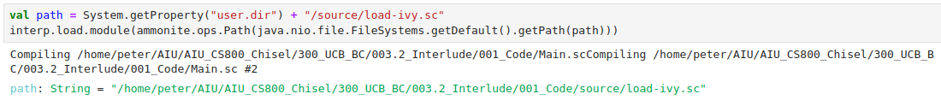
3.5.1 Setup
https://github.com/freechipsproject/chisel-bootcamp
Setup
1. Scala uses maven to setup path to with for source folder for Scala Libraries and get Scala Property.

Slide 6
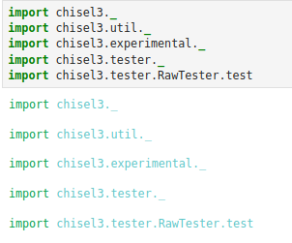
3.5.1 Setup
https://github.com/freechipsproject/chisel-bootcamp
Setup
1. import chisel3 library, utility, tester harness (horse controller), etc.

Slide 7
3.5.2 Scala OOP

Slide 8
3.5.2 Scala OOP
https://github.com/freechipsproject/chisel-bootcamp
Scala Object-Oriented Programming
1. Scala implements the OOP (Object-Oriented Programming) paradigm.
2. We have already seen classes. In addition to Class, Scala has more features as below.:
  a. Abstract classes
  b. Traits
  c. Objects
  d. Companion Objects
  e. Case Class

Slide 9
3.5.3 Abstract Class/Example

Slide 10
3.5.3 Abstract Class/Example
https://github.com/freechipsproject/chisel-bootcamp
Abstract Class
1. Abstract classes are same as other programming languages.
2. Abstract classes define many unimplemented values that subclasses must implement.
3. Any object can only directly inherit from one parent abstract class.

Slide 11
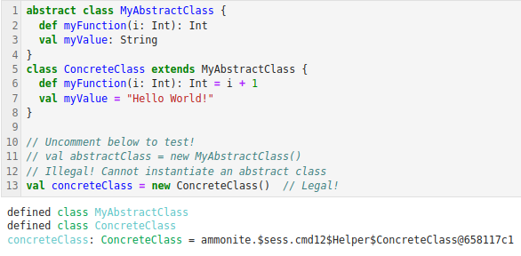
3.5.3 Abstract Class/Example
https://github.com/freechipsproject/chisel-bootcamp
Abstract Class Example
1. Below, we show how to use the abstract class and concrete class.
2. First, we define abstract class, inside the abstract class, we only define the empty function and string.
> abstract class MyAbstractClass {
> def myFunction (i: Int): Int
> val myValue : String
> }
3. Then, we define the concrete class. We filled the code in the function and string:
> class concreteClass extends MyAbstractClass {
> def myFunction (I: int) { … }
> val myValue = “Hello World!”
> }
2
3
4. We CANNOT instantiate the abstract Class. The Code is comment out
5. We CAN instantiate the concrete class.
4
5

Slide 12
3.5.4 Trait Class/Example

Slide 13
3.5.4 Trait Class/Example
https://github.com/freechipsproject/chisel-bootcamp
Trait Class
1. Traits (特征) are very similar to abstract classes in that they can define unimplemented values.
2. However, they differ in two ways:
  a. A class can inherit from multiple traits
  b. A trait cannot have constructor parameters

Slide 14
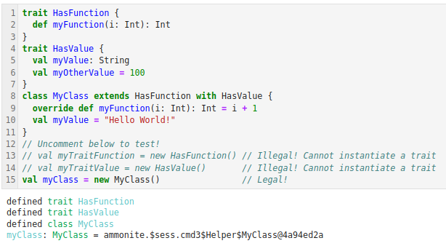
3.5.4 Trait Class/Example
https://github.com/freechipsproject/chisel-bootcamp
Trait Class Example
1. In Scala, Traits are used to implements multiple inheritance.
2. Below code is example for Trait class, we have class MyClass extends from both traits HasFunction and HasValue.
Note:
1. To inherit multiple traits, chain class in sequence as below:
> class MyClass extends HasTrait1 with HasTrait2 with HasTrait3 …
2. In general, we always use traits over abstract classes, unless you are sure that you really want to the single-inheritance restriction of abstract classes.

Slide 15
3.5.5 Object/Example

Slide 16
3.5.5 Object/Example
https://github.com/freechipsproject/chisel-bootcamp
Object
1. Scala has singleton Classes, called Objects.
2. You cannot instantiate an object (no need to call new); You can simply directly reference it.
3. Singleton Classes/Objects are similar to Java static classes.

Slide 17
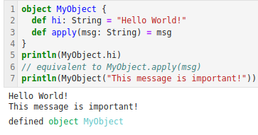
3.5.5 Object/Example
https://github.com/freechipsproject/chisel-bootcamp
Object Example
1. Below is the object (Singleton) example:
2. We cannot use object (Singleton) to create another object.
3. We can only access the value and functions inside the object.

Slide 18
3.5.6 Companion Object/Example

Slide 19
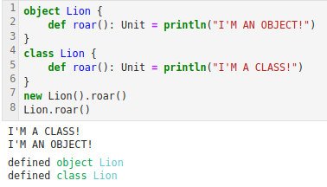
3.5.6 Companion Object/Example
https://github.com/freechipsproject/chisel-bootcamp
Companion Object Example
1. When a class and an object use the same name and defined in the same file, the object is called a companion object.
https://www.geeksforgeeks.org/scala-singleton-and-companion-objects/
2. When you use new before the class/object name, it will instantiate object with the class. If you don't use new, it will reference the object.
3. Note:
Companion objects are usually used for the following reasons:
  a. to contain constants (Object constant) related to the class
  b. to execute code (constant object) before/after the class constructor
  c. to create multiple constructors (instantiate a class) for a class

Slide 20
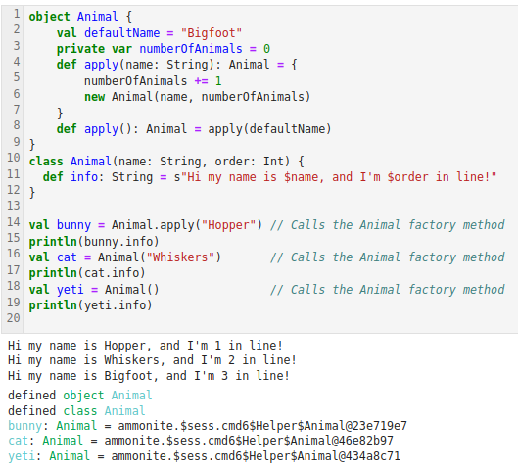
3.5.6 Companion Object/Example
https://github.com/freechipsproject/chisel-bootcamp
Companion Object Example
1. In the below example, we have same name “Animal” for both object “Animal” and class “Animal”.
2. Here, we instantiate 3 objects: “Hopper”, “Whiskers”, and “” with Default name “Bigfoot”, with object “Animal”.
2. We want each animal to have a name, and to know its order within all instantiations.
3. Finally, if no name is given, it should get a default name.

Slide 21
3.5.6 Companion Object/Example
https://github.com/freechipsproject/chisel-bootcamp
Companion Object Example
What's happening here?
1. Our Animal companion object defines a constant relevant to class Animal:
> val defaultName = "Bigfoot"
2. It also defines a private mutable integer to keep track of the order of Animal instances:
> private var numberOfAnimals = 0

Slide 22
3.5.6 Companion Object/Example
https://github.com/freechipsproject/chisel-bootcamp
Companion Object Example
What is happening here? (continue)
4. These factory methods can be called naively like this
> val bunny = Animal.apply("Hopper")
which eliminates the need to use the new keyword, but the real magic is that the compiler assumes the apply method any time it sees parentheses applied to an instance or object:
> val cat = Animal("Whiskers"

Slide 23
3.5.6 Companion Object/Example
https://github.com/freechipsproject/chisel-bootcamp
Companion Object Example
What is happening here? (continue)
5. Factory methods, usually provided via companion objects, allow alternative ways to express instance creations, provide additional tests for constructor parameters, conversions, and eliminate the need to use the keyword new.
Note that you must call the companion object's apply method for numberOfAnimals to be incremented.

Slide 24
3.5.6 Companion Object/Example
https://github.com/freechipsproject/chisel-bootcamp
Companion Object Example
Chisel uses many companion objects, like Module.
When you write the following:
> val myModule = Module (new MyModule)
We are calling the Module companion object, so Chisel can run background code before and after instantiating MyModule.

Slide 25
3.5.7 Case Class

Slide 26
3.5.7 Case Class
https://github.com/freechipsproject/chisel-bootcamp
Case Class
Case Class are a special type of Scala class that provides some cool additional features. They are very common in Scala programming, so this section outlines some of their useful features:
  Allows external access to the class parameters
  Eliminates the need to use new when instantiating the class
  Automatically creates an unapply method that supplies access to all of the class Parameters.
  Cannot be subclassed from
Google search “What is difference from regular class and case class”
Ans: In Scala, a case class is a specialized type of class, similar to a regular class, but with built-in features for modeling data and pattern matching, including automatic generation of equals(), hashCode(), toString(), and a companion object with an apply() and unapply() method.

Slide 27
3.5.7 Case Class
https://github.com/freechipsproject/chisel-bootcamp
Case Class
Q: What are the key difference from regular class and case class
Ans: Below are the key differences:
Case Class:
  1. Data Modeling: Case Class are designed for representing data structures, often used for immutable data.
  2. Pattern Matching: They are well-suited for pattern matching, which allows you to decompose the structure of a case class instance and extract its values.
  3. Automatic Features: The case keyword triggers the compiler to generate:
    a. equals() and hashCode() methods for structural comparison.
    b. toString() method for a user-friendly representation of the object.
    c. A companion object with apply() for creating instances and unapply() for pattern matching.
  4. Immutability: By default, case class parameters are public and immutable, making them suitable for data modeling scenarios.
  5. No new keyword: You can create instances of Case Class without the new keyword, using the companion object's apply() method.
  5. Extensibility: Case Class can extend other classes, but they cannot extend other Case Class.
  6. Use Case: Ideal for representing data models, algebraic data types, and scenarios where pattern matching is beneficial.
Regular Classes:
  1. General Purpose: Regular classes are more general-purpose and can represent both data and behavior.
  2. No Automatic Features: You need to manually implement methods like equals(), hashCode(), and toString() if needed.
  3. Mutability: You have more control over the mutability of class members.
  4. Extensibility: Regular classes can extend other classes, including other regular classes.
  5. Use Case: Suitable for representing complex objects with methods and state, or when you need fine-grained control over object creation and behavior.

Slide 28
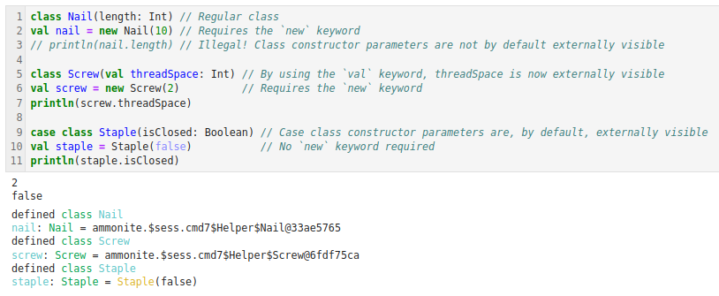
3.5.7 Case Class
https://github.com/freechipsproject/chisel-bootcamp
Case Class
In the following example, we declare three different classes, Nail, Screw, and Staple.
1. Nail is a regular class, and its parameters are not externally visible because we did not use the val keyword in the argument list. It also requires the new keyword when declaring an instance of Nail.
2. Screw is declared similarly to Nail, but includes val in the argument list. This allows its parameter, threadSpace, to be visible externally.
3. Staple is a case class, Staple gets the benefit of all its parameters being externally visible (without needing the val keyword).
In addition, Staple does not require using new when declaring a case class. This is because the Scala compiler automatically creates a companion object for every case class in your code, which contains an apply method for the case class.

Slide 29
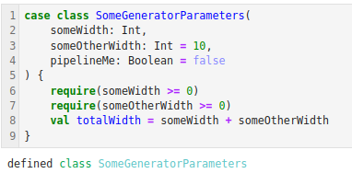
3.5.7 Case Class
https://github.com/freechipsproject/chisel-bootcamp
Case Class
Case Class are nice containers for generators with lots of parameters.
The constructor gives you a good place to define derived parameters and validate input.

Slide 30
3.5.8 Inheritance with Chisel

Slide 31
3.5.8 Inheritance with Chisel
https://github.com/freechipsproject/chisel-bootcamp
Inheritance with Chisel
1. We have seen Modules and Bundles.
2. Every Chisel module you make is a class extending the base type Module.
3. Every Chisel IO you make is a class extending the base type Bundle (or, in some special cases, Bundle's supertype Record).
4. Chisel hardware types, all have Data as a supertype.
5. We uses object oriented programming to create hierarchical hardware blocks and object reuse.
6. We will discuss more about types and Data in the next Module on type generic generators.

Slide 32
3.5.9 Gray Encoder/Decoder Example

Slide 33
3.5.9 Gray Encoder/Decoder Example
https://github.com/freechipsproject/chisel-bootcamp
Gray Encoder/Decoder Example
1. When we create a hardware object in Chisel, we need Module as a superclass.
2. Below is an example of gray encode and decoder.
3. We create a Module and connecting multiple instantiations of them together hierarchically.
Q: What is Gray Encode and Decoder?
Ans: Gray encoders and decoders utilize a Gray code, a binary numeral system where successive values differ by only one bit, to minimize errors during transitions and improve data integrity, especially in applications like rotary encoders and data acquisition systems.

Slide 34
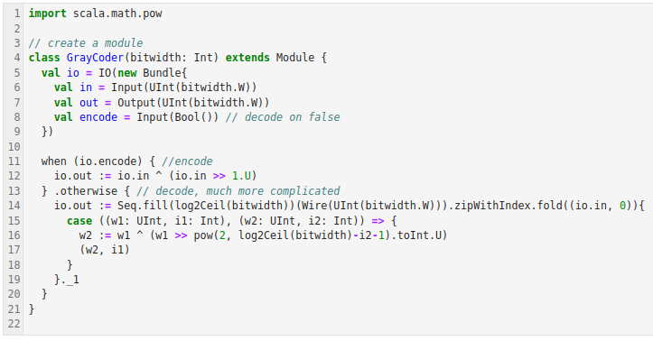
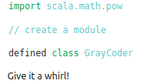
3.5.9 Gray Encoder/Decoder Example
https://github.com/freechipsproject/chisel-bootcamp
Gray Encoder/Decoder Example
1. Below, we create a hardware Gray encoder/decoder which is inherited from Module.
2. The encode or decode operation choice is hardware programmable.

Slide 35
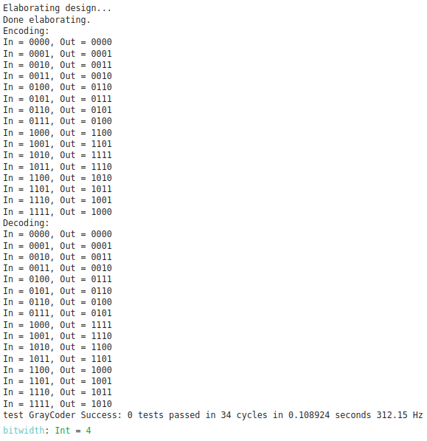
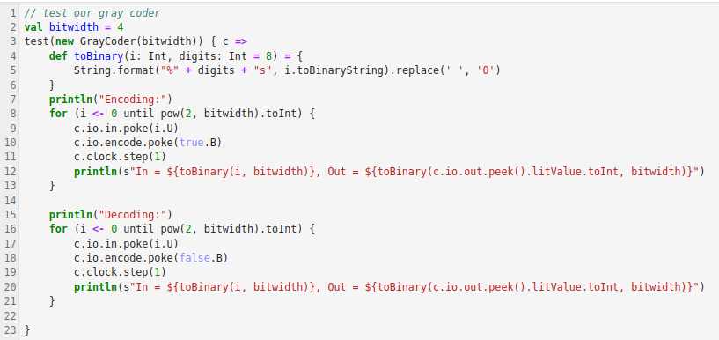
3.5.9 Gray Encoder/Decoder Example
https://github.com/freechipsproject/chisel-bootcamp
Gray Encoder/Decoder Example
Below is the tester for Gray Encoder and Decoder

Slide 36
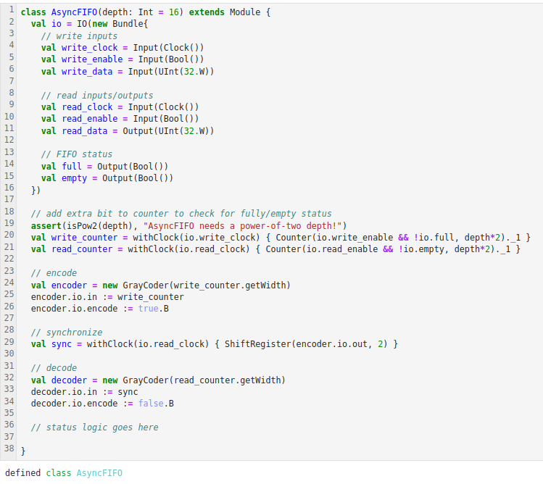
3.5.9 Gray Encoder/Decoder Example
https://github.com/freechipsproject/chisel-bootcamp
Gray Encoder/Decoder Example
1. Gray codes are often used in asynchronous interfaces.
2. Usually Gray counters are used rather than fully-featured encoders/decoders.
3. Below is an example AsyncFIFO. We use the above Gray coder.
4. The control logic and tester will be discussed later on.
5. For now, look at how the Gray coder is instantiated multiple times and connected.

Slide 37
End

