Slide 1

1.1 Introduction
Peter H. Chen

Slide 2
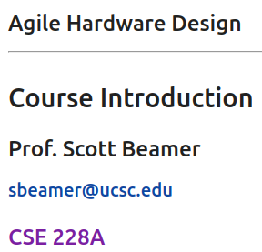
1.1 Introduction
https://www.youtube.com/watch?v=L2e-55iSA_8&list=PLfrN7RIcMe6g2LBRJLTHTdhyj5s8ag0Rg&index=1
Introduction (0:00-0:39/56:21)
1. This course “Agile Hardware Design” is taught by Professor Scott Beamer at UC Santa Cruz.
2. We use Chisel (Constructing Hardware in Scala Embedded Language) tool for hardware design in the class.
3. Chisel is developed by UC Berkeley and released in 2012.
4. Chisel is used to construct 128 bits RISCV architecture.
5. We can find UCSC lecture notes as below link:
https://github.com/agile-hw/lectures/tree/main/01-intro

Slide 3
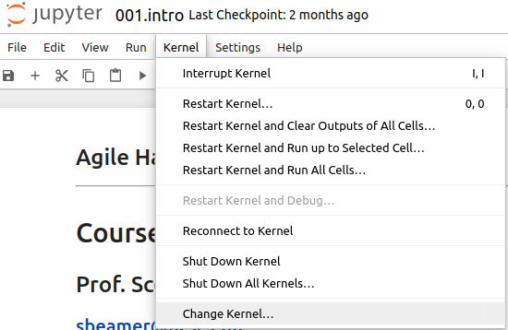
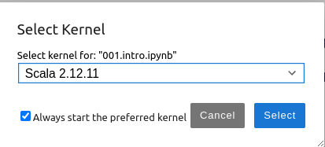
1.1 Introduction
https://www.youtube.com/watch?v=L2e-55iSA_8&list=PLfrN7RIcMe6g2LBRJLTHTdhyj5s8ag0Rg&index=1
Introduction (0:00-0:39/56:21)
Agile Hardware Design with Chisel (Constructing Hardware in Scala Embedded Language)
Topics:
1. Setup: > Jupyter notebook 001.intro.pynb, Select Scala, run all cells.
2. Why Advanced Hardware Design? Mobile phone, Data center, IoT, Electrical Vehicle, AI, laptop, etc.
3. Increase Performance/Reduce Cost in Hardware Design Cycle.
4. Hardware Design Cycle: Traditional Waterfall vs. Modern Agile
5. Open Source Design: RISCV 128 Open Source shareware
6. Hardware Generator: Generate/Reuse ASIC RTL (Register transfer Level) Verilog and FPGA Verilog
7. Chisel combines Scala (OOP, Functional Programming) and Domain-Specific Language (ASIC/FPGA Verilog).
8. Lecture, Lab, Project

Slide 4
1.2 Plan

Slide 5
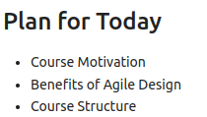
1.2 Plan
https://www.youtube.com/watch?v=L2e-55iSA_8&list=PLfrN7RIcMe6g2LBRJLTHTdhyj5s8ag0Rg&index=1
Plan (0:40-0:41/56:21)
Plan for today:
1. Course Motivation
2. Agile Hardware Design
3. Course Structure

Slide 6
1.3 Why Advanced Hardware Design

Slide 7
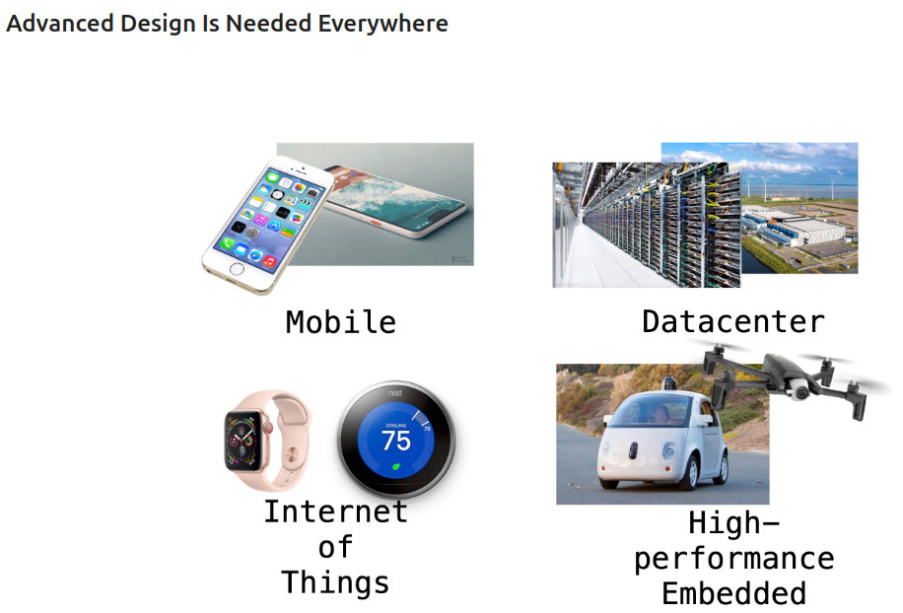
1.3 Advanced Hardware Design
https://www.youtube.com/watch?v=L2e-55iSA_8&list=PLfrN7RIcMe6g2LBRJLTHTdhyj5s8ag0Rg&index=1
Advanced Hardware Design (0:42-1:00/56:21)
1. A lot of hardware design, Mobile phone, Data center, IoT, Electrical Vehicle, AI, laptop, etc.
2. We need Advanced Chips and All these designs come together.

Slide 8
1.3 Why Advanced Hardware Design
https://www.youtube.com/watch?v=L2e-55iSA_8&list=PLfrN7RIcMe6g2LBRJLTHTdhyj5s8ag0Rg&index=1
Why Advanced Advanced Design (1:01-1:34/56:21)
Why do we need Agile/Chisel in Hardware Design?
1. As hardware design become complicated: Mobile phone, Data center, IoT, Electrical Vehicle, and AI, we need Advanced Chips and make all these designs come together.
2. Hardware Design need to increase energy efficiency even Moore’s Law is still appear. CPU and AI accelerator need to improve energy efficient for application. Design Cost need to be reduced: 3nm, 2nm, etc. Cost hundreds of million dollars for design. We need cheaper design flow.
3. Traditional, we have one step Waterfall/HW Design: Design, Specification, Implementation, Integration, Optimization, Verification.
Modern Agile Hardware Design use Chisel software to develop hardware: Design, Implementation, Optimization, Verification.
4. Chisel is open source: faster, bigger community, share components.
5. Chisel use generator to generate components better than reuse proprietary components.
6. Chisel (Construct Hardware in Scala Embedded Language) inherited Object-Oriented Design and Functional Programming.
7. Scala is interpreter based and easy to run inside the Jupyter notebook.
8. Chisel is open source with lot of code example, homework, lab, and projects.

Slide 9
1.4 Fast/Reduce Cost Hardware Design

Slide 10
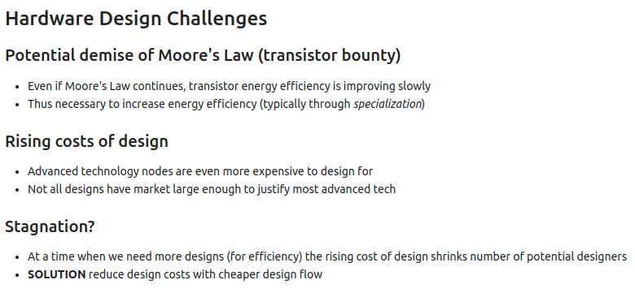
1.4 Fast/Reduce Cost Hardware Design
https://www.youtube.com/watch?v=L2e-55iSA_8&list=PLfrN7RIcMe6g2LBRJLTHTdhyj5s8ag0Rg&index=1
Fast/Reduce Cost Hardware Design (1:35-3:09/56:21)
1. Moore’s law disappear quickly: Hardware Design need to improve design performance even Moore’s Law is still appear.
2. CPU and AI accelerator need to improve energy efficient for application.
3. Design Cost need to be reduced: 3nm, 2nm, edge design, etc. Cost hundreds of million dollars for design.
4. Problem: We need more design but the design cost need to be reduced. How to solve these problems?
5. Solution: We need cheaper and easier way for design flow. How do we get there?

Slide 11
1.4 Traditional Waterfall Design

Slide 12
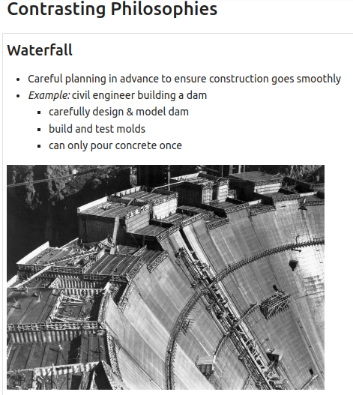
1.4 Traditional Waterfall Design
https://www.youtube.com/watch?v=L2e-55iSA_8&list=PLfrN7RIcMe6g2LBRJLTHTdhyj5s8ag0Rg&index=1
Traditional Waterfall Design (3:10-4:24/56:21)
Historically, we have the Waterfall philosophy for hardware design flow.
We have a lot of engineers try to build a dam.
1. We carefully design and model dam.
2. We build and test model
3. Finally, we pour the concrete. We only have one chance. You can pour the concrete only you are very sure.

Slide 13
1.5 Waterfall vs. Agile Design Flow

Slide 14
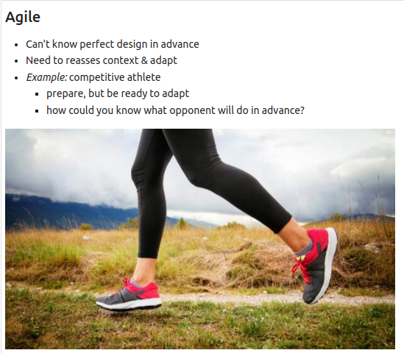
1.5 Waterfall vs. Agile Design Flow
https://www.youtube.com/watch?v=L2e-55iSA_8&list=PLfrN7RIcMe6g2LBRJLTHTdhyj5s8ag0Rg&index=1
Waterfall vs. Agile Design Flow (4:25-5:45/56:21)
In the software computing age, we have contrast software philosophy for agile hardware design. We can try things out with software.
Maybe the design is not perfect. We can change a line of code.
In Waterfall Hardware design, we need a design document, we need specification. In Agile Hardware Design, we get something working by software, not all features, not be optimized. It is iterated and improve upon it.
In Waterfall, we do once. In Agile software, we take advantage to do several times, if something wrong, we change one line of code and test, again and again.

Slide 15
1.6 Waterfall vs. Agile Design Flow

Slide 16
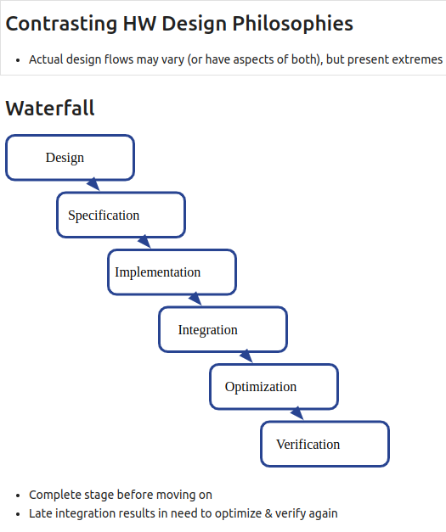
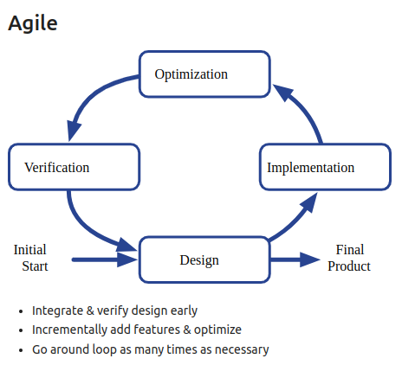
1.6 Waterfall vs. Agile Design Flow
https://www.youtube.com/watch?v=L2e-55iSA_8&list=PLfrN7RIcMe6g2LBRJLTHTdhyj5s8ag0Rg&index=1
Waterfall vs. Agile Design Flow (5:46-8:18/56:21)
Below, we compare the Waterfall vs. Agile HW Design flow.
Waterfall/HW Design: Design, Specification, Implementation, Integration, Optimization, Verification.
Agile Software Design Loop: Design, Implementation, Optimization, Verification.

Slide 17
1.7 Agile Technique

Slide 18
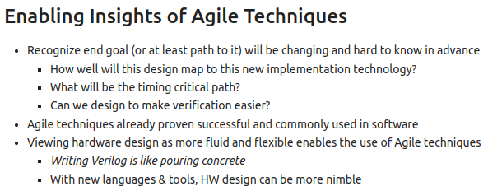
1.7 Agile Technique
https://www.youtube.com/watch?v=L2e-55iSA_8&list=PLfrN7RIcMe6g2LBRJLTHTdhyj5s8ag0Rg&index=1
Agile Technique (8:19-10:57/56:21)
We change hardware design concept with software philosophy. We adapt design frequently.
Write Verilog is just like pour the concrete.
With Chisel/Scala tools, Hardware design become more nimble/agile.

Slide 19
1.8 Agile Hardware Design Flow

Slide 20
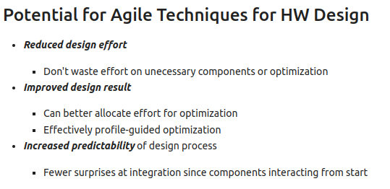
1.8 Agile Hardware Design Flow
https://www.youtube.com/watch?v=L2e-55iSA_8&list=PLfrN7RIcMe6g2LBRJLTHTdhyj5s8ag0Rg&index=1
Agile Hardware Design Flow (10:58-13:12/56:21)
We use Software Agile Technique for Hardware Waterfall Design.
1. Reduce Design time: Reduce revised time, Optimization
2. Improve design: Resource allocation, profile optimization
3. Predictability: Easier to integrate

Slide 21
1.9 Open Source Design

Slide 22
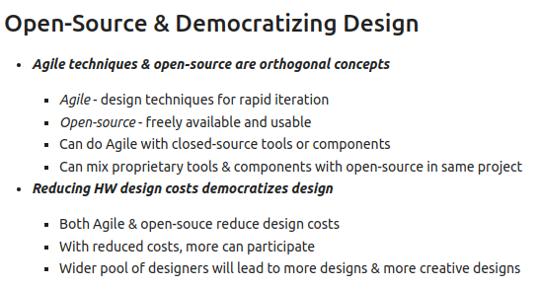
1.9 Open Source Design
https://www.youtube.com/watch?v=L2e-55iSA_8&list=PLfrN7RIcMe6g2LBRJLTHTdhyj5s8ag0Rg&index=1
Open Source Design (13:13-15:19/56:21)
1. Open source are free to university and agile design: Save cost and rapid design
2. Open source has more participation big designer pool: More people involved and better result.

Slide 23
1.10 Improve Productivity

Slide 24
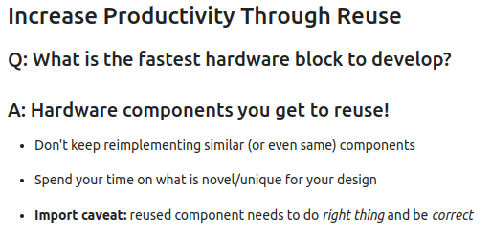
1.10 Improve Productivity
https://www.youtube.com/watch?v=L2e-55iSA_8&list=PLfrN7RIcMe6g2LBRJLTHTdhyj5s8ag0Rg&index=1
Improve Productivity (15:20-18:07/56:21)
Q: What is the fastest block to develop?
Ans: Change passing parameter and reuse.
The reuse block need to be correct.

Slide 25
1.11 HW Generator

Slide 26
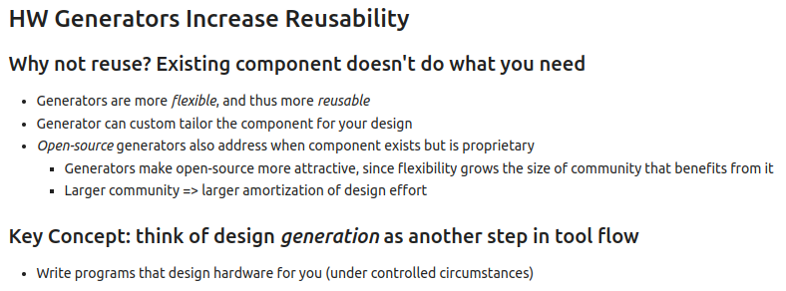
1.11 HW Generator
https://www.youtube.com/watch?v=L2e-55iSA_8&list=PLfrN7RIcMe6g2LBRJLTHTdhyj5s8ag0Rg&index=1
HW Generator (18:08-25:13/56:21)
HW Generator generates Verilog component. Generators increase usability. Why not reuse? Existing component doesn’t do what you want
1. Software is flexible than hardware Component Verilog. Generators are meta programs and are more flexible and more reusable. Generators are template program with passing parameters to produce the hardware component.
2. Generator can custom tailor and fit for your design need.
3. Open Source Generator is more attractive than proprietary component. Open source is bigger community than proprietary resource.

Slide 27
1.12 Chisel Tool

Slide 28
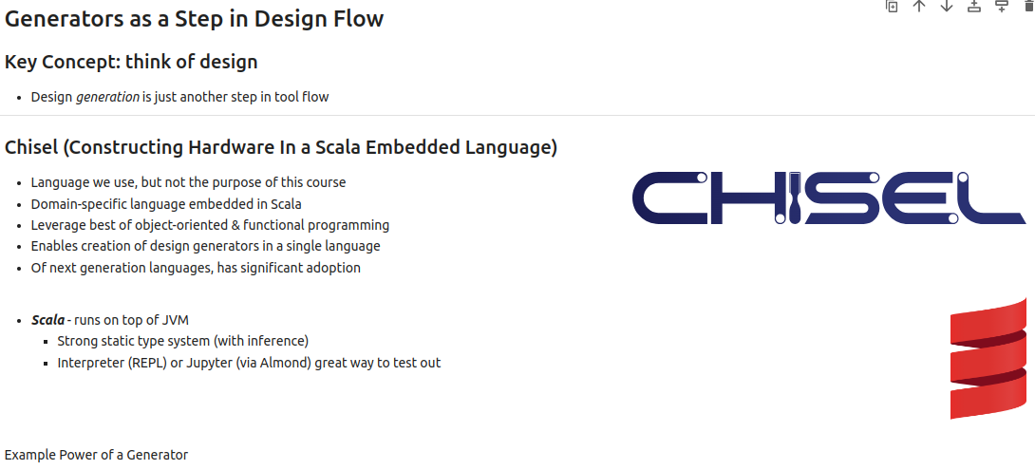
1.12 Chisel Tool
https://www.youtube.com/watch?v=L2e-55iSA_8&list=PLfrN7RIcMe6g2LBRJLTHTdhyj5s8ag0Rg&index=1
Chisel Tool (25:14-31:04/56:21)
Chisel (Constructing Hardware In a Scala Embedded Language).
1. Chisel is software tool. In Chisel, we write software to develop the hardware Verilog design.
2. Chisel is domain-specific language embedded in Scala.
3. Chisel inherited Scala (similar to Java/C++) Object-Oriented Programming and Functional Programming.
4. Chisel create and generate Verilog hardware generator in one single language.
5. Chisel embedded in Scala and adopt next generation language.
Scala (Scalable Language) run on JVM (Java Virtual Machine):
1. Scala is a strong static type. It is easy to inference/understand)
2. Scala is an interpreter is easier to try/run. We will also use Jupyter to try.

Slide 29
1.13 Common Themes

Slide 30
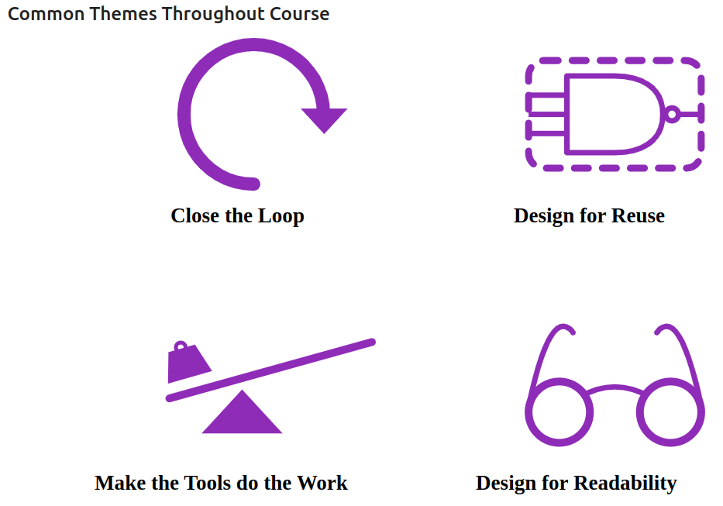
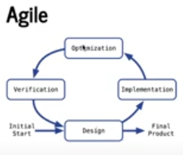
1.13 Common Themes
https://www.youtube.com/watch?v=L2e-55iSA_8&list=PLfrN7RIcMe6g2LBRJLTHTdhyj5s8ag0Rg&index=1
Common Themes (31:05-35:13/56:21)
Below are the themes (topics) we commonly used.
1. Close the loop, 2. Design for Reuse, 3. Make the tools do the works, 4. Design for Readability (Make code more clear).

Slide 31
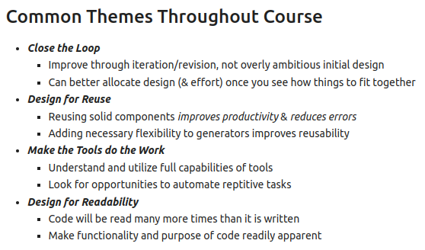
1.14 Common Themes
https://www.youtube.com/watch?v=L2e-55iSA_8&list=PLfrN7RIcMe6g2LBRJLTHTdhyj5s8ag0Rg&index=1
Common Themes (35:14-35:39/56:21)
Below are the main key topics.

Slide 32
1.14 Who Need Chisel?

Slide 33
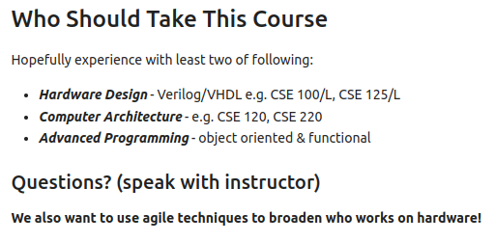
1.14 Who Need Chisel?
https://www.youtube.com/watch?v=L2e-55iSA_8&list=PLfrN7RIcMe6g2LBRJLTHTdhyj5s8ag0Rg&index=1
Who Need Chisel? (35:40-37:41/56:21)
1. Hardware: Hardware Design/Computer Architecture
2. Advanced Programming: Object-Oriented Programming and Functional Programming

Slide 34
1.15 Staff

Slide 35
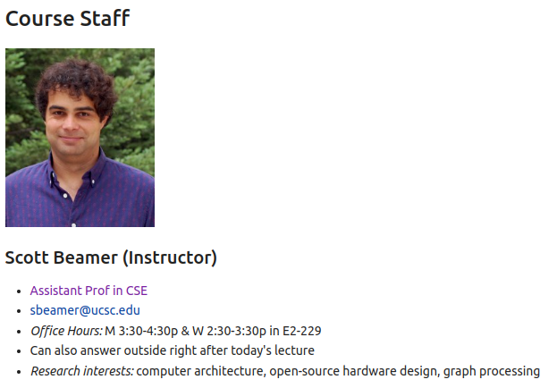
1.15 Staff
https://www.youtube.com/watch?v=L2e-55iSA_8&list=PLfrN7RIcMe6g2LBRJLTHTdhyj5s8ag0Rg&index=1
Staff (37:42-38:45/56:21)
Scott Beamer: Computer Architecture, Open Source Hardware Design using Chisel, Graph Processing

Slide 36
1.16 Course Structure

Slide 37
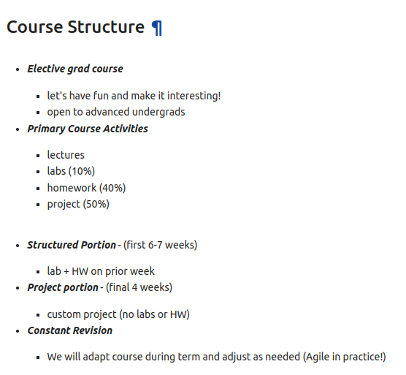
1.16 Course Structure
https://www.youtube.com/watch?v=L2e-55iSA_8&list=PLfrN7RIcMe6g2LBRJLTHTdhyj5s8ag0Rg&index=1
Course Structure (38:46-41:47/56:21)
1. Lab, HW: 6-7 weeks
2. Project (4 weeks)

Slide 38
1.17 Lecture

Slide 39
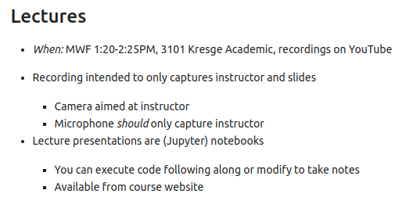
1.17 Lecture
https://www.youtube.com/watch?v=L2e-55iSA_8&list=PLfrN7RIcMe6g2LBRJLTHTdhyj5s8ag0Rg&index=1
Lecture (41:48-43:13/56:21)
Scala run in Jupyter Notebook

Slide 40
1.18 Lab

Slide 41
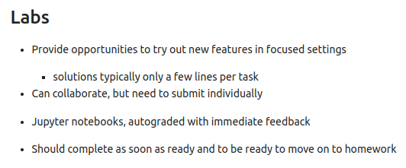
1.18 Lab
https://www.youtube.com/watch?v=L2e-55iSA_8&list=PLfrN7RIcMe6g2LBRJLTHTdhyj5s8ag0Rg&index=1
Lab (43:14-44:39/56:21)
Short problem to try out, for example, in one line of code in Jupyter Notebook.
Should be done in few minutes.

Slide 42
1.19 Homework

Slide 43
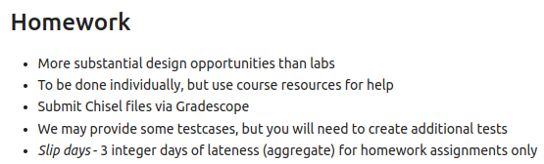
1.19 Homework
https://www.youtube.com/watch?v=L2e-55iSA_8&list=PLfrN7RIcMe6g2LBRJLTHTdhyj5s8ag0Rg&index=1
Homework (44:40-49:01/56:21)
Homework is more complicate Design and more grade points than Lab.

Slide 44
1.20 Project

Slide 45
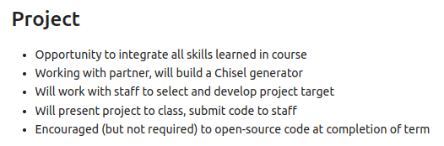
1.20 Project
https://www.youtube.com/watch?v=L2e-55iSA_8&list=PLfrN7RIcMe6g2LBRJLTHTdhyj5s8ag0Rg&index=1
Project (49:02-51:43/56:21)
1. Integrate all we learned
2. Work with partner
3. Build a Chisel Generator
4. Work with staff and select project
5. Present in class
6. Use open source code to complete the project.

Slide 46
1.21 Resource

Slide 47
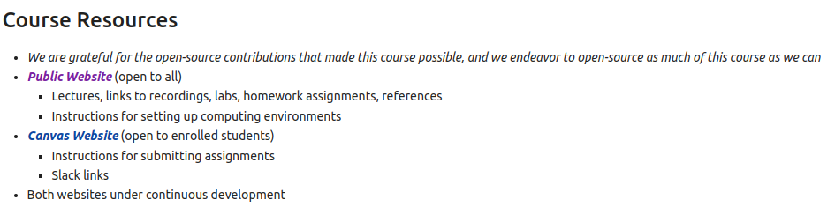
1.21 Resource
https://www.youtube.com/watch?v=L2e-55iSA_8&list=PLfrN7RIcMe6g2LBRJLTHTdhyj5s8ag0Rg&index=1
Resource (51:44-53:20/56:21)
We use open sources.

Slide 48
1.22 Concrete Learning Objective

Slide 49
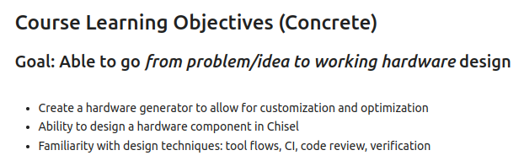
1.22 Concrete Learning Objective
https://www.youtube.com/watch?v=L2e-55iSA_8&list=PLfrN7RIcMe6g2LBRJLTHTdhyj5s8ag0Rg&index=1
Concrete Learning Objective (53:21-54:41/56:21)
Concrete Goal: From problem/idea to Hardware Design
CI (Continuous Integration)

Slide 50
1.23 Meta Learning Objective

Slide 51
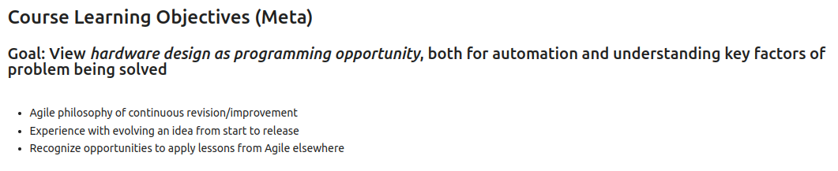
1.23 Meta Learning Objective
https://www.youtube.com/watch?v=L2e-55iSA_8&list=PLfrN7RIcMe6g2LBRJLTHTdhyj5s8ag0Rg&index=1
Meta Learning Objective (54:42-56:21/56:21)
From Hardware Design to Programming, automation, key factors of solved problem
1. Improvement
2. New idea
3. Agile

Slide 52
End

