Slide 1

0.1 TOC (Table Of Content)
Peter H. Chen

Slide 2
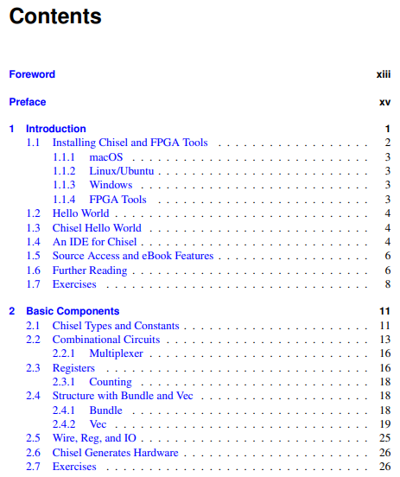
0.1 TOC (Table Of Content)
https://www.imm.dtu.dk/~masca/chisel-book.html
Chapter 1 and 2
1. Introduction
  1.1 Install Chisel and FPGA Tools
  1.2 Hello World
  1.3 Chisel Hello World
  1.4 Chisel IDE
  1.5 Resource
  1.6 More Reading
  1.7 Exercise
2. Basic Components
  2.1 Chisel Types and Constants
  2.2 Combinational Circuits (Mux)
  2.3 Registers (Counter)
  2.4 Bundle/Vec
  2.5 Wire, Reg, and IO
  2.6 Generate Hardware
  Exercise

Slide 3
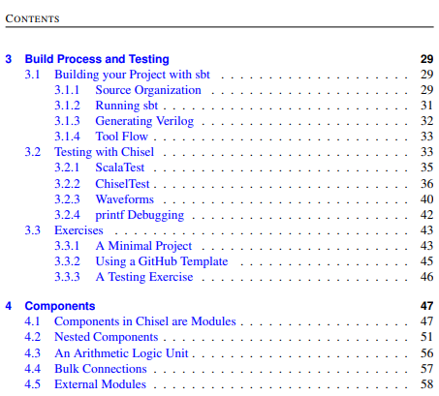
0.1 Digital Design with Chisel: TOC
https://www.imm.dtu.dk/~masca/chisel-book.html
Chapter 3 and 4
3. Build Process and Testing
  3.1 Build with SBT (Simple Build Tool)
  3.2 Chisel Testing
  3.3 Exercise
4. Components
  4.1 Chisel Components and Modules
  4.2 Nested Components
  4.3 Arithmetic Logic
  4.4 Bulk Connection
  4.5 External Modules

Slide 4
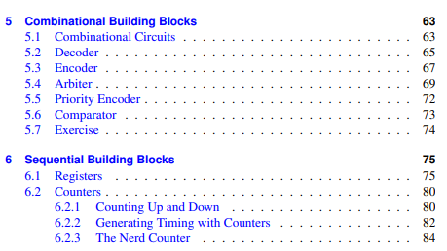
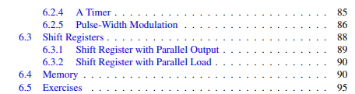
0.1 Digital Design with Chisel: TOC
https://www.imm.dtu.dk/~masca/chisel-book.html
Chapter 5 and 6
5. Combinational Blocks
  5.1 Combinational Circuits
  5.2 Decoder
  5.3 Encoder
  5.4 Arbiter
  5.5 Priority Encoder
  5.6 Comparator
  5.6 Exercise
6. Sequential Block
  6.1 Registers
  6.2 Counters (Count up/down, Timing, Nerd Counter, Timer, Pulse-Width Modulation)
  6.3 Shift Register (Parallel Output/Load)
  6.4 Memory
  6.5 Exercise

Slide 5
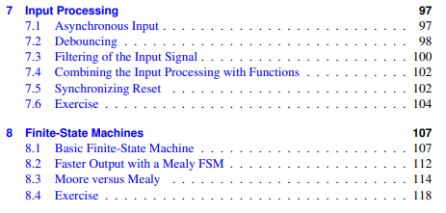
0.1 Digital Design with Chisel: TOC
https://www.imm.dtu.dk/~masca/chisel-book.html
Chapter 7 and 8
7. Input Processing
  7.1 Asynchronous Input
  7.2 Debugging
  7.3 Input Signal Filter
  7.4 Input Processing with Functions
  7.5 Synchronizing Reset
  7.6 Exercise
8. FSM (Finite-State Machine)
  8.1 Basic FSM
  8.2 Faster Output with Mealy FSM
  8.3 Moore FSM vs Mealy FSM
  8.4 Exercise

Slide 6
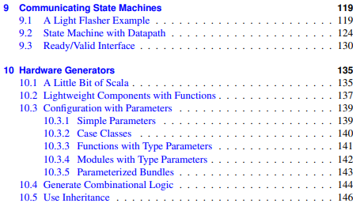

0.1 Digital Design with Chisel: TOC
https://www.imm.dtu.dk/~masca/chisel-book.html
Chapter 9 and 10
9. Communication State Machine
  9.1 Light Flasher Example
  9.2 Datapath State Machine
  9.3 Ready/Valid Interface
10. Hardware Generator
  10.1 Introduction to Scala
  10.2 Lightweight Components with Function
  10.3 Parameters Configuration
  10.4 Generate Combinational Logic
  10.5 Inheritance
  10.6 Hardware Generation/Functional Programming (Minimum Search/Arbitration Tree)

Slide 7
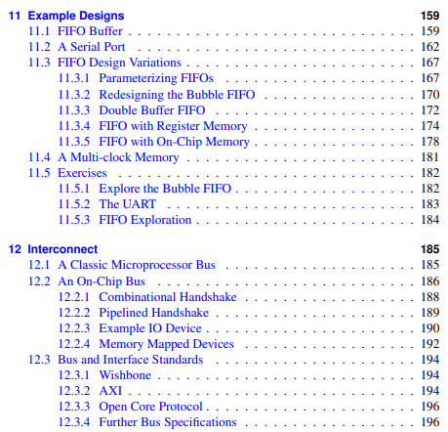
0.1 Digital Design with Chisel: TOC
https://www.imm.dtu.dk/~masca/chisel-book.html
Chapter 11 and 12
11. Design Example
  11.1 FIFO Buffer
  11.2 Serial Port
  11.3 FIFO Design Variations (Parameterize FIFO, Bubble FIFO, Double Buffer, Register Memory, On-Chip Memory)
  11.4 Multi-Clock Memory
  11.5 Exercise (Bubble FIFO, UART, FIFO Exploration)
12. Interconnect
  12.1 Microprocessor Bus
  12.2 On Chip Bus (Combinational Handshake, Pipeline Handshake, IO Device, Memory Map Device)
  12.3 Bus Interface Standard (Wishbone, AXI, Open Core Protocol, Bus Specification)

Slide 8
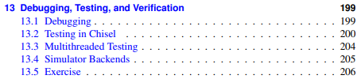
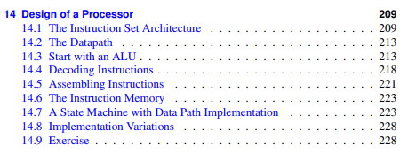
0.1 Digital Design with Chisel: TOC
https://www.imm.dtu.dk/~masca/chisel-book.html
Chapter 13 and 14
13. Debug, Test, and Verification
  13.1 Debug
  13.2 Test
  13.3 Multi-thread Testing
  13.4 Backend Simulator
  13.5 Exercise
14. Processor Design
  14.1 ISA (Instruction Set Architecture)
  14.2 Datapath
  14.3 ALU
  14.4 Decode Instruction
  14.5 Assembly Instruction
  14.6 Instruction Memory
  14.7 State Machine with Datapath
  14.8 Variation Implement
  14.9 Exercise

Slide 9
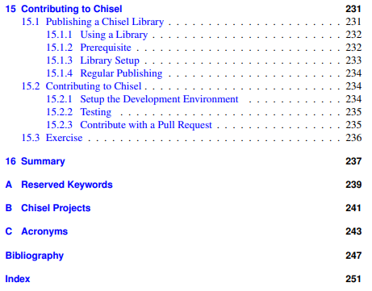
0.1 Digital Design with Chisel: TOC
https://www.imm.dtu.dk/~masca/chisel-book.html
Chapter 15 and 16
15. Contribution
  15.1 Publication (Library, Prerequisite, Setup Library, Paper)
16. Summary
A. Keywords
B. Projects
C. Acronyms

Slide 10
End

