Slide 1

20 Chisel Miscellaneous
Peter H. Chen

Slide 2
20 Chisel Miscellaneous
https://www.youtube.com/watch?v=EOMMpYBo8To&list=PLfrN7RIcMe6g2LBRJLTHTdhyj5s8ag0Rg&index=22
Chisel Miscellaneous (0:00-0:05/1:05:51)
We discuss Chisel Miscellaneous for Hardware Design.
Topics:
1. Chisel Verilog/Hardware are Static Structure and Dynamic Signal Connection
2. Convert AND into Nested when condition
3. In Chisel, we use val (immutable hardware structure) to replace var (mutable)
4. Use Immutable Seq() for Functional Programming (map, reduce, zip, etc) more than Mutable ArrayBuffer().
5. for/foreach has side effect (Change from input to output). map/zip are immutable.
6. Avoid put hardware declaration inside the when block. Put the hardware declaration outside the when block.
7. Difference of until and to.
8. Difference of assume, assert, and require
9. Flatten bundle of data type.

Slide 3
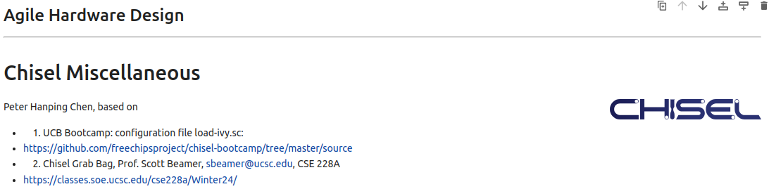
20 Chisel Miscellaneous
https://www.youtube.com/watch?v=EOMMpYBo8To&list=PLfrN7RIcMe6g2LBRJLTHTdhyj5s8ag0Rg&index=22
Chisel Miscellaneous (0:06-0:10/1:05:51)
We discuss the Chisel Review based on:
1. UCB Bootcamp: configuration file load-ivy.sc:
https://github.com/freechipsproject/chisel-bootcamp/tree/master/source
2. Chisel Grab Bag, Prof. Scott Beamer, sbeamer@ucsc.edu, CSE 228A
https://classes.soe.ucsc.edu/cse228a/Winter24/

Slide 4
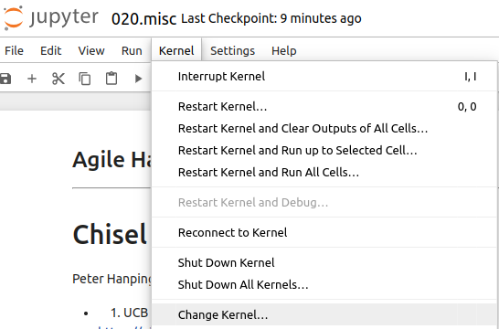
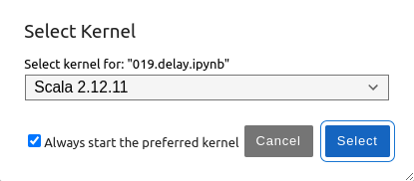
20 Chisel Miscellaneous
https://www.youtube.com/watch?v=EOMMpYBo8To&list=PLfrN7RIcMe6g2LBRJLTHTdhyj5s8ag0Rg&index=22
Chisel Miscellaneous (0:11-0:20/1:05:51)
Setup Scala 2.12.11:
> jupyter notebook 020.misc.ipynb
Kernel > Change Kernel ,,, > Select Scala 2.12.11
Run > Run All Cells

Slide 5
20.1 Plan

Slide 6
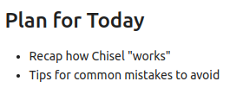
20.1 Plan
https://www.youtube.com/watch?v=EOMMpYBo8To&list=PLfrN7RIcMe6g2LBRJLTHTdhyj5s8ag0Rg&index=22
Plan (0:21-0:25/1:05:51)
Today, we clarify about Chisel.
1. Review Chisel.
2. Avoid Common Mistake

Slide 7
20.2 Import Chisel Library

Slide 8
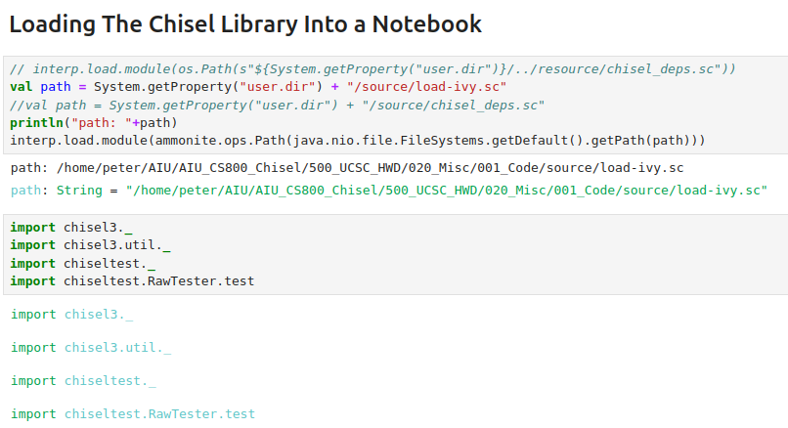
20.2 Import Chisel Library
https://www.youtube.com/watch?v=EOMMpYBo8To&list=PLfrN7RIcMe6g2LBRJLTHTdhyj5s8ag0Rg&index=22
Import Chisel Library (0:26-0:57/1:05:51)

Slide 9
20.3 Review Chisel/Scala

Slide 10
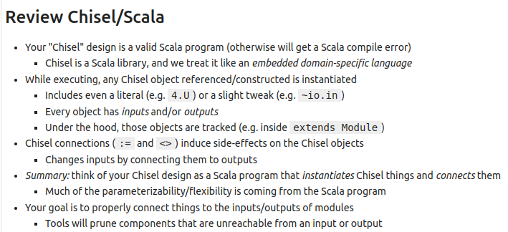
20.3 Review Chisel/Scala
https://www.youtube.com/watch?v=EOMMpYBo8To&list=PLfrN7RIcMe6g2LBRJLTHTdhyj5s8ag0Rg&index=22
Review Chisel/Scala (0:58-4:13/1:05:51)
1. Chisel is a Scala Library. Chisel is a embedded domain-specific language of Scala language.
2. Chisel is object (wire, IO, register, IO, module) instantiated, literal, input/output. Chisel objects are tracked and inside the extended Module.
3. Chisel connections (:= and <>) has side effect (Change input into output).
4. Parameters come from Scala Program
5. Goal: Connect module input to the module output.

Slide 11
20.4 Hardware Design

Slide 12
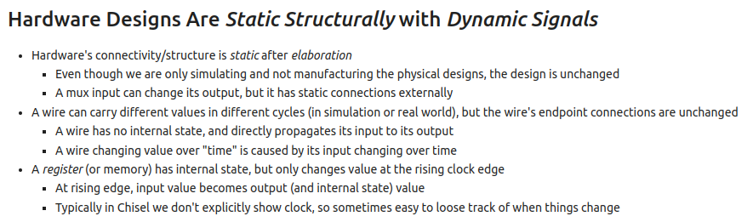
20.4 Hardware Design
https://www.youtube.com/watch?v=EOMMpYBo8To&list=PLfrN7RIcMe6g2LBRJLTHTdhyj5s8ag0Rg&index=22
Hardware Design (4:14-7:00/1:05:51)
Hardware designs are Static Structure with Dynamic Signals.
1. Hardware structure is static and connection is static. Hardware Structure (or Data Structure) is fixed and never change.
2. Wire carry different signals and values inside the wire. Values is change. Wire has no internal state.
3. Register (or memory) has internal state. Register change value at the clock edge. Chisel does not show clock.

Slide 13
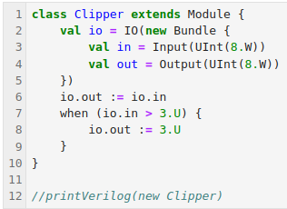
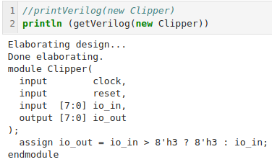
20.4 Hardware Design
https://www.youtube.com/watch?v=EOMMpYBo8To&list=PLfrN7RIcMe6g2LBRJLTHTdhyj5s8ag0Rg&index=22
Hardware Design (7:11-7:15/1:05:51)
Left below: Chisel Code and
Right below: Hardware Verilog.

Slide 14
20.5 Nested when to AND

Slide 15

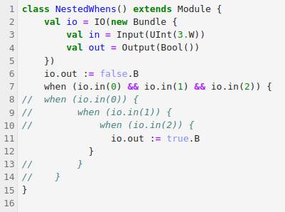
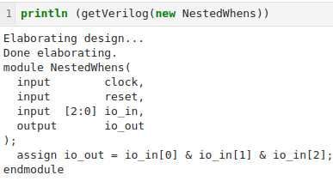
20.5 Nested when to AND
https://www.youtube.com/watch?v=EOMMpYBo8To&list=PLfrN7RIcMe6g2LBRJLTHTdhyj5s8ag0Rg&index=22
Nested when to AND (7:16-8:30/1:05:51)
We AND all conditions together. The results are the same.

Slide 16

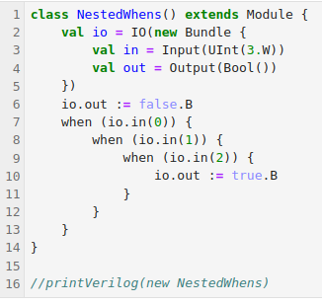
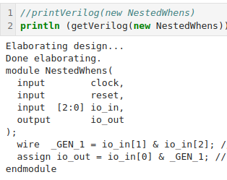
20.5 Nested when to AND
https://www.youtube.com/watch?v=EOMMpYBo8To&list=PLfrN7RIcMe6g2LBRJLTHTdhyj5s8ag0Rg&index=22
Nested when to AND (7:16-7:30, 8:31-13:11/1:05:51)
We have several when in nest. We AND all conditions together.
We prefer this way since we can insert more command between the “when” loop.

Slide 17
20.6 Dynamic Connect/Static Structure

Slide 18
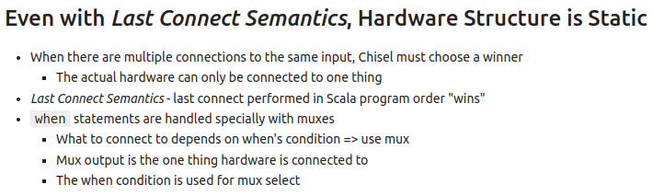
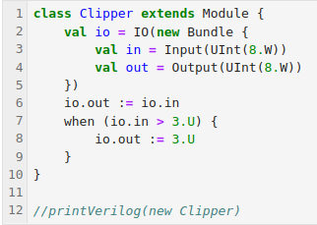
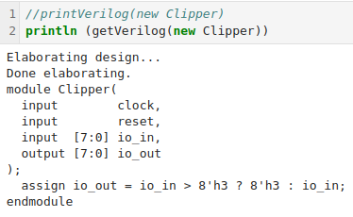
20.6 Dynamic Connect/Static Structure
https://www.youtube.com/watch?v=EOMMpYBo8To&list=PLfrN7RIcMe6g2LBRJLTHTdhyj5s8ag0Rg&index=22
Dynamic Connect/Static Structure (13:12-14:17/1:05:51)
Even we connect several times, the Hardware structure still Fixed.
Below, we over-write with condition.

Slide 19
20.7 Mutability

Slide 20
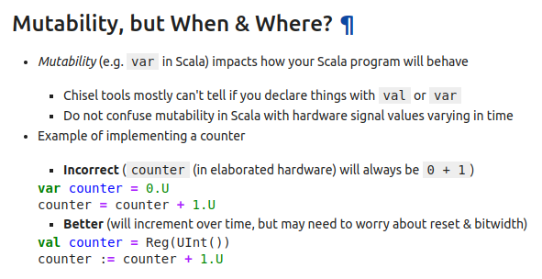
20.7 Mutability
https://www.youtube.com/watch?v=EOMMpYBo8To&list=PLfrN7RIcMe6g2LBRJLTHTdhyj5s8ag0Rg&index=22
Mutability (13:12-17:09/1:05:51)
Do we use val or var?
1. Chisel does not know designer use val or var.
2. When we use var, the input counter increase the value by 1.
3. When we use Chisel library val counter = Reg (UInt()), then Chisel Library knows the designer uses val.
4. The input register is a val and no change in input value.
5. We have a input register for counter is fixed but output register with input counter + 1.

Slide 21
20.8 Why Use val to Replace var

Slide 22
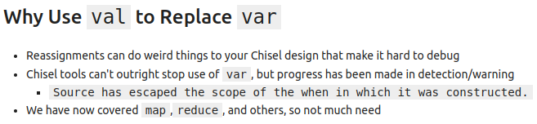
20.8 Why Use val to Replace var
https://www.youtube.com/watch?v=EOMMpYBo8To&list=PLfrN7RIcMe6g2LBRJLTHTdhyj5s8ag0Rg&index=22
Why Use val to Replace var (17:10-19:09/1:05:51)
Why do we use val to replace var?
1. We use var first.
2. If we use val to replace var.

Slide 23
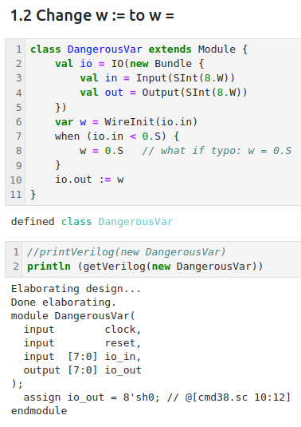
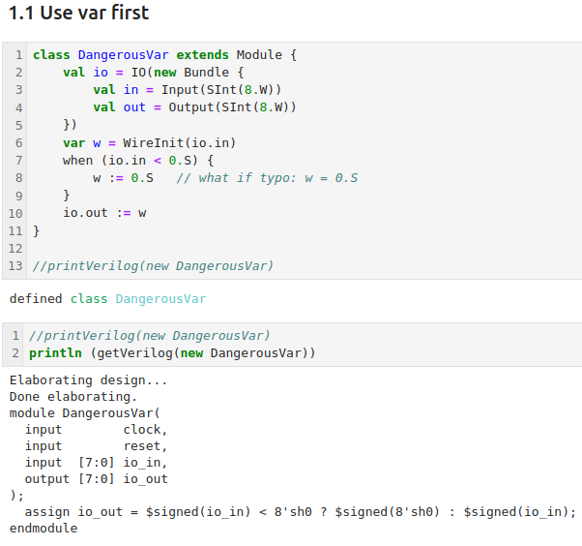
20.8 Why Use val to Replace var
https://www.youtube.com/watch?v=EOMMpYBo8To&list=PLfrN7RIcMe6g2LBRJLTHTdhyj5s8ag0Rg&index=22
Why Use val to Replace var (19:10-19:30/1:05:51)
We use var first.
1. In Left Below, 2. We have w :=, 3. the generated Verilog code is correct.
4. Right bbelow, 5. We make mistake w =, 6. the generated Verilog code is incorrect
5
2
6
3

Slide 24
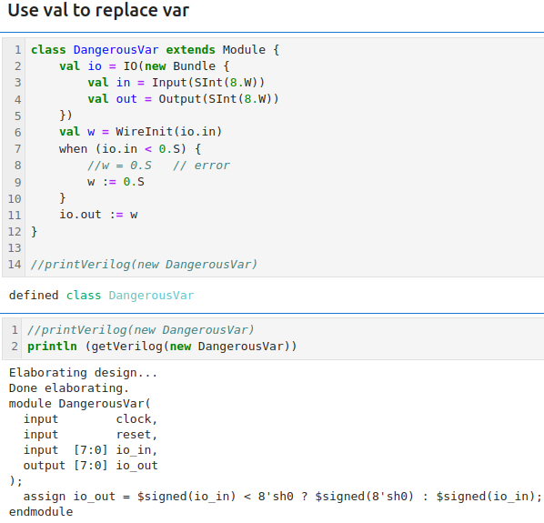
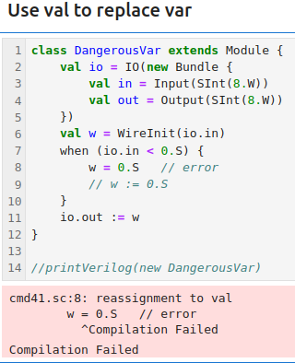
20.8 Why Use val to Replace var
https://www.youtube.com/watch?v=EOMMpYBo8To&list=PLfrN7RIcMe6g2LBRJLTHTdhyj5s8ag0Rg&index=22
Why Use val to Replace var (19:31-22:39/1:05:51)
We replace var to val. The hardware is fixed by val (constant). This will prevent implementation error.
1. In the left below, 2. we change “w = 0.5”, 3. chisel will give us error.
4. In the right below, 5. we use “w := 0.5”, 6. the chisel generate the correct Verilog code,
5
2
3
6

Slide 25
20.9 Mutable/Immutable Collection

Slide 26
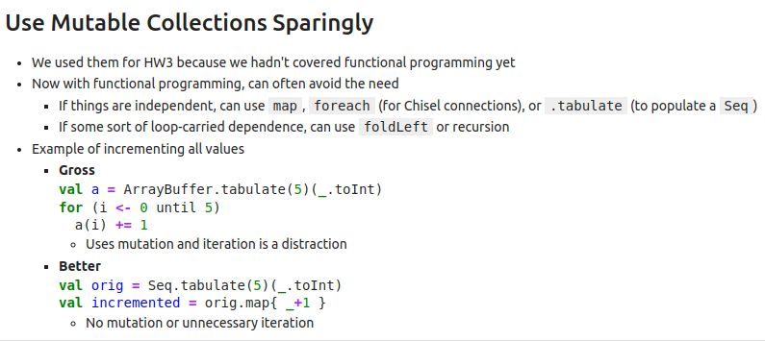
20.9 Mutable/Immutable Collection
https://www.youtube.com/watch?v=EOMMpYBo8To&list=PLfrN7RIcMe6g2LBRJLTHTdhyj5s8ag0Rg&index=22
Mutable/Immutable Collection (22:40-31:27/1:05:51)
1. We use the same val concept to create table.
2. After we create the table, we can fill up or operation of data in the table.
3. We prefer to use immutable Seq() instead of mutable ArrayBuffer().
4. Chisel have ArrayBuffer() and Seq(). ArrayBuffer() is mutable and Seq() is immutable.
5. ArrayBuffer() is good for mutable operation, such as, ordering, iteration, etc. We do not prefer to use mutable collection ArrayBuffer().
6. Seq() is better for functional programming, map, reduce, etc. We prefer to use immutable collection Seq().

Slide 27
20.10 Reduce Passing Parameter

Slide 28
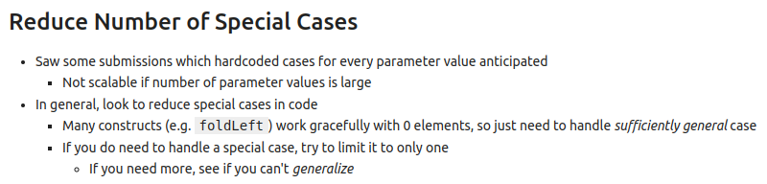
20.10 Reduce Passing Parameter
https://www.youtube.com/watch?v=EOMMpYBo8To&list=PLfrN7RIcMe6g2LBRJLTHTdhyj5s8ag0Rg&index=22
Reduce Passing Parameter (31:28-32:48/1:05:51)
1. Try to minimize number of parameters (to to limit to only one) passing parameter.
2. Too many parameters are difficult for Chisel Library to generate Verilog.

Slide 29
20.11 Chisel for/foreach Side Effect

Slide 30
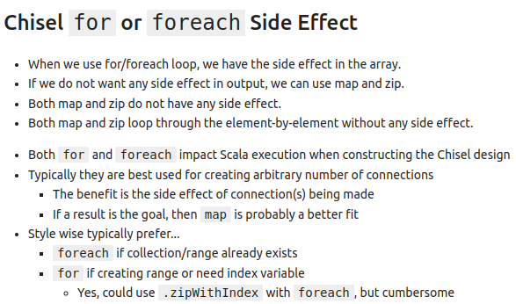
20.11 Chisel for/foreach Side Effect
https://www.youtube.com/watch?v=EOMMpYBo8To&list=PLfrN7RIcMe6g2LBRJLTHTdhyj5s8ag0Rg&index=22
Chisel for/foreach Side Effect (32:49-34:14/1:05:51)
When we use for/foreach loop, we have the side effect in the array.
If we do not want any side effect in output, we can use map and zip.
Both map and zip do not have any side effect.
Both map and zip loop through the element-by-element without any side effect.

Slide 31
20.12 Extra Logic

Slide 32
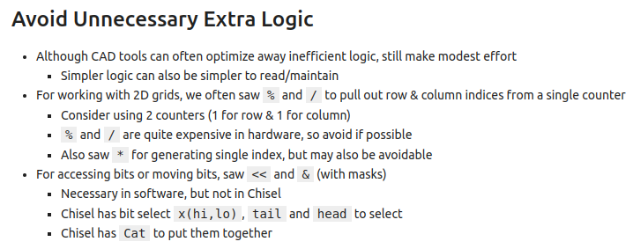
20.12 Extra Logic
https://www.youtube.com/watch?v=EOMMpYBo8To&list=PLfrN7RIcMe6g2LBRJLTHTdhyj5s8ag0Rg&index=22
Extra Logic (34:15-38:00/1:05:51)
Each logic generate Verilog Code (Hardware Element).
Avoid Extra Logic.
Each operator (%, /, <<, &, etc) is a hardware element, very expensive cost.

Slide 33
20.14 Avoid Hardware Declaration Inside when

Slide 34
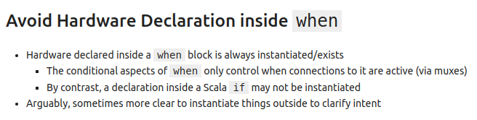
20.14 Avoid Hardware Declaration Inside when
https://www.youtube.com/watch?v=EOMMpYBo8To&list=PLfrN7RIcMe6g2LBRJLTHTdhyj5s8ag0Rg&index=22
Avoid Hardware Declaration Inside When (38:01-39:30/1:05:51)
In when block, the hardware declaration is always create hardware elements.
Try not to declare hardware inside the when block.

Slide 35
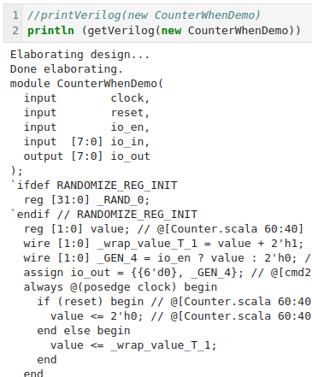
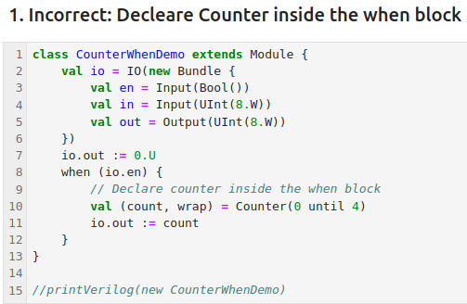
20.14 Avoid Hardware Declaration Inside when
https://www.youtube.com/watch?v=EOMMpYBo8To&list=PLfrN7RIcMe6g2LBRJLTHTdhyj5s8ag0Rg&index=22
Avoid Hardware Declaration Inside When (39:31-39:40/1:05:51)
1. Left below, we declare the counter inside the when block.
2. Right below, we have counter always there.
> wire [1:0] _GEN_4 = io_en ? Value : 2’h’0
3. The io enable that affects the output _GEN_4which connected to the output.
> assign io_out = {{6’d0}, _GEN_4}
But io enable does not affect the counter value _GEN_4.
Because the counter is inside the when block, the counter does not use output the when block.
How to correct the code?

Slide 36
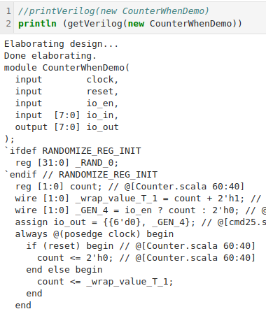
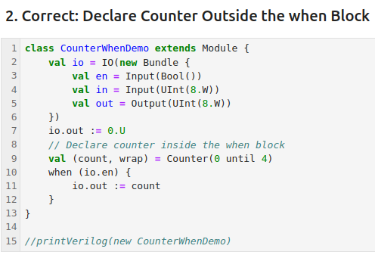
20.14 Avoid Hardware Declaration Inside when
https://www.youtube.com/watch?v=EOMMpYBo8To&list=PLfrN7RIcMe6g2LBRJLTHTdhyj5s8ag0Rg&index=22
Avoid Hardware Declaration Inside When (39:41-42:11/1:05:51)
1. Move the Counter declaration outside the when block.
2. Because the hardware always there, logically, it make more sense to move outside the when control block.
> val (count, wrap) = Counter (0 until 4)
> when (io.en) {
> io.out := count
>}

Slide 37
20.15 Difference: until vs to

Slide 38
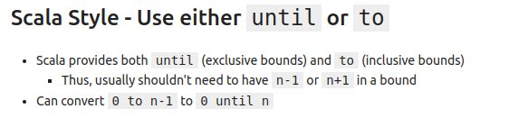
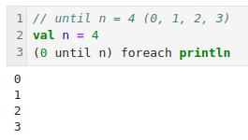
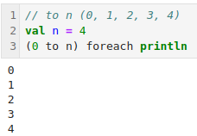
20.15 Difference: until vs to
https://www.youtube.com/watch?v=EOMMpYBo8To&list=PLfrN7RIcMe6g2LBRJLTHTdhyj5s8ag0Rg&index=22
Difference: until vs to (42:12-42:53/1:05:51)
What is difference of until vs to. They are not the same.
Below, we have n = 4.
1. 0 unit n: 0, 1, 2, 3
2. 0 to n: 0, 1, 2, 3, 4

Slide 39
20.16 assume, assert, and require

Slide 40
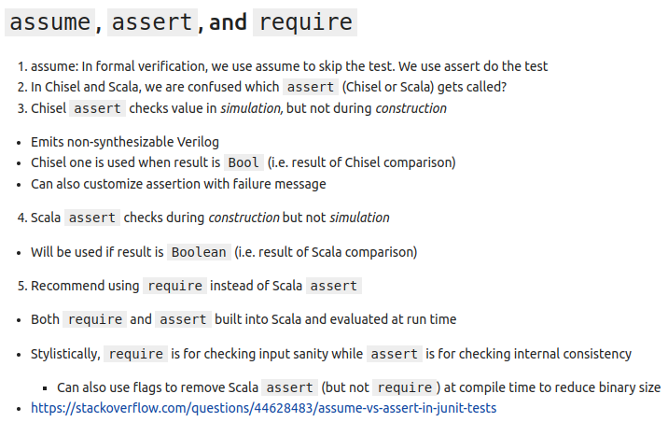
20.16 assume, assert, and require
https://www.youtube.com/watch?v=EOMMpYBo8To&list=PLfrN7RIcMe6g2LBRJLTHTdhyj5s8ag0Rg&index=22
assume, assert, and require (42:54-49:17/1:05:51)
1. assume: In formal verification, we use assume to skip the test. assert do the test.
2. assert: Scala construction: Scala get called in construction. Chisel simulation: Chisel get called in simulation.
3. require: require is used to check the input (external parameter). assert is used to check the internal.
https://stackoverflow.com/questions/44628483/assume-vs-assert-in-junit-tests

Slide 41
20.17 Different assert

Slide 42
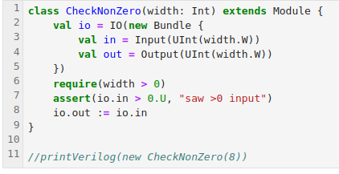
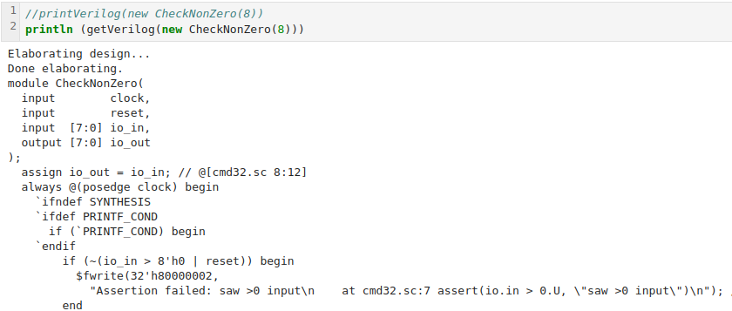
20.17 Different assert
https://www.youtube.com/watch?v=EOMMpYBo8To&list=PLfrN7RIcMe6g2LBRJLTHTdhyj5s8ag0Rg&index=22
Different assert (49:18-50:02/1:05:51)
1. we assert
> assert (io.in > 0.U, “Saw > 0 input”)

Slide 43
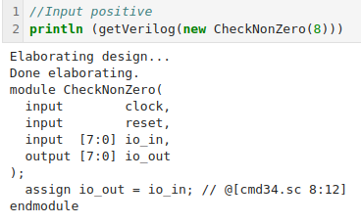
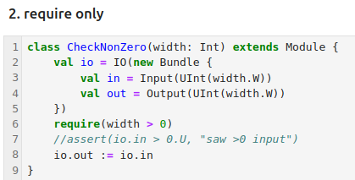

20.17 Different assert
https://www.youtube.com/watch?v=EOMMpYBo8To&list=PLfrN7RIcMe6g2LBRJLTHTdhyj5s8ag0Rg&index=22
Different assert (50:03-50:02/1:05:51)
We use require only
1. check positive
2. check negative: Error out.
1
2

Slide 44
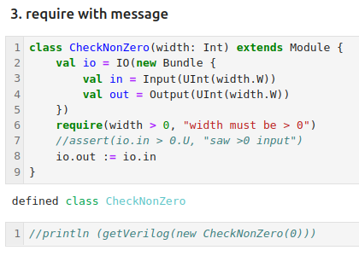
20.17 Different assert
https://www.youtube.com/watch?v=EOMMpYBo8To&list=PLfrN7RIcMe6g2LBRJLTHTdhyj5s8ag0Rg&index=22
Different assert (50:03-52:02/1:05:51)
Require with message.
Note: My version is crash.

Slide 45
20.18 Module, Function, or Class

Slide 46
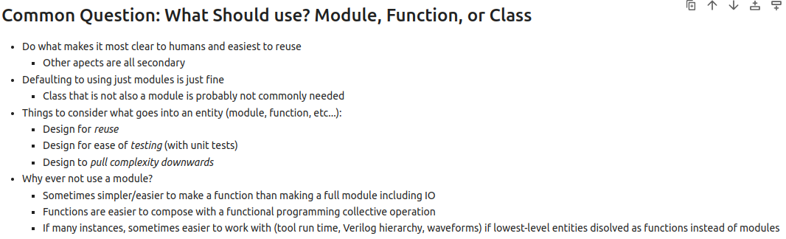
20.18 Module, Function, or Class
https://www.youtube.com/watch?v=EOMMpYBo8To&list=PLfrN7RIcMe6g2LBRJLTHTdhyj5s8ag0Rg&index=22
Module, Function, or Class (53:03-59:05/1:05:51)
Which one should we use? Module, Function, or Class?
module (object): objects are singleton instances, Only one instance of the object in the application.
def: Function. Functional Programming. If we have very simple application. Use function is easier.
class: OOP for reuse.

Slide 47
20.19 Flatten Bundle of Data

Slide 48
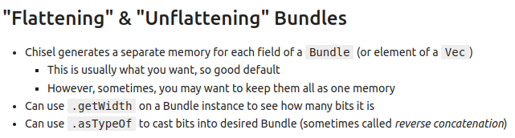
20.19 Flatten Bundle
20.19 Flatten Bundle of Data
https://www.youtube.com/watch?v=EOMMpYBo8To&list=PLfrN7RIcMe6g2LBRJLTHTdhyj5s8ag0Rg&index=22
Flatten Bundle of Data (59:06-1:00:05/1:05:51)
Q. What is Bundle in Chisel?
Ans:
1. In Chisel, a bundle is a class that groups named fields (variables) of different Chisel data types together into a single, coherent unit.
2. This allows for the creation of custom data structures, similar to records or structs in other programming languages

Slide 49
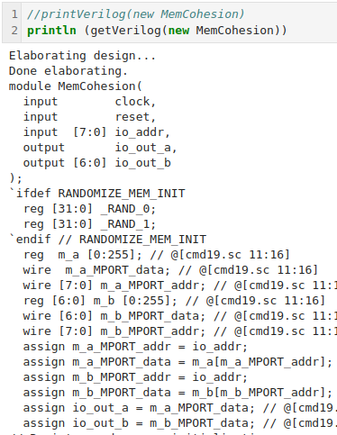
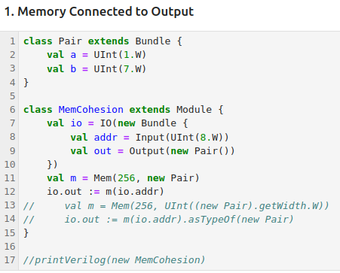
20.19 Flatten Bundle
20.19 Flatten Bundle of Data
https://www.youtube.com/watch?v=EOMMpYBo8To&list=PLfrN7RIcMe6g2LBRJLTHTdhyj5s8ag0Rg&index=22
Flatten Bundle of Data (59:06-1:00:30/1:05:51)
Memory connected output

Slide 50
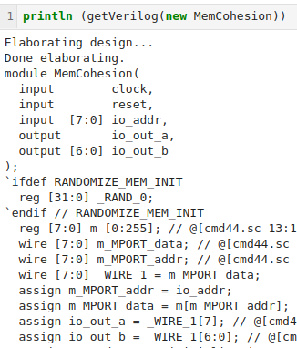
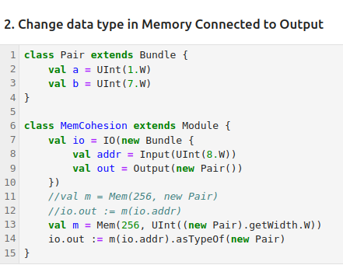
20.19 Flatten Bundle
20.19 Flatten Bundle of Data
https://www.youtube.com/watch?v=EOMMpYBo8To&list=PLfrN7RIcMe6g2LBRJLTHTdhyj5s8ag0Rg&index=22
Flatten Bundle of Data (1:00:31-1:05:51/1:05:51)
We change the content of memory with different width and data type.

Slide 51
End

