Slide 1

2.1 Hello Chisel
Peter H. Chen

Slide 2
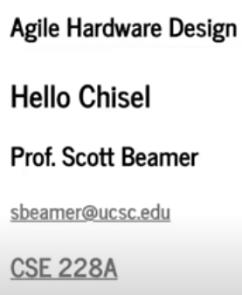
2.1 Hello Chisel
https://www.youtube.com/watch?v=9GD6PROUlWw&list=PLfrN7RIcMe6g2LBRJLTHTdhyj5s8ag0Rg&index=2
Hello Chisel (0:00-0:24/53:20)
We are going to use Chisel for Agile Hardware Design.

Slide 3
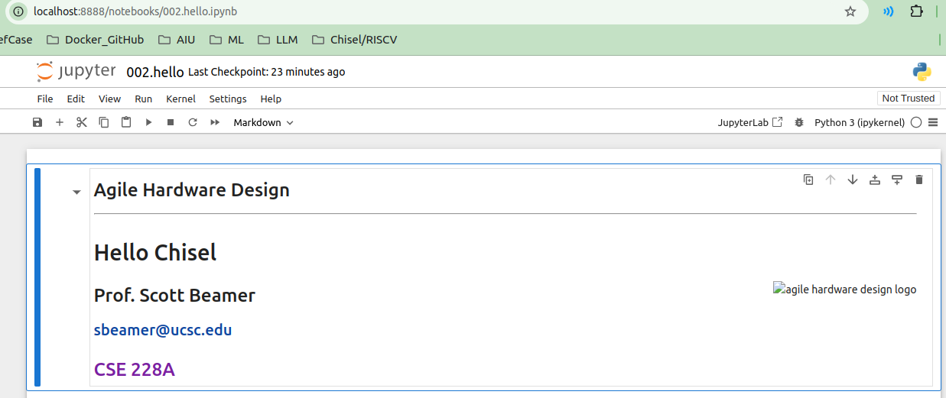
2.1 Hello Chisel
https://www.youtube.com/watch?v=9GD6PROUlWw&list=PLfrN7RIcMe6g2LBRJLTHTdhyj5s8ag0Rg&index=2
Hello Chisel (0:00-0:24/53:20)
Use below command to install Jupyter Notebook
> sudo apt-get update
> sudo apt-get install python3
> sudo apt-get install python3-pip
> sudo pip3 install jupyter
> jupyter notebook 002.hello.ipynb

Slide 4
End

