Slide 1

0 Chisel Introduction
Peter H. Chen

Slide 2
0 Chisel Introduction
https://github.com/ucb-bar/chisel-tutorial?tab=readme-ov-file
Chisel Instruction
Chisel (Constructing Hardware in Scala Embedded Language) is an open-source hardware construction language at UC Berkeley that support advanced hardware design using highly parameterized generators and layered domain-specific hardware languages.

Slide 3
0.2 Install Chisel

Slide 4
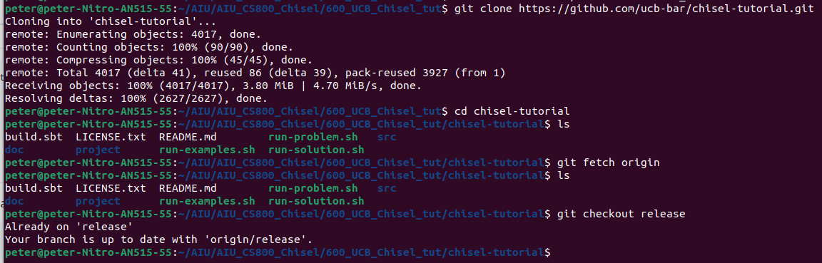
0.2 Install Chisel
https://github.com/ucb-bar/chisel-tutorial?tab=readme-ov-file
Install Chisel
Getting the Repo:
1. We clone the remote chisel to local drive.
> git clone https://github.com/ucb-bar/chisel-tutorial.git
Change to chisel-tutorial directory:
> cd chisel-tutorial
2. We downloads commits, files, and refs from a remote repository into your local repo.
In Git, "origin" is a shorthand name for the remote repository that a project was originally cloned from.
> git fetch origin
3. The git checkout command lets you navigate between the branches created by git branch. Checking out a branch updates the files in the working directory to match the version stored in that branch, and it tells Git to record all new commits on that branch.
> git checkout release
1
2
3

Slide 5
End

