Slide 1

3.1 Parameter
Peter H. Chen

Slide 2
3.1 Parameter
https://github.com/freechipsproject/chisel-bootcamp
Parameter
We discuss Scala Collections and Chisel Generators.
1. Scala Collections are important building blocks for dealing with situations like this.
2. Chisel Generators will frequently have to deal with variable numbers of objects, whether they are IOs, modules, or test vectors.
3. We introduce Scala collections and how to use them with Chisel generators.
Topics:
1. Setup: Select scala 2.12.11 for Jupyter notebook and run.
2. Scala Collection and Verilog Generator
3. Write FIR (Finite Impulse Response) Golden Model
4. Write Test for FIR Filter: Take the previous working FIR Filter as golden.
5. Write Test for FIR Golden Model: Write new FIR Flexible Model.
6. Write Parameterized FIR Generator.
7. Write ManyElement Filter
8. Test Different size of FIR Filter
9. Test Big Tap Data
10. Hardware Collection: Design with collection of hardware components
11. Exercise (Problem and Solution): Write Model and Test for 32-bits RISC-V Processor

Slide 3
3.2.1 Setup

Slide 4
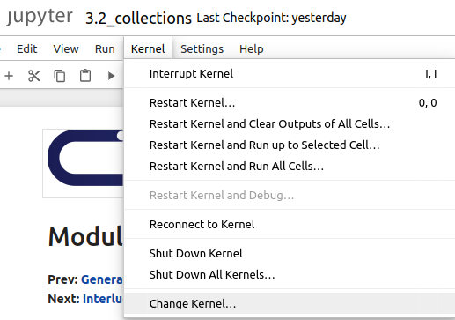
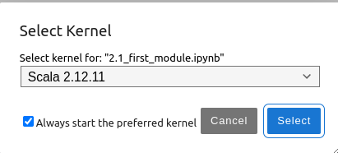
3.2.1 Setup
https://github.com/freechipsproject/chisel-bootcamp
Setup
1. Change folder to chisel-bootcamp. If you want to work on your working space, copy image folder and source folder to your working directory.
> cd chisel-bootcamp
2. Start Jupyter notebook
> jupyter notebook 3.2_collections.ipynb
3. Select the scala interpreter: > Kernel > Change Kernel… >Scala 2.12.11
3

Slide 5
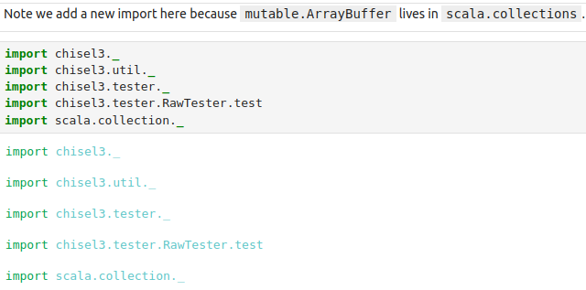
3.2.1 Setup
https://github.com/freechipsproject/chisel-bootcamp
Setup
1. Scala uses maven to setup path to with for source folder for Scala Libraries and get Scala Property.
2. import chisel3 library, utility, tester harness (horse controller), and test interface function.
3. We import the Collection.* for mutable.ArrayBuffer

Slide 6
3.2.2 Collection and Generator

Slide 7
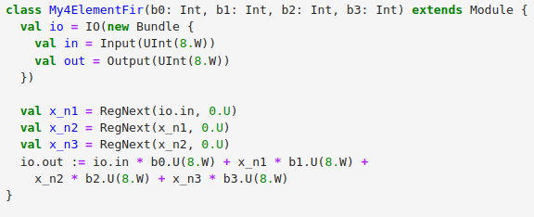
3.2.2 Collection and Generator
https://github.com/freechipsproject/chisel-bootcamp
Collection and Generator
1. We focus on Scala Collections and Chisel Generators.
2. Instead of looking at an instance of a circuit, i.e., a particular circuit, we will consider how to create a generator of a circuit.
3. Below is the FIR (Finite Impulse Response) code.
4. This circuit is a simple generator. It can generate versions of this 4-tap filter with different coefficients.
5. If we want to flexible control for the circuit.
  a. Write Scala FIR (FIR Golden Model with any number of taps).
  b. Write test and take result of section 2.5 FIR Filter.
  c. Write Test for Golden Model “Class My4ElementFir”.
  d. Test the new circuit using our new test harness.

Slide 8
3.2.3 Write FIR Golden Model

Slide 9
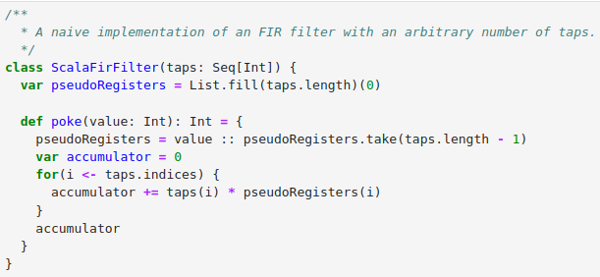
3.2.3 Write FIR Golden Model
https://github.com/freechipsproject/chisel-bootcamp
Write FIR Golden Model in Scala
Below, we Write a flexible FIR Golden Model (a configurable Model of FIR with any number of Taps).
Seq
The taps has become a Seq[Int]. Here, we pass an arbitrarily-long sequence of Int into the class ScalaFirFilter.
Registers
> var pseudoRegisters = List.fill(taps.length)(0)
We create a register List that will hold values from previous cycles. We use List to add an element to the head and removing the last element. We initializing this list to contain all zeros.
Poke
Function Method poke() pick the register input and output the sum (of coefficient * shift register input with clock cycle).

Slide 10
3.2.3 Write FIR Golden Model
https://github.com/freechipsproject/chisel-bootcamp
Write FIR Golden Model in Scala
Computing the output
1. Loop for each element in list.
2. Multiply the tap coefficient with the registers list and add them together (put result in accumulator).
3. output the result (accumulator)

Slide 11
3.2.3 Write FIR Golden Model
https://github.com/freechipsproject/chisel-bootcamp
Write FIR Golden Model in Scala
Updating the registers
> pseudoRegisters = value :: pseudoRegisters.take(taps.length – 1)
1. The ::() operator: Add an element to the beginning of the List.
> val m1 = List(1, 2, 3) // m1 = (1, 2, 3)
> val res = m1.::("5") // m1.::() operator; “.” is to access the member function
> println (res) // (5, 1, 2, 3)
> https://www.geeksforgeeks.org/scala-list-operator-with-example/
2. The pseudoRegisters.take() take 0 to (taps.n -2) elements (before taps.n-1)
3. Use “::” (concatenate) to add taps (0 to n-2) and value. // (value, 0, 1, 2, …. n-2), n-1 is shift right (shift out).

Slide 12
3.2.4 Write Test for FIR Filter

Slide 13
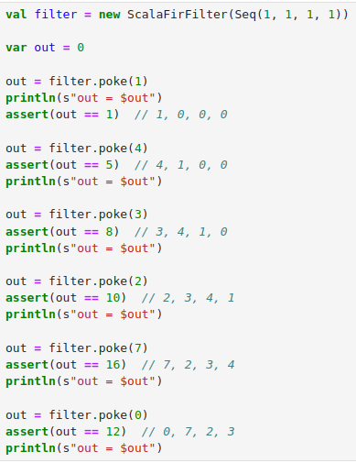
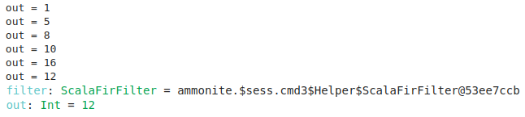
3.2.4 Write Test for FIR Filter
https://github.com/freechipsproject/chisel-bootcamp
Write Test for FIR Filter
In section 2.5, we have class ScalaFirFilter() for FIR Filter.
We already known 2.5 FIR Filter is working.
We will use the results (output: 1, 5, 8, 10, 16, 12) to verify the Golden Model “class My4ElementFir()”
The results should be same.

Slide 14
3.2.5 Write Test FIR Golden Model

Slide 15
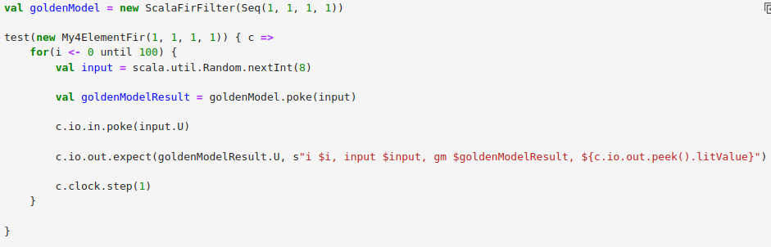

3.2.5 Write Test for FIR Golden Model
https://github.com/freechipsproject/chisel-bootcamp
Write Test for FIR Golden Model
Now,
1. We want to pick the results of 2.5 FIR Filter (ScalaFirFilter) as the Golden Results.
2. Compare the Golden Results with the FIR Golden Model (Current development).
3. We test runs for 100 cycles, and checks results of two designs (2.5 FIR Filter and 3.2 FIR Golden “class My4ElementFir). The simulation are passed in 100 cycles.

Slide 16
3.2.6 Parameterized FIR Generator

Slide 17
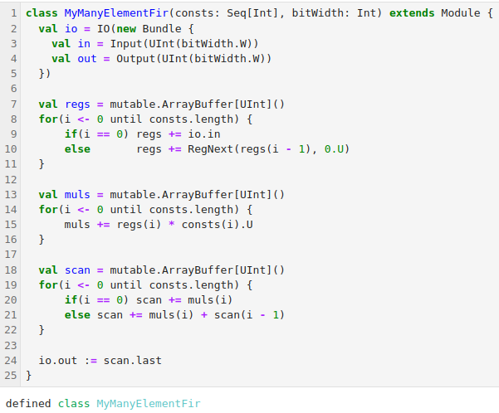
3.2.6 Parameterized FIR Generator
https://github.com/freechipsproject/chisel-bootcamp
Parameterized FIR Generator
Below,
1. We created a new Filter class, MyManyElementsFilter. MyManyElementsFilter takes a Seq of constants to use for taps. This list can be any number of elements.
2. For good measure a bitWidth has been added that allows us to control the sizes of numbers that can be handled by our circuit.
3. In response the variable length we have had to refactor the creation of registers and how they are connected.
4. The methodology used below uses a simple subset of the available library of collection functions.
5. Later sections show how to simplify the expression.

Slide 18
3.2.6 Parameterized FIR Generator
https://github.com/freechipsproject/chisel-bootcamp
Parameterized FIR Generator
1. There are three parallel sections starting at lines 7, 13, and 18. We are using a Scala collection type called ArrayBuffer.
2. ArrayBuffer allows you to append elements using the += operator.

Slide 19
3.2.6 Parameterized FIR Generator
https://github.com/freechipsproject/chisel-bootcamp
Parameterized FIR Generator
1. First, we create an ArrayBuffer regs whose elements will be UInts.
2. Then iterate over the taps, adding the input as the first element followed by creating registers using RegNext which connect the input of the register to the previous element (regs(i-1)) and initializes it to unsigned zero (0.U).

Slide 20
3.2.6 Parameterized FIR Generator
https://github.com/freechipsproject/chisel-bootcamp
Parameterized FIR Generator
1. These registers will hold the previous values of inputs as they are needed.
2. Next, we create another ArrayBuffer muls of UInts.
3. Each element of muls will be a node whose i-th element is the product of the regs(i) and const(i

Slide 21
3.2.6 Parameterized FIR Generator
https://github.com/freechipsproject/chisel-bootcamp
Parameterized FIR Generator
Note:
1. The use of the scan.last method. It takes the last element of a collection, and is a more elegant alternative to regs(i - 1) used during the regs construction.

Slide 22
3.2.7 ManyElement Filter

Slide 23
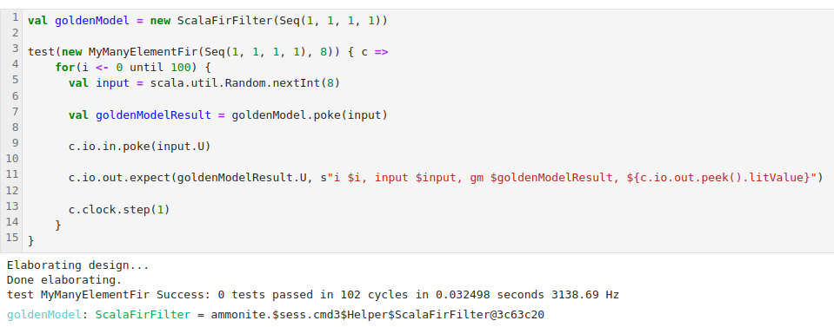
3.2.7 ManyElement Filter
https://github.com/freechipsproject/chisel-bootcamp
ManyElement Filter
We create an instance of MyManyElementFir and run test.
We have test with “Success: 0” means “0 failed, all passed” in 102 cycles.

Slide 24
3.2.8 Test Different Size of FIR Filter

Slide 25
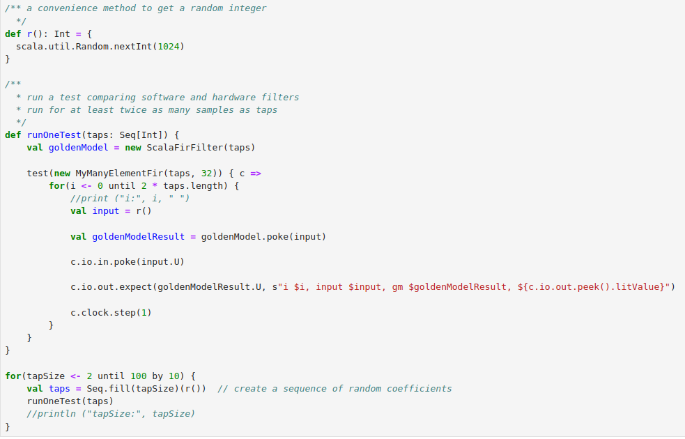
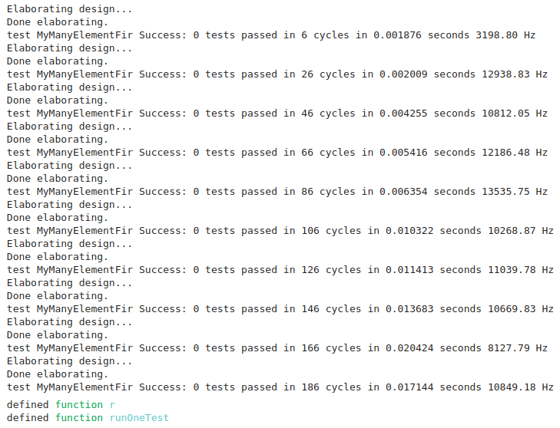
3.2.8 Test Different Size of FIR Filter
https://github.com/freechipsproject/chisel-bootcamp
Test Different Size of FIR Filter
We create some helper functions. Here:
1. r: random number
2. runOneTest(): creates a golden model and a hardware simulation of a filter for a particular set of taps,
3. then runs at least twice width of the number of taps of data through the filter.

Slide 26
3.2.9 Test Big Tap Data

Slide 27

3.2.9 Test Big Tap Data
https://github.com/freechipsproject/chisel-bootcamp
Test Big Tap Data
1. Below, we run a single test on a 1000 tap FIR filter.
2. It can take a minute or so to run (Below, we run 4.5 sec CPU time. But Scala/Jupyter will run longer).

Slide 28
3.2.10 Hardware Collection

Slide 29
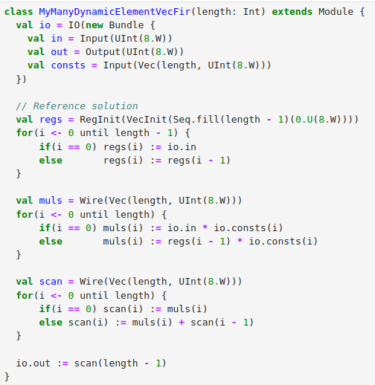
3.2.10 Hardware Collection
https://github.com/freechipsproject/chisel-bootcamp
Hardware Collection
Example: Add run-time configurable taps to our FIR
1. Below, we adds an additional consts vector to the IO of our FIR generator which allows the coefficients to be changed externally after circuit generation.
2. This is done with the Chisel collection type Vec. Vec supports many of the scala collection methods but it can only contain Chisel hardware elements. Vec should only be used in situations where ordinary Scala collections won't work.
3. Basically this is in one of two situations. We need:
  a. a collection of elements in a Bundle, typically a Bundle that will be used as IO.
  b. to access the collection via an index that is part of the hardware (think Register File).
1
2
3

Slide 30
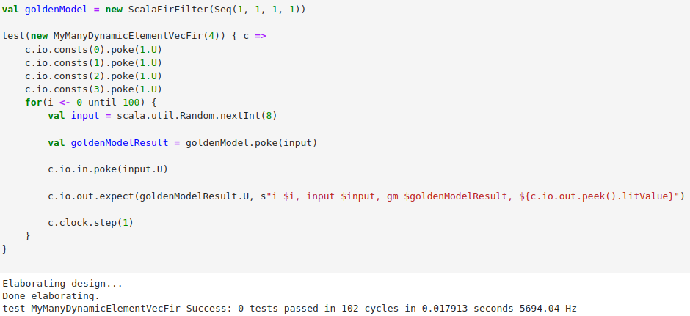
3.2.10 Hardware Collection
https://github.com/freechipsproject/chisel-bootcamp
Hardware Collection
Example: Add run-time configurable taps to our FIR
1. We create a variable goldenModel = new ScalaFirFilter (…).
2. Use goldenModel.poke() to get the result.

Slide 31
3.2.11 Exercise: 32-bits RISC-V Processor

Slide 32
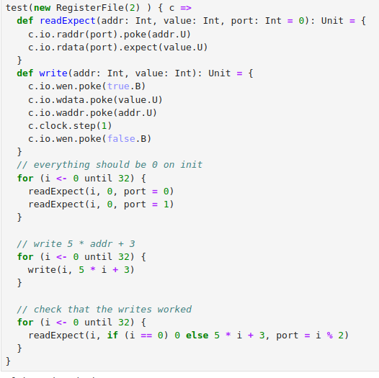
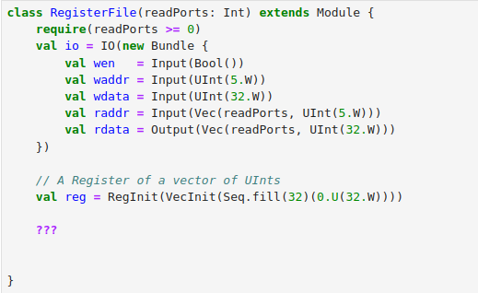
3.2.11 Exercise: 32-bits RISC-V Processor
https://github.com/freechipsproject/chisel-bootcamp
Exercise: 32-bits RISC-V Processor
1. A register file is an important building block for making a processor. A register file is an array of registers that can be read from or written to via a number of read or write ports. Each port consists of an address and data field.
2. The RISC-V instruction set architecture defines several variants, the simplest of which is called RV32I. RV32I has a size-32 array of 32-bit registers. The register at index 0 (the first register) is always zero when you read from it, regardless of what you write to it (it's often useful to have 0 handy).
3. Implement a register file for RV32I with a single write port and a paramterized number of read ports. Writes will only be performed when wen (write enable) is asserted.

Slide 33
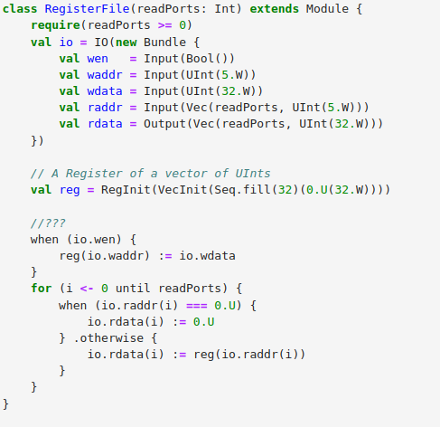
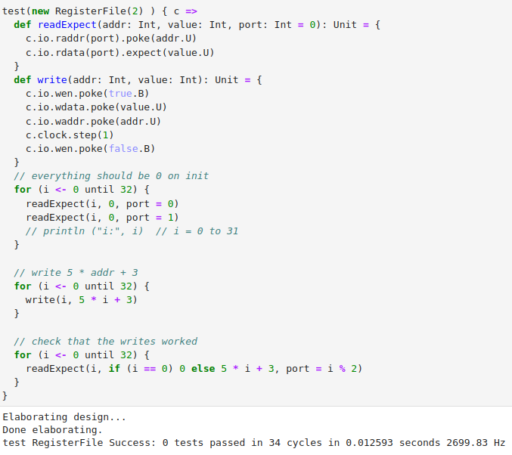
3.2.11 Exercise: 32-bits RISC-V Processor
https://github.com/freechipsproject/chisel-bootcamp
Exercise: 32-bits RISC-V Processor
Solution as below:

Slide 34
End

