Slide 1

9.1 SpinalHDL
Peter H. Chen

Slide 2

9.1 SpinalHDL
https://www.youtube.com/watch?v=XyDiz3SRogY&list=PLlu0CT-JnSasfpk8tq1ZDiE2G0AK1BhOg&index=9
SpinalHDL (0:00-0:12/21:02)
Chisel uses a paradigm behind SpinalHDL.
SpinalHDL is not a Hardware Description Language like Verilog.
SpinalHDL is a programming paradigm embedded into the Scala OOD and Functional Programming Language.
Q1: What is the relationship of Chisel and SpinalHDL?
Ans:
  1. Chisel is a HCL (Hardware Construction Language).
  2. SpinalHDL is a HDL (Hardware Description Language) core library that implements the Verilog RTL library.
  3. Chisel can import the SpinalHDL Core library.
Q2: Can we use SpinalHDL in Chisel?
Ans: Yes, you can reuse a SpinalHDL core in Chisel.
Q3: The SpinalHDL is a lot like Chisel. Why do we choose SpinalHDL?
Ans: SpinalHDL was developed parallel with Chisel. It is dedicated in the Core Library/examples for Construction of Digital Circuit.

Slide 3
9.2 SpinalHDL Introduction

Slide 4
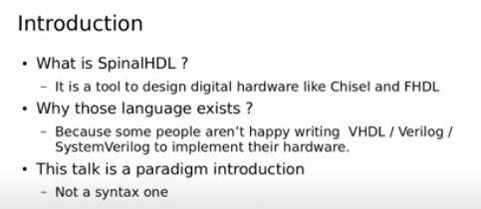
9.2 SpinalHDL Introduction
https://www.youtube.com/watch?v=XyDiz3SRogY&list=PLlu0CT-JnSasfpk8tq1ZDiE2G0AK1BhOg&index=9
SpinalHDL Introduction (0:13-0:56/21:02)
SpinalHDL is a Digital Hardware Design Tool like Chisel and FHDL (Fragmented Hardware Description Language).
Why use SpinalHDL?
1. SpinalHDL is open source.
2. SpinalHDL is embedded into Scala Language.
3. SpinalHDL remove hardware wiring: Create and connect complex buses like AXI in one single line and create your own bus definitions and abstraction layers.

Slide 5
9.3 SpinalHDL Adder Example

Slide 6
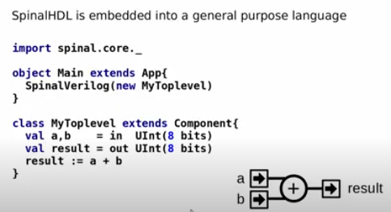
9.3 SpinalHDL Adder Example
https://www.youtube.com/watch?v=XyDiz3SRogY&list=PLlu0CT-JnSasfpk8tq1ZDiE2G0AK1BhOg&index=9
SpinalHDL Adder Example (0:57-2:58/21:02)
SpinalHDL embedded into general purpose programming language, i.e., Scala instead of Verilog.
SpinalHDL is a Scalar Library. We use the software tool for hardware design.
Below is the example:
1. Here, we import the spinal.core._ in Scala language.
2. Since we use Scala language, we can generate hardware. Here, in the main {} function, we call SpinalVerilog () function create hardware circuit.
3. We define Scala class MyTopLevel {}.
4. We define input a and b are 8 bits and output is result is 8 bits.
5. We add input a and b with operator “+” and output result.
6. Then, we generate the corresponding hardware netlist and run the simulation.

Slide 7
9.4 SpinalHDL Counter Example

Slide 8
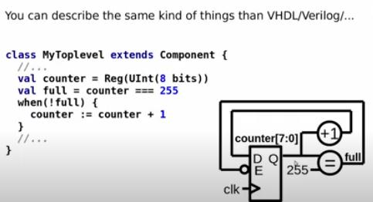
9.4 SpinalHDL Counter Example
https://www.youtube.com/watch?v=XyDiz3SRogY&list=PLlu0CT-JnSasfpk8tq1ZDiE2G0AK1BhOg&index=9
SpinalHDL Counter Example (2:59-3:56/21:02)
Below is SpinalHDL example for counter.
1. We assign counter is 8 bits.
2. We have conditional statement “===” to check 255 or not.
==: returns a boolean; ===: returns a column
3. The statement “=”
> full = counter
Assignment the counter bus
4. We use “when” to check there is a data inside.
5. The statement:
> counter := counter +1
create the register for us.

Slide 9
9.5 SpinalHDL vs Scala

Slide 10
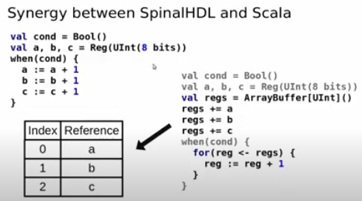
9.5 SpinalHDL vs Scala
https://www.youtube.com/watch?v=XyDiz3SRogY&list=PLlu0CT-JnSasfpk8tq1ZDiE2G0AK1BhOg&index=9
SpinalHDL vs Scala (3:57-6:37/21:02)
Below example:
Left hand side is the SpinalHDL: Regular way.
Right hand side is the SpinalHDL: Use Table Specification.

Slide 11
9.6 Register Bank: Regular Way

Slide 12
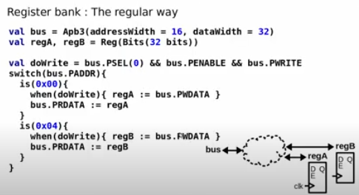
9.6 Register Bank: Regular Way
https://www.youtube.com/watch?v=XyDiz3SRogY&list=PLlu0CT-JnSasfpk8tq1ZDiE2G0AK1BhOg&index=9
Register Bank: Regular Way (6:38-7:34/21:02)
Below example:
1. We have a group of memory, the dot line area, with read and write.
2. We have register A and Register B.
3. The implementation, we have Apb3 (Advanced Peripheral Bus) for memory bus.
4. regA and regB for register A and register B.
5. Check the bus with switch (bus.PADDR)
6. Read data from memory address 0x00 and 0x04
7. Perform the write statement.

Slide 13
9.7 Register Bank: Use Table Specification

Slide 14
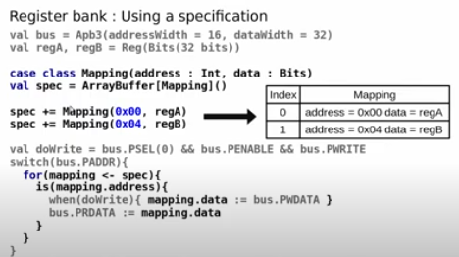
9.7 Register Bank: Use Table Specification
https://www.youtube.com/watch?v=XyDiz3SRogY&list=PLlu0CT-JnSasfpk8tq1ZDiE2G0AK1BhOg&index=9
Register Bank: Use Table Specification (7:35-9:16/21:02)
Below example, we use the table mapping to specify the data.
1. statement
> spec += Mapping (0x00, regA)
Associate the memory address and register data
Flush data to the the memory object spec .
2. statement:
> for (mapping <- spec)
Loop every bit in spec and assign the spec object to mapping object
3. statement
> is (mapping.address)
Check mapping address data, then perform the Write Data and map data to bus.

Slide 15
9.8 Register Bank: Define a Reusable Class

Slide 16
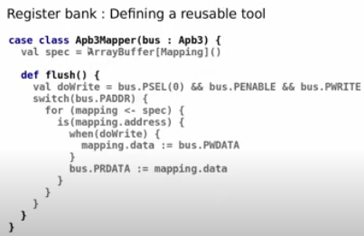
9.8 Register Bank: Define a Reusable Class
https://www.youtube.com/watch?v=XyDiz3SRogY&list=PLlu0CT-JnSasfpk8tq1ZDiE2G0AK1BhOg&index=9
Register Bank: Define a Reusable Class (9:17-9:54/21:02)
In software engineering, we define a Reusable Class Ap3Mapper {}.
Assign the spec data from memory mapping data.
We define a flush() function:
1. Assign doWrite flag.
2. Assign each bit of spec data to mapping data.
3. Check buss address.
4. Check the mapping address
5. if (doWrite) Assign mapping data.
6. Assign bus data from mapping data.

Slide 17
9.9 Register Bank: Use Defined Class

Slide 18
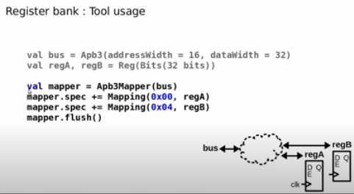
9.9 Register Bank: Use Defined Class
https://www.youtube.com/watch?v=XyDiz3SRogY&list=PLlu0CT-JnSasfpk8tq1ZDiE2G0AK1BhOg&index=9
Register Bank: Use Defined Class (9:55-11:17/21:02)
1. Create bus and register
2. Create map
3. map reg A
4. map reg B.
5. flush

Slide 19
9.10 Register Bank: OOD Coding

Slide 20
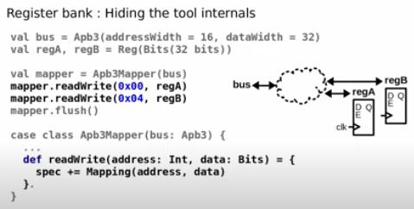
9.10 Register Bank: OOD Coding
https://www.youtube.com/watch?v=XyDiz3SRogY&list=PLlu0CT-JnSasfpk8tq1ZDiE2G0AK1BhOg&index=9
Register Bank: OOD Coding (11:18-12:18/21:02)
1. Create bus and register
2. Create map object
3. object read/wite register A
4. object read/write register B
5. object flush

Slide 21
End

