Slide 1

9.11 Register Bank: API Interface
Peter H. Chen

Slide 2
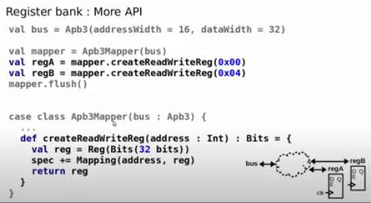
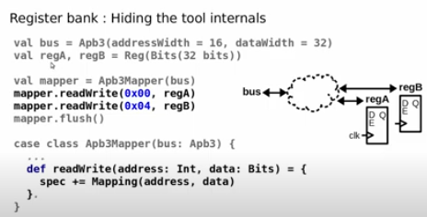
9.11 Register Bank: API Interface
https://www.youtube.com/watch?v=XyDiz3SRogY&list=PLlu0CT-JnSasfpk8tq1ZDiE2G0AK1BhOg&index=9
Register Bank: API Interface (12:19-13:34/21:02)
Use API for interface.
We instantiate twice:
> regA, regB Reg(…)
We can hide the creation and use member function with passing address.
> regA = mapper.createReadWriteReg(0x00)
> regB = mapper.createReadWriteReg(0x04)

Slide 3
9.12 Register Bank: More

Slide 4
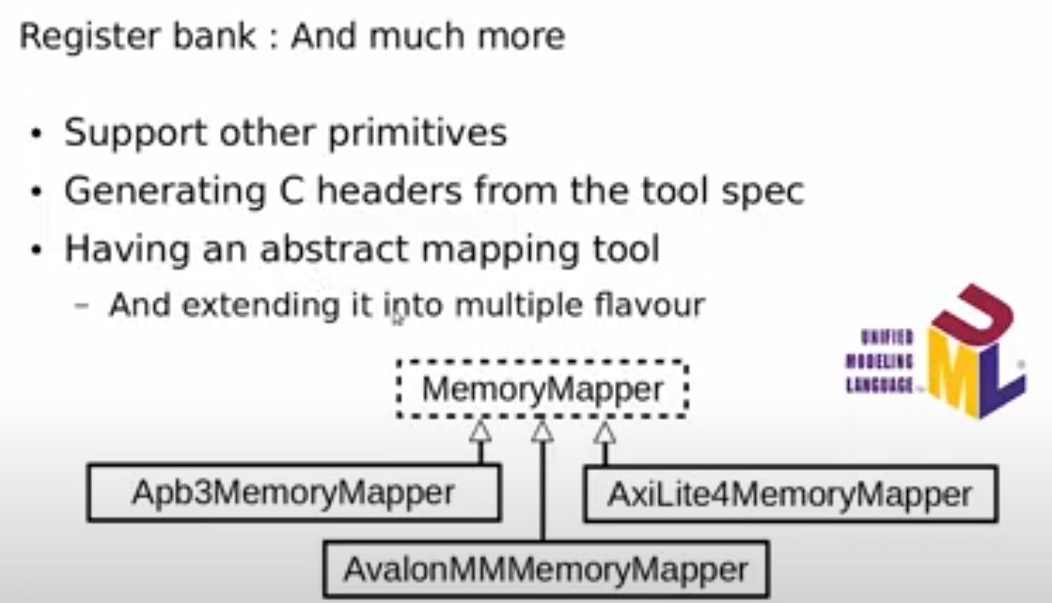
9.12 Register Bank: More
https://www.youtube.com/watch?v=XyDiz3SRogY&list=PLlu0CT-JnSasfpk8tq1ZDiE2G0AK1BhOg&index=9
Register Bank: More (13:35-14:25/21:02)
UML (Unified Modeling Language)
More primitives

Slide 5
9.13 Memory Bus Interconnect

Slide 6
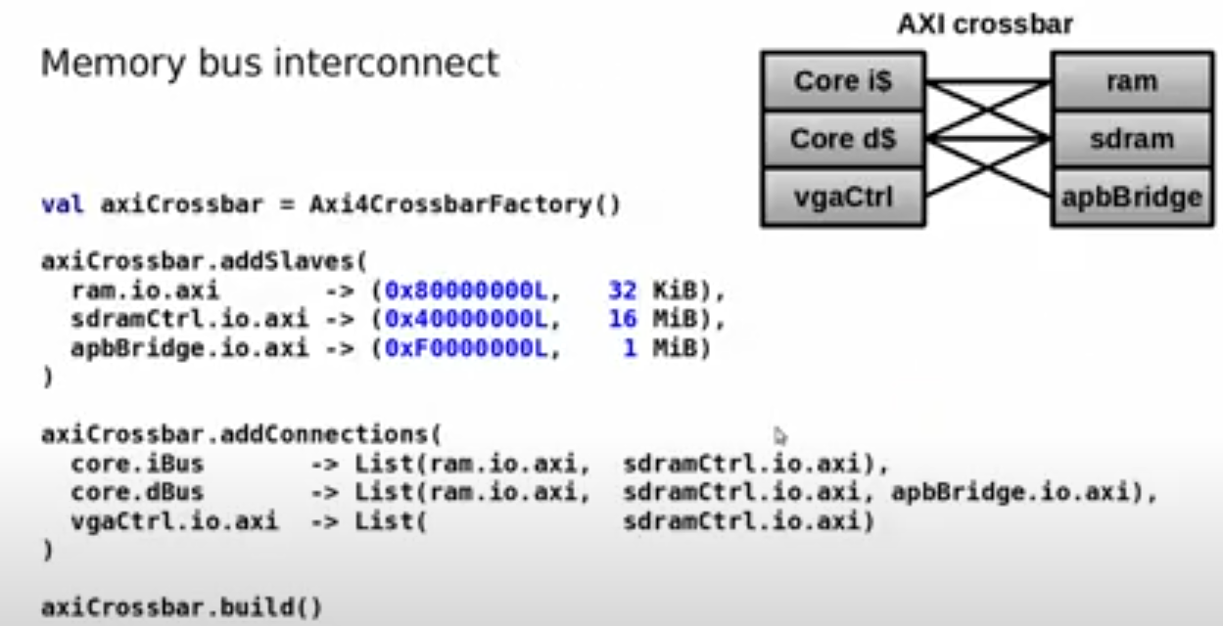
9.13 Memory Bus Interconnect
https://www.youtube.com/watch?v=XyDiz3SRogY&list=PLlu0CT-JnSasfpk8tq1ZDiE2G0AK1BhOg&index=9
Memory Bus Interconnect (14:26-15:59/21:02)
Mapping Memory: AXI (Advanced eXtensible Interface). AXI is a communication protocol for on-chip busses. AXI is a part of AMBA (Advanced Microcontroller Bus Architecture) standard developed by ARM.
If we have Core, VGA controller, RAM, SDRAM, Bridge, etc, we can connect them together easily under the SoC. Interconnect will link every hardware together.
APB (Advanced Peripheral Bus)
1. Add Slave
2. Add Connection
3. Build

Slide 7
9.14 CPU Design: VexRiscv

Slide 8
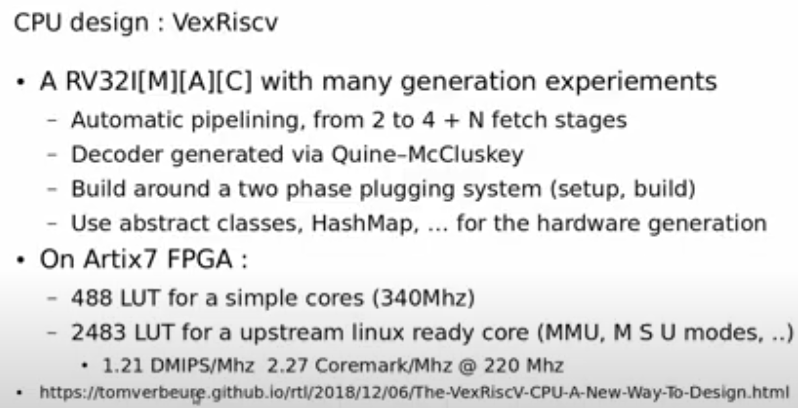
9.14 CPU Design: VexRiscv
https://www.youtube.com/watch?v=XyDiz3SRogY&list=PLlu0CT-JnSasfpk8tq1ZDiE2G0AK1BhOg&index=9
CPU Design: VexRiscv (16:00-17:00/21:02)
CPU Design: VexRiscv. A new way to design CPU.
On Artix7 FPGA: Video Game developer.
https://tomverbeure.github.io/rtl/2018/12/06/The-VexRiscV-CPU-A-New-Way-To-Design.html

Slide 9
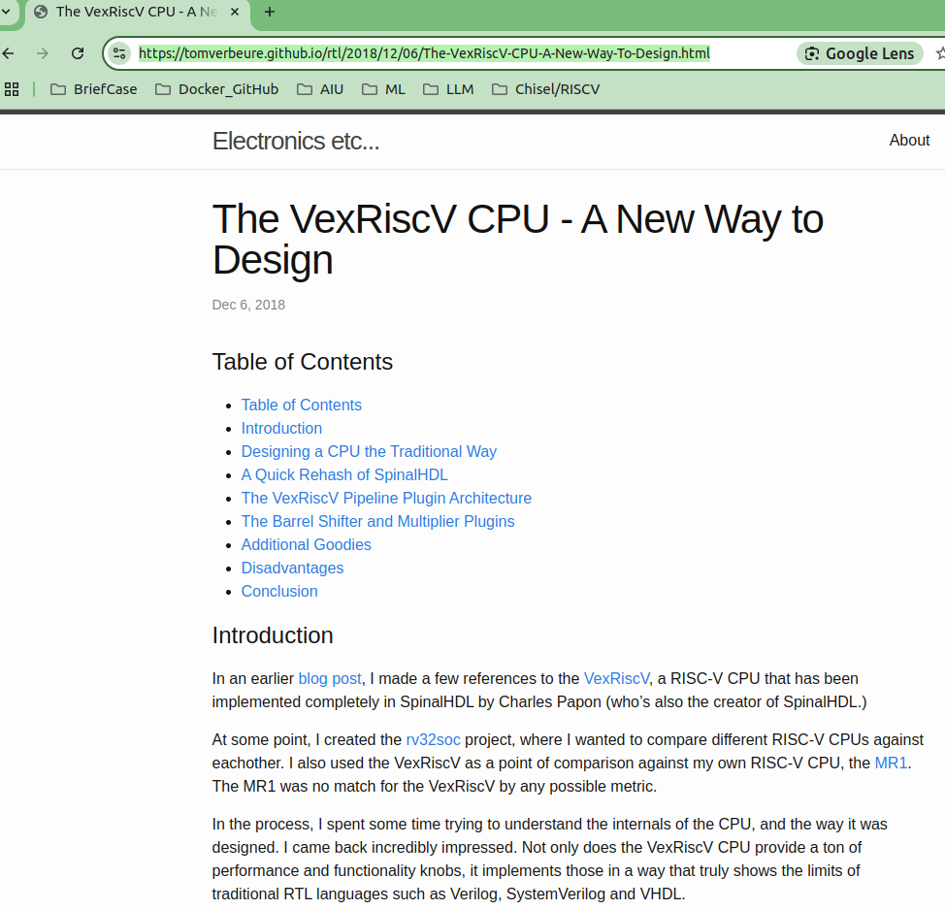
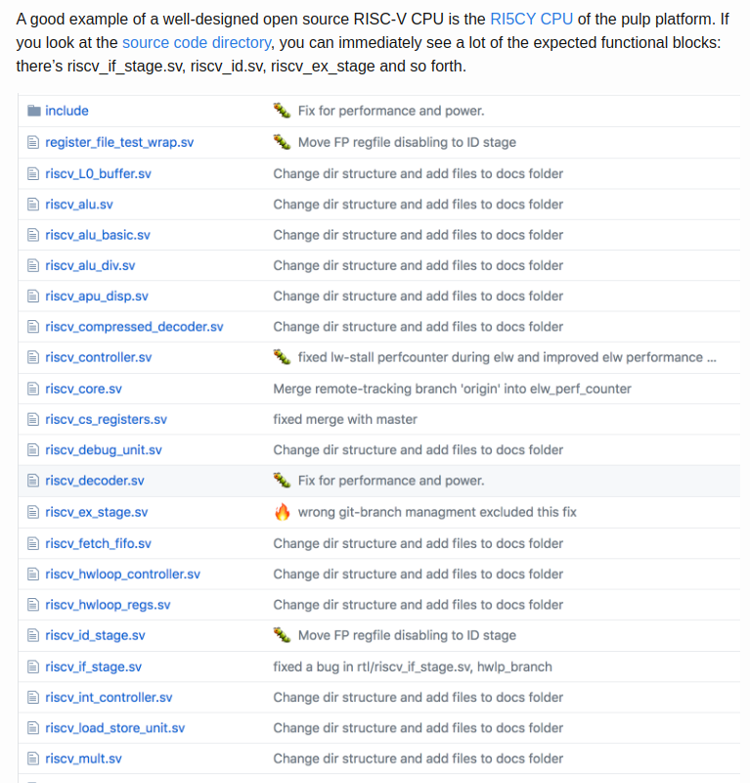
9.14 CPU Design: VexRiscv
https://www.youtube.com/watch?v=XyDiz3SRogY&list=PLlu0CT-JnSasfpk8tq1ZDiE2G0AK1BhOg&index=9
CPU Design: VexRiscv (17:01-10:00/21:02)
Traditional Way: A lot of Verilog Code
https://tomverbeure.github.io/rtl/2018/12/06/The-VexRiscV-CPU-A-New-Way-To-Design.html

Slide 10
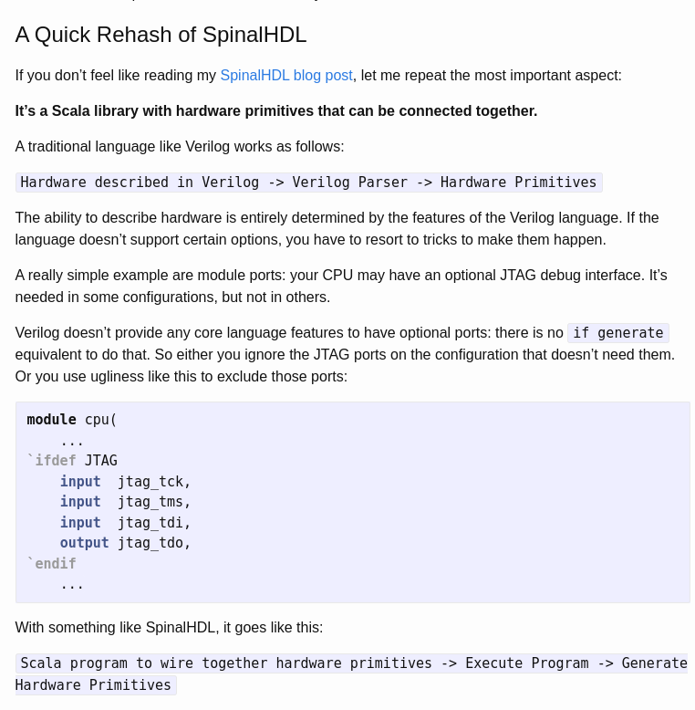
9.14 CPU Design: VexRiscv
https://www.youtube.com/watch?v=XyDiz3SRogY&list=PLlu0CT-JnSasfpk8tq1ZDiE2G0AK1BhOg&index=9
CPU Design: VexRiscv (18:01-19:11/21:02)
New Way: Use SpinalHDL to generate the design.
https://tomverbeure.github.io/rtl/2018/12/06/The-VexRiscV-CPU-A-New-Way-To-Design.html

Slide 11
9.15 SpinalHDL Community

Slide 12
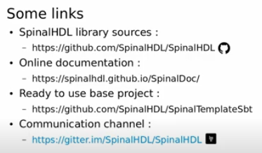
9.15 SpinalHDL Community
https://www.youtube.com/watch?v=XyDiz3SRogY&list=PLlu0CT-JnSasfpk8tq1ZDiE2G0AK1BhOg&index=9
SpinalHDL Community (19:12-21:02/21:02)
Q: The SpinalHDL is a lot like Chisel. Why do we choose SpinalHDL?
Ans: SpinalHDL was developed parallel with Chisel. It dedicated in the Core Library for Construction of Digital Circuit.

Slide 13
End

