Slide 1

4 Sequential Circuit
Peter H. Chen

Slide 2
4 Sequential Circuit
https://www.youtube.com/watch?v=8bunNSs_D5g&list=PLfrN7RIcMe6g2LBRJLTHTdhyj5s8ag0Rg&index=4
Sequential Circuit (0:00-0:34/1:03:50)
We discuss Chisel Combinational Logic.
Topics:
1. Setup: jupyter notebook, select scala, and run cells
2.

Slide 3
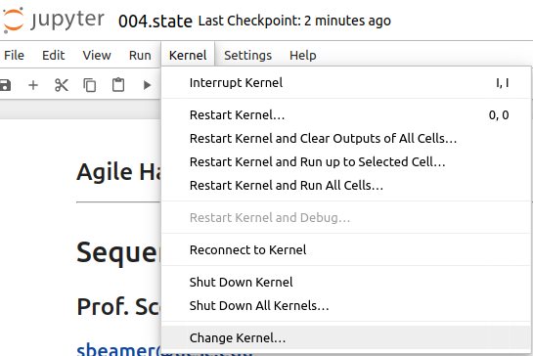
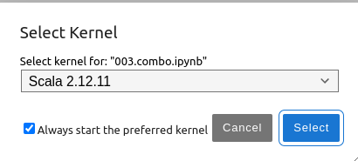
4 Sequential Circuit
https://www.youtube.com/watch?v=8bunNSs_D5g&list=PLfrN7RIcMe6g2LBRJLTHTdhyj5s8ag0Rg&index=4
Sequential Circuit (0:00-0:34/1:03:50)
We discuss Chisel Sequential Circuit.
> jupyter notebook 004.combo.ipynb > Kernel > Change Kernel … > Select Scala2.21.22
> Run All Cells

Slide 4
4.1 Plan

Slide 5
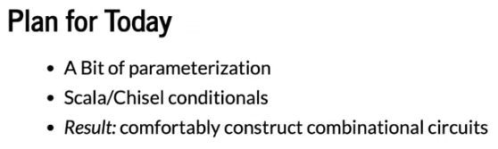
4.1 Plan
https://www.youtube.com/watch?v=8bunNSs_D5g&list=PLfrN7RIcMe6g2LBRJLTHTdhyj5s8ag0Rg&index=4
Plan (0:36-1:25/1:03:50)

Slide 6
End

